Slide 1
Part 1
Introduction

Slide 2
Chapter 1 Why Study Financial Markets and Institutions?

Slide 3
Chapter Preview
The evening news features a segment about the bond market and interest rates. What does this mean for your small retail business? Should you borrow money? Issue stock instead of using a bank loan?
What does all this mean? Do I care about interest rates? What about the turmoil in Europe? Are imports more expensive?

Slide 4
Chapter Preview
These are good questions. Of course, the answer to these questions can be found in this book. In fact, this books touches on a variety of topics, including the Fed, stocks markets, bond markets, and banks. We will begin to appreciate many exciting issues related to these topics during the course of this term.

Slide 5
Chapter Preview
We preview subjects of interest to anyone who is a part of a productive society. Topics include:
Why Study Financial Markets?
Why Study Financial Institutions?
Applied Managerial Perspective
How Will We Study Financial Markets and Institutions

Slide 6
Chapter Preview
We preview subjects of interest to anyone who is a part of a productive society. Topics include: Web Exercise
Concluding Remarks

Slide 7
Why Study Financial Markets?
Financial markets are crucial in our economy.
Channel funds from savers to investors, promoting economic efficiency.
Market activity affects: personal wealth, business firms, and economy

Slide 8
Why Study Financial Markets?
Well functioning financial markets are key factors in producing high economic growth.
We will briefly examine each of these markets, key statistics, and how we will examine them throughout this course.

Slide 9
Why Study Financial Markets? Debt Markets & Interest Rates
Debt markets allow governments, corporations, and individuals to borrow.
Borrowers issue a security, called a bond, offering interest and principal over time.
The interest rate is the cost of borrowing.

Slide 10
Why Study Financial Markets? Debt Markets & Interest Rates
Many types of market interest rates: mortgage rates, car loan rates, credit card rates, etc.
The level of these rates are important. For example, mortgage rates in the early part of 1983 exceeded 13%.

Slide 11
Why Study Financial Markets? Debt Markets & Interest Rates
Understanding the history of interest rates is beneficial.
We will study these further in the book: types and characteristics of bonds; theories on how rates are determined.

Slide 12
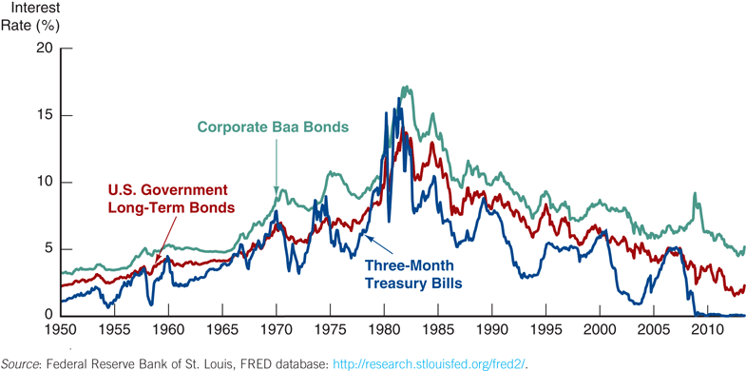
Bond Market and Interest Rates
Figure 1.1 Interest Rates on Selected Bonds, 1950–2013

Slide 13
Why Study Financial Markets? Debt Markets & Interest Rates
For the moment, we will turn to other topics, but revisit these topics.
In chapters 2, 11, 12, and 14, we will examine the role of debt markets in the economy.
In chapters 3 through 5, we will examine the characteristics of interest rates.

Slide 14
Why Study Financial Markets? The Stock Market
The stock market is the market where common stock (or just stock) are traded.
Companies initially sell stock (in the primary market) to raise money. After that, the stock is traded among investors.
The stock market receives the most attention from the media.

Slide 15
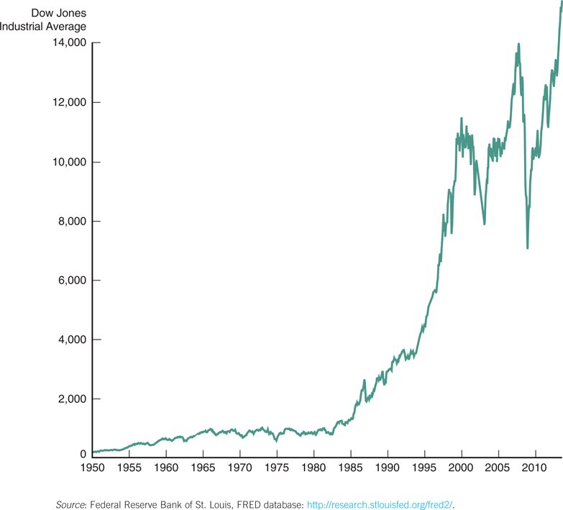
Stock Market
Figure 1.2 Stock Prices as Measured by the Dow Jones Industrial Average, 1950–2013

Slide 16
Why Study Financial Markets? The Stock Market
Companies, not just individuals, also watch the market.
Often seeking additional funding
The success of SEOs is dependent on the company’s stock

Slide 17
Why Study Financial Markets? The Stock Market
In chapter 2, we will examine the role of the stock market in the financial system.
In chapters 6 and 13, we will further look at how stock prices behave to information in the marketplace.

Slide 18
Why Study Financial Markets? The Foreign Exchange Market
The foreign exchange market is where international currencies trade and exchange rates are set.
Although most people know little about this market, it has a daily volume nearing $3 trillion!

Slide 19
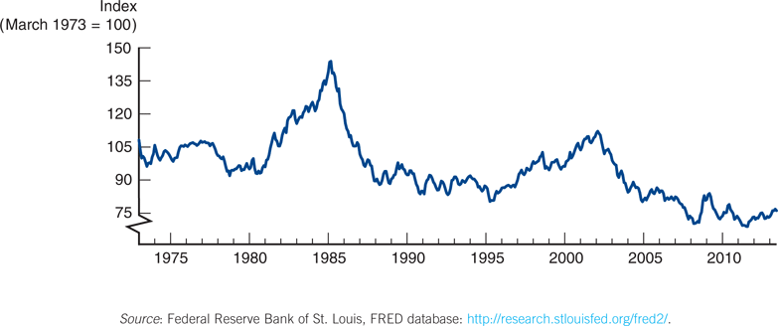
Foreign Exchange Market
Figure 1.3 Exchange Rate of the U.S. Dollar, 1970–2013

Slide 20
Why Study Financial Markets? The Foreign Exchange Market
These fluctuations matter!
In recent years, consumers have found that vacationing in Europe is expensive, due to a weakening dollar relative to the Euro.
When the dollar strengthens, foreign purchase of domestic goods falls.

Slide 21
Why Study Financial Markets? The Foreign Exchange Market
In chapter 15, we will examine how exchange rates are determined in both the short- and long-run.

Slide 22
Why Study Financial Institutions?
We will also spend considerable time discussing financial institutions - the corporations, organizations, and networks that operate the so-called “marketplaces.” We will look at:
Structure of the Financial System
Helps funds move from savers to investors
Financial Crises
The “Great Recession” of 2007–2009 was the worst financial crisis since the Great Depression. Why did it happen?

Slide 23
Why Study Financial Institutions?
Central Banks and the Conduit of Monetary Policy
The role of the Fed, and foreign counterparts, in the management of interest rates and the money supply
The International Financial System
Capital flows between countries impacts domestic economies
Need to understand exchange rates, capital controls, and the role of agencies such as the IMF

Slide 24
Why Study Financial Institutions?
Banks and Other Financial Institutions
Includes the role of insurance companies, mutual funds, pension funds, etc.
Financial Innovation
Focusing on improvements in technology and the impact on financial product delivery
Managing Risk in Financial Institutions
Focusing on risk management in the financial institution

Slide 25
Applied Managerial Perspective
Financial institutions are among the largest employers in the U.S. and often pay high salaries.
Knowing how financial institutions are managed may help you better deal with them.

Slide 26
How We Study Financial Markets and Institutions
Basic Analytic Framework
Simplified models are constructed, explained, and then manipulated to illustrate various phenomena.
“Practicing Manager” cases are used to tie theoretical and empirical aspects.

Slide 27
How We Study Financial Markets and Institutions
Other features
Case studies
Applications and Numerical Examples
Special Interest Boxes
Hundred of analytical end-of-chapter problems
Predicting the Future problems

Slide 28
Exploring the Web
Web Exercise
The World Wide Web is an enormous resource for present and historical information. We will periodically present web exercises to introduce some of the important locations for information, and how to use it.

Slide 29
Exploring the Web
Web Exercise
The next three slides (starting on page 10 in the text) show you how to (1) find historical interest rates from the Fed and save the information, (2) how to import the data into Excel, and (3) how to examine the information using an Excel chart.

Slide 30
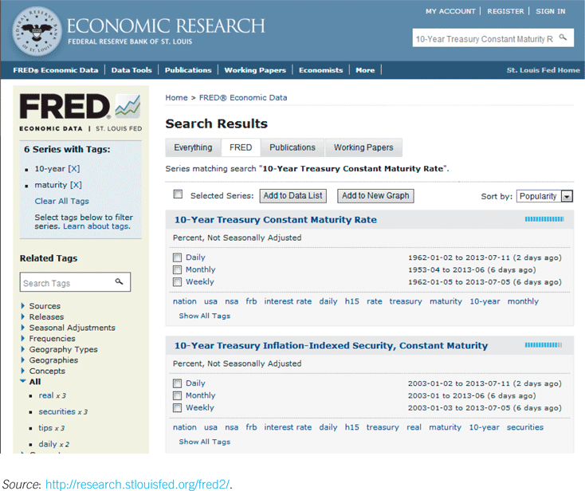
Exploring the Web
Figure 1.4 Federal Reserve Bank of St. Louis, FRED Database
To analyze interest rates, you must collect market interest-rate data. One metric commonly used is U.S. Treasury data. The Fed website maintains historical data on U.S. Treasury yields.

Slide 31
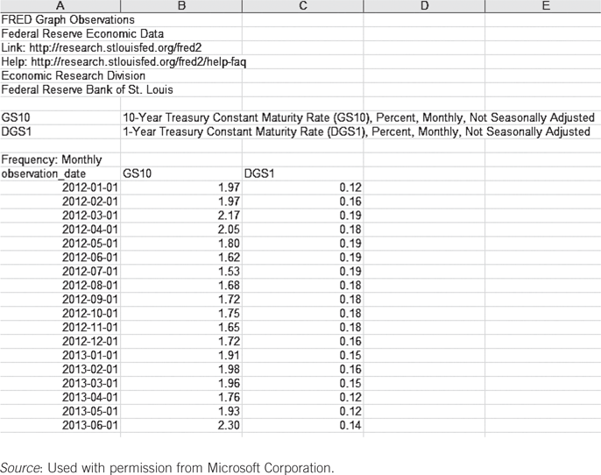
Exploring the Web
Figure 1.5 Excel Spreadsheet with Interest-Rate Data
Many websites are designed so that the data can be easily imported into Excel for further data analysis.

Slide 32
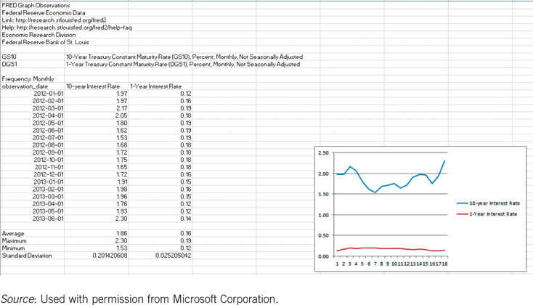
Exploring the Web
Figure 1.6 Excel Graph of Interest-Data
Powerful tools in spreadsheet programs allow you to graph data, run regressions, and conduct scenario analysis.

Slide 33
Concluding Remarks
This field is an exciting one, and this book will help you develop skills to further your career and your understanding of financial events.
You will also have a better understanding of the controversies to hotly debated in the political arena.

Slide 34
Chapter Summary
Why Study Financial Markets?: the three primary markets (bond, stock, and foreign exchange) were briefly introduced.
Why Study Financial Institutions?: the market, institutions, and key changes affecting these were outlined.

Slide 35
Chapter Summary (cont.)
Applied Managerial Perspective: the book will often present material to better understand how actual managers use the information in daily operations.
How We Will Study Financial Markets and Institutions: we outlines the three key components: analytical framework, features, and web exercises.

