Slide 1
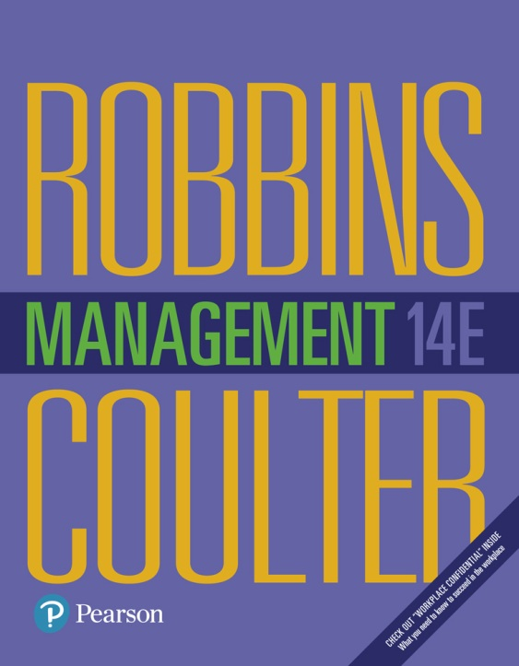
Management
Fourteenth Edition
Chapter 1
Managers and You in the Workplace

Slide 2
Learning Objectives
1.1 Tell who managers are and where they work.
Know how to manage your time.
1.2 Explain why managers are important to organizations.
1.3 Describe the functions, roles, and skills of managers.
Develop your skill at being politically aware.
1.4 Describe the factors that are reshaping and redefining the manager’s job.
1.5 Explain the value of studying management.

Slide 3
Who Is a Manager?
Manager: someone who coordinates and oversees the work of other people so that organizational goals can be accomplished.
Manager is also defined as a person responsible for supervising and motivating employees and for directing the progress of an organization.
Examples: restaurant manager, project manager.
Notes:
Managers run large corporations, medium-sized businesses, and entrepreneurial start-ups. They’re found in government departments, hospitals, small businesses, not-for-profit agencies, museums, schools, and even such nontraditional organizations such as political campaigns and music tours. In many organizations, the changing nature of work has blurred the distinction between managers and non-managerial employees. So, how do we define who managers are? A manager is someone who coordinates and oversees the work of other people so that organizational goals can be accomplished.

Slide 4
Exhibit 1-1 Levels of Management
Notes:
In traditionally structured organizations (often pictured as a pyramid because more employees are at lower organizational levels than at upper organizational levels), managers can be classified as first-line, middle, or top management.

Slide 5
Classifying Managers
First-Line Managers: manage the work of non-managerial employees (e.g. foreman).
Middle Managers: manage the work of first-line managers. They are mainly responsible for turning company strategy into action (e.g. divisional manager, Store manager, branch manager)
Top Managers: responsible for making organization-wide decisions and establishing plans and goals that affect the entire organization (e.g. Chief Executive Officer (CEO), Chief Financial Officer (CFO)
Notes:
At the lowest level of management, first-line managers manage the work of non-managerial employees who typically are involved with producing the organization’s products or servicing the organization’s customers. First-line managers may be called supervisors or even shift managers, district managers, department managers, or office managers.
Middle managers manage the work of first-line managers and can be found between the lowest and top levels of the organization. They may have titles such as regional manager, project leader, store manager, or division manager.
At the upper levels of the organization are the top managers, who are responsible for making organization-wide decisions and establishing the plans and goals that affect the entire organization. These individuals typically have titles such as executive vice president, president, managing director, chief operating officer, or chief executive.

Slide 6
Where Do Managers Work?
Managers work in organizations.
organization: is a deliberate arrangement of people to accomplish some specific purpose (e.g. university, college, hospital).
Notes:
What is an organization? It’s a deliberate arrangement of people to accomplish some specific purpose. Your college or university is an organization; so are fraternities and sororities, government departments, churches, Zynga, your neighborhood grocery store, the United Way, the St. Louis Cardinals baseball team, and the Mayo Clinic, all are considered organizations and have three common characteristics.
First, an organization has a distinct purpose typically expressed through goals the organization hopes to accomplish. Second, each organization is composed of people. It takes people to perform the work that’s necessary for the organization to achieve its goals. Third, all organizations develop a deliberate structure within which members do their work.

Slide 7
Exhibit 1-2 Characteristics of organizations
Notes:
In traditionally structured organizations (often pictured as a pyramid because more employees are at lower organizational levels than at upper organizational levels), managers can be classified as first-line, middle, or top management.

Slide 8
Characteristics of Organizations
First, an organization has a distinct purpose typically expressed through goals the organization hopes to accomplish.
Second, each organization is composed of people. It takes people to perform the work that’s necessary for the organization to achieve its goals.
Third, all organizations develop a deliberate structure within which members to do their work. That structure may be open and flexible, with no specific job duties.

Slide 9
Why Are Managers Important?
Achieve company targets: organizations need their managerial skills and abilities now more than ever
Responsibility: Managers are critical to getting things done
Managers do matter to organizations (in order to build a great relationship between employees and their direct leaders).
Provide you feedback on how you’re doing
Inspire you professionally and personally
Notes:
Let’s look at three reasons why managers are important to organizations.
First, managers are important because organizations need their managerial skills and abilities more than ever in uncertain, complex, and chaotic
times. As organizations deal with today’s challenges, managers play an important role in identifying critical issues and crafting responses.
Another reason why managers are important to organizations is because they’re critical to getting things done. The job of a manager is to ensure that all the employees are getting their jobs done.
Managers matter. A Gallup poll has found that the single most important variable in employee productivity and loyalty isn’t pay, or benefits, or the workplace environment—it’s the quality of the relationship between employees and their direct supervisors.

Slide 10
What Do Managers Do?
Management involves coordinating and overseeing the work activities of others so that their activities are completed efficiently and effectively.
Management includes ensuring that work activities are done efficiently and effectively by the people responsible for completing them.
Notes:
Management involves coordinating and overseeing the work activities of others so their activities are completed efficiently and effectively. While coordinating and overseeing the work of others is what distinguishes a managerial position from a non-managerial one, this doesn’t mean that managers can do what they want anytime, anywhere, or in any way. Instead, management involves ensuring that work activities are completed efficiently and effectively by the people responsible for doing them, or, at least that’s what managers should be doing.

Slide 11
Efficiency and Effectiveness
Efficiency: doing things right without wasting resources. Getting the most output from the least amount of input. Short-term goals.
Effectiveness: doing the right things in order to achieve organizational long-term goals. It is related to accomplishing a task or producing a desired result.
Notes:
Efficiency refers to getting the most output from the least amount of inputs or resources. Managers deal with scarce resources—including people, money, and equipment—and want to use those resources efficiently.
Effectiveness is often described as “doing the right things,” that is, doing those work activities that will result in achieving goals.
Whereas efficiency is concerned with the means of getting things done, effectiveness is concerned with the ends, or attainment of organizational goals.

Slide 12
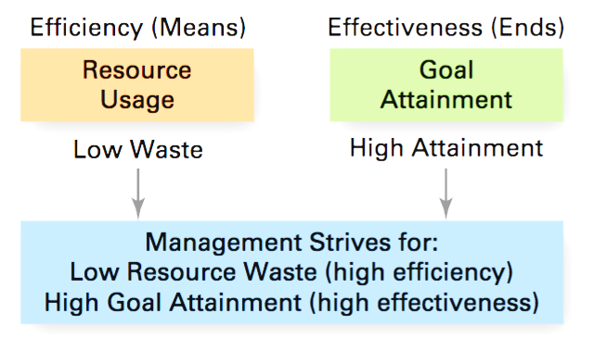
Exhibit 1-3 Efficiency and Effectiveness in Management

Slide 13
Management Functions
Planning: Defining goals, establishing strategies to achieve goals, and developing plans to integrate and coordinate activities
Organizing: Arranging and structuring work to accomplish organizational goals. Determining what tasks are to be done, who is to do them, how the tasks are to be grouped, who reports to whom, and where decisions are to be made.
leading: Working with and through people to accomplish goals. It is also the use of influence to motivate employees to achieve organizational goals
Controlling: Monitoring, comparing, and correcting work
Notes:
According to the functions approach, managers perform certain activities or functions as they efficiently and effectively coordinate the work of others. What are these functions? Henri Fayol, a French businessman, first proposed in the early part of the twentieth century that all managers perform five functions: planning, organizing, commanding, coordinating, and controlling. Today, these functions have been condensed to four: planning, organizing, leading, and controlling (see Exhibit 1-4).

Slide 14
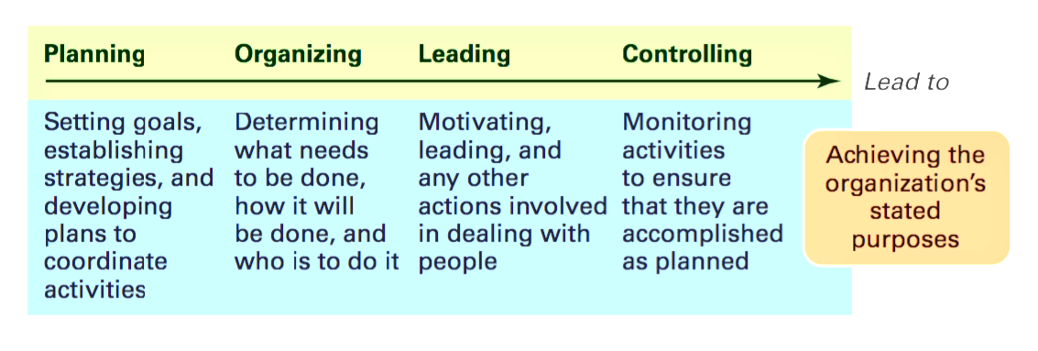
Exhibit 1-4 Four Functions of Management
Notes:
As managers engage in planning, they set goals, establish strategies for achieving those goals, and develop plans to integrate and coordinate activities.
When managers organize, they determine what tasks are to be done, who is to do them, how the tasks are to be grouped, who reports to whom, and where decisions are to be made.
When managers motivate subordinates, help resolve work group conflicts, influence individuals or teams as they work, select the most effective communication
channel, or deal in any way with employee behavior issues, they’re leading. To ensure goals are met and work is done as it should be, managers monitor and evaluate performance. Actual performance is compared with the set goals. If those goals aren’t achieved, it’s the manager’s job to get work back on track.
This process of monitoring, comparing, and correcting is the controlling function.

