Slide 1
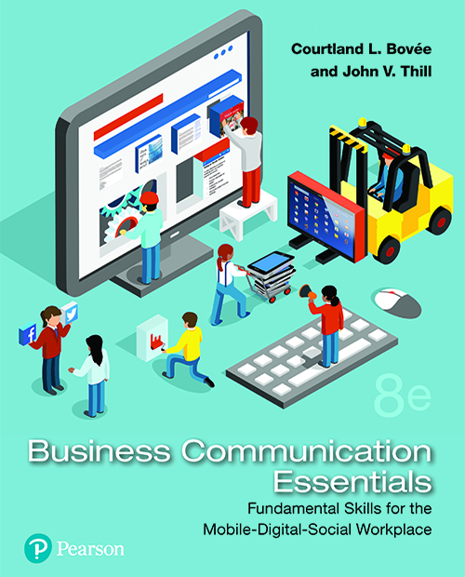
Business Communication Essentials
Eighth Edition
Chapter 1
Professional Communication in Today’s Digital, Social, Mobile World
Copyright © 2019, 2016, 2014 Pearson Education, Inc. All Rights Reserved.
Notes:
If this PowerPoint presentation contains mathematical equations, you may need to check that your computer has the following installed:
1) MathType Plugin
2) Math Player (free versions available)
3) NVDA Reader (free versions available)

Slide 2
Learning Objectives (1 of 2)
1.1 Define communication, and explain the importance of effective business communication.
1.2 Explain what it means to communicate as a professional in a business context.
1.3 Describe the communication process model, and explain how social media are changing the nature of business communication.
1.4 Outline the challenges and opportunities of mobile communication in business.

Slide 3
Learning Objectives (2 of 2)
1.5 Define ethics, explain the difference between an ethical dilemma and an ethical lapse, and list six guidelines for making ethical communication choices.
1.6 Explain how cultural diversity affects business communication, and describe the steps you can take to communicate more effectively across cultural boundaries.
1.7 List four general guidelines for using communication technology effectively.
1.8 Identify six related skills that you will have the opportunity to develop as you work on your communication skills in this course.

Slide 4
Understanding Why Communication Matters
LO 1.1 Define communication and explain the importance of effective business communication.
Notes:
Communication is the process of transferring information and meaning between senders and receivers, using one or more written, oral, visual, or electronic channels. The essence of communication is sharing—providing data, information, insights, and inspiration in an exchange that benefits both you and the people with whom you are communicating.
You will invest a lot of time and energy in this course to develop communication skills, so it’s fair to ask if it will all be worthwhile. This section outlines the many ways in which good communication skills are good for your career and your company.

Slide 5
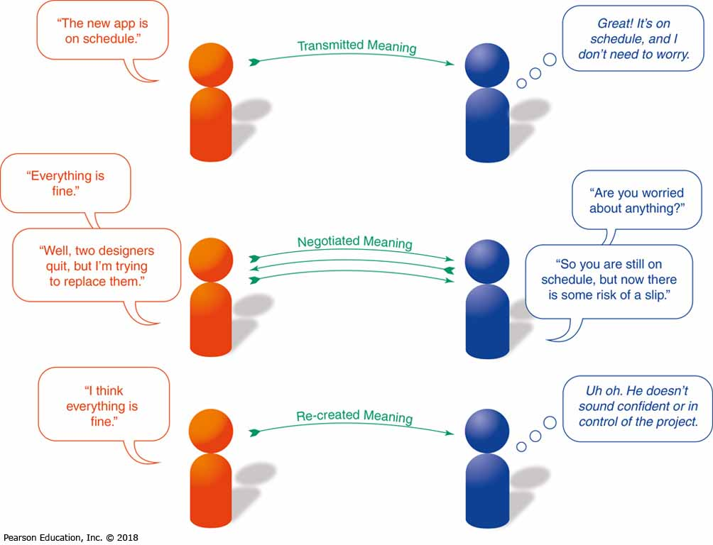
Communication Is important to Your Career
Notes:
Improving your communication skills may be the single most important step you can take in your career. You can have the greatest ideas in the world, but they’re no good to your company or your career if you can’t express them clearly and persuasively.
Many companies now supplement their permanent workforces with independent contractors who are brought on for a short period or even just a single project. Chances are you will spend some of your career as one of these freelancers, working without the support network that an established company environment provides. You will have to “sell yourself” into each new contract, communicate successfully in a wide range of work situations, and take full responsibility for your career growth and success.
If you launch a company or move into an executive role in an existing organization, you can expect communication to consume the majority of your time. Top executives spend most of their workdays communicating, and businesspeople who can’t communicate well don’t stand much chance of reaching the top.
If you learn to write well, speak well, listen well, and recognize the appropriate way to communicate in any situation, you’ll gain a major advantage that will serve you throughout your career.

Slide 6
Communication Is Important (1 of 2)
To Your Company
A Stronger Sense of Trust
Closer Marketplace Ties
Opportunities for Influence
Better Productivity and Problem Solving
Better Financial Returns and Results
Notes:
Aside from the personal benefits, communication should be important to you because it is important to your company. Effective communication helps businesses in numerous ways:
A stronger sense of trust between individuals and organizations
Closer ties with important communities in the marketplace
Opportunities to influence conversations, perceptions, and trends
Increased productivity and faster problem solving
Better financial results and higher return for investors

Slide 7
Communication Is Important (2 of 2)
To Your Company
Earlier Warning of Potential Problems
Stronger, More Timely Decision Making
Clear, Persuasive Marketing Messages
Increased Employee Engagement
Notes:
Earlier warning of potential problems, from rising business costs to critical safety issues
Stronger decision making based on timely, reliable information
Clearer and more persuasive marketing messages
Greater employee engagement with their work, leading to higher employee satisfaction and lower employee turnover

Slide 8
What Makes Business Communication Effective?
Provide practical information
Give facts, not vague impressions
Deliver information concisely and efficiently
Clarify expectations and responsibilities
Offer compelling, persuasive arguments and recommendations
Notes:
Effective communication strengthens the connection between a company and its stakeholders, those groups affected in some way by the company’s actions. Conversely, when communication breaks down, the results can range from time wasting to tragic. To make your communication efforts as effective as possible, focus on making them practical, factual, concise, clear, and persuasive.
Provide practical information.
Give facts rather than vague impressions.
Present information in a concise, efficient manner.
Clarify expectations and responsibilities.
Offer compelling, persuasive arguments and recommendations.

Slide 9
Summary of Discussion (1 of 8)
In this section, we discussed the following:
Communication Is Important to Your Career
Communication Is Important to Your Company
What Makes Business Communication Effective
The next section will cover Communicating as a Professional.

Slide 10
Communicating as a Professional
LO 1.2 Explain what it means to communicate as a professional in a business context.
Notes:
You’ve been communicating your entire life, of course, but if you don’t yet have a lot of work experience, the expectations of a professional environment might require some adjustment. As the next slide shows, a good place to start is considering what it means to be a professional.

Slide 11
What Is Professionalism?
Excellence
Teamwork
Ethical Behavior
Dependability
Etiquette
Positive Attitude
Notes:
Professionalism is the quality of performing at a high level and conducting oneself with purpose and pride. True professionals go beyond the minimum expectations and commit to making meaningful contributions. Professionalism can be broken down into six distinct traits:
Striving to excel
Being dependable and accountable
Being a team player
Demonstrating a sense of etiquette
Making ethical decisions
Maintaining a positive outlook
All of the elements in this list depend on effective communication.

Slide 12
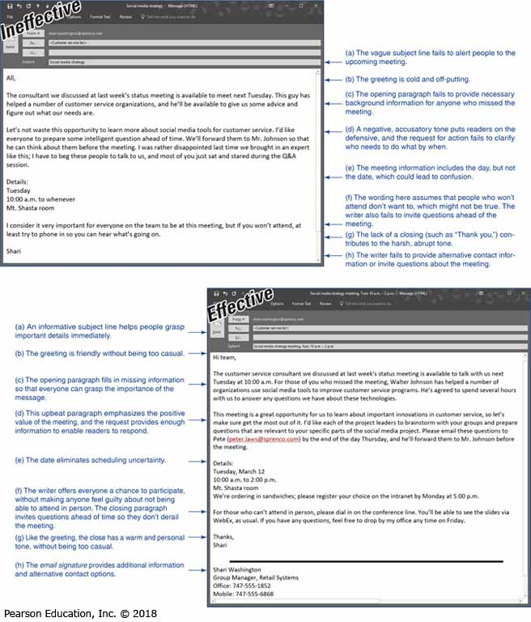
Understanding What Employers Expect from You (1 of 2)
Possessing digital information fluency
Organizing ideas and information
Expressing coherent, persuasive ideas
Listening actively to others
Communicating in diverse situations
Notes:
No matter how good you are at accounting, engineering, law, or whatever professional specialty you pursue, employers expect you to be competent at a wide range of communication tasks. In fact, employers start judging your ability to communicate before you even show up for your first interview, and the process of evaluation never really stops. Fortunately, the skills that employers expect from you are the same skills that will help you advance in your career:
Recognizing information, using efficient search techniques to locate reliable information sources, and using gathered information ethically (This collection of skills is often referred to as digital information fluency.)
Organizing ideas and information logically and completely
Expressing yourself coherently and persuasively in a variety of media
Actively listening to others
Communicating effectively with people from diverse backgrounds and experiences

Slide 13
Understanding What Employers Expect from You (2 of 2)
Using communication technologies effectively
Using standard grammar and spelling
Communicating in a civilized manner
Practicing ethical communication
Managing time and resources
Using critical thinking
Notes:
Using communication technologies effectively and efficiently
Following accepted standards of grammar, spelling, and other aspects of high-quality writing and speaking
Communicating in a civilized manner that reflects contemporary expectations of business etiquette
Communicating ethically, even when choices aren’t crystal clear
Managing your time wisely and using resources efficiently
Using critical thinking, which is the ability to evaluate evidence completely and objectively in order to form logical conclusions and make sound recommendations
You’ll practice these skills throughout this course, but don’t stop there. Successful professionals hone communication skills throughout their careers.

Slide 14
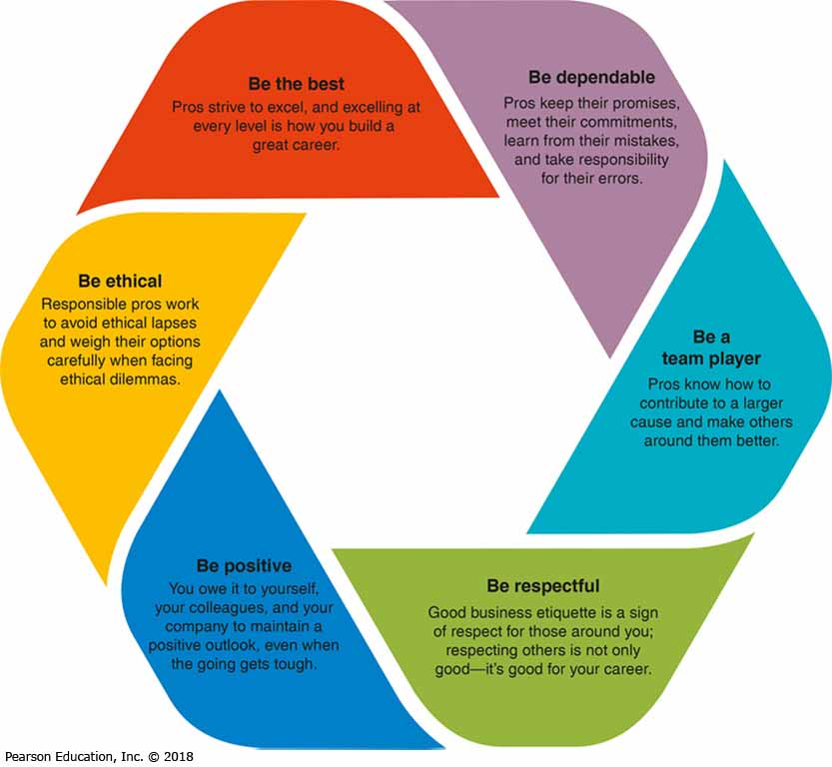
Communicating in an Organizational Context
Notes:
Every organization has a formal communication network, in which ideas and information flow along the lines of command (i.e., the hierarchical levels) in the company’s organization structure. In a formal network, information flows in three directions: downward communication flows from executives to employees; upward communication flows from employees to executives; and horizontal communication flows between departments.
Every organization also has an informal communication network (i.e., the grapevine or the rumor mill) that encompasses all communication that occurs outside the formal network. Some of this communication takes place naturally as employees interact on the job and in social settings; some of it takes place when the formal network doesn’t provide information that employees want. In fact, the inherent limitations of formal communication networks helped spur the growth of social media in the business environment.

Slide 15
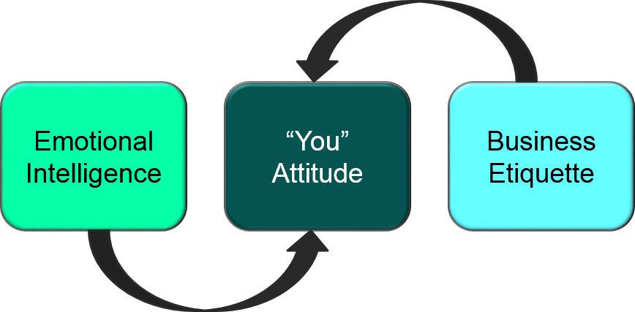
Adopting an Audience-Centered Approach
Notes:
Adopting an audience-centered approach means focusing on and caring about the members of your audience. This approach is also known as adopting the “you” attitude.
Learn as much as possible about your audience. If you’re addressing people you don’t know, try to project yourself into their position by using common sense and imagination. Relating to the needs of others is a key part of emotional intelligence, widely considered to be a vital characteristic of successful managers and leaders.
The more you know about your audience, the easier it will be to concentrate on their needs—which, in turn, will make it easier for them to hear your message, understand it, and respond positively.
An important element of audience-centered communication is etiquette, the expected norms of behavior in a particular situation. The way you conduct yourself can have a profound influence on your company’s success and your career.

Slide 16
Summary of Discussion (2 of 8)
In this section, we discussed the following:
What Is Professionalism?
Understanding What Employers Expect from You
Communicating in an Organizational Context
Adopting an Audience-Centered Approach
The next section will cover Exploring the Communication Process.

Slide 17
Exploring the Communication Process
LO 1.3 Describe the communication process model, and the ways social media are changing the nature of business communication.
Notes:
This section explores the communication process in two stages: first, by following a message from one sender to one receiver in the basic communication model; and second, by expanding on that with multiple messages and participants in the social communication model.

Slide 18
The Basic Communication Model (1 of 2)
The Sender Has an Idea
Sender Encodes Idea as a Message
Sender Produces the Message
Sender Transmits the Message
Notes:
By viewing communication as a process, you can identify and improve the skills you need to be more successful.
The sender has an idea. The success of a communication effort starts here and depends on the nature of the idea and the motivation for sending it.
The sender encodes the idea as a message. When someone puts an idea into a message, he or she is encoding it, or expressing it in words and images.
The sender produces the message in a transmittable medium. The sender needs a communication medium to present the message to the intended audience.
The sender transmits the message through a channel. The communication channel is the system used to deliver the message.

Slide 19
The Basic Communication Model (2 of 2)
Audience Receives Sender’s Message
Audience Decodes the Message
Audience Responds to the Message
Audience Gives Feedback to Sender
Notes:
The audience receives the message. It is not enough for the message to reach the intended audience. The audience must also sense the presence of a message, select it from all the other messages, and perceive it as an actual message.
The audience decodes the message. Decoding is complex; receivers often extract different meanings from messages than the meanings that senders intended.
The audience responds to the message. Before a receiver can respond as the sender hopes, the receiver must remember the message long enough to act on it, must be able to act on it, and must be motivated to respond.
The audience sends feedback—verbal, nonverbal, or both. Just like the original message, however, this feedback from the receiver needs to be decoded carefully.
This process is complex, so communication efforts often fail to achieve the sender’s objective.

Slide 20
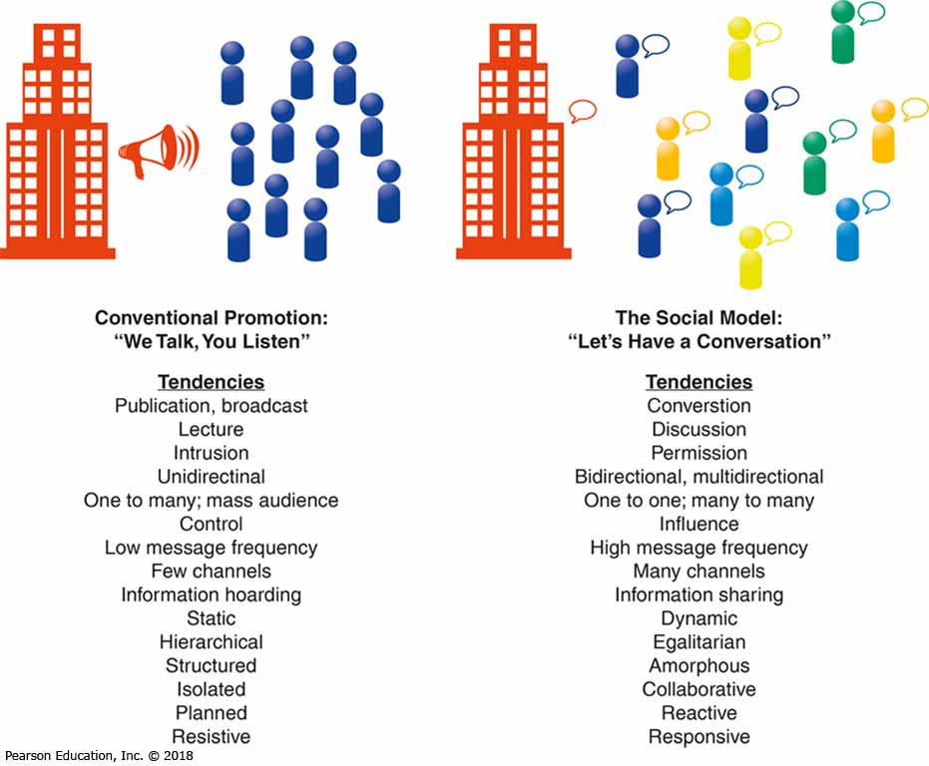
Social Communication Model
Notes:
The traditional model of business communication was largely defined by a publishing or broadcast mindset. For external communication, a company released carefully scripted messages to a mass audience that often had few, if any, ways to respond. Likewise, customers and other interested parties had few ways to connect with one another to ask questions, share information, or offer support. Internal communication tended to follow the same “we talk, you listen” model, as upper managers issued directives to lower-level supervisors and employees.
Today, a variety of technologies have enabled and inspired a new approach to business communication. In contrast to the publishing mindset, this new social communication model is interactive, conversational, and usually open to all who wish to participate. Audience members are no longer passive recipients of messages; instead, they are active participants in a conversation.
This new model is revolutionizing business communication. Social media have given customers and other stakeholders a voice they did not have in the past. And businesses are listening to that voice.

Slide 21
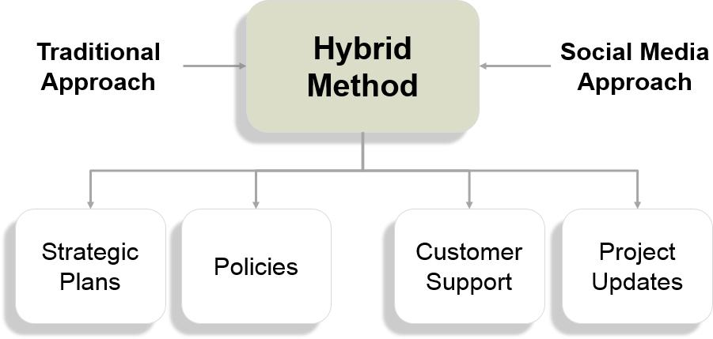
Social Communication Model (in Practice)
Notes:
Of course, no matter how enthusiastically a company embraces the social communication model, it is not going to be run as a social club in which everyone has a say and a vote. Instead, a hybrid approach is emerging in which some communications (such as strategic plans and policy documents) follow the traditional approach and others (such as project management updates and customer support messages) follow the social model.

Slide 22
Summary of Discussion (3 of 8)
In this section, we discussed the following:
The Basic Communication Model
The Social Communication Model
The next section will cover The Mobile Revolution.

Slide 23
The Mobile Revolution
LO 1.4 Outline the challenges and opportunities of mobile communication in business.
Notes:
As much of a game-changer as social media have been, some experts predict that mobile communication will change the nature of business communication even more.
Companies recognize the value of integrating mobile technology, from communication platforms to banking to retail. Given the advantages and the rising expectations of employees and customers, firms on the leading edge of the mobile revolution are working to integrate mobile technology throughout their organizations.
This section offers a high-level view of the mobile revolution, and you’ll see coverage of specific topics integrated throughout the book, in everything from collaborative writing and research to presentations and job-search strategies.

Slide 24
The Rise of Mobile as a Communication Platform
Globally, about 80 percent of Internet users access the web with a mobile device
Mobile is the primary communication tool for many business professionals
About 50 percent of U.S. consumers use mobile devices exclusively to search online
Smartphones keep people connected 24/7
Notes:
For millions of people around the world, a mobile device is their primary way to access the Internet. Globally, roughly 80 percent of Internet users access the web at least some of the time with a mobile device.
Mobile has become the primary communication tool for many businesspeople, including a majority of executives under age 40.
Roughly half of U.S. consumers use a mobile device exclusively for their online search needs, and many online activities that eventually migrate to a PC screen start out on a mobile screen.
Smartphones have become intensely personal devices in ways that PCs never did. Many users are closely connected to their phones 24/7, and to all the information sources, conversations, and networks that those phones can connect to. As a result, mobile connectivity can start to resemble a continuous stream of conversations that never quite end, which influences the way businesses need to interact with their stakeholders.
In addition, wearable technology such as smartwatches make it easier to read message content quickly.

Slide 25
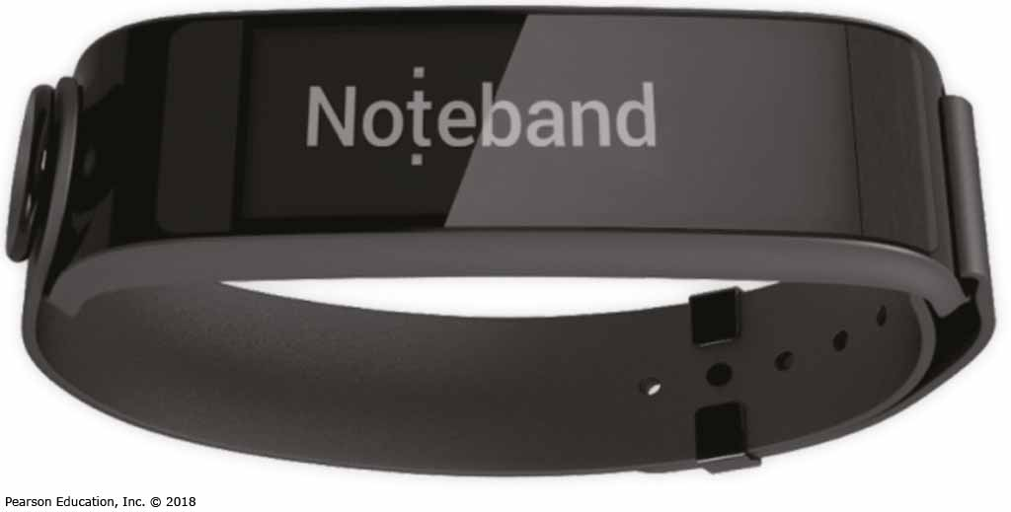
Mobile Technologies Are Changing Business Communication
Mobile-First Approach
Radical Connectivity
Notes:
The rise of mobile communication has some obvious implications. For example, many users expect websites to be mobile-friendly, and they’re likely to avoid sites that aren’t optimized for mobile. As mobile access overtakes computer-based access, some companies now take a mobile-first approach, in which websites are designed for optimum viewing on smartphones and tablets. Another successful approach is creating mobile apps that offer a more interactive and mobile-friendly experience than a conventional website can offer.
Furthermore, mobile changes the way people communicate, which has profound implications for virtually every aspect of business communication. The term radical connectivity describes “the breathtaking ability to send vast amounts of data instantly, constantly, and globally.” People who’ve grown up with mobile communication technology expect to have immediate access to information and the ability to stay connected to their various social and business networks.

Slide 26
Mobile Technology and Business Communication Practices (1 of 2)
Challenges of constant connectivity
Challenges for creating/consuming content
Multitasking and other distractions
Pressures on standards of grammar and writing
Sensory and cognitive extensions
Notes:
Here are the most significant ways that mobile technology is changing the practice of business communication:
Constant connectivity is a mixed blessing. Like social media, mobile connectivity can blur the boundaries of personal and professional time and space. On the other hand, it can give employees more flexibility to meet their personal and professional obligations.
Mobile factors present challenges for creating and consuming content, whether it’s typing an email message or watching a video.
Mobile users are often multitasking, so they can’t give full attention to the information on their screens. Moreover, mobile use often occurs in environments with multiple distractions and barriers to successful communication.
Mobile communication, particularly text messaging, has put pressure on traditional standards of grammar, punctuation, and writing in general.
Mobile devices can serve as sensory and cognitive extensions. For example, they can help people experience more of their environment and have instant access to information without relying on faulty and limited human memory.

Slide 27
Mobile Technology and Business Communication Practices (2 of 2)
Security and privacy concerns
Productivity and collaboration
Assistance with business tasks
Decision making and problem solving
Engaging experiences for customers
Notes:
Mobile devices create a host of security and privacy concerns, for end users and corporate technology managers alike. These devices don’t always have the rigorous security controls that corporate networks need, and users don’t always use them in secure ways.
Mobile tools can enhance productivity and collaboration by making it easier for employees to stay connected and giving them access to information and work tasks during forced gaps in the workday or while traveling.
Mobile apps can assist in a wide variety of business tasks, from research to presentations.
Mobile connectivity can accelerate decision making and problem solving by putting the right information in the hands of the right people at the right time. Mobile communication also makes it easier to quickly tap into pockets of expertise within a company.
With interactivity designed to take advantage of the capabilities of mobile devices (including cameras, accelerometers, compasses, and GPS), companies can create more engaging experiences for customers and other users.
The mobile revolution complicates business communication in some ways, but it can enhance communication in many ways if done thoughtfully. You’ll read more about mobile in the chapters ahead.

Slide 28
Summary of Discussion (4 of 8)
In this section, we discussed the following:
The Rise of Mobile as a Communication Platform
Mobile Technologies Are Changing Business Communication
Mobile Technology and Business Communication Practices
The next section will cover Committing to Ethical Communication.

Slide 29
Committing to Ethical Communication
LO 1.5 Define ethics, explain the difference between an ethical dilemma and an ethical lapse, and list six guidelines for making ethical communication choices.
Notes:
Ethics are the accepted principles of conduct that govern behavior within a society. Ethical communication includes all relevant information, is true in every sense, does not violate the rights of others, and is not deceptive in any way.

Slide 30
Unethical Communication (1 of 2)
Plagiarizing Ideas or Products
Omitting Essential Information
Selectively Misquoting
Notes:
Unethical communication can distort the truth or manipulate audiences in a variety of ways. Plagiarism involves using someone else's words or other creative products and ideas and claiming them as your own. Omitting essential information the audience needs to make an intelligent, objective decision is unethical. Selective misquoting involves distorting or hiding the true intent of someone else’s words.

Slide 31
Unethical Communication (2 of 2)
Misrepresenting Numbers
Distorting Visual Displays
Risking Privacy and Security
Failing to Disclose Financially Beneficial Relationships
Notes:
Misrepresenting numbers involves manipulating data by decreasing numbers, altering statistics, or omitting numerical data. Distorting visuals involves making a product look bigger or changing the scale of graphs and charts to exaggerate or conceal differences. Finally, failing to respect privacy or information security needs is unethical and may be illegal.
The widespread use of social media has exposed the issue of transparency. In this context, transparency involves a sense of openness—of giving everyone involved in a conversation the information they need to process a message accurately. A key aspect of transparency is knowing who is behind the message.
It is unethical for bloggers not to disclose that they have been paid to review or have otherwise benefited from reviewing products on their blog.

Slide 32
Distinguishing Ethical Lapses from Ethical Dilemmas
What’s an Ethical Dilemma?
Choosing among Conflicting Alternatives
What’s an Ethical Lapse?
Making a Choice That’s Clearly Unethical
Notes:
Every company has responsibilities to its stakeholders, and those various groups often have competing interests. In some situations, what's right for one group may be wrong for another.
An ethical dilemma involves choosing among alternatives that aren't clear-cut (perhaps two conflicting alternatives are both ethical and valid, or perhaps the alternatives lie somewhere in the gray area between clearly right and clearly wrong). Unlike a dilemma, an ethical lapse is a clearly unethical or illegal choice.

Slide 33
Making Ethical Choices
Have you defined the situation fairly ?
What is your intention in communicating?
What impact will your message have?
What good or harm will be achieved?
Will your assumptions change?
Are you comfortable with the decision?
Notes:
Whether or not formal guidelines are in place, every employee has the responsibility to communicate in an ethical manner. In the absence of clear guidelines, ask yourself the following questions about your business communications:
Have you defined the situation fairly and accurately?
What is your intention in communicating the message?
What impact will the message have on the people who receive it, or who might be affected by it?
Will the message achieve the greatest possible good while doing the least possible harm?
Will the assumptions that you have made change over time? That is, will a decision that seems ethical now seem unethical in the future?
Are you comfortable with your decision? Would you be embarrassed if it were printed in tomorrow’s newspaper or spread across the Internet?
If you’re unsure of the legal ramifications of a message you intend to send, ask for guidance from your company’s legal department.

Slide 34
Summary of Discussion (5 of 8)
In this section, we discussed the following:
Unethical Communication
Distinguishing Ethical Lapses from Ethical Dilemmas
Making Ethical Choices
The next section will cover Communicating in a World of Diversity.

Slide 35
Communicating in a World of Diversity
LO 1.6 Explain how cultural diversity affects business communication, and describe the steps you can take to communicate more effectively across cultural boundaries.
Notes:
Throughout your career, you will interact with people who differ in race, age, gender, sexual orientation, national and regional attitudes and beliefs, family structure, religion, native language, physical and cognitive abilities, life experience, and educational background. Although the concept of diversity is often framed in terms of ethnic background, a broader and more useful definition includes all the characteristics and experiences that define each of us as individuals.
This section looks at the advantages and challenges of a diverse workforce from a communication perspective, key differences among cultures, and advice for communicating across cultures.

Slide 36
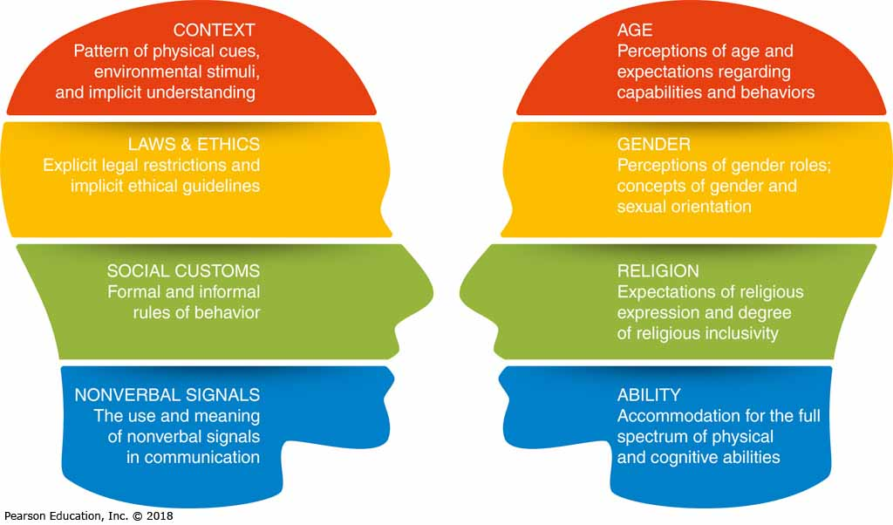
Advantages of a Diverse Workforce
Obtaining More Views and Ideas
Understanding Diverse Markets
Accessing a Wider Pool of Talent
Notes:
A diverse workforce offers a broader spectrum of viewpoints and ideas, helps companies understand and identify with diverse markets, and enables companies to benefit from a wider range of employee talents.

Slide 37
Challenges of a Diverse Workforce
Understanding the Effects of Culture
Developing Cultural Competency
Notes:
For all their benefits, diverse workforces and markets present communication challenges, and understanding the effect of culture on communication is essential:
Culture is a shared system of symbols, beliefs, attitudes, values, expectations, and norms for behavior.
Culture influences the way people perceive the world and respond to others, which affects the way they communicate as both senders and receivers.
These influences operate on such a fundamental level that people often don’t recognize the influence of culture on their beliefs and behaviors. This subconscious effect of culture can create friction because it leads people to assume that everybody thinks and feels the way they do. However, differences between cultures can be profound.
Developing cultural competency can keep cultural differences from impeding communication. Such competency involves an appreciation for the cultural differences that affect communication, and the ability to adjust one’s style when sending and receiving messages across cultural boundaries.

Slide 38
Key Aspects of Cultural Diversity
Cultural Context
Legal and Ethical
Social Customs
Nonverbal Signals
Age Differences
Gender Differences
Religious Differences
Ability Differences
Notes:
You don’t need to become an expert in the details of every culture in which you do business, but you do need to attain a basic level of cultural proficiency to ensure successful communication. You can start by recognizing and accommodating the following differences: cultural context, legal and ethical views, social customs, nonverbal signals, age, gender, religion, and abilities. All of these differences are covered in this section.
Note: This discussion of cultural diversity is an overview only, with some generalizations that won’t be accurate in every situation. Always consider the unique circumstances of each encounter when making communication decisions.

Slide 39
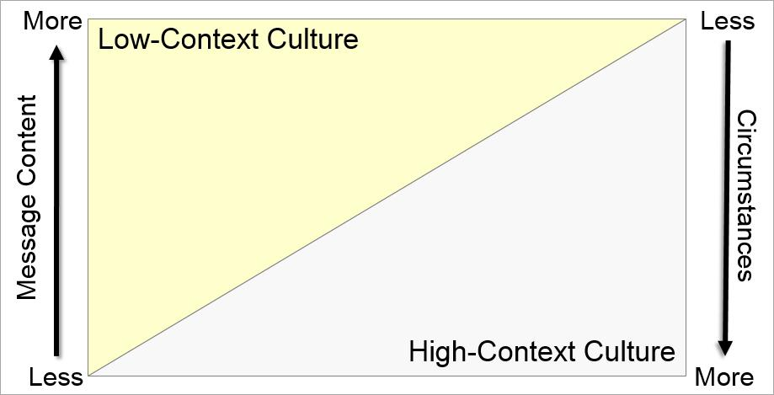
Cultural Context
Notes:
Every attempt at communication occurs within a cultural context—the mixture of traditions, expectations, and unwritten social rules that help convey meaning between members of the same culture. Cultures vary widely in the role that context plays in communication.
In a high-context culture, people rely less on the explicit content of the message and more on the context of nonverbal actions and environmental setting to convey meaning. In such cultures, as individuals grow up, they learn how to recognize situational cues (such as gestures and tone of voice) and how to respond as expected. In addition, in a high-context culture, the primary role of communication is often building relationships, not exchanging information.
In a low-context culture, people rely more on the explicit content of the message and less on circumstances and cues to convey meaning. In other words, more of the conveyed meaning is encoded into the actual message itself.
The different expectations of low- and high-context cultures can create friction and misunderstanding when people try to communicate across cultural boundaries.

Slide 40
Legal and Ethical Differences
Seek Mutual Ground
Withhold Judgment
Send Honest Messages
Respect Cultural Differences
Notes:
Cultural context also influences legal and ethical behavior. For example, because low-context cultures value the written word, written agreements are binding. High-context cultures put less emphasis on the written word and consider personal pledges more important than contracts. They also tend to view law with flexibility; on the other hand, low-context cultures value the letter of the law.
Ethical principles are based to a large extent on cultural values, so trying to make ethical choices across cultures can be complicated. When communicating across cultures, keep your messages ethical by applying four basic principles:
Actively seek mutual ground.
Send and receive messages without judgment.
Send messages that are honest.
Show respect for cultural differences.

Slide 41
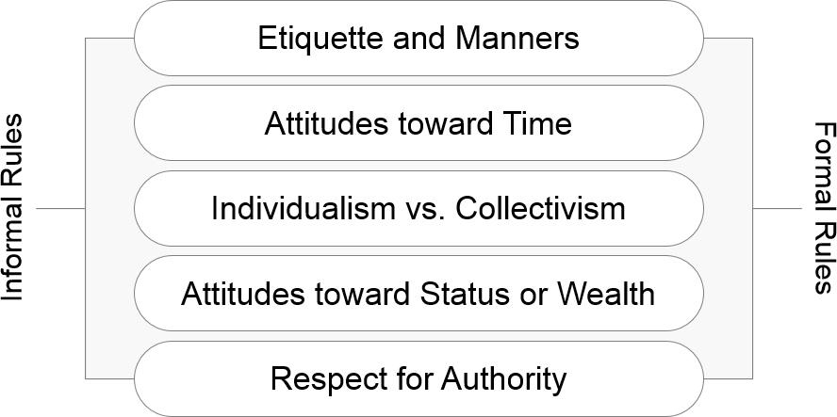
Social Customs
Notes:
Social behavior is guided by numerous rules, some of them formal and specifically articulated (table manners are a good example) and others more informal and learned over time (such as the comfortable standing distance between two speakers in an office). The combination of formal and informal rules influences the overall behavior of everyone in a society in such areas as manners, attitudes toward time, individual versus community values, attitudes toward status and wealth, and respect for authority.
Understanding the nuances of social customs takes time and effort, but most businesspeople are happy to explain the habits and expectations of their culture. Plus, they will view your curiosity as a sign of respect.

Slide 42
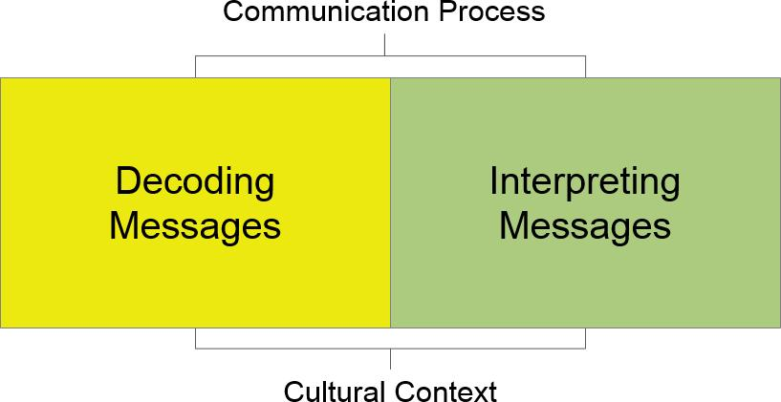
Nonverbal Communication
Notes:
Nonverbal communication is a vital part of the communication process. Everything from facial expressions to style of dress can influence the way receivers decode messages, and the interpretation of nonverbal signals can vary widely from culture to culture. Don’t assume that the gestures you grew up with will translate to another culture; doing so could lead to embarrassing mistakes. You will learn more about nonverbal communication in Chapter 2.

Slide 43
Age Differences
Cultures that Value Youth
Cultures that Value Seniority
Cultures with Multiple Generations Shaped by World Events
Notes:
In some cultures, youth is associated with strength, energy, possibilities, and freedom. Age is often associated with declining powers and a loss of respect and authority. In contrast, in cultures that value age and seniority, longevity earns respect and increasing power and freedom.
Each generation can bring particular strengths to the workplace. For instance, older workers can offer broader experience, the benefits of important business relationships nurtured over many years, and high degrees of “practical intelligence,” such as the ability to solve complex, poorly-defined problems. However, getting the benefits of having multiple generations in a workplace can require some accommodation on everyone’s part because of differing habits and perspectives.
In addition to cultural values associated with various life stages, each of the generations in the workforce has been shaped by dramatically different world events, social trends, and technological advances.

Slide 44
Gender Differences
Perception of Men and Women
Percentage of Management Roles
Different Communication Styles
Outdated Concepts of Gender and Sexual Orientation
Notes:
Gender influences workplace communication in several important ways. First, the perception of men and women in business varies from culture to culture, and gender bias can range from overt discrimination to subtle and even unconscious beliefs.
Second, although the ratio of men and women in entry-level professional positions is roughly equal, the percentage of management roles held by men increases steadily the further one looks up the corporate ladder. This imbalance can significantly affect communication in such areas as mentoring, which is a vital development opportunity for lower and middle managers who want to move into senior positions.
Third, evidence suggests that men and women tend to have somewhat different communication styles. Broadly speaking, men emphasize content and outcomes in their communication efforts, whereas women place a higher premium on relationship maintenance. Changing these perceptions could go a long way toward improving communication and equity in the workplace.
Discriminatory company policies and the behaviors and attitudes of coworkers can deprive people who do not fit or wish to be fit into a simplistic heterosexual, male/female categorization of a fair and satisfying work experience.

Slide 45
Religious Differences
Personal Beliefs
Workplace Issues
Notes:
As one of the most personal and influential aspects of life, religion brings potential for controversy in a work setting—as evidenced by a significant rise in the number of religious discrimination lawsuits. Some employees feel they should be able to express their beliefs in the workplace, but companies try to avoid situations in which openly-expressed religious differences cause friction between employees or distract employees from their responsibilities. As more companies work to establish inclusive workplaces, you can expect to see this issue being discussed at many companies in the coming years.

Slide 46
Ability Differences
Respect for Individuals
Sensitivity to Differences
Use of Assistive Technologies
Notes:
People whose hearing, vision, cognitive ability, or physical ability to operate computers is impaired can be at a significant disadvantage in today’s workplace. As with other elements of diversity, success starts with respect for individuals and sensitivity to differences. Employers can also invest in a variety of assistive technologies that help create a vital link for thousands of employees with disabilities, giving them opportunities to pursue a greater range of career paths and giving employers access to a broader base of talent.

Slide 47
Advice for Improving Intercultural Communication (1 of 2)
Avoid ethnocentrism
Avoid stereotyping individuals
Don’t assume others are like you
Accept differences; don’t be judgmental
Communicate respect in other cultures
Notes:
In any cross-cultural situation, whether it is within your own office or with an audience halfway around the world, you can communicate more effectively if you heed the following tips:
Avoid ethnocentrism, or judging other groups according to the standards, behaviors, and customs of one’s own group.
Avoid stereotyping, or assigning a wide range of generalized attributes to an individual on the basis of membership in a particular group.
Don’t automatically assume that others think, believe, or behave as you do.
Accept differences in others without judging them.
Learn how to communicate respect in various cultures.

Slide 48
Advice for Improving Intercultural Communication (2 of 2)
Tolerate ambiguity and control frustration
Look beyond superficial factors
Recognize your own cultural biases
Be flexible and prepared to change
Observe and learn about other cultures
Notes:
Tolerate ambiguity and control your frustration.
Don’t be distracted by superficial factors such as personal appearance.
Recognize your own cultural biases.
Be flexible and be prepared to change your habits and attitudes.
Observe and learn; the more you learn, the more effective you’ll be.

Slide 49
Writing for Multilingual Audiences
Use Plain Language
Use Clear Examples
Avoid Slang & Jargon
Use Short Paragraphs
Use Precise Words
Cite Numbers Carefully
Be Brief
Use Transitions
Notes:
Ideally, businesses can communicate with employees, customers, and other stakeholders in their native languages. However, translation isn’t always cost effective or possible. To write effectively for people who may not be comfortable using your language, remember these tips:
Use plain language. Use short, precise words that say exactly what you mean.
Avoid words with multiple meanings. As much as possible, choose words that have only one obvious meaning in the context you’re using them.
Be clear. Rely on specific terms and concrete examples to explain your points.
Cite numbers carefully. Use figures (such as “27”) instead of spelling them out (“twenty-seven”).
Avoid slang and be careful with technical jargon and abbreviations. Slang and other nonstandard usages can be difficult or impossible for your audience to translate.
Be brief. Construct sentences that are short and simple.
Use short paragraphs. Each paragraph should stick to one topic.
Use transitions generously. Help readers follow your train of thought.

Slide 50
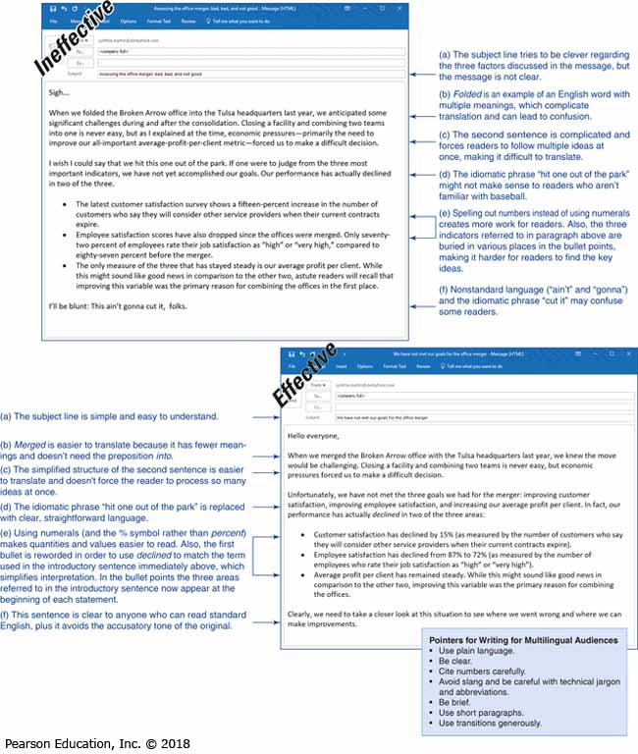
Speaking with Multilingual Audiences (1 of 2)
Speak clearly and simply
Look for feedback
Rephrase as needed
Clarify your meaning with examples
Don’t “talk down” to others
Notes:
When speaking in English to people whose native language is not English, you may find these tips helpful:
Speak clearly, simply, and relatively slowly. Pronounce words clearly, stop at distinct punctuation points, and make one point at a time.
Look for feedback. Be alert to signs of confusion in your listener. Realize that nods and smiles do not necessarily mean understanding.
Rephrase if necessary. If someone does not seem to understand you, rephrase using simpler words.
Clarify your meaning with repetition and examples. Use concrete and specific examples to illustrate difficult or vague ideas.
Do not talk down to the other person. Try not to over-enunciate and do not “blame” the listener for not understanding. Say, “Am I going too fast?” rather than “Is this too difficult for you?”

Slide 51
Speaking with Multilingual Audiences (2 of 2)
Learn common greetings and key phrases
Listen with care and respect
Adapt your style to the other person
Check for comprehension often
Clarify what will happen next
Notes:
Learn important phrases in your audience’s language. Learn common greetings and a few simple phrases in the other person’s native language; this not only makes initial contact easier, but it also shows respect.
Listen carefully and respectfully. If you don’t understand a comment, ask the person to repeat it.
Adapt your conversation style to the other person’s style. For instance, if the other person appears to be direct and straightforward, follow suit.
Check frequently for comprehension. After you make each point, pause to gauge the other person’s comprehension before moving on.
Clarify what will happen next. At the end of a conversation, be sure that you and the other person agree on what has been said and decided.
Finally, remember that oral communication can be more difficult for audiences because it happens in real time and in the presence of other people. In some situations, written communication will be more successful because it gives a reader the opportunity to translate in private and at his or her own pace.

Slide 52
Summary of Discussion (6 of 8)
In this section, we discussed the following:
Advantages of a Diverse Workforce
Challenges of a Diverse Workforce
Eight Key Aspects of Cultural Diversity
Improving Intercultural Communication
Writing for Multilingual Audiences
Speaking with Multilingual Audiences
The next section will cover Using Technology to Improve Business Communication.

Slide 53
Using Technology to Improve Business Communication
LO 1.7 List four general guidelines for using communication technology effectively.
Notes:
Today’s businesses rely heavily on technology to enhance communication. In fact, many of the technologies you might use in your personal life are also used in business.
However, anyone who has used a computer, a smartphone, or other digital device knows that the benefits of technology are not automatic. To communicate effectively, learn to keep technology in perspective, guard against information overload and information addiction, use technological tools productively, and disengage from the computer frequently to communicate in person.

Slide 54
Keeping Technology in Perspective
What Technology Can Do
Help You Accomplish Essential Tasks
Support Interpersonal Communication
What Technology Cannot Do
Replace Interpersonal Communication
Think for You or Supply Essential Skills
Notes:
Perhaps the single most important point to remember about technology is that it’s simply a tool, a means by which you can accomplish certain tasks. It’s an aid to interpersonal communication, not a replacement for it. Technology can’t think for you or communicate for you. If you lack some essential skills, technology can’t fill in the gaps.

Slide 55
Using Tools Productively
Using Technologies Effectively
Using Technologies Efficiently
Learning Advanced Features
Notes:
You don’t have to become an expert to use most communication technologies effectively; but to work efficiently, you do need to be familiar with basic features and functions. Conversely, don’t worry about learning advanced features unless you really need to use them. Many software packages contain dozens of obscure features that typical business communicators rarely need.

Slide 56
Guarding Against Information Overload
Message Recipients
Set Filters and Priorities
Limit RSS and Twitter Feeds
Message Senders
Consider the Audience
Meet Audience Needs
Notes:
The overuse or misuse of communication technology can lead to information overload, in which people receive more information than they can effectively process. Information overload makes it difficult to discriminate between useful and useless information, lowers productivity, and amplifies employee stress both on the job and at home.
As a recipient, control the number and types of messages you receive. Use filtering to isolate high-priority messages that deserve your attention. Also, be wary of subscribing to too many Twitter streams and other sources. Instead, focus on the information you truly need to do your job.
As a sender, make sure every message you send is meaningful and important to your receivers.

Slide 57
Reconnecting with People Frequently
Solve Tough Problems
Maintain Interpersonal Relationships
Learn about Other People
Let People Get to Know Who You Are
Notes:
Technology can hinder communication if it’s overused. Speaking with people over the phone or in person can take more time and effort than sending an email or text message, but it’s often essential for solving tough problems and maintaining productive relationships.
Moreover, even the best communication technologies can’t show people who you really are. Step out from behind the technology frequently to learn more about the people you work with—and to let them learn more about you.

Slide 58
Summary of Discussion (7 of 8)
In this section, we discussed the following:
Keeping Technology in Perspective
Using Tools Productively
Guarding Against Information Overload
Reconnecting with People Frequently
The next section will cover Developing Skills for Your Career

Slide 59
Developing Skills for Your Career
LO 1.8 Identify six related skills that you will have the opportunity to develop as you work on your communication skills in this course.
Notes:
Summary of Discussion (7 of 8)Summary of Discussion (7 of 8)Summary of Discussion (7 of 8)Summary of Discussion (7 of 8)

Slide 60
Skills for Your Career
Critical Thinking
Collaboration
Learn About Other People
Knowledge Application and Analysis
Business Ethics and Social Responsibility
Information Technology Skills
Data Literacy
Notes:
This course will help you develop these skills and give you the opportunity to enhance a wide range of other skills.
You will need to use critical thinking to define and solve problems and make decisions or form judgments.
You will use collaboration as you work with classmates on reports, presentations, and other projects.
You will gain the ability to learn a concept and then apply that knowledge to other challenges.

Slide 61
Summary of Discussion (8 of 8)
In this section, we discussed the following:
Six Related Skills to Develop as You Work on Communication Skills
This concludes our discussion of Chapter 1: Professional Communication

Slide 62
Copyright

