Slide 1
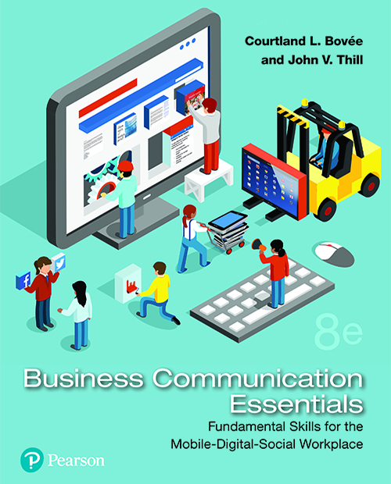
Business Communication Essentials
Eighth Edition
Chapter 6
Crafting Messages for Digital Channels
Copyright © 2019, 2016, 2014 Pearson Education, Inc. All Rights Reserved.
Notes:
If this PowerPoint presentation contains mathematical equations, you may need to check that your computer has the following installed:
1) MathType Plugin
2) Math Player (free versions available)
3) NVDA Reader (free versions available)

Slide 2
Learning Objectives (1 of 3)
6.1 Identify the major digital channels used for brief business messages, and describe the nine compositional modes needed for digital media.
6.2 Describe the use of social networks in business communication.
6.3 Explain how companies and business professionals can use content-sharing websites.

Slide 3
Learning Objectives (2 of 3)
6.4 Describe the evolving role of email in business communication, and explain how to adapt the three-step writing process to email messages.
6.5 Describe the advantages and disadvantages of business messaging, and identify guidelines for effective messaging in the workplace.

Slide 4
Learning Objectives (3 of 3)
6.6 Describe the use of blogging and microblogging in business communication, and briefly explain how to adapt the three-step writing process to blogging.
6.7 Explain how to adapt the three-step writing process to podcasts.

Slide 5
Digital Channels for Business Communication
LO 6.1 Identify the major digital channels used for brief business messages and describe the nine compositional modes needed for digital media.
Notes:
Social media are digital media/channel combinations that empower stakeholders as participants in the communication process by allowing them to share content, revise content, responded to content, or contribute new content. Therefore, the field of business communication is a lot more interesting—but also a lot more complicated—than it was just a few years ago.
Social media have reduced the amount of control businesses have over the content and process of communication, but today’s smart companies are learning how to adapt their communication efforts to this new media landscape and to welcome customers’ participation. Social media are also affecting business communication in other ways:
Revolutionizing internal communication
Breaking down traditional barriers in the organizational hierarchy
Promoting the flow of information and ideas
Enabling networks of individuals and organizations to collaborate on a global scale

Slide 6
Media Choices for Brief Messages
Social Networks
Content-Sharing Sites
Messaging
Email Messages
Podcasts
Blogs & Microblogs
Notes:
Today’s business communicators have a broad range of options for sending brief messages (from one or two sentences up to several pages long):
Social networks
Information and content sharing sites
Email
Instant messaging (IM)
Text messaging
Blogging and microblogging
Podcasting

Slide 7
Benefits of Printed Messages
Making a Formal Impression
Standing Out from Electronic Messages
Obeying Laws Requiring Printed Documents
Providing Unchangeable, Secure Records
Reaching Certain Audiences
Notes:
While most of your business communication is likely to be via electronic means, don’t automatically dismiss the benefits of printed messages. Here are several situations in which you should use a printed message over electronic alternatives:
When you want to make a formal impression
When you want to stand out from the flood of electronic messages
When you are legally required to provide information in printed form
When you need a permanent, unchangeable, or secure record
When you can’t reach a particular audience electronically

Slide 8
Compositional Modes for Digital Media (1 of 2)
Conversational Elements
Comments and Critiques
Orientations and Guidance
Summaries
Reference Materials
Narratives
Notes:
As electronic media evolve, business professionals often need to keep learning the operational details of new systems. Fortunately, you can succeed with written communication in virtually all electronic media by using one of the following compositional modes:
Conversations. IM is a great example of a written medium that mimics spoken conversation. The ability to think, compose, and type relatively quickly is important to maintaining the flow of an electronic conversation.
Comments and critiques. One of the most powerful aspects of social media is the opportunity to express opinions and provide feedback, whether it’s leaving comments on a blog post or reviewing products on an e-commerce site. On the downside, rants, insults, jokes, and blatant self-promotion are usually of little benefit to others.
Orientations. The ability to help people find their way through an unfamiliar system or subject is a valuable writing skill. Writing effective orientations can be a delicate balancing act because you need to know the material well enough to guide others through it while being able to view it from the perspective of a “newbie.”

Slide 9
Compositional Modes for Digital Media (2 of 2)
Teaser Messages and Links
Announcements and Updates
Tutorials and Advice
Notes:
Teasers. Teasers intentionally withhold key pieces of information as a way to pull readers or listeners into a story or other document. Teasers are widely used in marketing and sales messages. Be sure that the payoff, the information a teaser links to, is valuable and legitimate. You’ll quickly lose credibility if readers think they are being tricked into clicking through to information they don’t really want.
Status updates and announcements. Much social media writing involves status updates and announcements. Post only those updates that readers will find useful, and include only the information they need.
Tutorials. Given the community nature of social media, the purpose of many messages is to share how-to advice. Becoming known as a reliable expert is a great way to build customer loyalty for your company while enhancing your own personal value.

Slide 10
Creating Content for Social Media (1 of 2)
Support How Readers Want to Consume Information
Provide Information Followers Will Share
Start Conversations, Not Sales Pitches
Write Informally, But Not Carelessly
Use Concise, Informative Headlines
Notes:
No matter what media or compositional mode you are using for a particular message, writing for social media requires a different approach than traditional media. Consider these tips for creating successful content for social media:
There is no one best approach. Each reader will consume information differently.
One big benefit of social media is the “message boost” you get from followers who share information with their followers.
Remember that it’s a conversation, not a lecture or a sales pitch. One of the great appeals of social media is the feeling of conversation, of people talking with one another instead of one person talking at everyone else.
Write informally but not carelessly. Write as a human being with a unique, personal voice. However, don’t take this as an excuse for bad writing.
Create concise, specific, and informative headlines. Given the importance of headlines in the face of content snacking and information overload, headlines are extremely important in social media.

Slide 11
Creating Content for Social Media (2 of 2)
Get Involved and Stay Involved
Be Transparent and Honest
Think Before You Post a Message
Notes:
Get involved and stay involved. Don’t hide from criticism. Take the opportunity to correct misinformation or explain how mistakes will be fixed.
Be transparent and honest. Honesty is always essential, of course, but the social media environment is unforgiving.
Think before you post! You share the responsibility of keeping your company’s and your customers’ data private and secure. Assume that every message you send in any electronic medium will be stored forever and might be read by people far beyond your original audience.

Slide 12
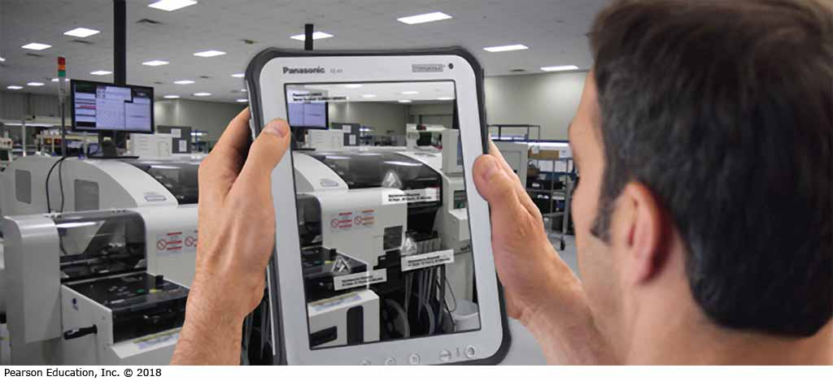
Optimizing Content for Mobile Devices
Mobile Specific Options
Location-Aware Content and Services
Augmented Reality
Wearable Technology
Blogging and Podcasting
Cloud-Based Services
Notes:
Look for opportunities to take advantage of mobile-specific capabilities to give audience members more-engaging ways to consume your content:
Location-based services. These services link online social networking with the physical world of retail stores and other locations. Location-based networking promises to become an important business communication medium because mobile consumers are a significant economic force.
Gamification. The addition of game-playing aspects to apps and web services, such as Foursquare’s “check-in competition,” can increase audience engagement and encourage repeat use.
Augmented reality. Superimposing data on live camera images can help mobile consumers learn about companies and services in the immediate vicinity. Other potential business uses include on-the-job training.
Wearable technology. Wearables push mobile connectivity to the next level. One of the key promises of wearable technology is simplifying and enhancing everyday tasks for consumers and employees alike.
Mobile blogging. Smartphones and tablets are ideal for mobile blogs for special-event coverage, such as live-blogging trade shows and industry conventions. Similarly, smartphone-based mobile podcasting tools make it easy to record audio on the go and post finished podcasts to your blog or website.
Cloud-based services. Mobile communication is ideal for digital services that rely on resources stored in the cloud.

Slide 13
Summary of Discussion (1 of 7)
In this section, we discussed the following:
Social Media and Business Communication
Media Choices for Brief Messages
Benefits of Printed Messages
Compositional Modes for Digital Media
Creating Content for Social Media
Optimizing Content for Mobile Devices
The next section will cover Social Networks.

Slide 14
Social Networks
LO 6.2 Describe the use of social networks in business communication.
Notes:
Social networks—online services that help people and organizations form connections and share information—have become a major force in both internal and external business communication in recent years. In addition to Facebook, a variety of public and private social networks are used by businesses and professionals.

Slide 15
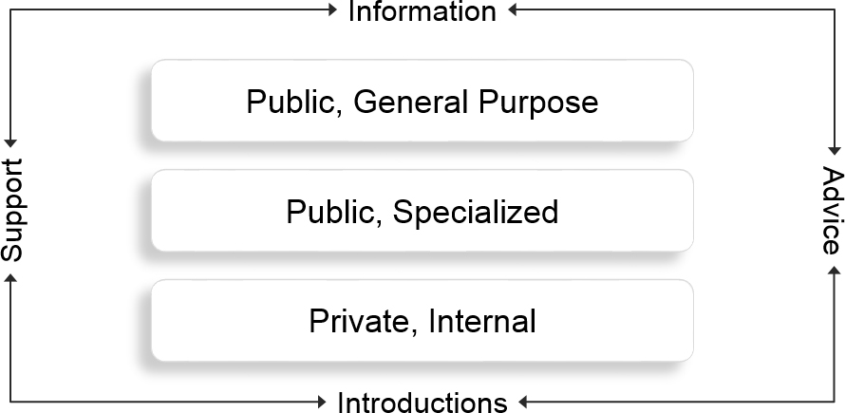
Categories of Social Networks
Notes:
Social networks can be grouped into three categories:
Public, general-purpose networks. Facebook is the largest of these, although Google+ is gaining membership rapidly. Regionally focused networks also have significant user bases in some countries.
Public, specialized networks. Whereas Facebook and Google+ serve a wide variety of personal and professional needs, other networks focus on a particular function or a particular audience. The most widely known of these is LinkedIn, with its emphasis on career- and sales-related networking.
Private networks. Some companies have built private social networks for internal use to meet the expectations of younger employees accustomed to social media and to capture the expert knowledge of older employees nearing retirement.
Regardless of the purpose and audience, social networks are most beneficial when all participants give and receive information, advice, support, and introductions—just as in offline social interaction.

Slide 16
Business Communication Uses of Social Networks (1 of 2)
Integrating Company Workforces
Fostering Collaboration
Building Communities Online
Socializing Brands and Companies
Understanding Target Markets
Recruiting Employees and Partners
Notes:
Integrating company workforces. Internal social networks can help companies grow closer, including helping new employees navigate their way through the organization, encouraging workforces to “jell” after reorganizations or mergers, and overcoming structural barriers in communication channels.
Fostering collaboration. Networks can play a major role in collaboration by identifying the best people to work on projects, giving meeting or seminar participants a way to meet before and after events, accelerating the development of teams, and sharing information throughout the organization.
Building communities. Social networks are a natural tool for bringing together communities of practice (people who engage in similar work) and communities of interest (people who share enthusiasm for a particular product or activity).

Slide 17
Business Communication Uses of Social Networks (2 of 2)
Connecting with Sales Prospects
Supporting Customer Service
Extending the Organization
Crowdspeaking
Notes:
Connecting with sales prospects. Salespeople on networks such as LinkedIn can use their network connections to identify potential buyers and then to ask for introductions through those shared connections. Sales networking can reduce cold calling potential customers out of the blue.
Supporting customers. Customer service is another one of the fundamental areas of business communication that have been revolutionized by social media. Social customer service involves using social networks and other social media tools to give customers a more convenient way to get help from the company and to help each other.
Extending the organization. Social networking is also fueling the growth of networked organizations, sometimes known as virtual organizations, where companies supplement the talents of their employees with services from one or more external partners.
Companies can take advantage of the social reach of their supports by recruiting the supports to spread their message.

Slide 18
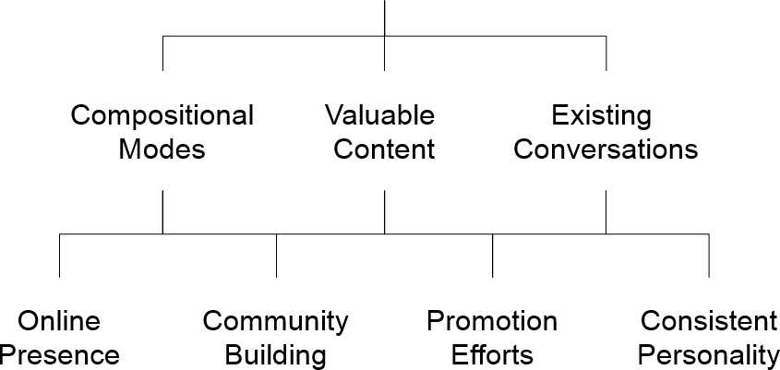
Business Communication Strategies on Social Networks
Notes:
Follow these guidelines to make the most of social networks for both personal branding and company communication:
Choose the best compositional mode for each message, purpose, and network. As you visit various social networks, take some time to observe the variety of message types you see in different parts of each website.
Offer valuable content to members of your online communities. People join social networks looking for connections and information. Use content marketing to provide free information to community members and build closer ties with current and potential customers.
Join existing conversations. Search for existing online conversations. Answer questions, solve problems, and respond to rumors and misinformation.
Anchor your online presence in your hub. While it’s important to be visible where your stakeholders are active, it’s equally important to anchor your presence at your own central hub—a web presence that you own and control.
Facilitate community building. Make it easy for customers and other audiences to connect with the company and with each other.
Restrict conventional promotional efforts to the right time and right place. Persuasive efforts are still valid for specific communication tasks, such as regular advertising and the product information pages on a website.
Maintain a consistent personality. Each social network is a unique environment with particular norms of communication. However, maintain a consistent personality across all the networks in which you are active.

Slide 19
Summary of Discussion (2 of 7)
In this section, we discussed the following:
Categories of Social Networks
Business Communication Uses of Social Networks
Business Communication Strategies on Social Networks
The next section will cover Content-Sharing Sites.

Slide 20
Content-Sharing Sites
LO 6.3 Explain how companies and business professionals can use content-sharing websites.
Notes:
Social networks allow members to share information and media items as part of the networking experience, but a variety of systems have been designed specifically for sharing content. The field is diverse and still evolving, but the possibilities can be divided into user-generated content sites, media curation sites, and community Q&A sites.

Slide 21
User-Generated Content Sites
Content That People Want to See and Share
Content That’s Easy to Find, Use, and Share
Topical Material
Alternative to Newsfeeds
Power of Community
Power of Shared Expertise
Notes:
YouTube, Flickr, Yelp, and other user-generated content (UGC) sites, in which users rather than website owners contribute most or all of the content, have become serious business tools.
As with other social media, the keys to effective user-generated content are making it valuable and making it easy. First, provide content that people want to see and share with colleagues. Keep videos short, generally no longer than three to five minutes. Second, make material easy to find, consume, and share through email, Twitter, Facebook, and other platforms.
Anyone who has signed up for more than a few newsfeeds has probably gotten so many RSS feeds so quickly that it’s impossible to manage them, let alone read them.
An intriguing alternative to newsfeeds is content curation, in which someone with expertise or interest in a particular field collects and republishes material on a particular topic.
New curation tools, including Pinterest and Scoop.it make it easy to assemble attractive online magazines or portfolios on specific topics. Although it raises important issues regarding content ownership and message control, curation has the potential to bring the power of community and shared expertise to many different fields. Ultimately, it could reshape audience behavior and the practice of business communication.

Slide 22
Community Q&A Sites
Build Your Personal Brand
Commit to Customer Service
Misinformation
Notes:
Community Q&A sites, on which visitors answer questions posted by other visitors, are a contemporary twist on the early ethos of computer networking, which was people helping each other. Community Q&A sites include dedicated customer support communities such as those hosted on Get Satisfaction, public sites such as Yahoo! Answers, and member-only sites such as LinkedIn Answers.
Responding to questions on Q&A sites can be a great way to build your personal brand, to demonstrate your company’s commitment to customer service, and to counter misinformation about your company and its products.

Slide 23
Summary of Discussion (3 of 7)
In this section, we discussed the following:
User-Generated Sites
Content Curation Sites
Community Q&A Sites
The next section will cover Email.

Slide 24
Email
LO 6.4 Describe the evolving role of email in business communication, and explain how to adapt the three-step writing process to email messages.
Notes:
Email has been a primary communication medium for many companies for decades. However, newer tools such as instant messaging, blogs, microblogs, social networks, and shared workspaces are taking over specialized tasks for which they are better suited. Therefore, email can seem a bit “old school,” but it is still one of the more important business communication tools.

Slide 25
Using Email in the Workplace (1 of 2)
Disadvantages
Availability of Alternatives
Indiscriminate Use
Low-Value Messages
Notes:
Over the years, email has been used for many communication tasks simply because it was the only widely available electronic medium for written messages and millions of users were comfortable with it. However, newer tools such as instant messaging, blogs, microblogs, social networks, and shared workspaces are taking over specific tasks for which they are better suited.
In addition, the indiscriminate use of email has lowered its appeal in the eyes of many professionals. It’s too easy to send low-value messages to multiple recipients and to trigger long message chains that are hard to follow. In fact, some managers are making changes to reduce or even eliminate email for internal communication.

Slide 26
Using Email in the Workplace (2 of 2)
Advantages
Universal
Accessing Messages
Sending Messages
Scheduling Messages
Notes:
Email has compelling advantages. First, it’s universal. Anybody with an email address can reach anybody else with an email address, no matter which systems the senders and receivers are on. You don’t need to join a special group in order to correspond. Second, it’s still the best medium for many private, short- to medium-length messages. Unlike IM, for instance, midsize messages are easy to compose and easy to read on email. Third, it’s non-instantaneous nature is an advantage when used properly. Email allows senders to compose substantial messages in private and on their own schedule, and it allows recipients to read those messages at their leisure.

Slide 27
Planning Email Messages
Analyzing the Situation
Gathering Information
Organizing the Message
Notes:
The solution to email overload starts in the planning step, by making sure every message has a useful, business-related purpose. Even with fairly short messages, spend a moment or two on the message planning tasks described in Chapter 4: analyzing the situation, gathering necessary information for your readers, and organizing your message. You’ll save time in the long run because you will craft a more effective message on the first attempt. Your readers will get the information they need and won’t have to generate follow-up messages asking for clarification or additional information.

Slide 28
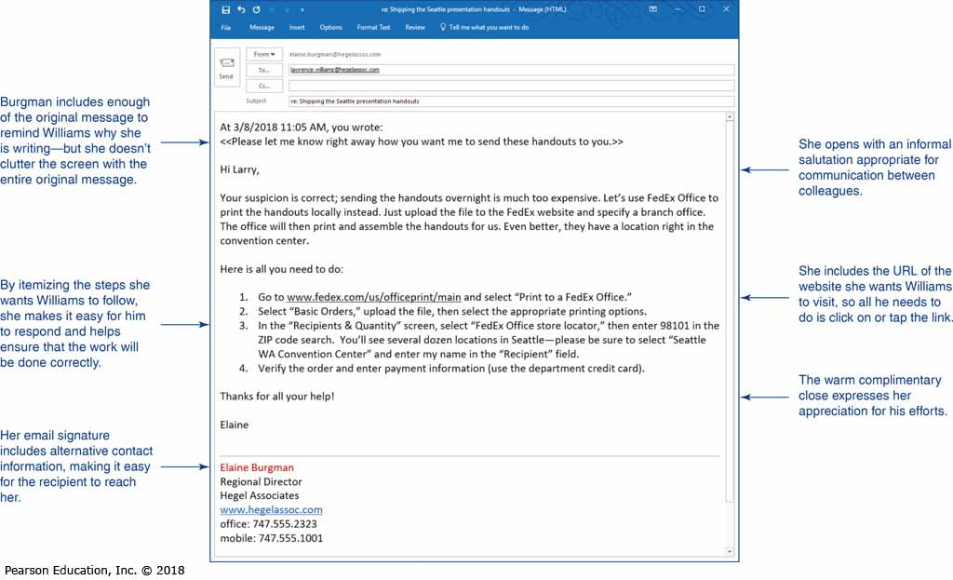
Writing Email
Business Communication
Expectations for Message Quality
Importance of Subject Lines
Importance of Opening Words
Notes:
Business email is a more formal medium than personal email. The expectations of writing quality are higher, and the consequences of bad writing or poor judgment can be much more serious.
The subject line in an email is one of the most important parts of every email message. It helps recipients decide which messages to read and when to read them. To capture your audience’s attention, include informative, compelling subject lines for your emails.
In addition, many email programs display the first few words or lines of incoming messages, even before the recipient opens the messages. In the words of social media public relations expert Steve Rubel, you can “tweetify” the opening lines of your email messages to make them stand out. In other words, choose the first few words carefully to grab your reader’s attention. Think of the first sentence as an extension of your subject line.
Over the years, the use of emoticons has been regarded as unprofessional. Recently, though, some professionals are using them for communication with close colleagues, even as other professionals view them as evidence of lazy or immature writing. In the face of these conflicting perspectives, the best advice is to avoid emoticons for all types of external business communication and for formal internal communication.

Slide 29
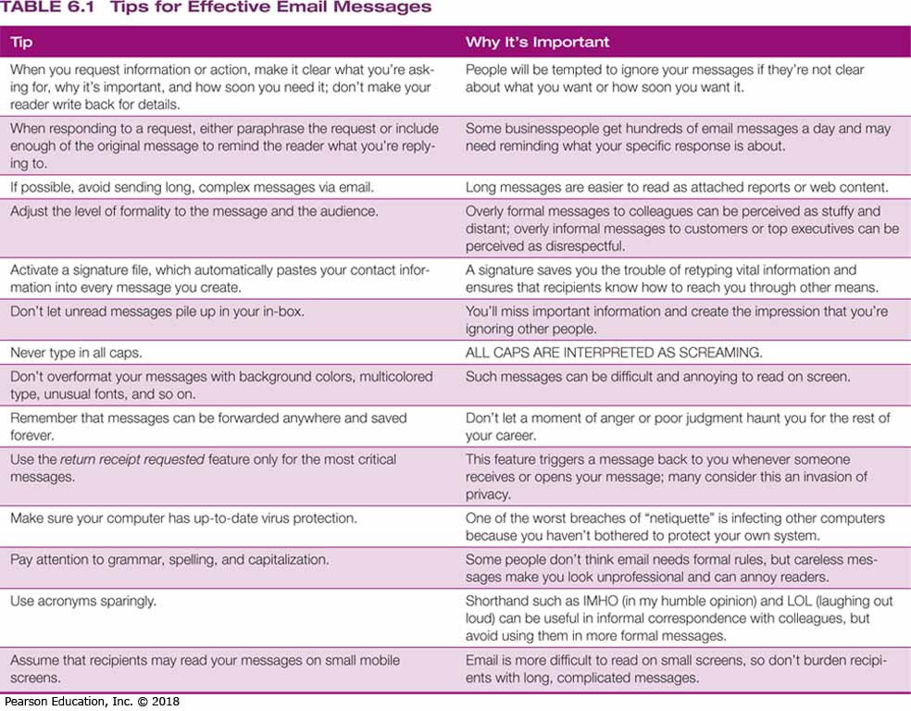
Completing Email Messages
Revising
Proofreading
Producing
Distributing
Notes:
Particularly for important messages, a few moments of revising and proofing might save you hours of headaches and damage control. Also, lean in favor of simplicity when it comes to producing your email messages. A clean, easily readable font, in black, on a white background is sufficient for nearly all email messages.
Take advantage of your email system’s ability to include a signature (most corporate systems support this). The signature gives your messages a more professional appearance and makes it easy for others to communicate with you through other channels.
When you’re ready to distribute your message, pause to verify what you’re doing before you click “Send.” Double-check your addressees to make sure you’ve included everyone necessary—and no one else. Don’t set the message priority to “High” or “Urgent” unless your message is truly urgent. Finally, if you intend to include an attachment, be sure that it is attached.

Slide 30
Summary of Discussion (4 of 7)
In this section, we discussed the following:
Advantages and Disadvantages of Email
Planning Email Messages
Writing Email Messages
Completing Email Messages
The next section will cover Messaging.

Slide 31
Messaging
LO 6.5 Describe the advantages and disadvantages of business messaging, and identify guidelines for effective messaging in the workplace.
Notes:
For both routine communication and exchanges during online meetings, IM is now widely used throughout the business world. Business-grade IM systems offer a range of capabilities, including basic chat, presence awareness, remote display of documents, video capabilities, remote control of other computers, automated newsfeeds from blogs and websites, and automated bot capabilities.
Text messaging has a number of applications in business as well, including marketing, customer service, security, crisis management, and process monitoring. However, since IM is currently more versatile and more widely used in business than text messaging, the following sections focus on IM. Many of the benefits, risks, and guidelines that pertain to IM will pertain to text messaging as well.

Slide 32
Understanding the Advantages and Disadvantages of Messaging (1 of 2)
Opportunities Involved in Using Messaging:
Rapid Response to Urgent Messages
Lower Cost Than Phone and Email
Ability to Mimic Conversations
Available on a Wide Range of Devices
Less Misuse as a Broadcasting Method
Notes:
The benefits of messaging in meetings (and in the workplace in general) include its rapid response to urgent messages, lower cost than both phone calls and email, ability to mimic conversation more closely than email, and availability on a wide range of devices from PCs to phones to PDAs. In addition, because it more closely resembles one-on-one conversation, IM doesn’t get misused as a one-to-many broadcast method as often as email does.

Slide 33
Understanding the Advantages and Disadvantages of Messaging (2 of 2)
Challenges Involved with Using Messaging:
Speed and Accuracy of User
Danger of Security Problems
More Misinterpretation
Notes:
Messaging is at the mercy of other’s typing speed and accuracy. Systems vary widely in their levels of security and privacy, and public systems are not as secure or private. Messaging is a lean medium with less ability to convey nuances and nonverbal signals, which increases the changes of misinterpretation.

Slide 34
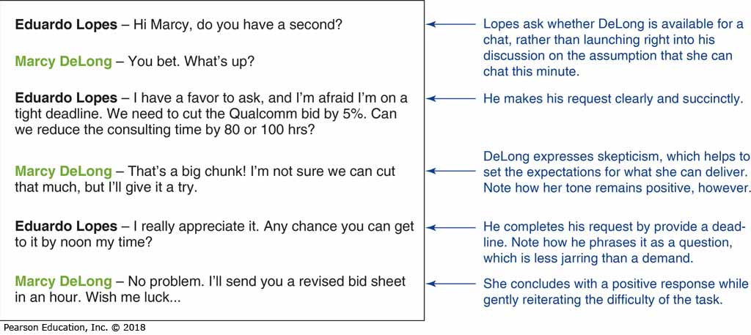
Guidelines For Successful Messaging
Planning Instant Messages
Writing Instant Messages
Completing Instant Messages
Notes:
Although instant messages are often conceived, written, and sent within a matter of seconds, the principles of the three-step process still apply:
Planning instant messages. Except for simple exchanges, take a moment to plan IM “conversations” in much the same way you would plan an important conversation. A few seconds of planning can help you deliver information in a coherent, complete way that minimizes the number of individual messages required.
Writing instant messages. As with email, the appropriate writing style for business IM is more formal than the style you may be accustomed to with personal IM or text messaging.
Completing instant messages. The only task in the completing stage is to send your message. Just quickly scan it before sending, to make sure you don’t have any missing or misspelled words, and verify that your message is clear and complete.

Slide 35
Using Workplace Messaging Effectively (1 of 2)
Use Instant Messaging Courteously
Use “Away” Status while Working
Be Cautious with Private Information
Avoid Sending Personal Messages
Notes:
To use IM effectively, keep in mind some important behavioral issues: the potential for constant interruptions; the ease of accidentally mixing personal and business messages; the risk of being out of the loop (when you are away from your PC or other IM device); and the vast potential for wasted time. Regardless of the system you may be using, you can make IM more efficient and effective by following these tips:
Be courteous when using IM; unless the message is urgent, use email or another type of message.
Unless a meeting is scheduled, make yourself unavailable when you need to focus on other work.
If you are not on a secure system, do not send confidential information.
Be extremely careful about sending personal messages—they have a tendency to pop up on other people’s computers at embarrassing moments.

Slide 36
Using Workplace Messaging Effectively (2 of 2)
Limit Use of Unplanned Meetings
Don’t Send Long, Complex Messages
Avoid Multiple IM Conversations
Observe All Security Guidelines
Notes:
Do not use IM for important but impromptu meetings if you cannot verify that everyone will be present.
Do not use IM for lengthy, complex messages; email is better for those.
Try to avoid carrying on multiple IM conversations at once to minimize the chance of sending messages to the wrong people.
Follow all security guidelines designed to protect information and systems.

Slide 37
Summary of Discussion (5 of 7)
In this section, we discussed the following:
Understanding the Benefits and Risks of Messaging
Adopting the Three-Step Process for Successful Messaging
Using Workplace Messaging Effectively
The next section will cover Blogging and Microblogging.

Slide 38
Blogging and Microblogging
LO 6.6 Describe the use of blogging and microblogging in business communication, and briefly explain how to adapt the three-step writing process to blogging.
Notes:
Blogs—online journals that are easier to personalize and update than conventional websites—are now a major force in business communication. Millions of business-oriented blogs are now in operation, and blogs have become an important source of information for consumers and professionals alike.

Slide 39
Effective Blogs and Microblogs
Use Personal, Authentic Style
Deliver New Information Fast
Feature Topics of Peak Interest
Encourage Conversations
Notes:
Good business blogs and microblogs pay close attention to several important elements:
Communicating with personal style and an authentic voice
Delivering new information quickly
Choosing topics of peak interest to audiences
Encouraging audiences to join the conversation

Slide 40
Understanding Business Applications of Blogging (1 of 3)
Anchor for Social Media Presence
Project Management and Communication
Company News and Updates
Customer Support for Products/Services
Public Relations and Media Relations
Notes:
Blogs are a potential solution whenever you have a continuing stream of information to share with virtually any online audience. Here are some of the many ways businesses are using blogs:
Anchoring the social media presence. Companies can use blogs as a social media hub.
Project management and team communication. Blogs are a convenient way to keep project teams up to date.
Company news. Corporate blogs can keep employees up to date on news and other timely issues.
Customer support. Customers can check a company’s blog for answers to FAQs, as well tips and advice for products and services.
Public relations and media relations. The public relations and marketing departments can share company news with the general public and journalists.

Slide 41
Understanding Business Applications of Blogging (2 of 3)
Recruit Potential Employees
Policy and Issue Discussions
Crisis and Emergency Communication
Market Research and Feedback
Brainstorming Sessions
Notes:
Recruiting. Telling potential employees about the benefits of working at a firm and responding to their questions.
Policy and issue discussions. Offering a public forum for discussing legislation, regulations, and other broad issues of interest to an organization.
Crisis communication. Using blogs is a convenient way to provide up-to-the-minute information during emergencies, to correct misinformation, or respond to rumors.
Market research. In addition to using their own blogs to solicit feedback, today’s companies should monitor blogs that are likely to discuss them, their executives, and their products.
Brainstorming. Online brainstorming via blogs offers a way for people to toss around ideas and build on each others’ contributions.

Slide 42
Understanding Business Applications of Blogging (3 of 3)
Employee Engagement
Customer Education
Word-of-Mouth Marketing
Influence on Traditional Media Coverage
Community Building
Notes:
Employee engagement. Blogs can enhance communication across all levels of a company.
Customer education. Blogs can help current and potential customers understand your products and services.
Word-of-mouth marketing. Bloggers often make a point of providing links to other blogs and websites that interest them, giving marketers a great opportunity to have their messages spread by enthusiasts.
Influencing traditional media news coverage. Prolific bloggers who provide valuable and consistent content are often considered subject-matter experts, so they’re often called upon when journalists need insights into various topics.
Community building. Communities of readers can “grow” around a popular blog, as readers participate in the flow of ideas via comments on various posts.

Slide 43
Adapting the Three-Step Process for Successful Blogging
Plan
Audience
Purpose
Scope
Write
Write in a Comfortable, Personal Style
Know Your Subject and Provide Links
Complete
Evaluate
Proofread
Tag and Post
Notes:
The three-step writing process is easy to adapt to blogging tasks. The planning step is particularly important if you’re considering starting a blog, because you’re planning an entire communication channel, not just a single message. Pay close attention to your audience, your purpose, and your scope.
After you begin writing your blog, the careful planning needs to continue with each message. Write in a comfortable, personal style. Bear in mind, though, that comfortable does not mean careless, and sloppy writing will damage your credibility. Naturally, your readers will expect you to be knowledgeable, but if you don’t have all the information yourself, simply provide links to other blogs and websites.
Completing messages for your blog is usually quite easy. Evaluate the content and readability of your message, proofread to correct any errors, then post the message using your blogging system’s tools. If your blog doesn’t already have one, be sure to include one or more newsfeed options so that your audience can automatically receive headlines. Finally, make your material easier to find by tagging it with descriptive words.

Slide 44
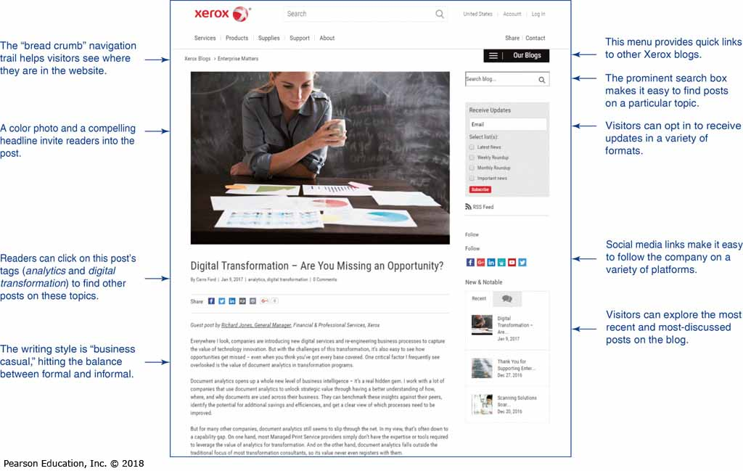
Business Applications of Blogging
Notes:
Use content, writing style, and features to create an effective, reader-friendly company blog.

Slide 45
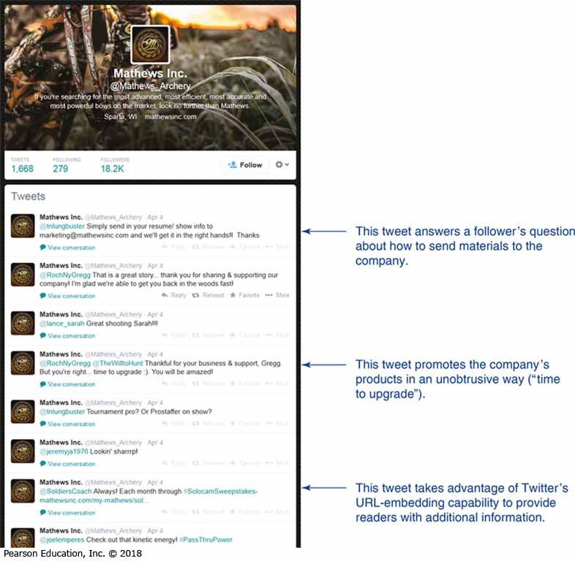
Microblogging (1 of 2)
Microblogs in Business
Company Updates
Sales Promotions
Tips for Product Use
Information from Experts
Headlines of New Blogs
Backchannel for Meetings
Notes:
A microblog is a variation on blogging in which messages are sharply restricted to specific character counts. Like regular blogging, microblogging is now a mainstream business medium. Many of the concepts of regular blogging apply to microblogging, although the severe length limitations call for a different approach to composition.
Microblogs are frequently used for providing company updates, offering coupons and notice of sales, presenting tips on product usage, sharing relevant and interesting information from experts, and announcing headlines of new blog posts. Microblogging also fuels the backchannel in meetings and presentations.

Slide 46
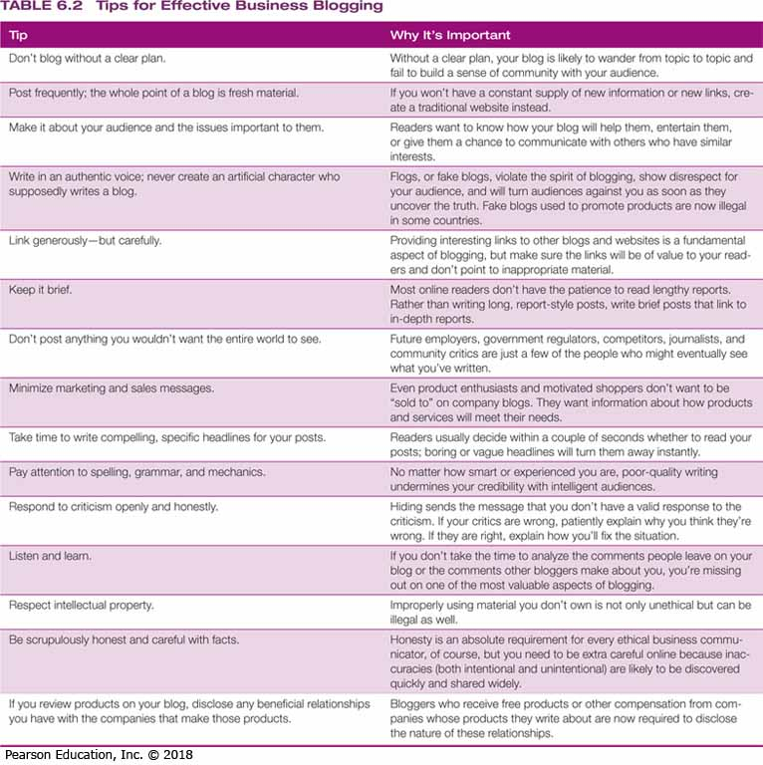
Microblogging (2 of 2)
Microblogs in Business
Real-Time News Source
Customer Service
Crowdsourcing
Retweeting Messages
Topics of Interest
Ongoing Conversations
Notes:
By following top names in your field, you can customize Twitter as your own real-time news source.
Customer service is becoming a popular use for Twitter as well, thanks to its ease, speed, and the option to switch between public tweets and private direct messages as the situation warrants.
The social networking aspect of microblogs makes them good for crowdsourcing research questions by asking followers for input or advice.
The ease of retweeting, the practice of forwarding messages from other Twitter users, is the microblogging equivalent of sharing other content from other bloggers via content curation.
Microblogging uses the informal Twitter hashtag feature, which makes it easy for people to label and search for topics of interest and to monitor ongoing Twitter conversations about particular topics.
Although microblogs are designed to encourage spontaneous communication, when you’re using the medium for business communication, don’t just tweet out whatever pops into your head. Make sure messages are part of your overall communication strategy.

Slide 47
Summary of Discussion (6 of 7)
In this section, we discussed the following:
Effective Blogs and Microblogs
Understanding Business Applications of Blogging
Adapting the Three-Step Process for Successful Blogging
Microblogging
The next section will cover Podcasting.

Slide 48
Podcasting
LO 6.7 Explain how to adapt the three-step writing process to podcasts.
Notes:
Podcasting is the process of recording audio or video files and distributing them online via RSS subscriptions. Podcasting combines the media richness of voice or visual communication with the convenience of portability. The most obvious use for podcasting is to replace existing audio and video messages. Training is another good use; you may already have taken a college course via podcasts. Podcasting is also a great way to offer free previews of seminars and training classes. Many business writers and consultants use podcasting to build their personal brands and to enhance their other product and service offerings.

Slide 49
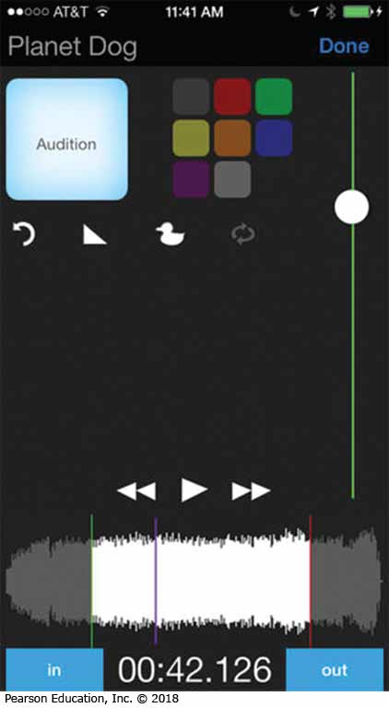
Using the Three-Step Process for Podcasting
Plan
Situation
Information
Organization
Write
Transitions, Previews, and Reviews
Scripting vs. Improvising
Complete
Editing
Recording
Publishing
Notes:
As with blogs, the three-step process also adapts nicely to podcasting.
Focus the planning step on analyzing the situation, gathering the information you’ll need, and organizing your material. One vital step depends on whether you intend to create podcasts for limited use or to create a podcasting channel, designed for a wider public audience. If you plan on creating a podcast channel, consider the topics you will address over time to make sure that you have a sustainable purpose. Maintaining a consistent schedule is also important to keep the attention of listeners
As you organize and move into the writing step, pay close attention to previews, transitions, and reviews. These steering devices are especially vital in audio and video recordings because these formats lack the visual cues that audiences rely on in print media. You’ll need to decide whether to: (a) script your podcast completely, then read it word for word; or (b) improvise from a speaking outline and notes.
In the completing step, keep in mind that editing is much more difficult in an audio or video medium such as podcasting. Therefore, take extra care to revise your script or think through your speaking notes before you begin to record. The closer you can get to recording podcasts in one take, the more productive you will be. When each recording is ready, use your system’s tools to prepare the audio file and publish it via a newsfeed. You may also want to integrate your podcasts with a related blog. Doing so will allow you to provide additional information, and encourage feedback from your audience.

Slide 50
Resources Required for Podcasting
Recording
Audio Recording
Editing Software
Production Quality
Distributing
Media Stores
Hosting Services
Blog Content
Notes:
The equipment needed to record podcasts depends on the degree of production quality you want to achieve and whether you plan to record in a studio or on the go.
Most personal computers, smartphones, and other devices now have basic audio recording capability, including built-in microphones, and free editing software is available online. If you need higher production quality or greater flexibility, you’ll need to add additional pieces of hardware and software, such as an audio processor (to filter out extraneous noise and otherwise improve the audio signal), a mixer (to combine multiple audio or video signals), a better microphone, and more sophisticated recording and editing software. You may also need to improve the acoustics of the room in which you are recording, to minimize echoes, noise, and other problems.
Podcasts can be distributed in several ways, including through media stores such as iTunes, dedicated podcast hosting services, or on a blog with content that supports the podcasting channel.

Slide 51
Summary of Discussion (7 of 7)
In this section, we discussed the following:
Using the Three-Step Process for Podcasting
Resources Required for Podcasting
This concludes our discussion of Chapter 6: Crafting Messages for Digital Channels.

Slide 52
Copyright

