Slide 1
Chapter 3
Application of Matrices in Economics

Slide 2
Example 1:
Let matrix A represent the sales (in thousands of dollars) for the Walbash Company in 2011 in various cities, and let matrix B represent the sales (in thousands of dollars) for the same company in 2012 in the same cities.
Chicago Atlanta Memphis
$A=\left[\begin{matrix}450 & 280 & 850 \\ 400 & 350 & 150\end{matrix} \right]\begin{matrix}Wholesale \\ Retail\end{matrix}$
Chicago Atlanta Memphis
$B=\left[\begin{matrix}375 & 300 & 710 \\ 410 & 300 & 200\end{matrix} \right]\begin{matrix}Wholesale \\ Retail\end{matrix}$

Slide 3
Write the matrix that represents the total sales by type and city for both years.
$$A+B=\left[\begin{matrix}450 & 280 & 850 \\ 400 & 350 & 150\end{matrix} \right]+\left[\begin{matrix}375 & 300 & 710 \\ 410 & 300 & 200\end{matrix} \right]$$
$$A+B=\left[\begin{matrix}825 & 580 & 1560 \\ 810 & 650 & 350\end{matrix} \right]$$

Slide 4
(b) Write the matrix that represents the change in sales by type and city from 2011 to 2012
$$A−B=\left[\begin{matrix}450 & 280 & 850 \\ 400 & 350 & 150\end{matrix} \right]−\left[\begin{matrix}375 & 300 & 710 \\ 410 & 300 & 200\end{matrix} \right]$$
$$A−B=\left[\begin{matrix}75 & −20 & 140 \\ −10 & 50 & −50\end{matrix} \right]$$

Slide 5
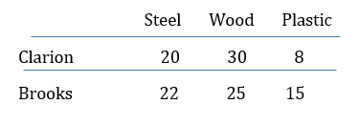
Example 2:
Pentico Industries must choose a supplier for the raw materials that it uses in its two manufacturing divisions at Clarion and Brooks. Each division uses different unit amounts of steel, wood, and plastic as shown in the table below.

Slide 6
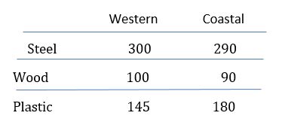
The two supply companies being considered, Western and Coastal, can each supply all of these materials, but at different prices per unit, as described in the following table.
Use matrix multiplication to decide which supplier should be chosen to supply
(a) the Clarion division and
(b) the Brooks division.

Slide 7
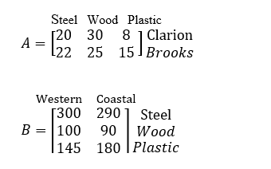
Solution :
The different amounts of products needed can be placed in matrix A and the prices charged by the suppliers in matrix B.

Slide 8
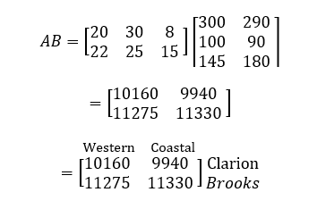
The price from each supplier for each division is found from the product AB.

Slide 9
Results :

Slide 10
Example 3:
The Walters Manufacturing Company needs to know how best to use the time available within its three manufacturing departments in the construction and packaging of the three types of metal storage sheds. Each one must be stamped, painted, and packaged. Table 3.6 shows the number of hours required for the processing of each type of shed. Using the information in the table, determine how many of each type of shed can be produced if the stamping department has 3200 hours available, the painting department has 1700 hours, and the packaging department has 1300 hours.

Slide 11
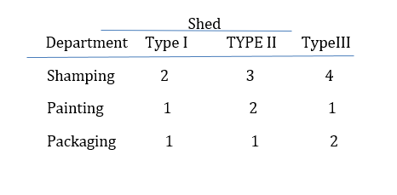
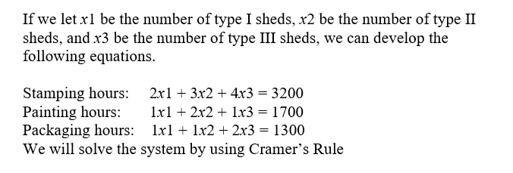
Solution

Slide 16
Example 4:
The Ace Freight Company has an order for two products to be delivered to two stores of a company. The table gives information regarding the two products.
(a) If truck A can carry 2350 cu ft and 23,000 lb, how many of each product can it carry?
(b) If truck B can carry 2500 cu ft and 24,500 lb, how many of each product can it carry?

Slide 17
Solution: By using inverse of a square matrix
If we let be the number of units of product I, be the number of units of product II, we can develop the following equations :

Slide 19
Solution: By using inverse of a square matrix
b) If we let be the number of units of product I, be the number of units of product II, we can develop the following equations :

