Slide 1
Gene mutations
Sabha Rabaya, MSc

Slide 2
Human Genetic Diversity: Mutation Vs. Polymorphism
Mutation
Polymorphism
Genetic alteration
Frequency in a population; less than 1% (rare variant)
Genetic alteration
Frequency in a population; more than 1% (common)
This definition is independent of functional or pathogenic relevance of alteration: most of common variants (polymorphisms) are without effect on human health, but some can modify the risk of common diseases (as tumors…)

Slide 3
Types of Mutations
Genetic disorders can be caused by numerous types of mutations. Generally speaking, there are three groups:
Numerical chromosome abnormalities
.
Structural chromosome abnormalities
.
DNA/Gene mutations that alter the function of individual genes
.

Slide 4
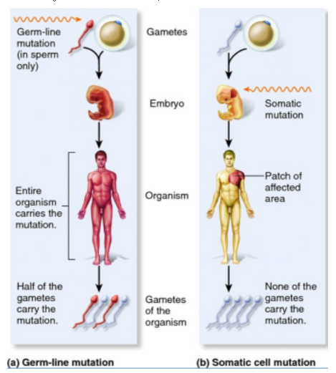
Gene Mutations
Germline and Somatic Mutation
Germline mutation,
The change occurs during the DNA replication that precedes meiosis.
The resulting gamete and all the cells that descend from it after fertilization have the mutation—that is, every cell in the body.
Germline mutations are transmitted to the next generation of individuals. (Inheritable)
Somatic mutation
Occurs during DNA replication before mitosis
passed to the next generation of cells, but not to all the cells in the individual’s body. (noninheritable)

Slide 5
Causes of Mutations
A mutation can occur spontaneously or be induced by exposure to a chemical or radiation.
An agent that causes mutation is called a mutagen.
Mutations
Spontaneous Mutations
Induced Mutations

Slide 6
Spontaneous Mutations
A spontaneous mutation usually originates as an error in DNA replication.
Different genes have different spontaneous mutation rates.
In some genes, mutations are more likely to occur in regions called hot spots, where sequences are repetitive.
Induced Mutations
Mutagens

Slide 7
Types of Gene Mutations
Single gene disorders

Slide 8
Mutations
DNA/Gene mutations: Monogenic disorders/single gene disease
A genetic disease occurs when an alteration in the DNA of an essential gene changes the amount or function, or both, of the gene products—typically messenger RNA (mRNA) and protein but occasionally specific noncoding RNAs (ncRNAs) with structural or regulatory functions.
The same single-gene disease can result from different types of mutations.
With regard to changes in the DNA sequence (e.g., point mutations, trinucleotide repeat expansion, and gene duplication).
With regard to functional changes (e.g., altered expression, disrupted messenger RNA [mRNA] splicing, and alteration in protein structure).

Slide 9
The Effects of Mutations on Protein Functions
Mutations involving protein-coding genes have been found to cause disease through one of four different effects on protein function
The most common effect by far is a loss of function of the mutant protein.
Gain of function, the acquisition of a novel property by the mutant protein
Heterochronic expression mutation, the expression of a gene at the wrong time
Ectopic expression mutation, the expression of a gene in the wrong place.

Slide 10
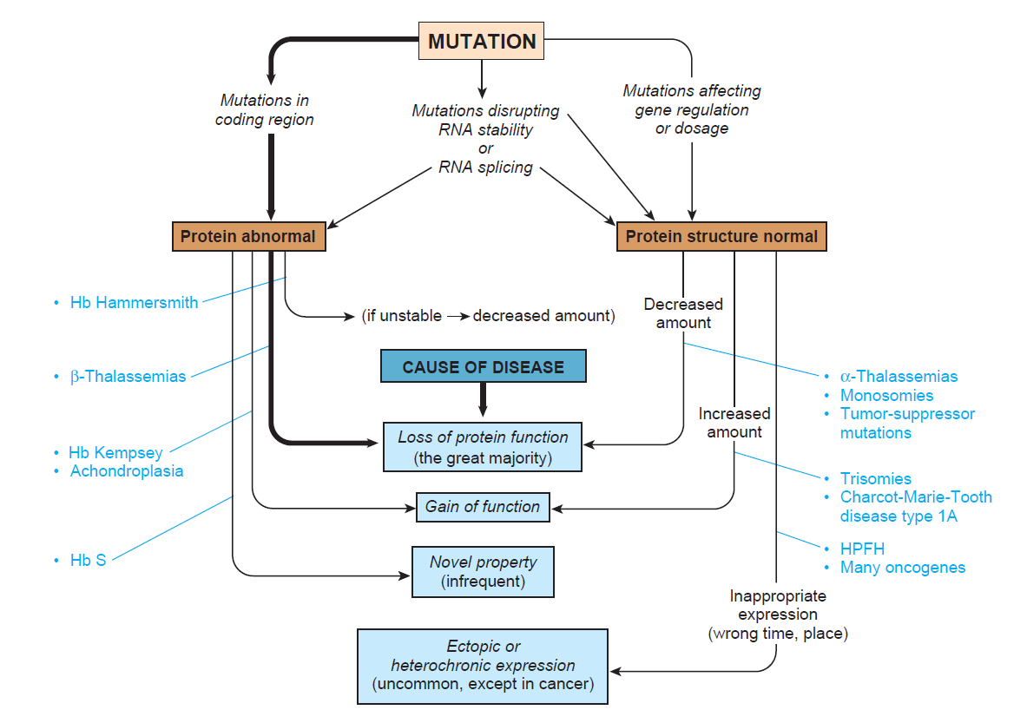
Mechanisms by which disease-causing mutations produce
disease

Slide 11
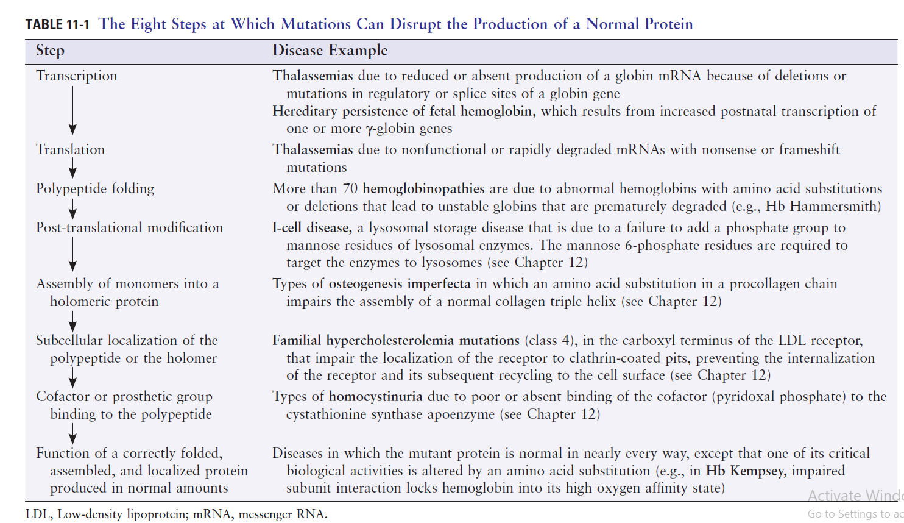

Slide 12
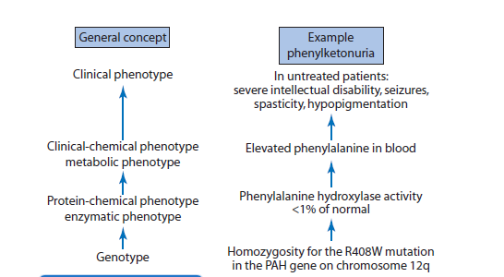
Pathomechanisms of Genetic disease
From Genotype to Phenotype

Slide 13
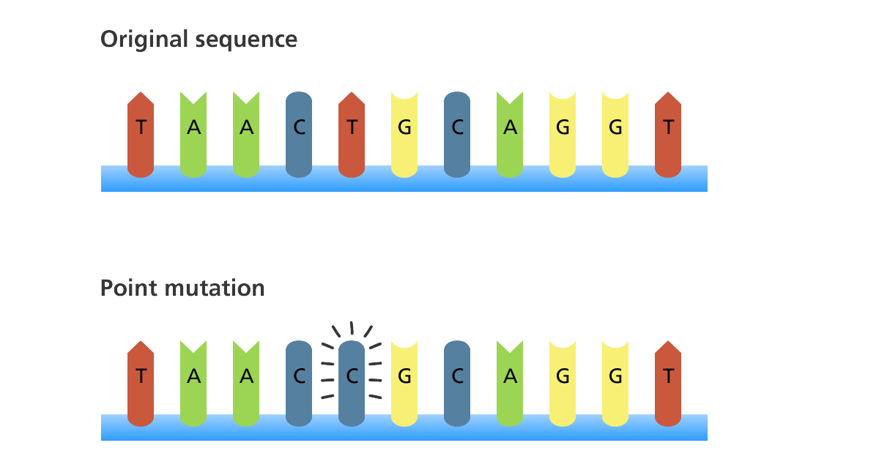
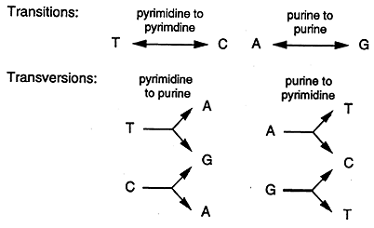
Types of gene mutations
Point mutations
A point mutation is a change in a single DNA base
Point mutations may or may not cause changes at the protein level.
Types:
Substitution (base exchange), by far the most frequent type
Insertion (one additional nucleotide)
Deletion (loss of a nucleotide)
Transition mutation
Transversion mutation

Slide 14
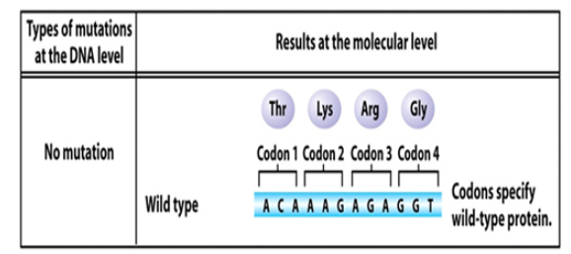
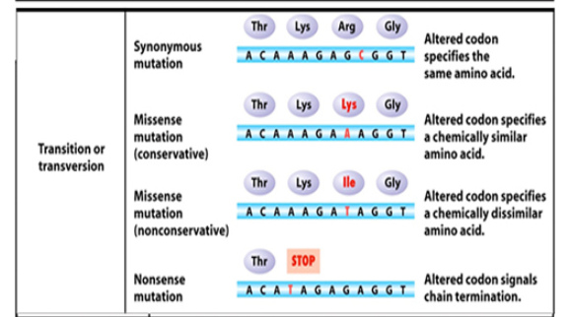
Consequences of point mutations
Silent or synonymous - triplet code changes, but the encoded amino acid does not.

Slide 15
Consequences of point mutations
2. Missense - codon change alters the amino acid encoded
The functional effects of missense mutations can be manifold: they might not be functionally relevant at all, they may render the protein nonfunctional, they may affect binding sites with other proteins, they may impair the protein’s ability to be functionally modified (e.g.,
by phosphorylation), or they may affect splicing of the pre-mRNA, leading to a completely different effect on protein structure and function.

Slide 16
Consequences of point mutations
3. Nonsense - codon changes from an amino acid code to a "stop" codon, changing the nature of the final protein product.
—UAA, UAG, or UGA

Slide 17
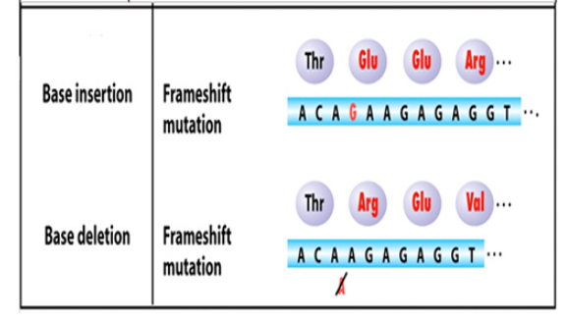
Consequences of point mutations
4. Frameshift - any addition or deletion which alters the reading frame (i.e., not in a multiple of three).
THE FAT CAT ATE THE RAT -->delete first "E"--> THF ATC ATA TET HER AT...

Slide 18
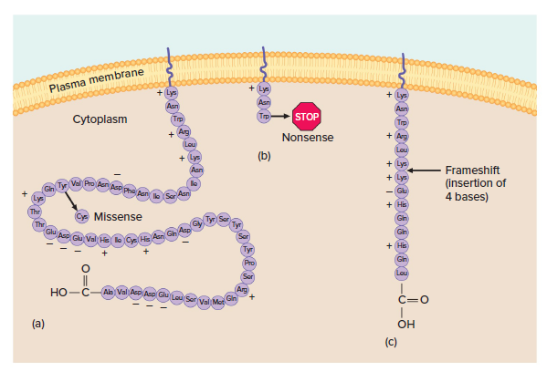
Familial hypercholesterolemia
LDL receptor
Familial hypercholesterolemia (FH) is an autosomal dominant disorder characterized by a high plasma level of low-density lipoprotein cholesterol (LDL-C).
Can lead to early heart disease and heart attacks

Slide 19
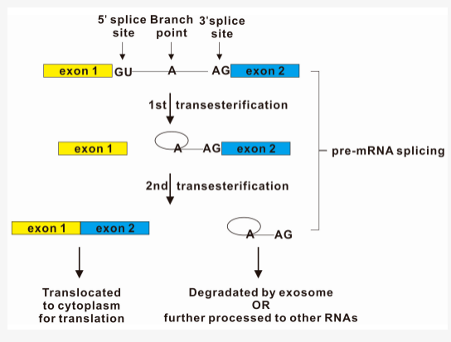
Consequences of point mutations
Accepter Site
Donor site
Mutations that affect splicing (splice site mutations)
Pre-mRNA processing: Splicing
Splice site mutations are DNA sequence changes
that alter or abolish correct mRNA splicing

Slide 20
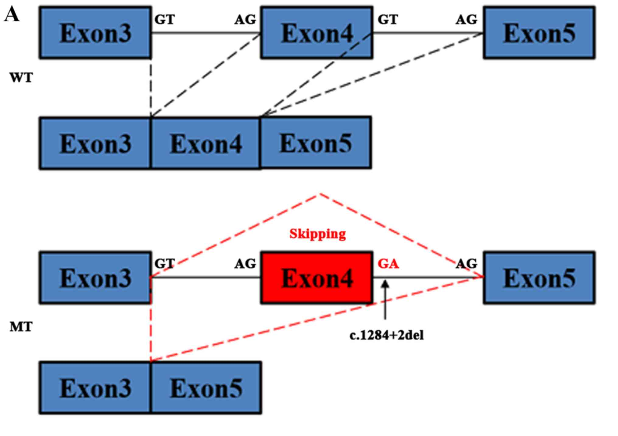

Slide 21
Cystic Fibrosis
Cystic fibrosis (CF) is an autosomal recessive disorder caused by >1600 mutations in the CF transmembrane conductance regulator (CFTR) gene, a percent of these mutations are splice site mutations.
The cystic fibrosis transmembrane conductance regulator (CFTR) is a cAMP-activated chloride and bicarbonate channel expressed at the apical surface of secretory epithelia, including the airways, sweat glands, gastrointestinal tract, and other tissues
CF is a multiorgan system disease, its effects on the pulmonary system are the leading cause of patient morbidity and mortality.
When mutations occur in one or both copies of the gene, ion transport is defective, and results in a buildup of thick mucus throughout the body, leading to respiratory insufficiency, along with many other systemic obstructions and abnormalities

Slide 22
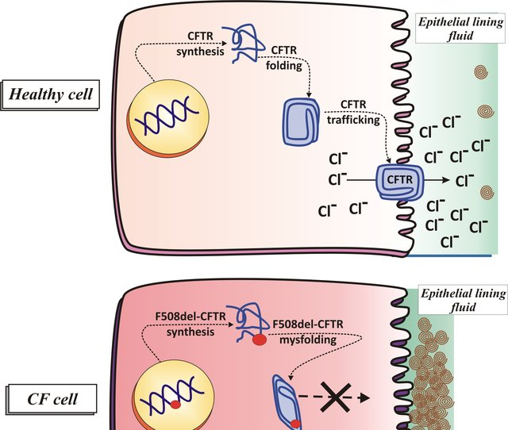
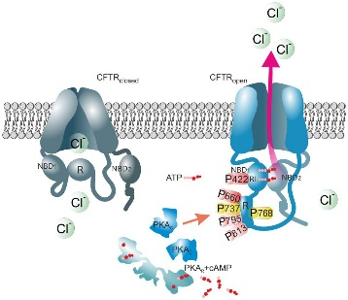
CFTR

Slide 23
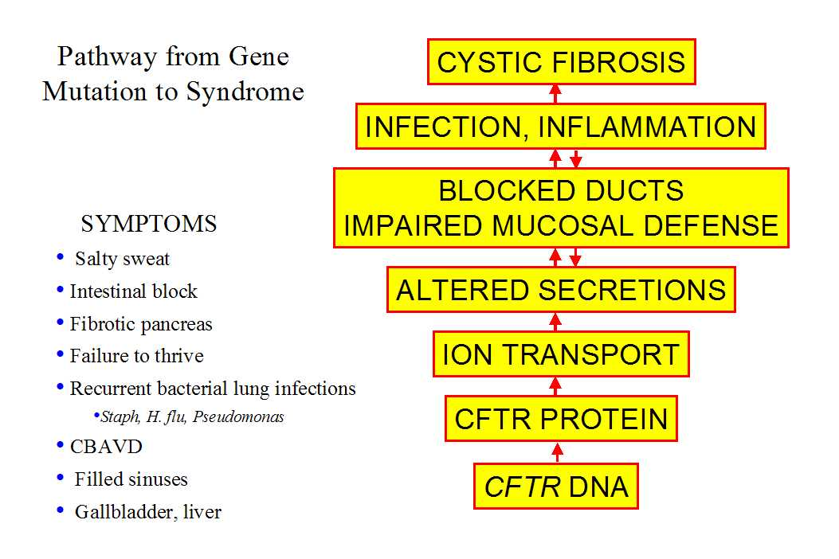
Cystic Fibrosis

Slide 24
Dynamic Mutations, Expanding repeat mutations
Progressive intergenerational expansion of a simple DNA repeat
Trinucleotide repeats are in the class of minisatellites in the human genome and are composed of multiple repetitions of three nucleotides (e.g., CAGCAGCAG…CAG or CCGCCGCCG…CCG), which normally occur in groups of 5 to 30 repeats.
An essential feature of disease-associated repeats is their instability: if there are more than a certain number of repeats in the sequence, transmission through gametogenesis may be associated with expansion of the repeat.
There are also disorders caused by an expansion of dinucleotide and tetranucleotide repeats.
Microsatellites, also known as simple sequence repeats or tandem repeats, are normally polymorphic nucleotide sequences scattered throughout the human genome.

Slide 25
The mechanism behind expanding repeat diseases lies in
the DNA sequence.
The bases of the repeated triplets implicated in the expansion diseases, unlike others, bond to each other in ways that bend the DNA strand into shapes, such as hairpins.
These shapes then interfere with DNA replication, which extends the expansion.
Once the repeats are translated, the extra-long proteins harm cells

Slide 26
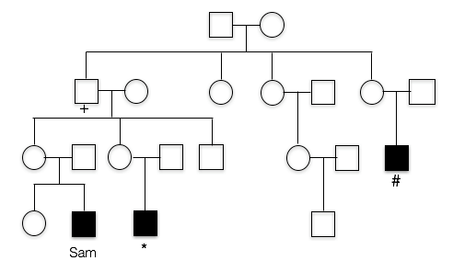
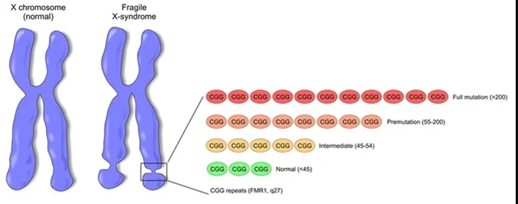
Fragile X syndrome FXS
Progressive intergenerational expansion of a simple DNA repeat, (CGG)n, located within the 5’ -untranslated region (UTR) of the FMR1 gene
Expansion of a CGG repeat beyond 200 copies causes hypermethylation and prohibits transcription of the gene.
Symptoms: Intellectual disability, delayed development
X linked Dominant
FXS is more common in boys than it is in girls

Slide 27
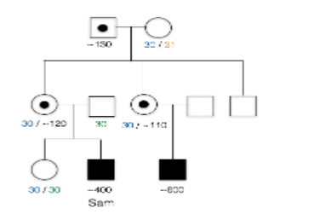
Repeat expansion diseases typically show clinical anticipation – that is, the tendency for disease severity to increase in successive generations of a family.

Slide 28
Huntington disease
Polyglutamine disease
CAG trinucleotides in the coding sequence of HTT gene.
CAG encodes for the amino acid glutamine, and expansion of the repeat causes integration of an increasing number of glutamine residues into a polyglutamine tract within the respective protein. Once the number of glutamines exceeds a certain threshold, the physical properties of the protein change, leading to intracellular aggregation and finally cell (neurons) death .
the number of CAG repeats is less than 26, while in persons with HD the gene usually contains more than 40 repeats.
neurodegenerative disorder: Psychiatric symptoms, motor symptoms (uncontrolled movements)…….may have trouble walking, speaking and swallowing
autosomal dominant

Slide 29
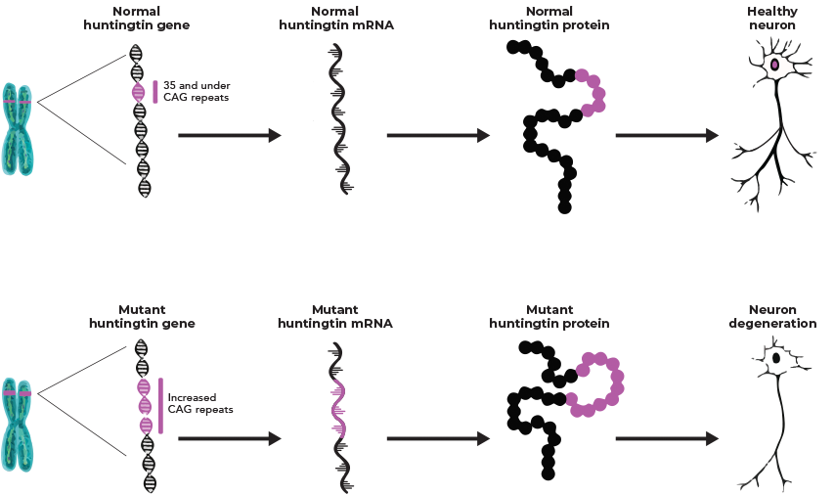

Slide 30
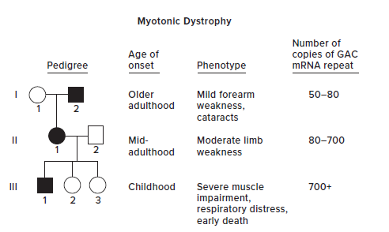
Myotonic dystrophy
(CTG)n repeat expansions (GAC mRNA repeats)
The wild type repeat number is 5 to 37; a person with the disease has from 50 to thousands of copies
increasing number of CUG trinucleotides in the 3’UTR of the DMPK gene
Pathogenesis in myotonic dystrophy is not related to the protein coded by the DMPK gene but is due to abnormal RNA transcript processing. The long tract with repetitive CUGs in the mRNA leads to sequestration and/or upregulation of RNA-binding proteins and disruption of various RNA processes, ranging from pre-mRNA splicing to protein translation, for a number of different genes. Deficiencies of these genes explain the divergent symptoms in many organ systems.

Slide 31
Myotonic dystrophy
Multi-system disease (with skeletal muscle, cardiac, neuroendocrine involvement)
Muscular dystrophy and Myotonia (relaxation of a muscle is impaired)
Autosomal Dominant

Slide 32
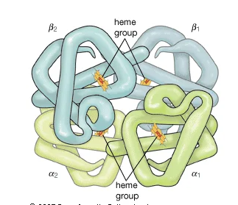
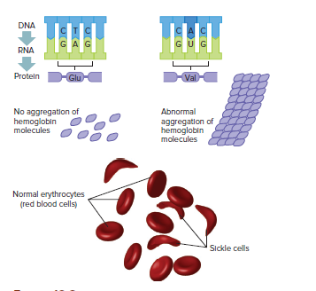
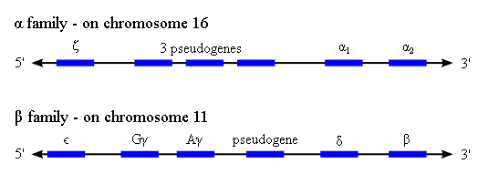
A Closer Look at Two Mutations (12.2)
Sickle cell disease (sickle cell anemia)
HBB: beta globin gene encodes
for beta globin polypeptide chain
Autosomal Recessive
Glutamic acid: Polar
Valine: non-polar
The formation of polymerized haemoglobin leading to erythrocyte rigidity and appearance of characteristic sickle-shaped Red blood Cells (RBCs) resulting in vascular occlusion and haemolysis is central to the molecular pathogenesis of the disease.
Video

Slide 33
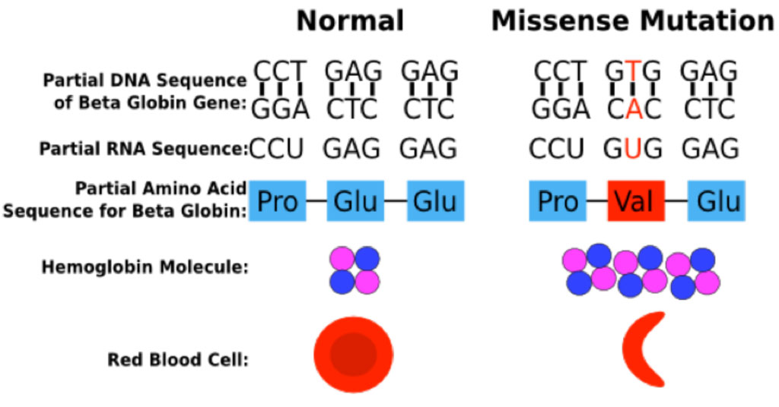
Hemoglobin polymerization

Slide 34
A Closer Look at Two Mutations:Thalassemia
2. Thalassemia
Thalassemias are characterized by the disruption of the synthesis of normal adult hemoglobin (HbA; an α₂β₂ tetramer) consequent to a diverse array of genetic mutations/deletions to either the β or α-hemoglobin chain genes
Beta thalassemia: reduced or absent production of beta globin chain, as a consequence, β thalassemia is characterized by the presence of highly unstable monomeric α-chains as these chains cannot self-associate
Autosomal recessive
Different mutations; point mutations, small insertions, deletions

Slide 35
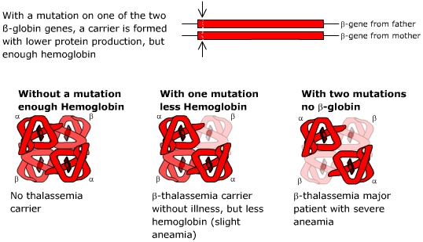
A Closer Look at Two Mutations (12.2): Beta Thalassemia

Slide 36
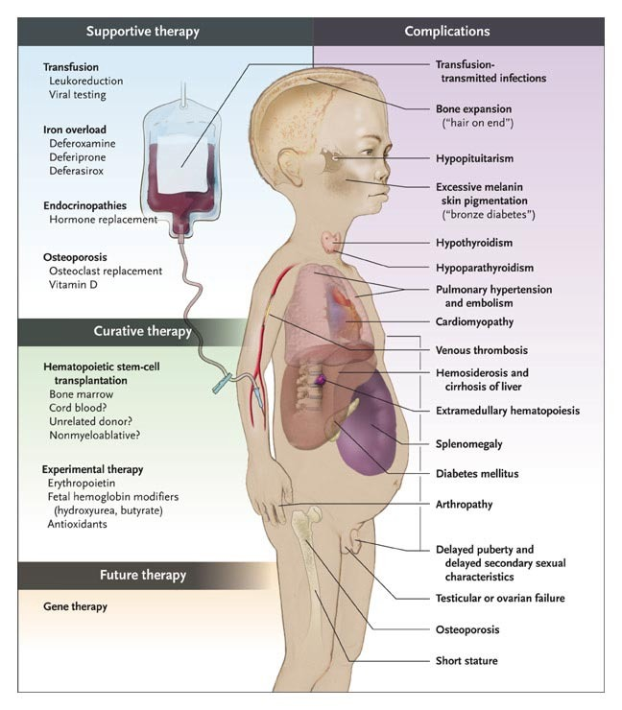
Beta Thalassemia
Symptoms

Slide 37
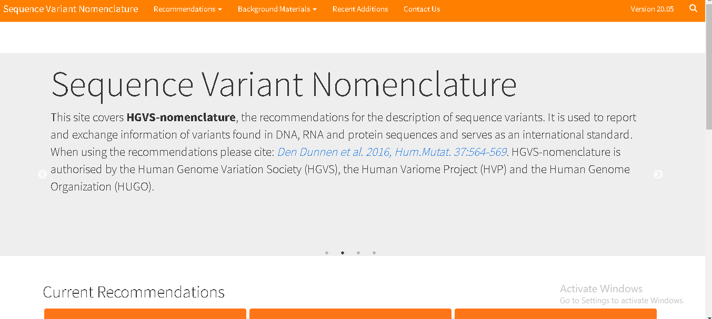
Notes on Nomenclature

Slide 38
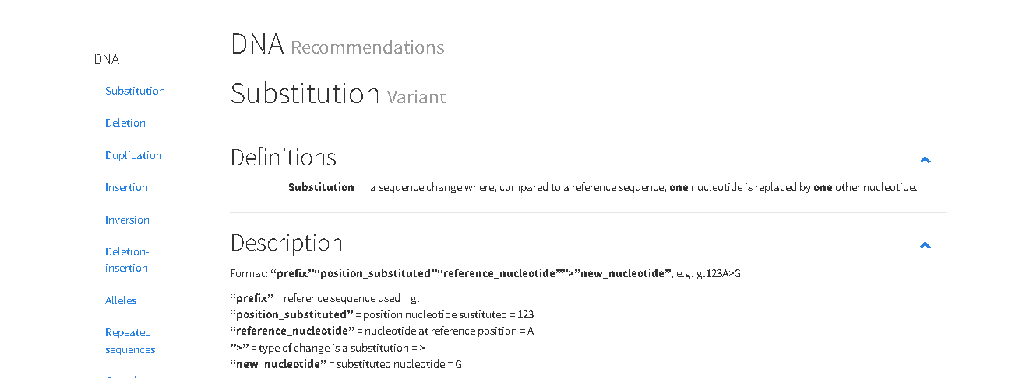
Notes on Nomenclature

Slide 39
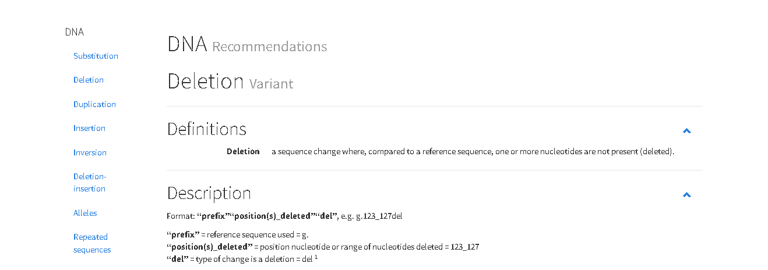
Notes on Nomenclature

Slide 40
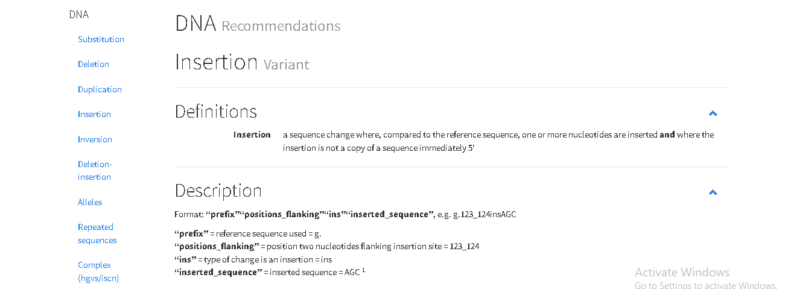
Notes on Nomenclature

