Slide 1
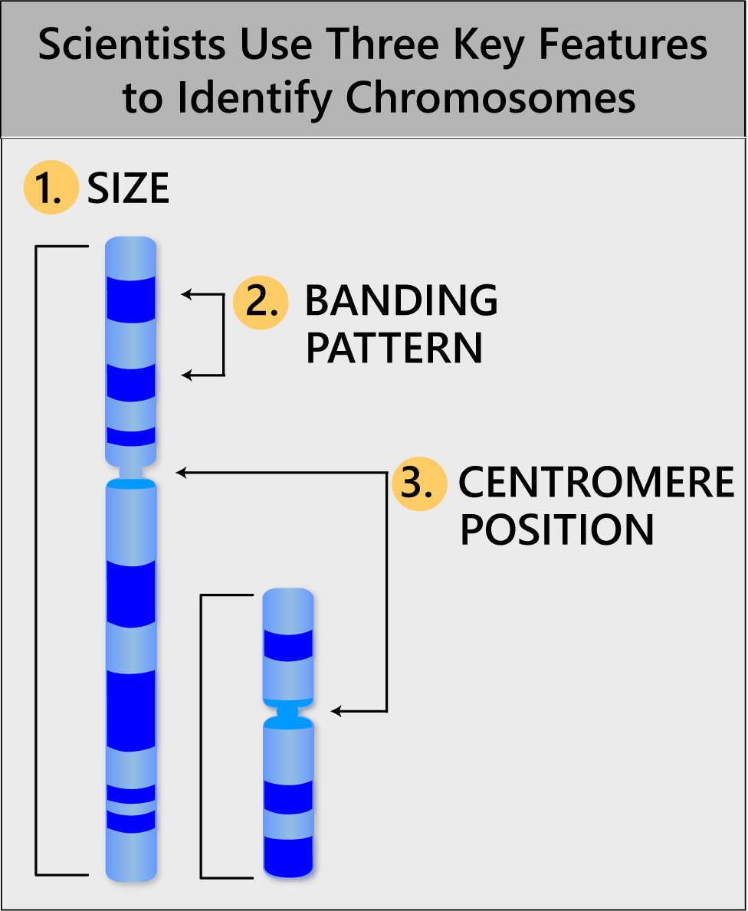
Chromosomes
Human chromosomes are often classified into three types according to the position of the centromere
Metacentric chromosomes
Submetacentric:
Acrocentric chromosomes,
Telocentric :
The centromere at one end and only a single arm
Does not occur in the normal human karyotype, but it is occasionally observed in chromosome rearrangements.
Notes:
the centromere lies near the center of the chromosome.
chromosomes have a centromere that is off-center, so that one chromosome arm is longer than the other. The short arm is designated "p" (for petite), and the long arm is designated "q" (because it follows the letter "p").
the centromere is very near one end.
The human acrocentric chromosomes (chromosomes 13, 14, 15, 21, and 22) have small, distinctive masses of chromatin known as satellites attached to their short arms by narrow stalks (called secondary constrictions). The stalks of these five chromosome pairs contain hundreds of copies of genes for ribosomal RNA (the major component of ribosomes; see Chapter 3) as well as a variety of repetitive sequences.

Slide 2
Chromosomes
Notes:
https://slideplayer.com/slide/8297768/
https://www.researchgate.net/publication/287237374_Animal_genomes_under_the_focus_of_cytogenetics/figures?lo=1
https://www.researchgate.net/publication/318218839_Karyological_evidence_of_hybridogenesis_in_Greenlings_Teleostei_Hexagrammidae/figures?lo=1
https://www.google.com/imgres?imgurl=https%3A%2F%2Fslidetodoc.com%2Fpresentation_image_h%2F21258cd8fc4d01f9baecf7ba693fb731%2Fimage-11.jpg&imgrefurl=https%3A%2F%2Fslidetodoc.com%2Fwelco-me-karyotyping-chromosome-banding-and-chromosome-painting%2F&tbnid=Q6SYSyRGewKFqM&vet=12ahUKEwj7m9fTvfb1AhU8_rsIHXk_BXYQMygtegUIARCaAg..i&docid=YM2kWmvnE5a95M&w=612&h=792&q=chromosome%2Bshapes%2Blabeled%2Bkaryotype&ved=2ahUKEwj7m9fTvfb1AhU8_rsIHXk_BXYQMygtegUIARCaAg

Slide 3
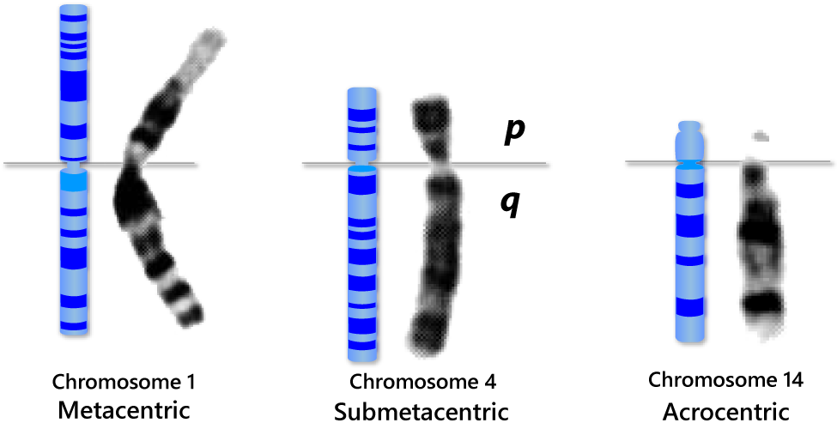
Chromosomes

Slide 4
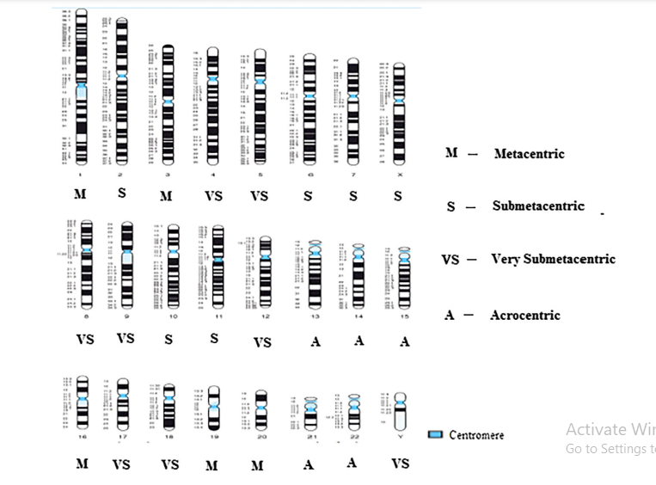
Human Chromosomes

Slide 5
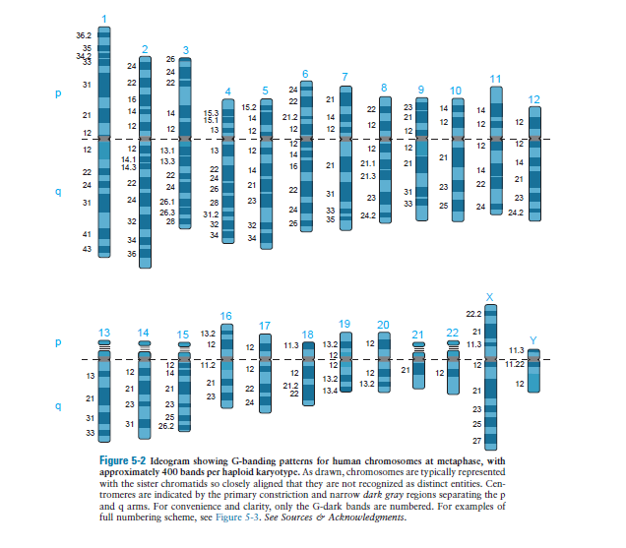
Chromosomes

Slide 6
Cytogenetics
Cytogenetics is the branch of genetics that studies the structure and behavior of chromosomes and their relation to human disease and disease processes.

Slide 7
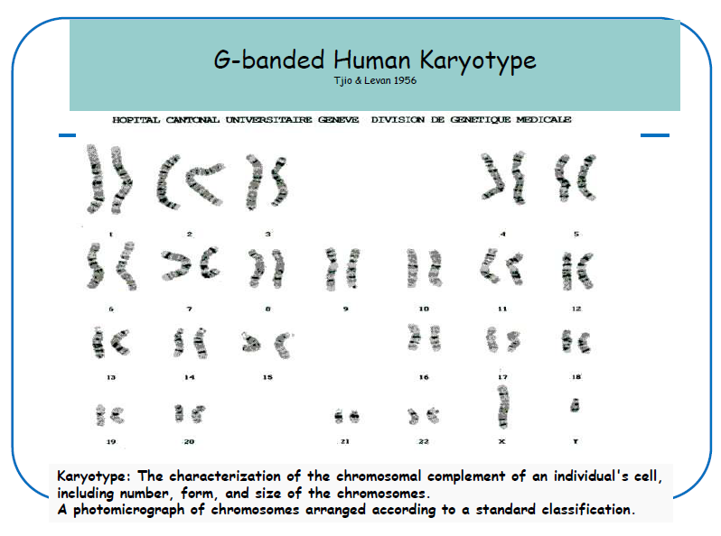
Karyotype

Slide 8
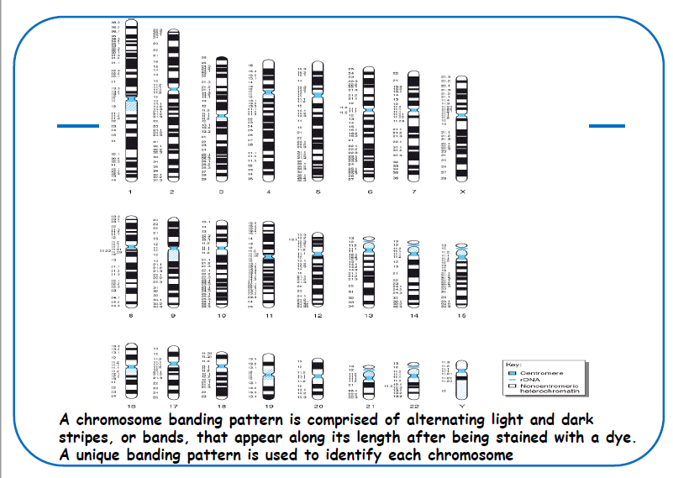
Karyotype

Slide 10
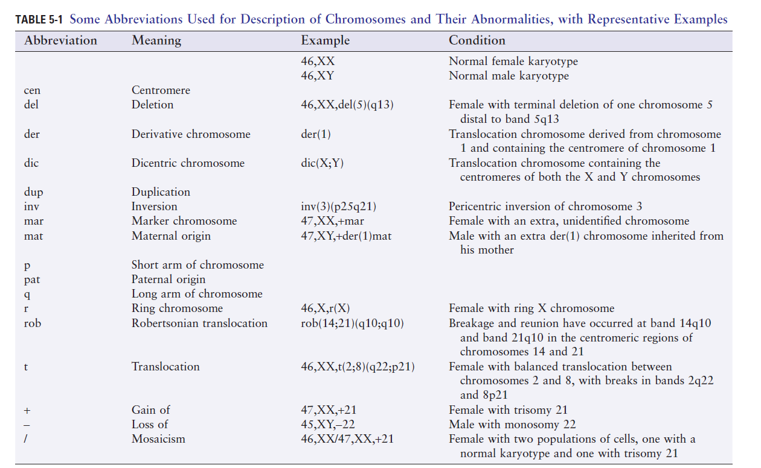

Slide 11
Chromosomal Abnormalities

Slide 12
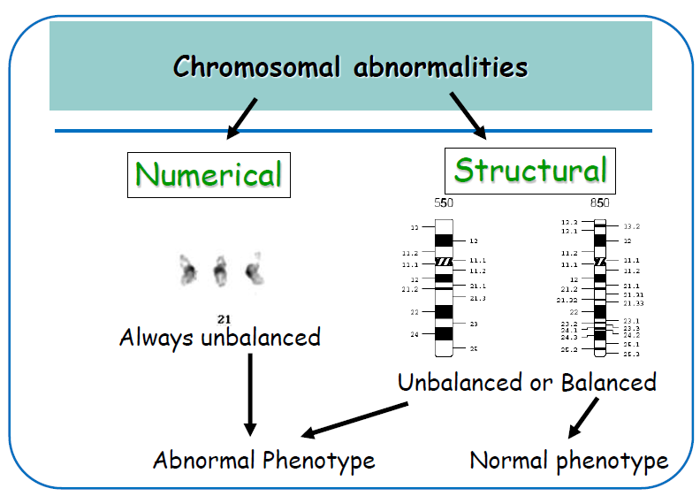
Chromosomal Abnormalities
-Balanced: the complete chromosome set is still present
-Unbalanced: there is additional or missing information

Slide 13
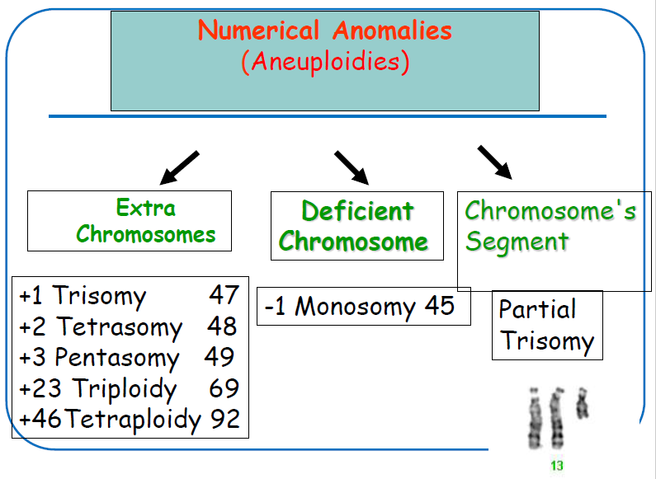
Numerical Chromosomal Abnormalities
-Leading cause of developmental disabilities and spontaneous
miscarriages
-Aneuploidy: abnormal chromosome number due to an extra or missing chromosome

Slide 14
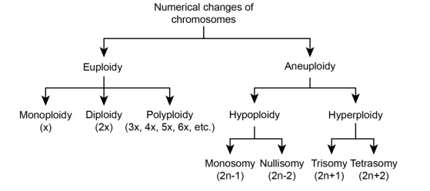
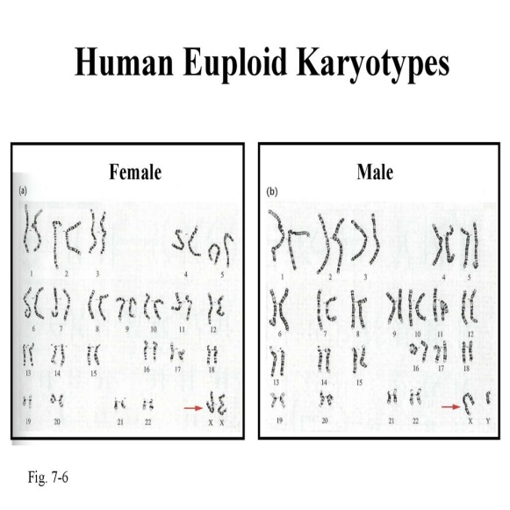
Numerical Chromosomal Abnormalities
Chromosome numbers can vary in two main ways
– Euploidy: Variation in the number of complete sets of chromosome
– Aneuploidy: Variation in the number of particular chromosomes within a set

Slide 15
Some Important Definitions
DEFINITIONS:
Ploidy: number of basic chromosome sets (a diploid has 2 sets; a hexaploid has 6 sets)
Euploid: organism containing multiples of the basic chromosome set
Monoploid: organisms with one chromosome set
Polyploid: organism containing more than two chromosome sets
Basic chromosome number, x (also called monoploid number): the number of different chromosomes that make up a single complete set. (In a diploid organism with 10 pairs of chromosomes, x = 10)
Haploid number, n: number of chromosomes in the gametes

Slide 16
Numerical Chromosomal Abnormalities
Polyploidy: abnormal multiple of 23 chromosomes
Triploidy: 69 chromosome, Tetraploidy: 92 chromosome,,,,etc.
Miscarried, stillbirth, or die shortly after birth
Aneuploidy: The occurrence of one or more extra or missing chromosomes leading to an unbalanced chromosome complement
Autosomal Monosomy: absence of one member of a pair of chromosomes
Autosomal Trisomy: The presence of an extra chromosome
Sex chromosomal aneuploidy

Slide 17
Mechanisms Leading to Aneuploidy
Meiotic Nondisjunction:
Segregation of chromosomes in human meiosis is remarkably error-prone
Some consequences of these errors to human reproductive health are failure of implantation, early pregnancy loss and birth defects or developmental delay in liveborns.
Chromosome nondisjunction is defined as the unbalanced segregation of chromosomes leading to aneuploidy and may occur at meiosis I(when homologous chromosomes segregate to opposite poles) or at meiosis II (when the two sister chromatids separate at the centromere and segregate to opposite poles)
Notes:
In human females meiosis Iis initiated during fetal development, but is not completed until some 20–40 years later when an egg is released from a follicle during ovulation. Meiosis II is not completed unless the egg is fertilized by a sperm. In contrast, spermatogenesis occurs continuously after puberty in males and it takes 9 weeks for a spermatogonium to develop into mature sperm, with meiosis requiring only 24 days to complete.

Slide 18
Mechanisms Leading to Aneuploidy
Notes:
Using pericentromeric markers, homozygosity or heterozygosity of centromeres on the extra chromosome in a trisomy can be used to determine whether a segregation error occurred in MI or MII
The failure of chromosomes to separate may occur via:
Failure of homologues to separate in Anaphase I (resulting in four affected daughter cells)
Failure of sister chromatids to separate in Anaphase II (resulting in only two daughter cells being affected)

Slide 19
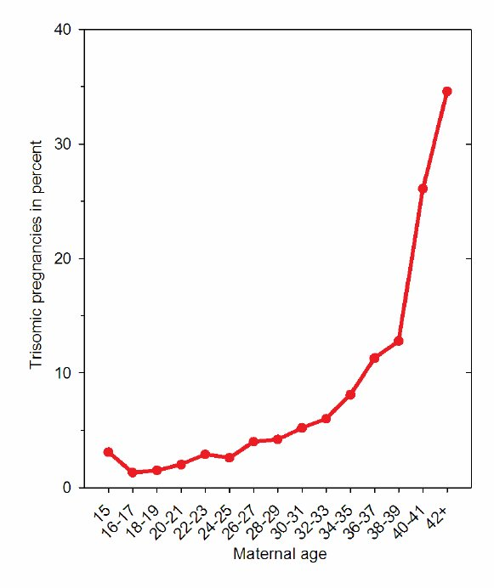
Mechanisms Leading to Aneuploidy
The vast majority of aneuploidy in humans is maternal in origin (i.e. due to an error present in the oocyte) and its incidence increases dramatically with maternal age
Why do most aneuploidy derives from errors in maternal meiosis?
likely because of the critical difference in the meiotic process between males and females
Why does aneuploidy increase with maternal age?
Recombination errors in early meiosis
A defective spindle assembly checkpoint in meiosis I
Deterioration of sister chromatid cohesion with age

Slide 20
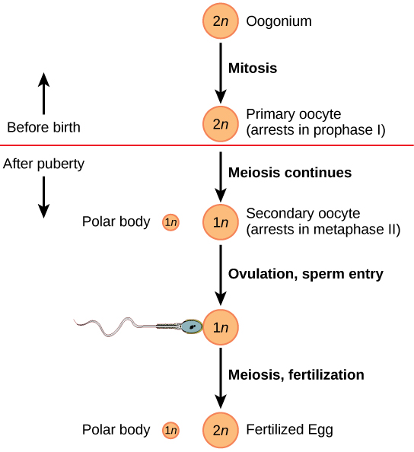
Mechanisms Leading to Aneuploidy
At Puberty
Notes:
In males this process initiates throughout lifetime after puberty. In contrast, in females meiosis initiates during fetal development, arrests at prophase I before birth, and does not resume until prior to ovulation in adulthood, up to 50 yr later in humans. The long time interval between meiotic arrest in the fetus and each ovulation cycle in the adult allows maternal age to affect aneuploidy incidence.

Slide 21
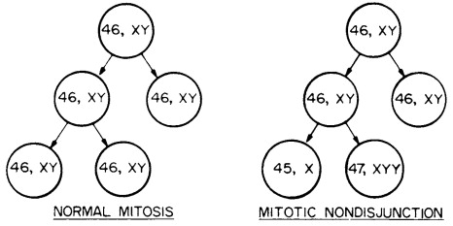
Mechanisms Leading to Aneuploidy
Mitotic Nondisjunction
Chromosome segregation errors may also occur during mitotic cell divisions and thus lead to mosaicism, with the presence of both aneuploid and normal diploid cells within one individual
Mitotic errors occurring during early development may lead to a mixture of abnormal and normal cells in the developing embryo
Note: Mosaicism is when a person has 2 or more genetically different sets of cells in their body

Slide 23
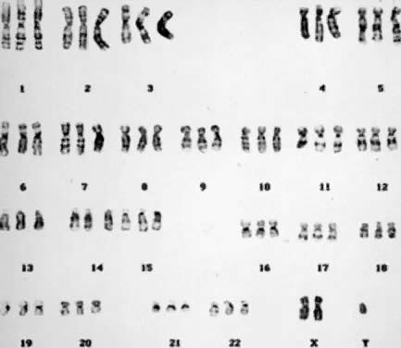
Polyploidy: Triploidy as an example
Triploid Karyotype
69, XXY
Triploidy is one of the most common chromosome abnormalities in humans, occurring in approximately 1 – 2 % of all conceptuses
Causes:
double fertilization of an ovum (dispermy)
fertilization of the ovum by a diploid sperm
failure of loss of the polar body of the ovum
The resulting karyotype may be 69, XXX or 69, XXY or 69, XYY.

Slide 25
Aneuploidy
Aneuploidy is the most common and clinically significant type of human chromosome disorder, 5% of all clinically recognized pregnancies.
The different conditions of aneuploidy are:
Nullisomy - the loss of both pairs of homologous chromosomes; individuals are called nullisomics and their chromosomal composition is 2N-2
Monosomy - the loss of a single chromosome; individuals are called monosomics and their chromosomal composition is 2N-1
Trisomy - the gain of an extra copy of a chromosome; individuals are called trisomics and their chromosomal composition is 2N+1
Tetrasomy - the gain of an extra pair of homologous chromosomes; individuals are called tetrasomics and their chromosomal composition is 2N+2

Slide 26
Aneuploidy: Autosomal Trisomy
Trisomy can exist for any part of the genome, but trisomy for a whole chromosome is only occasionally compatible with life.
Only three numerical chromosome abnormalities involving autosomes are viable after birth: trisomies 13, 18 and 21
Why??
Exceptions are partial trisomies or mosaics of trisomic and normal cell lines.

Slide 27
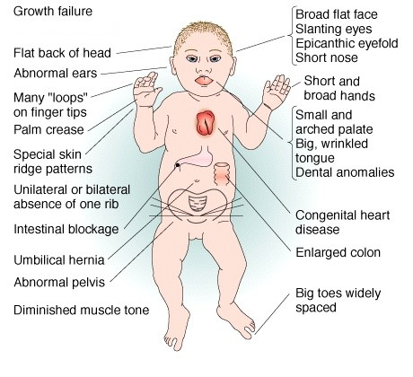
Down Syndrome (trisomy 21)
Trisomy 21 is the most frequent chromosome abnormality diagnosed in newborns (Incidence)
The risk for giving birth to a child with trisomy 21 increases with the mother’s age.
Clinical features
Notes:
incidence, in epidemiology, occurrence of new cases of disease, injury, or other medical conditions over a specified time period,

Slide 28
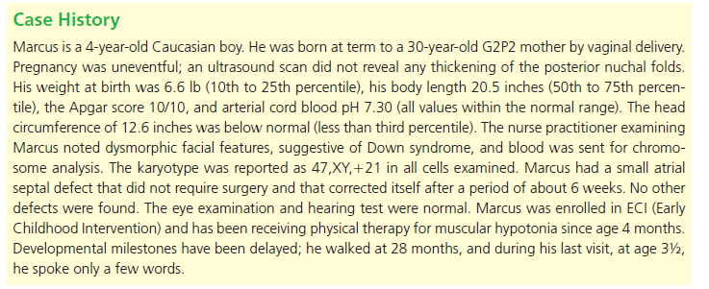
Down Syndrome (trisomy 21)

Slide 29
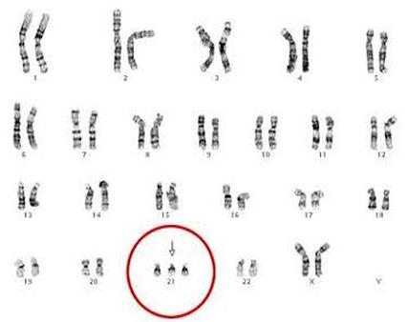
Down Syndrome (trisomy 21): Genetics
In 95% of cases, Down syndrome is caused by a free trisomy 21, giving a karyotype of 47,XX,+21 or 47,XY,+21.
Nondisjunction
Notes:
In about half of all translocation cases, one of the parents is carrying the rearrangement of chromosome 21 called a balanced translocation. The parent still has two copies of chromosome 21, but one of the copies may be attached to another chromosome. Since there is no gain or loss of genetic material, this chromosome arrangement has no effect on the parent's health. However, this chromosome arrangement can be passed down to the child resulting iin an unbalanced translocation. In an unbalanced translocation, the child inherits the two chromosomes that are attached to each other as well as a normal chromosome. Translocation Down syndrome is the only form of the disorder that can be passed from parents to child. The chance of passing on the unbalanced translocation depends on the sex of the parent who carries the rearranged chromosome 21:

Slide 30
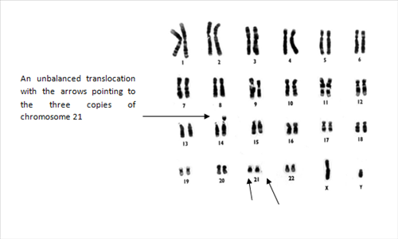
Down Syndrome (trisomy 21): Genetics
In approximately 4% of the patients there is a Robertsonian translocation, whereby the additional chromosome 21 is fused with another acrocentric chromosome (most frequently chromosome 14)
Familial Down Syndrome
Translocation Down syndrome is the only form of the disorder that can be passed from parents to child. But no effect on the parent's health
Recurrence risk
How does it occur??
Notes:
In genetics, the likelihood that a hereditary trait or disorder present in one family member will occur again in other family members

Slide 31
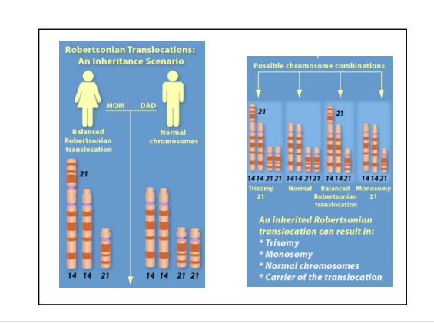
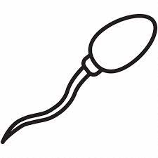
Down Syndrome (trisomy 21): Genetics

Slide 32
Down Syndrome (trisomy 21): Genetics
Approximately 1% of individuals with Down syndrome have a mosaic chromosomal complement, composed of a normal cell line and a trisomic cell line.

Slide 33
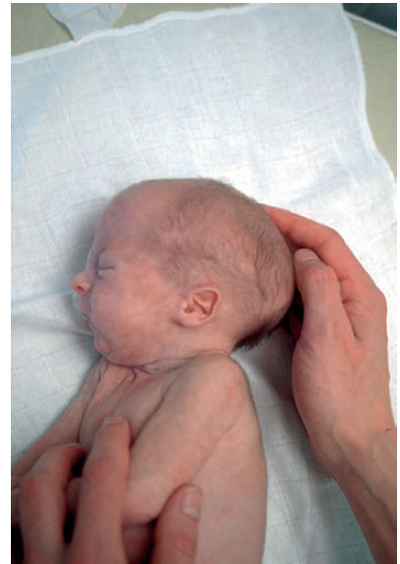
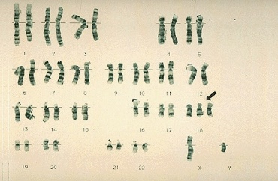
Edwards Syndrome (trisomy 18)
-The second most common trisomy
-90% of cases of trisomy 18 are due to
maternal nondisjunction
-Female more than males
-Low survival rate
Please watch the video in the link below
Living with Edwards Syndrome (Trisomy 18)
https://www.youtube.com/watch?v=fW7OhP6kfNI

Slide 34
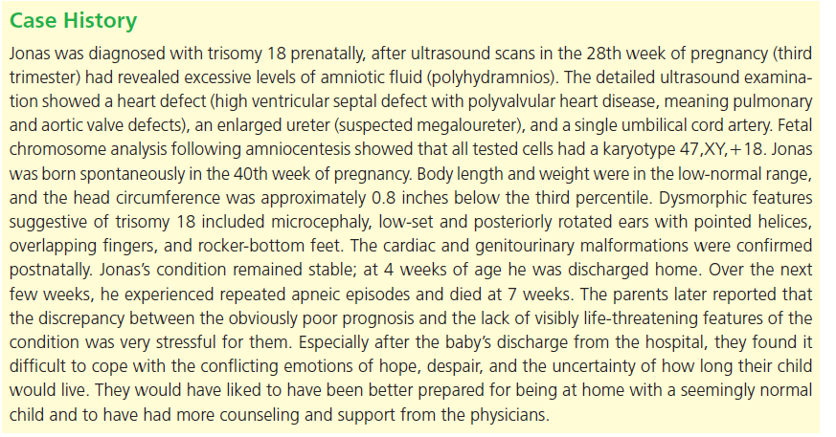
Edwards Syndrome (trisomy 18)

Slide 35
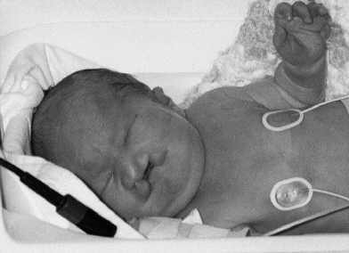
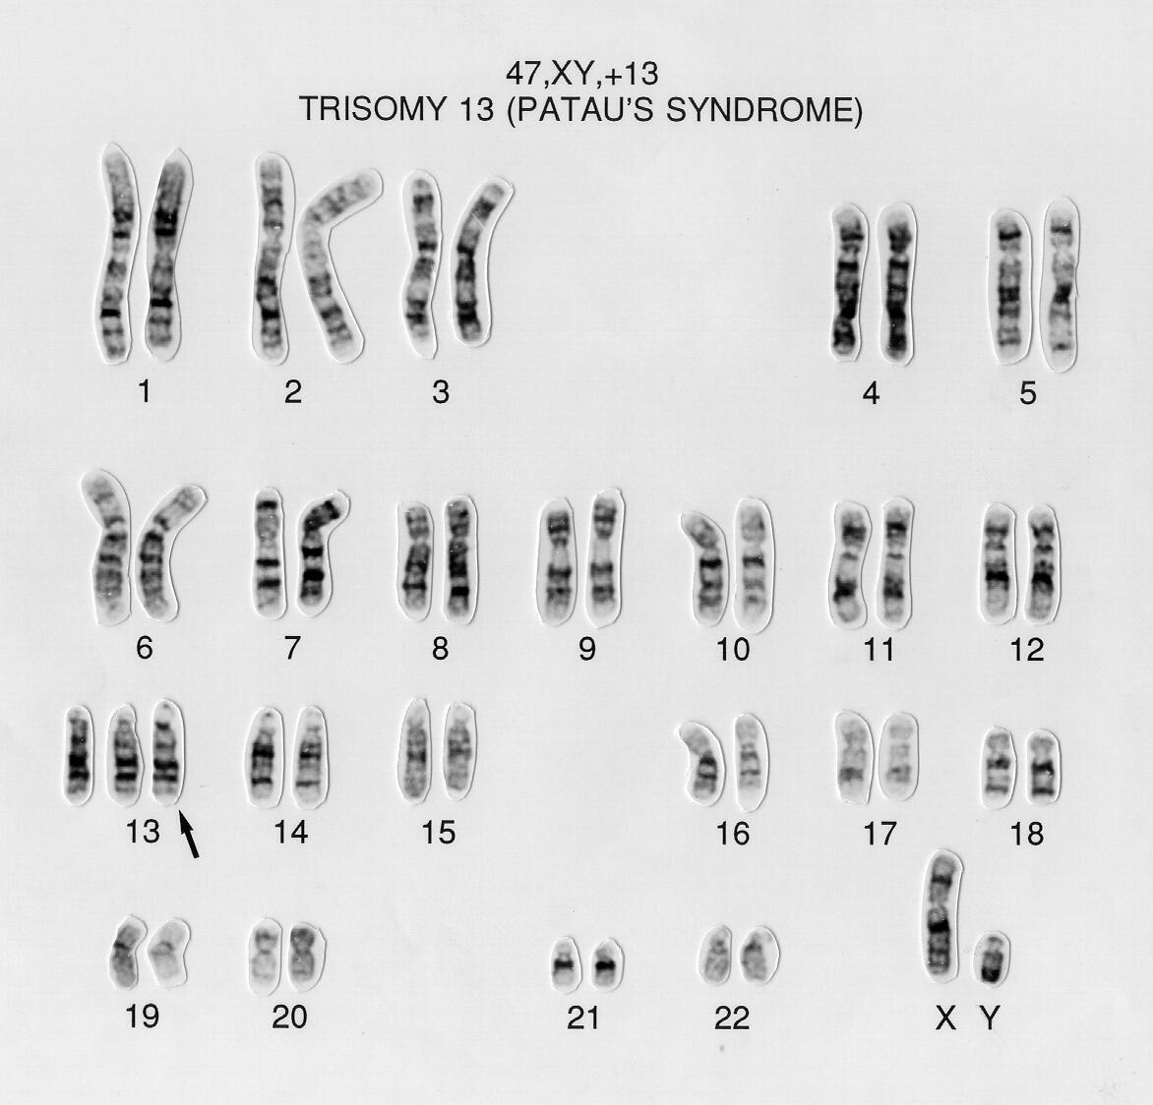
Patau Syndrome (trisomy 13)
75% of trisomy13 cases are due to maternal nondisjunction
Low survival rate
Please watch the video in the link below
https://www.youtube.com/watch?v=5eSP-cvc1Do

Slide 36
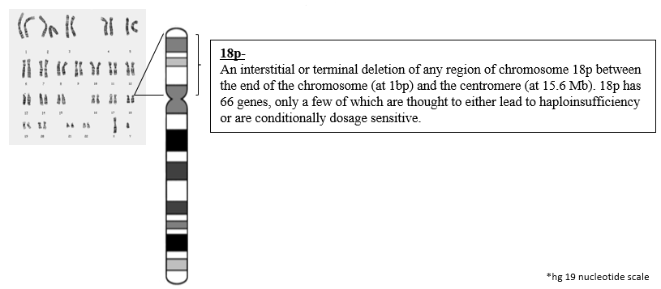
Autosomal Monosomy
Missing a copy of any autosome (non-sex chromosome)
Monosomies of autosomal chromosomes result in a very early, spontaneous miscarriage, often before the pregnancy is identified.
Partial Monosomy: a Portion of a chromosome is missing
e.g. partial monosomy 18p

Slide 37
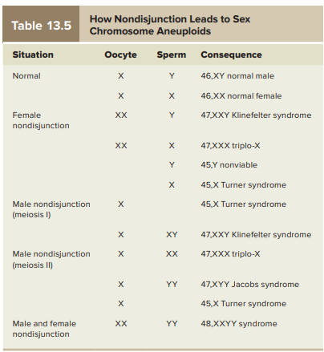
Sex Chromosome Aneuploidies: XXX, XYY, XXY, X
Less severe than autosomal chromosome aneuploidies
Female abnormalities are due to variations in the number of X chromosomes. Male abnormalities are the result of irregular numbers of either the X or the Y chromosome or both.
Female Sex Chromosome Abnormalities
Male Sex Chromosome Abnormalities

Slide 38
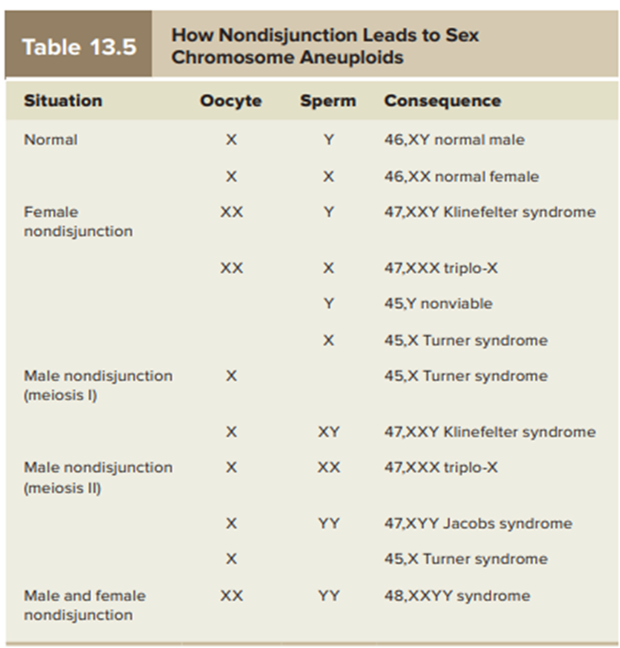
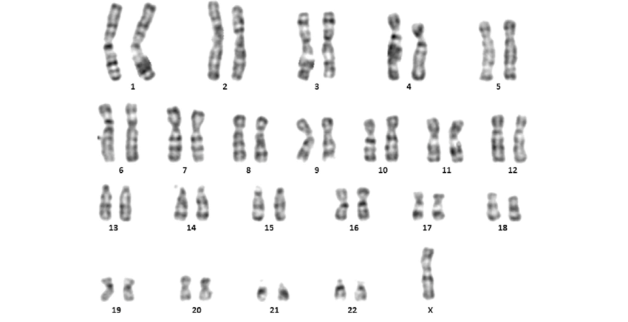
Female Sex Chromosome Abnormalities: Turner’s Syndrome (monosomy X)
-Occurs when females inherit only one X chromosome--their genotype is X0 (i.e., monosomy X)
-Frequency: 1/2000 live births
45,XO
Notes:
https://www.youtube.com/watch?v=DhypDYP3OI4

Slide 39
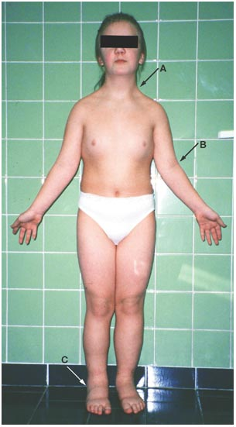
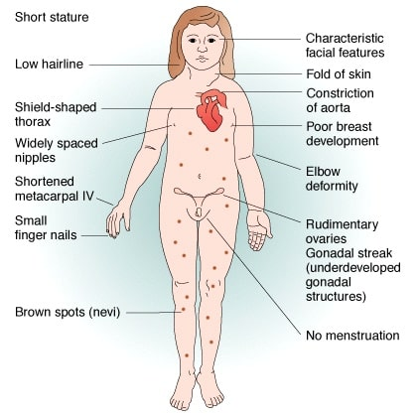
Female Sex Chromosome Abnormalities: Turner’s Syndrome (monosomy X)
-Phenotype
-Infertile
-Women with Turner syndrome have a higher than average incidence of thyroid disease, vision and hearing problems, heart defects, diabetes, and other autoimmune disorders.
Notes:
https://www.youtube.com/watch?v=DhypDYP3OI4

Slide 40
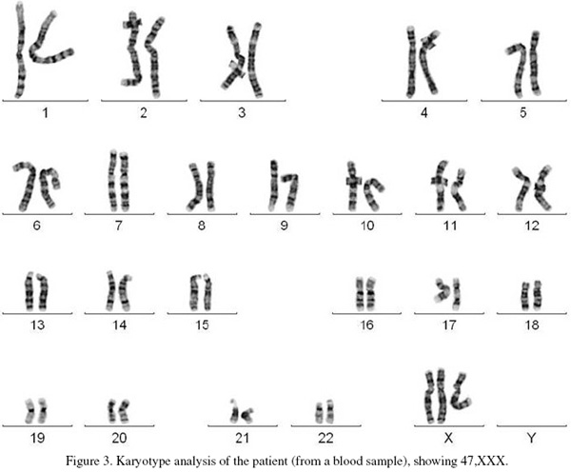
Female Sex Chromosome Abnormalities: Triple-X syndrome
-Occurs in women who inherit three X chromosomes--their genotype is XXX or more rarely XXXX or XXXXX
-Phenotype: Taller than average females
fertile

Slide 41
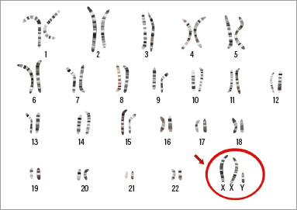
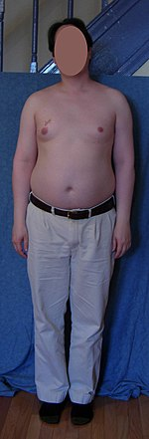
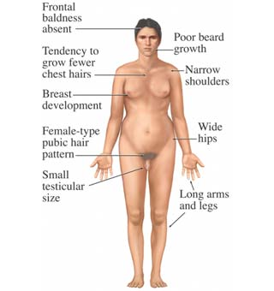
Male Sex Chromosome Abnormalities: Klinefelter syndrome
Males inherit one or more extra X chromosomes--their genotype is XXY or more rarely XXXY or XY/XXY mosaic
The frequency:1/650 births
Phenotype:
-Physical characteristics
-Sterile or nearly so
-usually have learning difficulties as children
have a higher than average risk of developing osteoporosis, diabetes, and other autoimmune disorders that are more common in women. This may be connected to low testosterone production
47,XXY

Slide 43
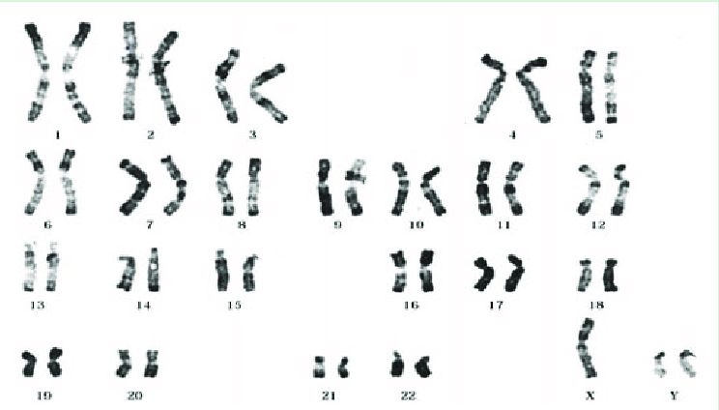
Male Sex Chromosome Abnormalities: XYY syndrome
-Males inherit an extra Y chromosome, genotype is XYY
-XYY syndrome is also referred to as Jacobs syndrome.

Slide 44
Male Sex Chromosome Abnormalities: XYY syndrome
The XYY phenotype commonly includes tall stature, macrocephaly.
generally appear and act normal. However, they produce high levels of testosterone
Usually fertile

Slide 45
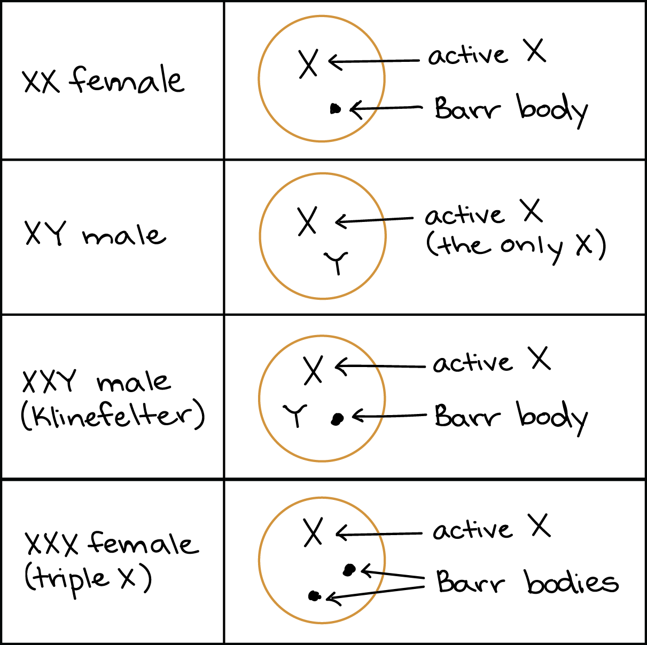
X-inactivation inactivation in in klinefelter and turner syndrome
What about dosage compensation when the number of x chromosomes is altered??
Lyon hypothesis: suggesting that dosage compensation in mammals is by inactivation of all but one X chromosome in cells with more than one X chromosome.
Why then, do the patients with these abnormalities have abnormal phenotype??
- Some genes escape inactivation
- Pattern of inactivation

Slide 46
X chromosome VS. Y chromosome

Slide 47
Structural chromosome abnormalities

Slide 48
Structural chromosome abnormalities
-Structural chromosome abnormalities occur when there is a change in the structure or parts of a chromosome.
-Structural chromosome abnormalities occur when part of a chromosome is missing, a part of a chromosome is extra, or a part has switched places with another part
-Structural chromosome abnormalities, depending on their size or location, can cause a variety of birth defects and intellectual disabilities
-Can be balanced or unbalanced
Balanced: if chromosomes have the normal amount of genetic material
Unbalanced: if chromosomes have extra or missing DNA segments

Slide 49
Structural chromosome abnormalities
Deletion
Duplication
Inversion
translocation
insertion
Ring chromosome
Isochromosome
occur in single chromosome

Slide 50
Structural chromosome abnormalities

Slide 51
How Structural chromosome abnormalities Occur?
Chromosomes may break “spontaneously” or by the effects of chemical and physical agents (e.g. ionizing radiation).

Slide 52
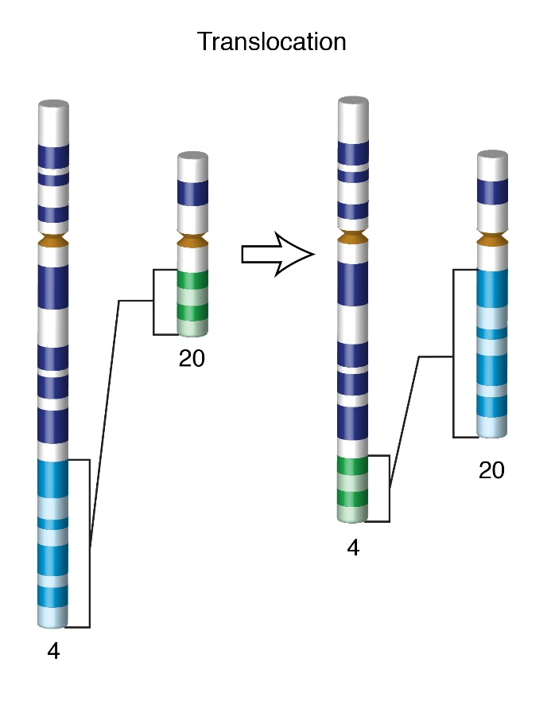
Structural chromosome abnormalities: Translocation
-A translocation occurs when a chromosome segment dissociates and reattaches to a different, nonhomologous chromosome.
-Translocations can be benign or have devastating effects depending on how the positions of genes are altered with respect to regulatory sequences.
-Chromosomal rearrangement
Two major types of translocation: Robertsonian translocation and reciprocal translocation
Cancer

Slide 53
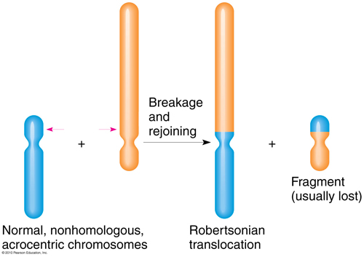
Robertsonian Translocation
In a Robertsonian translocation, the short arms of two different acrocentric chromosomes break, leaving sticky ends on the two long arms that join, forming a single, large chromosome with two long arms
Humans have five acrocentric chromosomes (13, 14, 15, 21 and 22).
Usually there are no adverse effects. But in some cases, genetic disorders can result if progeny inherit an unbalanced set of chromosomes due to the translocation in one parent.
Down syndrome
Notes:
https://youtu.be/vbGw4VanNjk
The person with the large, translocated
chromosome, called a translocation carrier, has 45
chromosomes instead of 46, but may not have symptoms if no
crucial genes have been deleted or damaged. Even so, he or she
may produce unbalanced gametes—sperm or oocytes with too
many or too few genes. This can lead to spontaneous abortion
or birth defects.

Slide 54
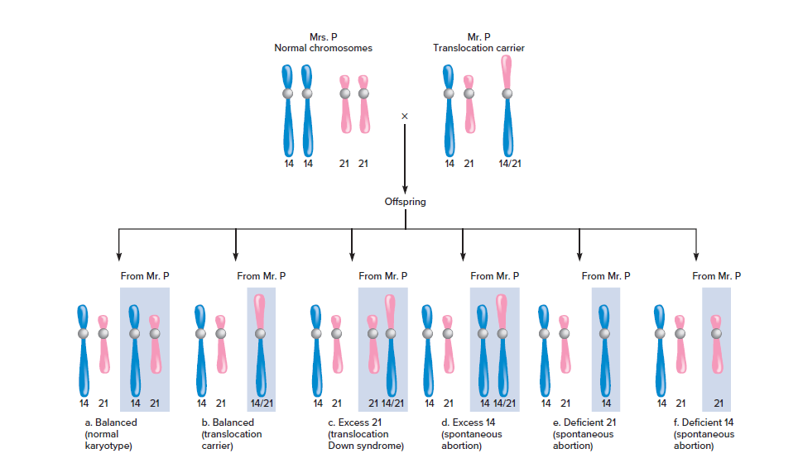

Slide 55
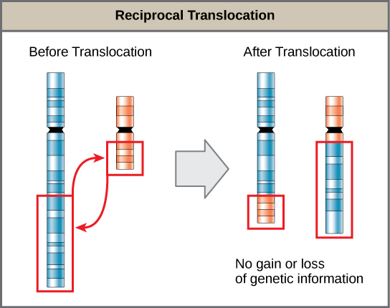
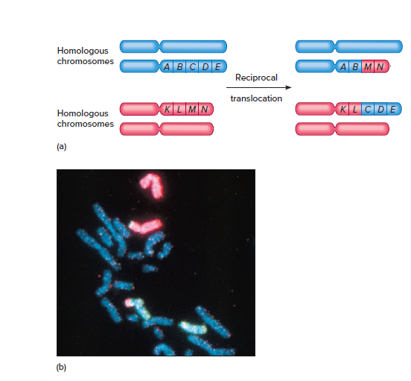
Reciprocal Translocation
If the chromosome exchange does not break any genes, then a person who has both translocated chromosomes is healthy and a translocation carrier.
Philadelphia chromosome associated with human lymphoma/leukemia

Slide 56
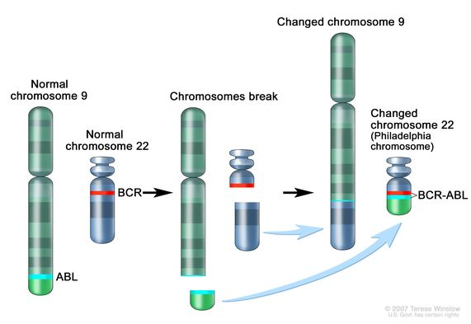
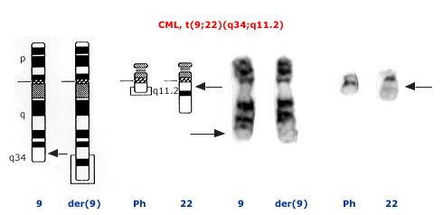
Reciprocal Translocation
Philadelphia chromosome. A piece of chromosome 9 and a piece of chromosome 22 break off and trade places. The BCR-ABL gene is formed on chromosome 22 where the piece of chromosome 9 attaches. The changed chromosome 22 is called the Philadelphia chromosome.

Slide 57
Structural chromosome abnormalities Nomenclature

