Slide 1
Chapter 04
Intermediate SQL

Slide 2
Transactions
4.3

Slide 3
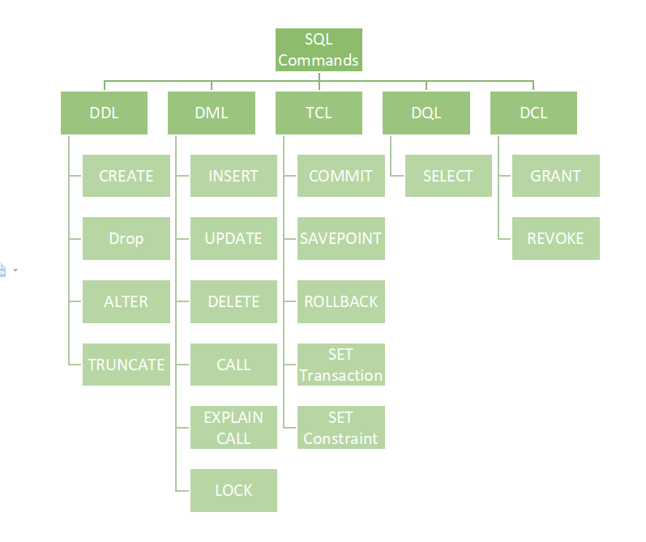

Slide 4
Transactions
A transaction consists of a sequence of query and/or update statements.
The SQL standard specifies that a transaction begins implicitly when an SQL statement is executed.

Slide 5
Transactions
One of the following SQL statements must end the transaction:
Commit work:
Commits the current transaction;
It makes the updates (DML) performed by the transaction become permanent in the database.
After the transaction is committed, a new transaction is automatically started.
Rollback work:
Causes the current transaction to be rolled back;
It undoes all the updates performed by the SQL statements in the transaction.
Thus, the database state is restored to what it was before the first statement of the transaction was executed.
Notes:
update student
set tot_cred = 60
where id=52872;
COMMIT;
ROLLBACK;

Slide 6
Integrity Constraints
4.4

Slide 7
Integrity Constraints
Integrity constraints ensure that changes made to the database by authorized users do not result in a loss of data consistency.
Examples of integrity constraints are:
No two instructors can have the same instructor ID.
Every department name in the course relation must have a matching department name in the department relation.
The budget of a department must be greater than $0.00.

Slide 9
Not Null Constraint

Slide 10
Unique Constraint
To name a UNIQUE constraint, and to define a UNIQUE constraint on multiple columns, use the following SQL syntax:
CREATE TABLE Persons2 ( ID int NOT NULL, LastName varchar(255) NOT NULL, FirstName varchar(255), Age int, CONSTRAINT UC_Person UNIQUE (ID,LastName)
);

Slide 11
The check Clause

Slide 12
Referential Integrity

Slide 13
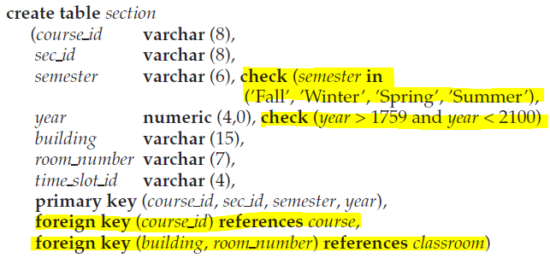
Example

Slide 14
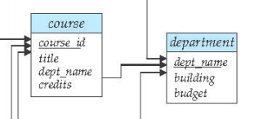
Example
Cascade means if I want to delete/update any record from (department) table<parent table> , that is led to delete/update all records have the same dept_name in course table <child table>
معناها الحرفي هو أسقط without cascade, delete or update led the referential integrity problem

Slide 15
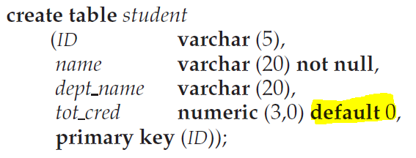
Default Values

Slide 16
SQL Data Types and Schemas
4.5

Slide 17
Date and Time Types in SQL
Date:
A calendar date containing a (four-digit) year, month, and day of the month.
‘2019-10-28’
Time:
The time of day, in hours, minutes, and seconds.
‘09:30:00’
Timestamp:
A combination of date and time.
‘2019-10-28 10:29:01.45’

Slide 18
Examples

Slide 19
Examples
select * from job_history
where start_date >= To_Date('01/01/1980','dd/mm/yyyy') and start_date <= To_Date('31/12/1989','dd/mm/yyyy')
select * from job_history
where start_date in ( To_Date('1/1/1987','dd/mm/yyyy'),To_Date('31/12/1989','dd/mm/yyyy'))
select count(employee_id) as x, extract(year from hire_date)
from employees
group by extract(year from hire_date)
order by x desc;
select first_name, extract(year from current_date) - extract (year from hire_date) as number_of_years_in_company
from employees

Slide 20
Index Creation
SQL CREATE INDEX statement creates indexes in a table for fast and efficient data retrieval.
CREATE INDEX Statement
The CREATE INDEX Statement in SQL is used to create indexes in tables and retrieve data from the database faster than usual.
Indexes are invisible structures that work behind the scenes to speed up data retrieval operations in databases. They are essential for optimizing query performance and improving overall system efficiency.
Indexes can not be seen by users, and are only used to speed up the process of searches/queries.
Important Points:
Only use INDEX constraint on a column, that is frequently searched or used in WHERE clauses of SELECT queries.
Adding Indexes to all columns makes the process of updating the database slower, as on each update Index updates as well.

Slide 21
Index Creation
Many queries reference only a small proportion of the records in a file.
For example, a query like “Find all instructors in the Physics department”.
It is inefficient for the system to read every record and to department field for the value “Physics”.
An index on an attribute of a relation is a data structure that allows the database system to find those tuples in the relation that have a specified value for that attribute efficiently, without scanning through all the tuples of the relation.

Slide 22
Index Creation
If we create in index on attribute ID of relation student, the database system can find the record with any specified ID value, such as 22201, or 44553, directly, without reading all the tuples of the student relation.
An index can also be created on a list of attributes, for example on attributes name, and dept name of student.

