Slide 1
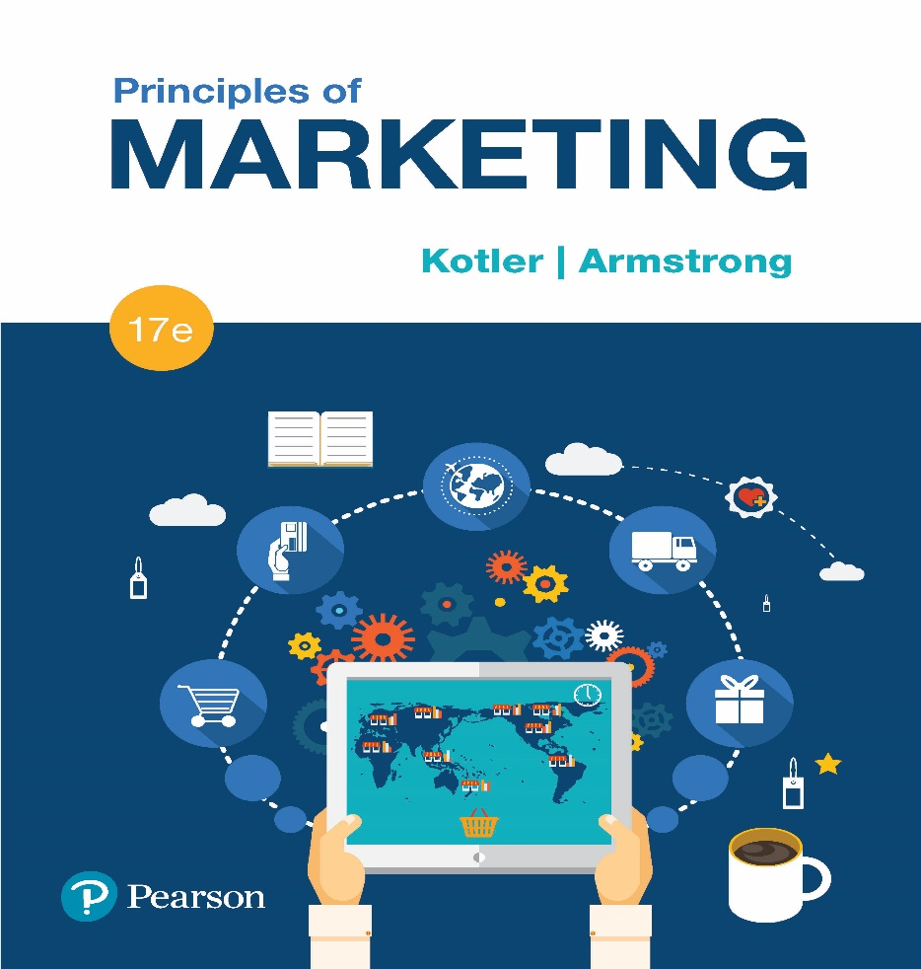
Principles of Marketing Seventeenth Edition
Chapter 1
Marketing: Creating Customer Value and Engagement
.

Slide 2
Learning Objectives
1-1 Define marketing and outline the steps in the marketing process.
1-2 Explain the importance of understanding the marketplace and customers and identify the five core marketplace concepts.
1-3 Identify the key elements of a customer-driven marketing strategy and discuss the marketing management orientations that guide marketing strategy.
1-4 Discuss customer relationship management and identify strategies for creating value for customers and capturing value from customers in return.
1-5 Describe the major trends and forces that are changing the marketing landscape in this age of relationships.

Slide 3
What is Marketing?
-Marketing is a process by which companies create value for customers and build strong customer relationships in order to capture value from customers in return.
-The primary/main objectives of marketing are:
1- attract new customers/clients by promising superior value
2- Keep and grow current customers/clients by delivering value and satisfaction
For example:
1- Nike leaves its competitors in the dust by delivering on its promise to
inspire and help everyday athletes to “Just do it.
2-Amazon dominants the online marketplace by creating a world-class online buying experience that helps customers to “find and discover anything they might want to buy online.”
3-Facebook has attracted more than 1.5 billion active web and mobile users worldwide by helping them to “connect and share with the people in their lives.”
Notes:
^{Discussion Question}
Ask students for examples of either national or local companies that are excellent at marketing and ask how they reflect the definition given in this slide.
Perhaps the simplest definition of marketing is engaging customers and managing profitable customer relationships.
The twofold goal of marketing is to:
attract new customers by promising superior value
grow current customers by delivering satisfaction
Sound marketing is critical to the success of every organization:
^{large for-profit firms}
^{not-for-profit organizations}
You already know a lot about marketing—it’s all around you:
products at your nearby shopping mall
ads that fill your TV screen and magazines, or stuff your mailbox
imaginative web sites and mobile phone apps
blogs, online videos, and social media
Today’s marketers reach you directly, personally, and interactively. They want to become a part of your life and enrich your experiences with their brands—to help you live their brands.

Slide 4
The marketing process
The marketing process involves five steps:
First, marketers need to understand the marketplace and customer needs and wants.
Second, marketers design a customer driven marketing strategy with the goal of getting, engaging, and growing target customers.
Third, marketers construct a marketing program that actually delivers superior value.
Fourth, engaging customers, building profitable customer relationships, and creating customer delight.
Five, the company reaps the rewards of strong customer relationships by capturing value from customers.
#Notes:
1- steps (1+2+3) form the basis for the fourth step.
2- The first four steps create value for customers.
Notes:
^{Discussion Question}
Ask students for examples of either national or local companies that are excellent at marketing and ask how they reflect the definition given in this slide.
Perhaps the simplest definition of marketing is engaging customers and managing profitable customer relationships.
The twofold goal of marketing is to:
attract new customers by promising superior value
grow current customers by delivering satisfaction
Sound marketing is critical to the success of every organization:
^{large for-profit firms}
^{not-for-profit organizations}
You already know a lot about marketing—it’s all around you:
products at your nearby shopping mall
ads that fill your TV screen and magazines, or stuff your mailbox
imaginative web sites and mobile phone apps
blogs, online videos, and social media
Today’s marketers reach you directly, personally, and interactively. They want to become a part of your life and enrich your experiences with their brands—to help you live their brands.

Slide 5
This important figure shows marketing in a nutshell. By creating value for customers, marketers capture value from customers in return.

Slide 6
As a first step, marketers need to understand customer needs and wants and the marketplace in which they operate.
We examine five core customer and marketplace concepts:
(1) needs, wants, and demands
(2) market offerings (products, services, and experiences)
(3) value and satisfaction
(4) exchanges and relationships; and
(5) markets.

Slide 7
Understanding the Marketplace and Customer Needs
Needs are states of felt deprivation. They include basic physical needs for food, clothing, warmth, and safety; social needs for belonging and affection; and individual needs for knowledge and self-expression. Marketers did not create these needs; they are a basic part of the human makeup.
Wants are the form human needs take as they are shaped by culture and individual personality.
-An American needs food but wants a Big Mac, fries, and a soft drink.
-Wants are shaped by one’s society and are described in terms of objects that will satisfy those needs
Demands are human wants that are backed by buying power.
-Given their wants and resources, people demand products and services with benefits that add up to the most value and satisfaction
Notes:
Human needs include basic physical needs for food, clothing, warmth, and safety; social needs for belonging and affection; and individual needs for knowledge and self-expression.
Wants are the form human needs take as they are shaped by one’s society and are described in terms of objects that will satisfy those needs.
When backed by buying power, wants become demands.
Outstanding marketing companies go to great lengths to learn about and understand their customers’ needs, wants, and demands. Take Target CEO Brian Cornell, who makes regular unannounced visits to Target stores, accompanied by local moms and loyal Target shoppers.
Discussion Question
Ask the students to
1) Give an example of a product (good or service) they purchased recently
2) Tell how that product satisfied a need, want or demand.

Slide 8
Understanding the Marketplace and Customer Needs
Market offerings are some combination of products, services, information, or experiences offered to a market to satisfy a need or want.
Market offerings are not limited to physical products. They also include services activities or benefits offered for sale that are essentially intangible and do not result in the ownership of anything. Examples of market offerings include banking, airline, hotel, tax preparation, and home repair services.
Marketing myopia is focusing only on existing wants and losing sight of underlying consumer needs. E.g. focusing just on quality and not on the actual demand of the customer. يركز قصر النظر التسويقي فقط على الاحتياجات الحالية ويغفل احتياجات المستهلك الأساسية. مثلا التركيز فقط على الجودة وليس على الطلب الفعلي للعميل.
Notes:
Market offerings include other entities, such as persons, places, organizations, information, and ideas.
Many sellers suffer from marketing myopia, the mistake of paying more attention to the specific products they offer than to the benefits and experiences produced by these products.
Marketing experiences:
More than just a sports bar, Buffalo Wild Wings mission is to provide a total eating and social environment that “fuels the sports fan experience” through in-store and online engagement. Smart marketers orchestrate several services and products, thereby creating brand experiences for consumers.

Slide 9
Understanding the Marketplace and Customer Needs
Customer Value and Satisfaction are key building blocks for developing and managing customer relationships.
Satisfied customers buy again and tell others about their good experiences.
Dissatisfied customers often switch to competitors and disparage انتقاص the product to others.
Exchange is the act of obtaining a desired object from someone by offering something in return. تقديم شيء في المقابل
Marketing actions try to create, maintain, and grow desirable exchange relationships.انشاء علاقاات تبادلية مرغوبة
Notes:
Marketing occurs when people decide to satisfy their needs and wants through exchange relationships. Exchange is the act of obtaining a desired object from someone by offering something in return. Marketing consists of actions taken to create, maintain, and grow desirable exchange relationships with target audiences involving a product, service, idea, or other object. Companies want to build strong relationships by consistently delivering superior customer value.

Slide 10
Understanding the Marketplace and Customer Needs
A market is set of actual and potential buyers.
Consumers market when they:
search for products
interact with companies to obtain information
make purchases
Note:
Companies address needs, wants, and demands by putting
forth a value proposition, a set of benefits that they promise to
consumers to satisfy their needs. The value proposition is fulfilledتتحق-انجاز
through a market offering, which delivers customer value and
satisfaction, resulting in long-term exchangeتبادل relationships with
customers.
Notes:
A market is the set of actual and potential buyers of a product or service. Sellers must search for buyers, identify their needs, design good market offerings, set prices for them, promote them, and store and deliver them. Although marketing was traditionally carried out by sellers, the concept now also includes consumers. Consumers engage in marketing when they search for products, interact with companies to obtain information, and make their purchases. Thus, in addition to customer relationship management, companies must also deal with customer-managed relationships as customers are empowered and marketing is made a two-way affair.

Slide 11
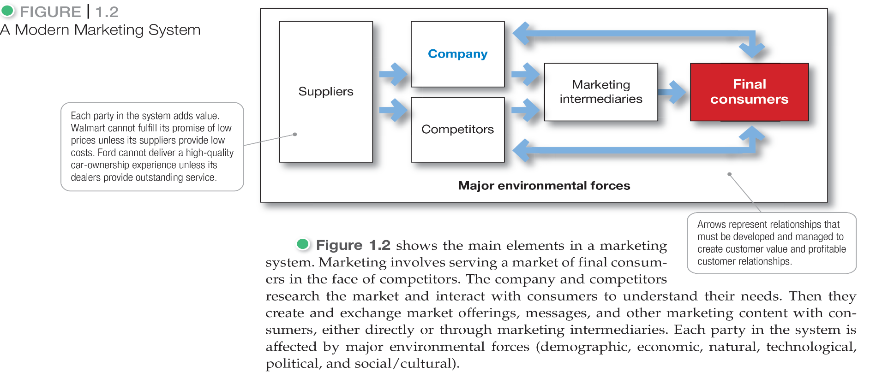
Understanding the Marketplace and Customer Needs Q) What / state the elements of modern market system
Notes:
A market is the set of actual and potential buyers of a product or service. These buyers share a particular need or want that can be satisfied through exchange relationships.
Figure 1.2 shows the main elements in a marketing system.
Each party in the system adds value for the next level and is affected by major environmental forces (demographic, economic, natural, technological, political, and social/cultural).
Marketing means managing markets to bring about profitable customer relationships. Activities such as consumer research, product development, communication, distribution, pricing, and service are core marketing activities.
Buyers also carry out marketing, thus, in addition to customer relationship management, today’s marketers must also deal effectively with customer-managed relationships.
Marketers are no longer asking only “How can we influence our customers?” but also “How can our customers influence us?” and even “How can our customers influence each other?”

Slide 12
Designing a Customer Value-Driven Marketing Strategy
Marketing management is the art and science of choosing target markets and building profitable relationships with them.
What customers will we serve (target market)?
To design a winning marketing strategy, the company must”
1-decide whom it will serve. It does this by dividing the
market into segments of customers (market segmentation)
2-selecting which segments it will cultivate (target marketing)
For example, Nordstrom profitably targets affluent professionals الاثرياء- الدخل المرتفع ; Dollar General profitably targets families with more modest means متوسطي الدخل
Ultimately, marketing managers must decide which customers they want to target and on the level, timing, and nature of their demand. Simply put, marketing management is customer management and demand management
Notes:
Discussion Question
Ask students to describe a market segment they are a part of for a specific product such as, athletic or fitness equipment or clothing.
Now that the company fully understands its consumers and the marketplace, it must decide which customers it will serve and how it will bring them value.
The marketing manager’s aim is to find, attract, keep, and grow target customers by creating, delivering, and communicating superior customer value.
To design a winning marketing strategy, the marketing manager must answer two important questions:
What customers will we serve (what’s our target market)?
How can we serve these customers best (what’s our value proposition)?

Slide 13
Designing a Customer Value-Driven Marketing Strategy
How can we best serve these customers (value proposition)?
A brand’s value proposition is the set of benefits or values it promises to deliver to customers to satisfy their needs.
e.g. 1- JetBlue promises to put “You Above All” by bringing “humanity back to travel.
2-Homewood Suites by Hilton wants you to “Make yourself at home.”
Note: Such value propositions differentiate one brand from another. They answer the customer’s question: “Why should I buy your brand rather than a competitor’s?” Companies must design strong value propositions that give them the greatest advantage in their target markets.
Notes:
Value proposition: Vine gives you “the best way to see and share life in motion” through “short, beautiful, looping videos in a simple and fun way for your friends and family to see.”
Discussion Question
Have the students evaluate one of the following value propositions in terms of how well the company delivers on the proposition.
BMW promises “the ultimate driving machine”
Nissan Leaf electric car is “100% electric. Zero gas. Zero tailpipe.”
New Balance’s Minimus shoes are “like barefoot only better.”
Vibram FiveFingers shoes: “You are the technology.”
Facebook helps you “connect and share with the people in your life”
YouTube “provides a place for people to connect, inform, and inspire others across the globe.”
The company must decide how it will serve targeted customers—how it will differentiate and position itself in the marketplace. A brand’s value proposition is the set of benefits or values it promises to deliver to consumers to satisfy their needs.
Value propositions differentiate one brand from another. They answer the customer’s question, “Why should I buy your brand rather than a competitor’s?” Companies must design strong value propositions that give them the greatest advantage in their target markets.

Slide 14
Marketing Management Orientations التوجهات
Production concept
Product concept
Selling concept
Marketing concept
Societal Marketing concept
Notes:
There are five. However, focusing only on the company’s products can also lead to marketing myopia. For exalternative concepts under which organizations design and carry out their marketing strategies: the production, product, selling, marketing, and societal marketing concepts.
Marketing management wants to design strategies that will build profitable relationships with target consumers.
Production concept: Consumers will favor products that are available and highly affordable.
The production concept is still a useful philosophy in some situations. For example in the highly competitive, price-sensitive Chinese market, both personal computer maker Lenovo and home appliance maker Haier dominate through low labor costs, high production efficiency, and mass distribution.
However, although useful in some situations, the production concept can lead to marketing myopia and losing sight of the real objective—satisfying customer needs and building customer relationships.
Product concept: Consumers favor products that offer the most quality, performance, and features.
The focus is on continuous product improvements. Product quality and improvement are important parts of most marketing strategiesample, some manufacturers believe that if they can “build a better mousetrap, the world will beat a path to their doors.”
But they are often rudely shocked. Buyers may be looking for a better solution to a mouse problem but not necessarily for a better mousetrap.
The better solution might be a chemical spray, an exterminating service, a house cat, or something else that suits their needs even better than a mousetrap.
Selling concept: Consumers will not buy enough of the firm’s products unless the firm undertakes a large-scale selling and promotion effort.
The selling concept is typically practiced with unsought goods—those that buyers do not normally think of buying, such as life insurance or blood donations. These industries must be good at tracking down prospects and selling them on a product’s benefits.
Such aggressive selling, however, carries high risks. It focuses on creating sales transactions rather than on building long-term, profitable customer relationships.
Marketing concept: Know the needs and wants of the target markets and deliver the desired satisfactions better than competitors.
Under the marketing concept, customer focus and value are the paths to sales and profits.
Instead of a product-centered make-and-sell philosophy, the marketing concept is a customer-centered sense-and-respond philosophy. The job is not to find the right customers for your product but to find the right products for your customers.
For societal marketing concept, see future slide.

Slide 15
Marketing management can adopt one of five competing market orientations.
The production concept holds that management’s task is to improve production efficiency and bring down prices. The product concept holds that consumers favor products that offer the most in quality, performance, and innovative features; thus, little promotional effort is required.
Product concept: Consumers favor تفضيل-محاباة products that offer the most quality, performance, and features. The focus is on continuous product improvements. Product quality and improvement are important parts of most marketing strategies ample, some manufacturers believe that if they can “build a better mousetrap, the world will beat a path to their doors.”
The selling concept holds thatيشير الى consumers will not buy enough of an organization’s products unless it undertakes a large-scale selling and promotion effort.

Slide 16
The marketing concept holds that achieving organizational goals depends on determining the needs and wants of target markets and delivering the desired satisfactions more effectively and efficiently than competitors do.
The societal marketing concept holds that generating customer satisfaction and long-run societal well-being رفاهيةthrough sustainable marketing strategies is key to both achieving the company’s goals and fulfilling الوفاء-الالتزامits responsibilities

Slide 17
Designing a Customer Value-Driven Marketing Strategy
Notes:
Figure 1.3 contrasts the selling concept and the marketing concept. The selling concept takes an inside-out perspective. It starts with the factory, focuses on the company’s existing products, and calls for heavy selling and promotion to obtain profitable sales. It focuses primarily on customer conquest—getting short-term sales with little concern about who buys or why.
In contrast, the marketing concept takes an outside-in perspective. As Herb Kelleher, the colorful founder of Southwest Airlines, once put it, “We don’t have a marketing department; we have a customer department.”
The marketing concept starts with a well-defined market, focuses on customer needs, and integrates all the marketing activities that affect customers. In turn, it yields profits by creating relationships with the right customers based on customer value and satisfaction.

Slide 18
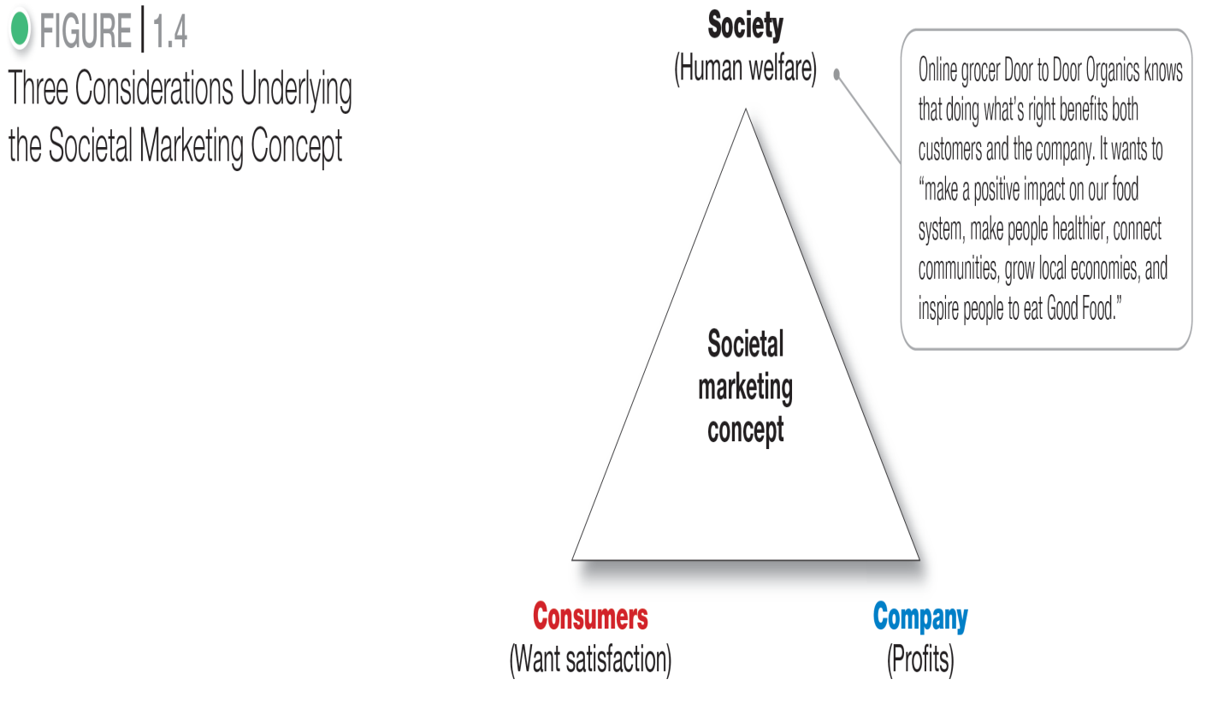
Designing a Customer Value-Driven Marketing Strategy
Societal marketing:
The company’s marketing decisions should consider consumers’ wants, the company’s requirements, consumers’ long-run interests, and society’s long-run interests.
Notes:
The societal marketing concept questions whether the pure marketing concept overlooks possible conflicts between consumer short-run wants and consumer long-run welfare. Is a firm that satisfies the immediate needs and wants of target markets always doing what’s best for its consumers in the long run?
The societal marketing concept holds that marketing strategy should deliver value to customers in a way that maintains or improves both the consumer’s and society’s well-being. It calls for sustainable marketing, socially and environmentally responsible marketing that meets the present needs of consumers and businesses while also preserving or enhancing the ability of future generations to meet their needs.
Even more broadly, many leading business and marketing thinkers are now preaching the concept of shared value, which recognizes that societal needs, not just economic needs, define markets.
Figure 1.4 shows that companies should balance three considerations in setting their marketing strategies: company profits, consumer wants, and society’s interests.
Discussion Question
Ask students how the societal marketing concept influences their buying decisions, including brand selection and where they make purchases.
What companies can you identify with social marketing?
What do these companies do that ties to the societal marketing concept?

Slide 19
Preparing an Integrated Marketing Plan and Program
The company’s marketing strategy outlines which customers it will serve and how it will create.
The marketer develops an integrated marketing program that will actually deliver the intended value to target customers value for these customers.
The marketing program builds customer relationships by transforming the marketing strategy into action
It consists تتألفof the firm’s marketing mix, the set of marketing tools the firm uses to implement its marketing strategy
Notes:
The company’s marketing strategy outlines which customers it will serve and how it will create value for these customers. Next, the marketer develops an integrated marketing program that will actually deliver the intended value to target customers. The marketing program builds customer relationships by transforming the marketing strategy into action. It consists of the firm’s marketing mix, the set of marketing tools the firm uses to implement its marketing strategy.
The major marketing mix tools are classified into four broad groups called the four Ps of marketing: product, price, place, and promotion. To deliver on its value proposition, the firm must first create a need-satisfying market offering (product). It must then decide how much it will charge for the offering (price) and how it will make the offering available to target consumers (place). Finally, it must engage target consumers, communicate about the offering, and persuade consumers of the offer’s merits (promotion).
The firm must blend each marketing mix tool into a comprehensive integrated marketing program that communicates and delivers the intended value to chosen customers.

Slide 20
Marketing Mix
The major marketing mix tools are classified into four broad groups, called the four Ps of marketing:
1-Product: Firm must first create a need-satisfying market offering
2-Price: Firm must then decide how much it will charge for the offering promotion
3-Place: How it will make the offering available to target consumers.
4-Promotion: Firm must engage target consumers, communicate about the offering, and persuade consumers of the offer’s merits.
Note: The firm must blend دمجeach marketing mix tool into is comprised of a set of tools known a comprehensive integrated marketing program that communicates and delivers the intended المراد value to chosen customers

Slide 21
Engaging Customers and Managing Customer Relationships
The first three steps in the marketing process—understanding the marketplace and customer needs, designing a customer value–driven marketing strategy, and constructing a marketing program—all lead up to the fourth and most important step: engaging customers and managing profitable customer relationships.
Customer relationship management: the overall process of building and maintaining profitable customer relationships by delivering superior customer value and satisfaction.
Importantly, customers often do not judge values and costs “accurately” or “objectively.” They act on perceived value.
Notes:
The first three steps in the marketing process—understanding the marketplace and customer needs, designing a customer value-driven marketing strategy, and constructing a marketing program—all lead up to the fourth and most important step: building and managing profitable customer relationships.
We first discuss the basics of customer relationship management. Then, we examine how companies go about engaging customers on a deeper level in this age of digital and social marketing.
Customer relationship management is perhaps the most important concept of modern marketing. Some marketers define it narrowly as a customer data management activity (a practice called CRM). By this definition, it involves managing detailed information about individual customers and carefully managing customer touchpoints to maximize customer loyalty.
In the broader sense, customer relationship management is the overall process of building and maintaining profitable customer relationships by delivering superior customer value and satisfaction. It deals with all aspects of acquiring, engaging, and growing customers.

Slide 22
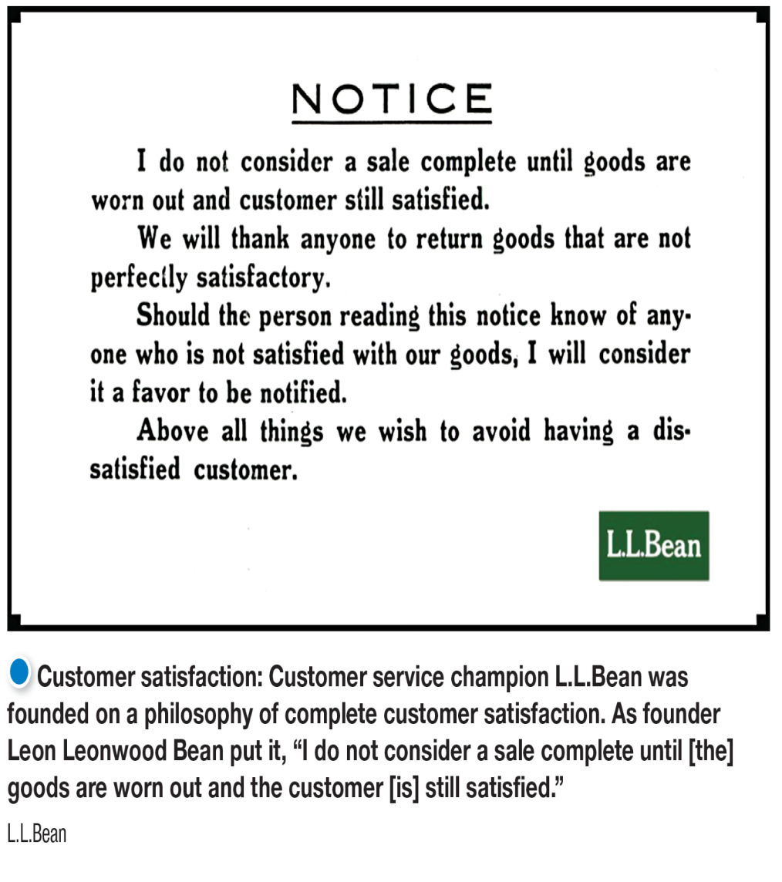
Managing Customer Relationships and Capturing Customer Value
Relationship Building Blocks
Customer- perceived value
Customer satisfaction
The extent to which perceived performance matches a buyer’s expectations
The customer’s evaluation of the difference between all the benefits and all the costs of a marketing offer relative to those of competing offers.
Notes:
The key to building lasting customer relationships is to create superior customer value and satisfaction. Satisfied customers are more likely to be loyal customers and give the company a larger share of their business.
A customer buys from the firm that offers the highest customer-perceived value—the customer’s evaluation of the difference between all the benefits and all the costs of a market offering relative to those of competing offers.
Customer satisfaction depends on the product’s perceived performance relative to a buyer’s expectations. If the product’s performance falls short of expectations, the customer is dissatisfied. If performance matches expectations, the customer is satisfied. If performance exceeds expectations, the customer is highly satisfied or delighted.
Outstanding marketing companies go out of their way to keep important customers satisfied. Most studies show that higher levels of customer satisfaction lead to greater customer loyalty, which in turn results in better company performance. Smart companies aim to delight customers by promising only what they can deliver and then delivering more than they promise.
Delighted customers not only make repeat purchases but also become willing marketing partners and “customer evangelists” who spread the word about their good experiences to others.

Slide 23
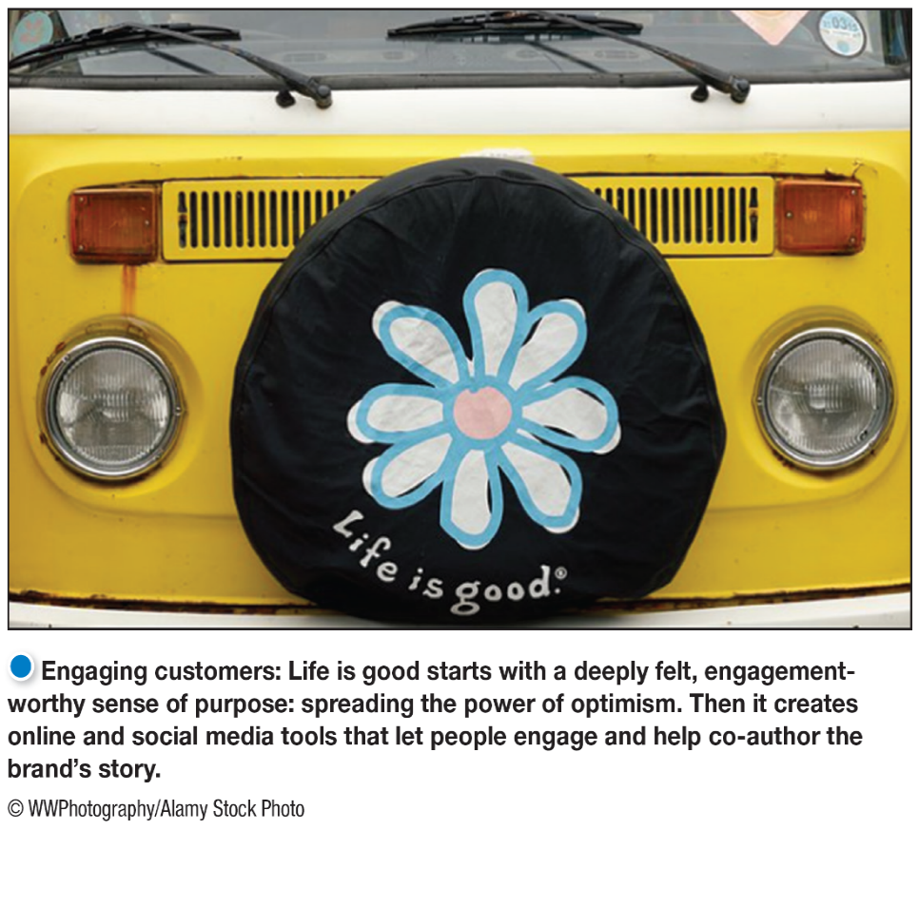
Managing Customer Relationships and Capturing Customer Value
Customer-Engagement Marketing
fosters direct and continuous customer involvement in shaping brand conversations, experiences, and community.
Customer-engagement marketing aims to make a brand a meaningful part of consumers’ conversations and lives through direct and continuous customer involvement in shaping brand conversations, experiences, and community
The aim of customer relationship management and customer engagement is to produce high customer equityحقوق ملكية , the total combined customer lifetime values of all of the company’s customers
Notes:
Customer-engagement marketing goes beyond just selling a brand to consumers. Its goal is to make the brand a meaningful part of consumers’ conversations and lives. Today, companies are using online, mobile, and social media to refine their targeting and to engage customers more deeply and interactively. The new marketing is customer-engagement marketing.
The burgeoning Internet and social media have given a huge boost to customer-engagement marketing. Today’s consumers are better informed, more connected, and more empowered than ever before.
Life is Good is a great example of customer-engagement marketing. The company starts with a deeply felt, engagement-worthy sense of purpose: spreading the power of optimism. Then it creates online and social media tools that let people engage and help co-author the brand’s story.
Discussion Question
Ask students how other companies have used Facebook, Twitter, Instagram, Snapchat, or other social networks for marketing purposes.

Slide 24
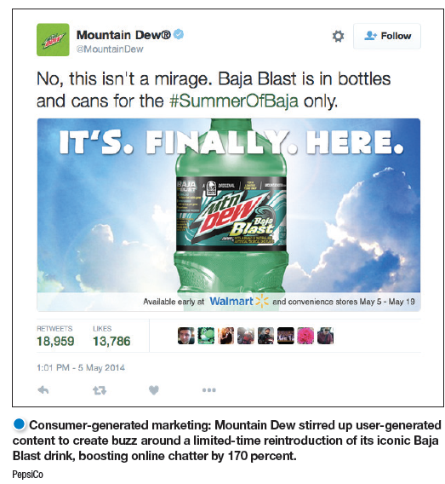
Managing Customer Relationships and Capturing Customer Value
Consumer-Generated Marketing
Brand exchanges created by consumers themselves.
Consumers are playing an increasing role in shaping brand experiences.
Partner relationship management involves working closely with partners in other company departments and outside the company to jointly bring greater value to customers.
Notes:
A growing form of customer-engagement marketing is consumer-generated marketing.
This might happen through uninvited consumer-to-consumer exchanges in blogs, video-sharing sites, social media, and other digital forums. But increasingly, companies themselves are inviting consumers to play a more active role in shaping products and brand content. Some companies ask consumers for new product and service ideas.
For example, Mountain Dew stirred up user-generated content to create buzz around a limited-time reintroduction of its iconic Baja Blast beverage, boosting online chatter by 170 percent.

Slide 25
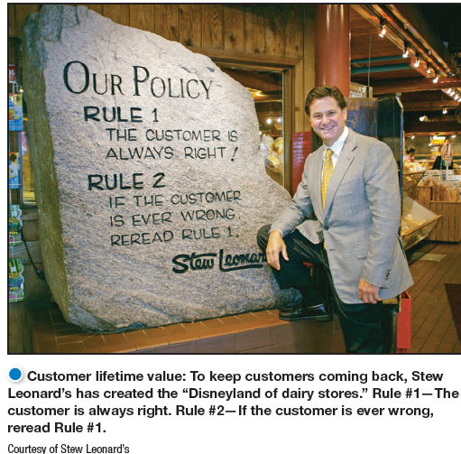
Managing Customer Relationships and Capturing Customer Value
Customer lifetime value is the value of the entire stream of purchases that the customer would make over a lifetime of patronage (care).
Share of customer is the portion of the customer’s purchasing that a company gets in its product categories.
Customer equity is the total combined customer lifetime values of all of the company’s customers.
The key to building lasting relationships is the creation of superior customer value and satisfaction. In return for creating value for targeted customers, the company captures value from customers in the form of profits and customer equity.
Notes:
At Stew Leonard’s profitable four-store supermarket, the lifetime revenue of a customer is $50,000. Because his average customer spends about $100 a week, shops 50 weeks a year, and remains in the area for about 10 years, losing one customer can be a significant loss.
Discussion Question
Ask students if they know of other retailers that build this kind of customer loyalty and retention.
Good customer relationship management creates customer satisfaction. In turn, satisfied customers remain loyal and talk favorably to others about the company and its products.
Studies show big differences in the loyalty of customers who are less satisfied, somewhat satisfied, and completely satisfied. Keeping customers loyal makes good economic sense. Loyal customers spend more and stay around longer. Research also shows that it’s five times cheaper to keep an old customer than acquire a new one. Conversely, customer defections can be costly. Losing a customer means losing more than a single sale. It means losing the entire stream of purchases that the customer would make over a lifetime of patronage.

Slide 26
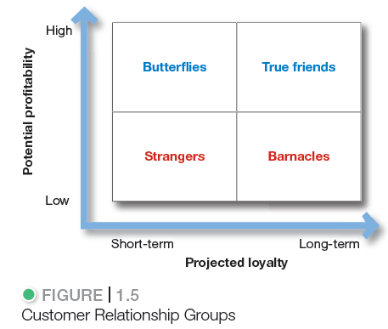
Building the Right Relationships with the Right Customers
Notes:
Figure 1.5 classifies customers into one of four relationship groups, according to their profitability and projected loyalty. Each group requires a different relationship management strategy.
Strangers show low potential profitability and little projected loyalty.
Butterflies are potentially profitable but not loyal.
True friends are both profitable and loyal.
Barnacles are highly loyal but not very profitable.
The point here is an important one: Different types of customers require different engagement and relationship management strategies. The goal is to build the right relationships with the right customers.

Slide 27
Building the Right Relationships with the Right Customers
Figure 1.5 classifies customers into one of four relationship groups, according to their profitability and projected loyalty. Each group requires a different relationship management strategy.
1-Strangers show low potential profitability and little projected loyalty.
2-Butterfliesالفراشات are potentially profitable but not loyal.
3-True friends are both profitable and loyal.
4-Barnaclesالنظارات are highly loyal but not very profitable.
Note: Different types of customers require different engagement and relationship management strategies. The goal is to build the right relation- ships with the right customers.

Slide 28
The Changing Marketing Landscape
Digital and social media marketing involves using digital marketing tools such as web sites, social media, mobile ads and apps, online videos, e-mail, and blogs that engage consumers anywhere, at any time, via their digital devices.
Online, mobile, and social media marketing offer exciting new opportunities to target customers more selectively and engage them more deeply.
The key is to blend the new digital approaches with traditional marketing to create a smoothly integrated marketing strategy and mix.
Notes:
The explosive growth in digital technology has fundamentally changed the way we live—how we communicate, share information, access entertainment, and shop.
An estimated 3.3 billion people—46 percent of the world’s population—are now online. Sixty-four percent of all American adults now own smartphones; 71 percent of those smartphones next to them when they sleep. These numbers will only grow as digital technology rockets into the future.
Petco’s Community site is a place where pet lovers can connect, share, and learn via a blog and discussion boards dedicated to pets of all types, from dogs and cats to birds, fish, and reptiles.

Slide 29
The Changing Economic Environment
Not-for-profit marketing growth
For example, not-for-profit St. Jude Children’s Research Hospital has a special
mission: “Finding curesالعلاج-الشفاء. Saving children.
Rapid globalization
American firms have been challenged at home by the skillful marketing of European and Asian multinationals. Companies such as Toyota, Nestlé, and Samsung have often outperformed their U.S. competitors in American markets.
Sustainable marketing- The Call for More Environmental and Social Responsibility
-Today’s marketers are being called on to develop sustainable marketing practices.
-Today’s customers expect companies to deliver value in a socially and environmentally
responsible way
Notes:
In recent years, marketing has also become a major part of the strategies of many not-for-profit organizations, such as colleges, hospitals, museums, zoos, symphony orchestras, foundations, and even churches. The nation’s not-for-profits face stiff competition for support and membership. Sound marketing can help them attract members, funds, and support. For example, Ben & Jerry’s three-part “linked prosperity” mission drives it to make fantastic ice cream (product mission), manage the company for sustainable financial growth (economic mission), and use the company “in innovative ways to make the world a better place” (social mission). Both Ben & Jerry’s and its products are “Made of Something Better.”
As they are redefining their customer relationships, marketers are also taking a fresh look at the ways in which they relate with the broader world around them. Today, almost every company, large or small, is touched in some way by global competition.
Marketers are reexamining their relationships with social values and responsibilities and with the very Earth that sustains us. As the worldwide consumerism and environmentalism movements mature, today’s marketers are being called on to develop sustainable marketing practices.

Slide 30
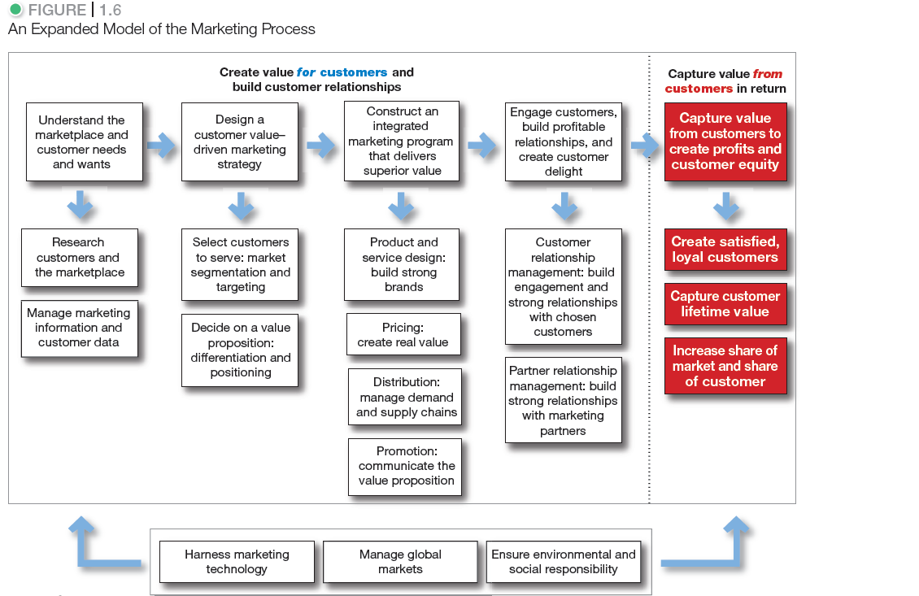
So, What Is Marketing? Pulling It All Together
Notes:
At the start of this chapter, Figure 1.1 presented a simple model of the marketing process. Now that we’ve discussed all the steps in the process, Figure 1.6 presents an expanded model that will help you pull it all together.

