Slide 1
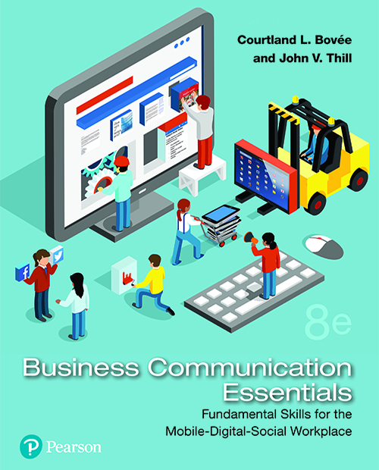
Business Communication Essentials
Eighth Edition
Chapter 8
Writing Negative Messages
Copyright © 2019, 2016, 2014 Pearson Education, Inc. All Rights Reserved.
Notes:
If this PowerPoint presentation contains mathematical equations, you may need to check that your computer has the following installed:
1) MathType Plugin
2) Math Player (free versions available)
3) NVDA Reader (free versions available)

Slide 2
Learning Objectives (1 of 2)
8.1 Apply the three-step writing process to negative messages.
8.2 Explain how to use the direct approach effectively when conveying negative news.
8.3 Explain how to use the indirect approach effectively when conveying negative news, and explain how to avoid ethical problems when using this approach.

Slide 3
Learning Objectives (2 of 2)
8.4 Describe successful strategies for sending negative messages on routine business matters.
8.5 Describe successful strategies for sending negative employment-related messages.
8.6 List the important points to consider when conveying negative organizational news.
8.7 Describe an effective strategy for responding to negative information in a social media environment.

Slide 4
Using the Three-Step Writing Process for Negative Messages
LO 8.1 Apply the three-step writing process to negative messages.
Notes:
Delivering negative information is rarely easy and never enjoyable, but with some helpful guidelines, you can craft messages that minimize negative reactions. Whenever you deliver negative news, you have five main goals:
To convey the bad news
To gain acceptance for it
To maintain as much goodwill as possible with your audience
To maintain a good image for your organization
To reduce future correspondence on the matter
Accomplishing all five goals requires careful attention to planning, writing, and completing your message.

Slide 5
Goals of Negative Messages
Convey the Bad News
Gain Acceptance of the News
Preserve Goodwill
Maintain or Repair Reputation
Reduce of Eliminate Future Correspondence on Issue
Notes:
Depending on the situation, you can have as many as five goals when communicating negative information:
To convey the bad news
To gain acceptance of the bad news
To preserve as much of your audience’s goodwill as possible
To maintain (or repair) your reputation or your organization’s reputation
To reduce or eliminate the need for future correspondence on the matter

Slide 6
Step 1: Planning Negative Messages
Planning Elements
Consider Your Audience and Purpose
Gather the Information You Need
Choose the Right Media and Channel
Choose the Best Approach
Notes:
When planning negative messages, remember that your audience does not want to hear what you have to say. To minimize the damage to business relationships and to encourage the acceptance of your message, plan carefully. With a clear purpose and your audience’s needs in mind, gather the information your audience will need in order to understand and accept your message.
Selecting the right combination of media and channels is critical. For instance, experts advise that bad news for employees should always be delivered in person whenever possible, both to show respect for the employees and to give them an opportunity to ask questions. However, an increasing number of managers appear to be using email and other electronic media to convey negative messages to employees.
Finally, the organization of a negative message requires particular care. A negative message using the direct approach opens with the bad news, proceeds to the reasons for the situation or the decision, and ends with a positive statement aimed at maintaining a good relationship with the audience. In contrast, the indirect approach opens with the reasons behind the bad news before presenting the bad news itself.

Slide 7
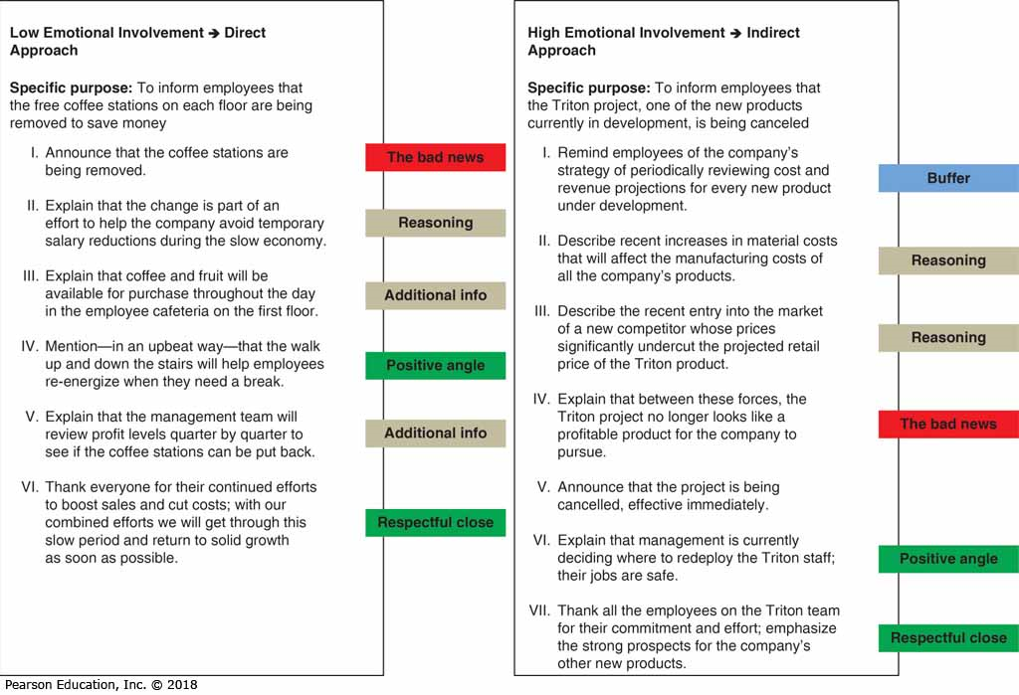
Choosing the Approach
Do You Need to Get the Reader’s Attention?
Does the Reader Prefer a Direct Approach?
How Important Is the News to the Reader?
Will the Negative News Come as a Shock?
Notes:
To decide which approach to take in any situation, ask yourself the following questions:
Do you need to get the reader’s attention immediately? If the situation is an emergency, or if someone has ignored repeated messages, the direct approach can help you get attention quickly.
Does the recipient prefer a direct style of communication? Some recipients prefer the direct approach no matter what, so if you know this, go with direct.
How important is this news to the reader? For minor or routine scenarios, the direct approach is nearly always best. However, if the reader has an emotional investment in the situation, or the consequences to the reader are considerable, the indirect approach is often better, particularly if the bad news is unexpected.
Will the bad news come as a shock? The direct approach is fine for many business situations in which people understand the possibility of receiving bad news. However, if the bad news might come as a shock to readers, use the indirect approach to help them prepare for it.

Slide 8
Step 2: Writing Negative Messages
Writing Elements
Write with Clarity and Sensitivity
Clarify Your Qualifications
Observe Communication Etiquette
Choose Positive, Productive Words
Notes:
By writing clearly and sensitively, you can take some of the sting out of bad news and help your reader accept the decision and move on. If your credibility hasn’t already been established with an audience, clarify your qualifications so message recipients won’t question your authority or ability.
When you use language that conveys respect and avoids an accusing tone, you protect your audience’s pride. This kind of communication etiquette is always important, but it demands special care with negative messages. Moreover, you can ease the sense of disappointment by using positive words rather than negative, counterproductive ones.

Slide 9
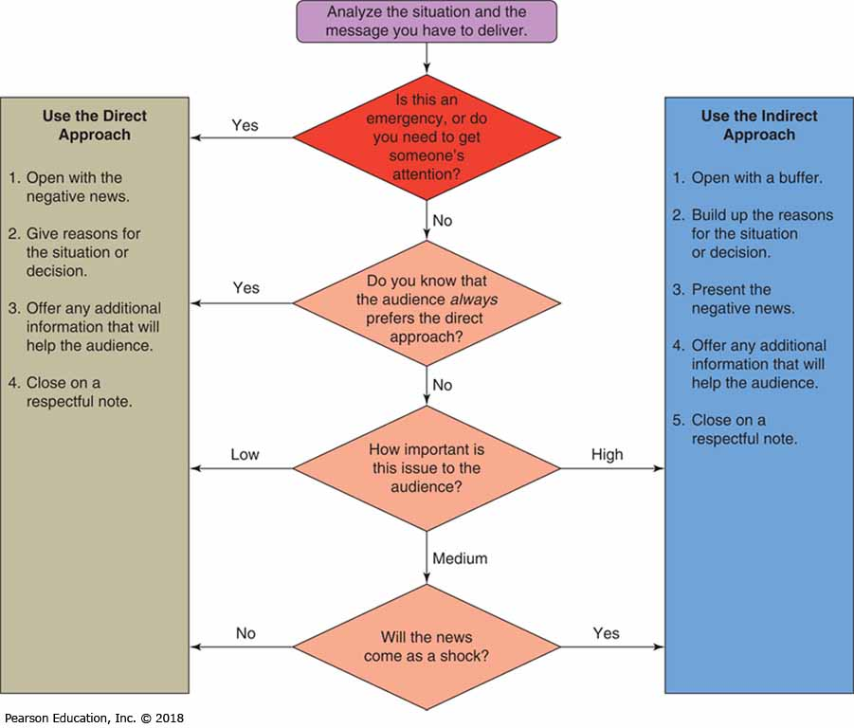
Step 3: Completing Negative Messages
Completing Elements
Revise Your Content
Produce Professional Documents
Proofread Your Work Carefully
Deliver Messages Promptly
Notes:
The need for careful attention to detail continues as you complete your message. Revise your content to make sure everything is clear, complete, and concise—even small flaws can be magnified in readers’ minds as they react to your negative news. Produce clean, professional documents, and proofread carefully to eliminate mistakes. Finally, be sure to deliver messages promptly; withholding or delaying bad news can be unethical and even illegal.

Slide 10
Summary of Discussion (1 of 7)
In this section, we discussed the following:
Step 1: Planning Negative Messages
Choosing the Approach
Step 2: Writing Negative Messages
Step 3: Completing Negative Messages
The next section will cover Using the Direct Approach for Negative Messages.

Slide 11
Using the Direct Approach for Negative Messages
LO 8.2 Explain how to use the direct approach effectively when conveying negative news.
Notes:
A negative message organized using the direct approach starts with a clear statement of the bad news, presents reasons for the decision (perhaps offering alternatives), and ends with a positive statement aimed at maintaining a good relationship with the audience. Stating the bad news at the beginning can have two advantages: (1) It makes a shorter message possible, and (2) it allows the audience to reach the main idea of the message in less time.

Slide 12
Opening with a Clear Statement of the Bad News
Use the Introductory Paragraph
Avoid Being Overly Blunt
Transition into the News
State Why You’re Writing, If Needed
Notes:
If you’ve chosen the direct approach to convey bad news, use the introductory paragraph of your message to share that information. To avoid being overly blunt, you can open with a neutral or positive statement that establishes common ground with the reader, then transition into the news. If necessary, remind the reader why you’re writing.

Slide 13
Providing Reasons and Additional Information
Explain Why the News Is Negative
Consider the Nature of the News
Assess Your Relationship with Readers
Determine Whether to Apologize
Notes:
In most cases, follow the direct opening with an explanation of why the news is negative. The extent of your explanation depends on the nature of the news and your relationship with the reader. However, you will encounter some situations in which explaining negative news is neither appropriate nor helpful, such as when the reasons are confidential, excessively complicated, or irrelevant to the reader.
Should you apologize when delivering bad news? Some experts have advised that a company should never apologize, even when it knows it has made a mistake; the apology might be taken as a confession of guilt that could be used against the company in a lawsuit. However, judges, juries, and plaintiffs tend to be more forgiving of companies that express sympathy for wronged parties; an apology can also help repair a company’s reputation.
The best general advice in the event of a serious mistake or accident is to immediately and sincerely express sympathy and offer help if appropriate, without admitting guilt; then seek the advice of your company’s lawyers before elaborating.

Slide 14
Closing on a Respectful Note
Show Respect for the Recipient
Consider Alternative Solutions
Try to Include Positive Statements
Avoid Creating False Hopes
Notes:
After you’ve explained the negative news, close the message in a way that respects the impact the negative news is likely to have on the recipient. If appropriate, consider offering your readers an alternative solution if you can, and if doing so is a good use of your time. Look for opportunities to include positive statements, but avoid creating false hopes. Ending on a false positive can leave readers feeling “disrespected, disregarded, or deceived.”

Slide 15
Summary of Discussion (2 of 7)
In this section, we discussed the following:
Opening with a Clear Statement of the Bad News
Providing Reasons and Additional Information
Closing on a Respectful Note
The next section will cover Using the Indirect Approach for Negative Messages.

Slide 16
Using the Indirect Approach for Negative Messages
LO 8.3 Explain how to use the indirect approach effectively when conveying negative news, and explain how to avoid ethical problems when using this approach.
Notes:
The indirect approach helps readers prepare for the bad news by outlining the reasons for the situation before presenting the bad news itself. However, the indirect approach is not meant to obscure bad news, delay it, or limit your responsibility. The purpose of this approach is to ease the impact of the bad news and help readers accept it. When done poorly, the indirect approach can be disrespectful and even unethical. When done well, it is a good example of “you-oriented” communication crafted with attention to both ethics and etiquette.

Slide 17
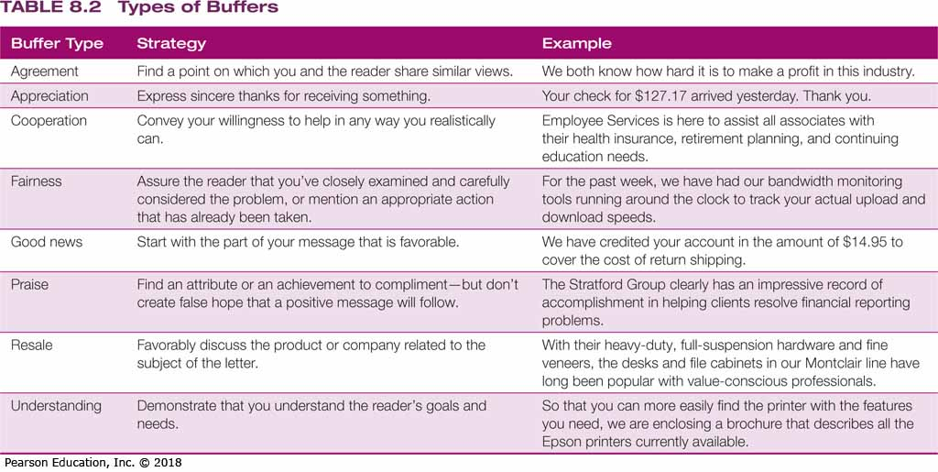
Opening with a Buffer
Neutral Statement
Express Your Appreciation
Assure Your Reader
Show That You Understand
Introduce the Subject Matter
Establish Common Ground
Notes:
Messages using the indirect approach open with a buffer—a neutral, noncontroversial statement that establishes common ground with the reader. Depending on the circumstances, a good buffer can express your appreciation for being considered, assure the reader of your attention to the request, indicate your understanding of the reader’s needs, introduce the general subject matter, or simply establish common ground with your readers.
A good buffer is relevant and sincere. In contrast, a poorly written buffer might trivialize the reader’s concerns, divert attention from the problem with insincere flattery or irrelevant material, or mislead the reader into thinking your message actually contains good news.

Slide 18
Provide Reasons and Additional Information
Introduce Negative Points Gradually
Provide Concise, Sufficient Details
Don’t Hide Behind Company Policy
Notes:
An ideal explanation section leads readers to your conclusion before you come right out and say it. The reader has followed your line of reasoning and is ready for the answer. By giving your reasons effectively, you help maintain focus on the issues at hand and defuse emotions that always accompany bad news. An effective way to do this is to start with positive or neutral points and move through progressively negative points. Provide enough detail for the audience to understand your reasons, but be concise.
Avoid hiding behind company policy to cushion your bad news. Skilled and sympathetic communicators explain company policy so that the audience can try to meet the requirements at a later time.
If you’ve done a good job of laying out your reasoning, then you’ve done everything you can to prepare the reader for the main idea, which is the negative news itself.

Slide 19
Continue with a Clear Statement of the Bad News
Deemphasize the Bad News
Use a Conditional Statement
Stress What You Can Do or Have Done
Notes:
Three techniques are especially useful for saying "no" as clearly and as kindly as possible.
First, deemphasize the bad news:
Minimize the space and time devoted to the bad news.
Subordinate the bad news within a complex or compound sentence.
Embed the bad news in the middle of a paragraph or use parenthetical expressions.
However, keep in mind that it's possible to abuse deemphasis. State the bad news clearly; then transition to any positive news that might balance the story.
Second, use a conditional statement (if or when) to imply that the audience could have received, or might someday receive, a favorable answer (“When you have more managerial experience, you are welcome to reapply”). Such a statement could motivate applicants to improve their qualifications.
Third, emphasize what you can do or have done, rather than what you cannot do. By focusing on the positive and implying the bad news, you can make the impact less personal and soften the blow.

Slide 20
Close on a Respectful Note
Avoid an Uncertain Conclusion
Limit Future Correspondence
Express Optimism, if Appropriate
Be Sincere and Avoid Clichés
Notes:
The conclusion is your opportunity to emphasize your respect for your audience, even though you’ve just delivered unpleasant news. A positive close builds goodwill, offers suggestions for action, provides a look toward the future, and is sincere.
Whatever type of conclusion you use, follow these guidelines:
Avoid an uncertain conclusion. If the situation or decision is final, avoid statements, such as “I trust our decision is satisfactory,” which can imply that the matter is open to discussion or negotiation.
Limit future correspondence. Encourage additional communication only if you’re willing to discuss your decision further.
Express optimism, if appropriate. If the situation might improve in the future, share that with your readers, if it’s relevant.
Be sincere. Steer clear of clichés that are insincere in view of the bad news. If you can’t help, don’t say, “If we can be of any help, please contact us.”
Keep in mind that the close is the last thing audience members have to remember you by. Even though they’re disappointed, leave them with the impression that they were treated with respect.

Slide 21
Summary of Discussion (3 of 7)
In this section, we discussed the following:
Opening with a Buffer
Providing Reasons and Additional Information
Continuing with a Clear Statement of the Bad News
Closing on a Respectful Note
The next section will cover Sending Negative Messages on Routine Business Matters.

