Slide 1
11
Current Liabilities and Payroll Accounting
Learning Objectives
1
Explain how to account for current liabilities.
2
Discuss how current liabilities are
reported and analyzed.
3
Explain how to account for payroll.

Slide 2
LEARNING
OBJECTIVE
Explain how to account for current liabilities.
1
What Is a Current Liability?
A debt that a
company expects to pay within one year or
the operating cycle, whichever is longer.
Current liabilities include notes payable, accounts payable, unearned revenues, and accrued liabilities such as taxes payable, salaries and wages payable, and interest payable.
LO 1

Slide 3
What Is a Current Liability?
Question
To be classified as a current liability, a debt must be expected to be paid within:
one year.
the operating cycle.
2 years.
(a) or (b), whichever is longer
LO 1

Slide 4
Current Liabilities
Notes Payable
Written promissory note.
Frequently issued to meet short-term financing needs.
Requires the borrower to pay interest.
Issued for varying periods.
LO 1

Slide 5
Notes Payable
Illustration: First National Bank agrees to lend $100,000 on September 1, 2017, if Cole Williams Co. signs a $100,000, 12%, four-month note maturing on January 1.
Instructions
Prepare the entry on September 1st.
Prepare the adjusting entry on December 31st, assuming monthly adjusting entries have not been made.
Prepare the entry required on January 1, 2018, the maturity date.
LO 1

Slide 6
Notes Payable
Illustration: First National Bank agrees to lend $100,000 on September 1, 2017, if Cole Williams Co. signs a $100,000, 12%, four-month note maturing on January 1.
a) Prepare the entry on September 1st.
Cash 100,000
Notes Payable 100,000
b) Prepare the adjusting entry on December 31st.
Interest Expense 4,000
Interest Payable 4,000
$100,000 x 12% x 4/12 = $4,000
LO 1

Slide 7
Notes Payable
Illustration: First National Bank agrees to lend $100,000 on September 1, 2017, if Cole Williams Co. signs a $100,000, 12%, four-month note maturing on January 1, 2018.
c) Prepare the entry at maturity.
Notes Payable 100,000
Interest Payable 4,000
Cash 104,000
LO 1

Slide 8
Current Liabilities
Sales Taxes Payable
Sales taxes are expressed as a stated percentage of the sales price.
Selling company (retailer)
collects tax from the customer.
enters tax separately in cash register or includes in total receipts.
remits the collections to the state’s department of revenue.
LO 1

Slide 9
Sales Taxes Payable
Illustration: The March 25 cash register reading for Cooley Grocery shows sales of $10,000 and sales taxes of $600 (sales tax rate of 6%), the journal entry is:
Mar. 25
Cash 10,600
Sales Revenue 10,000
Sales Tax Payable 600
LO 1

Slide 10
Sales Taxes Payable
Sometimes companies do not enter sales taxes separately in the cash register.
Illustration: Cooley Grocery enters total receipts of $10,600. Because the amount received from the sale is equal to the sales price 100% plus 6% of sales, (sales tax rate of 6%), the journal entry is:
Mar. 25
Cash 10,600
Sales revenue 10,000
*
Sales tax payable 600
* $10,600 ÷ 1.06 = $10,000
LO 1

Slide 11
Current Liabilities
Unearned Revenue
Revenues received before the company
delivers goods or
provides services.
Illustration 11-2
Unearned revenue and revenue accounts
LO 1

Slide 12
Unearned Revenue
Illustration: Superior University sells 10,000 season football tickets at $50 each for its five-game home schedule. The entry for the sale of season tickets is:
Aug. 6
Cash 500,000
Unearned Ticket Revenue 500,000
As each game is completed, Superior records the recognition of revenue with the following entry.
Sept. 7
Unearned Ticket Revenue 100,000
Ticket Revenue 100,000
LO 1

Slide 13
Current Liabilities
Current Maturities of Long-Term Debt
Portion of long-term debt that comes due in the current year.
No adjusting entry required.
Illustration: Wendy Construction issues a five-year, interest-bearing $25,000 note on January 1, 2017. This note specifies that each January 1, starting January 1, 2018, Wendy should pay $5,000 of the note. When the company prepares financial statements on December 31, 2017,
What amount should be reported as a current liability? ___________
What amount should be reported as a long-term liability? _________
$5,000
$20,000
LO 1

Slide 14
DO IT!
1
Current Liabilities
You and several classmates are studying for the next accounting examination. They ask you to answer the following questions.
If cash is borrowed on a $50,000, 6-month, 12% note on September 1, how much interest expense would be incurred by December 31?
Solution
$50,000 x 12% x 4/12 = $2,000
LO 1

Slide 15
DO IT!
1
Current Liabilities
You and several classmates are studying for the next accounting examination. They ask you to answer the following questions.
How is the sales tax amount determined when the cash register total includes sales taxes?
Solution
First, divide the total cash register receipts by 100% plus the sales tax percentage to find the sales revenue amount.
Second, subtract the sales revenue amount from the total cash register receipts to determine the sales taxes.
LO 1

Slide 16
DO IT!
1
Current Liabilities
You and several classmates are studying for the next accounting examination. They ask you to answer the following questions.
If $15,000 is collected in advance on November 1 for 3 months’ rent, what amount of rent revenue should be recognized by December 31?
Solution
$15,000 x 2/3 = $10,000
LO 1

Slide 17
LEARNING
OBJECTIVE
Discuss how current liabilities are reported and analyzed.
2
Reporting Uncertainty
Contingent liability - Potential liability that may become an actual liability in the future.
Three levels of probability:
Probable
Reasonably possible
Remote
LO 2

Slide 18
Reporting Uncertainty
Probability
Accounting
Probable
Accrue
Reasonably
Possible
Footnote
Remote
Ignore
LO 2

Slide 19
Reporting Uncertainty
Question
A contingent liability should be recorded in the accounts when:
it is probable the contingency will happen, but the amount cannot be reasonably estimated.
it is reasonably possible the contingency will happen, and the amount can be reasonably estimated.
it is probable the contingency will happen, and the amount can be reasonably estimated.
it is reasonably possible the contingency will happen, but the amount cannot be reasonably estimated.
LO 2

Slide 20
Accounting Across the Organization
Contingencies: How Big Are They?
Contingent liabilities abound in the real world. Consider Manville Corp., which fi led for bankruptcy when it was hit by billions of dollars in asbestos product-liability claims. Companies having multiple toxic waste sites are faced with cleanup costs that average $10 to $30 million and can reach as high as $500 million depending on the type of waste. For life and health insurance companies and their stockholders, the cost of diseases such as diabetes, Alzheimer’s, and AIDS is like an iceberg: Everyone wonders how big such costs really are and what damage they might do in the future. And frequent-flyer programs are so popular that airlines at one time owed participants more than 3 million round-trip domestic tickets. That’s enough to fly at least 5.4 billion miles—free for the passengers, but at what future cost to the airlines?
LO 2

Slide 21
Reporting a Contingent Liability
Product Warranties
Promise made by a seller to a buyer to make good on a deficiency of quantity, quality, or performance in a product.
Estimated cost of honoring product warranty contracts should be recognized as an expense in the period in which the sale occurs.
LO 2

Slide 22
Reporting a Contingent Liability
Illustration: Denson Manufacturing Company sells 10,000 washers and dryers at an average price of $600 each. The selling price includes a one-year warranty on parts. Denson expects that 500 units (5%) will be defective and that warranty repair costs will average $80 per unit. In 2017, the company honors warranty contracts on 300 units, at a total cost of $24,000. At December 31, compute the estimated warranty liability.
Illustration 11-3
Computation of estimated
product warranty liability
LO 2

Slide 23
Reporting a Contingent Liability
Illustration: Denson Manufacturing Company sells 10,000 washers and dryers at an average price of $600 each. The selling price includes a one-year warranty on parts. Denson expects that 500 units (5%) will be defective and that warranty repair costs will average $80 per unit. In 2017, the company honors warranty contracts on 300 units, at a total cost of $24,000. At December 31, compute the estimated warranty liability. Make the required adjusting entry.
Warranty Expense 40,000
Warranty Liability 40,000
LO 2

Slide 24
Reporting a Contingent Liability
Illustration: Prepare the entry to record the repair costs incurred in 2017 to honor warranty contracts on 2017 sales.
Warranty Liability 24,000
Repair Parts 24,000
Assume that the company replaces 20 defective units in January 2018, at an average cost of $80 in parts and labor.
Warranty Liability 1,600
Repair Parts 1,600
LO 2

Slide 25
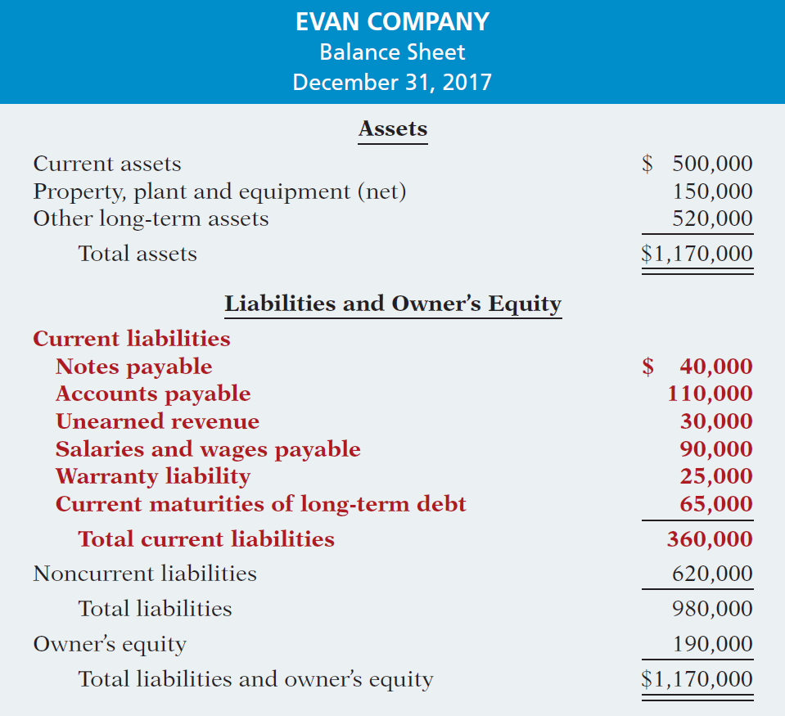
Illustration 11-4
Balance sheet reporting of current liabilities
LO 2

Slide 26
Analysis of Current Liabilities
Illustration 11-5
Liquidity refers to the ability to pay maturing obligations and meet unexpected needs for cash.
Current ratio permits us to compare the liquidity of different-sized companies and of a single company at different times.
Illustration 11-6
LO 2

Slide 27
DO IT!
2
Reporting and Analyzing
Lepid Company has the following account balances at December 31, 2017. Notes payable ($80,000 due after 12/31/18) $200,000, unearned service revenue $75,000, other long-term debt ($30,000 due in 2018) $150,000, salaries and wages payable $22,000, other accrued expenses $15,000, and accounts payable $100,000. In addition, Lepid is involved in a lawsuit. Legal counsel feels it is probable Lepid will pay damages of $38,000 in 2018.
Prepare the current liabilities section of Lepid’s December 31, 2017, balance sheet.
Lepid’s current assets are $504,000. Compute Lepid’s working capital and current ratio.
LO 2

Slide 28
DO IT!
2
Reporting and Analyzing
Prepare the current liabilities section of Lepid’s December 31, 2017, balance sheet.
Current liabilities
Notes payable $120,000
Accounts payable 100,000
Unearned service revenue 75,000
Lawsuit liability 38,000
Salaries and wages payable 22,000
Other accrued expenses 15,000
Long-term debt due within one year 30,000
Total current liabilities $400,000
LO 2

Slide 29
DO IT!
2
Reporting and Analyzing
Lepid’s current assets are $504,000. Compute Lepid’s working capital and current ratio.
Working capital = Current assets - Current liabilities =
$504,000 - $400,000 = $104,000
Current ratio = Current assets ÷ Current liabilities =
$504,000 ÷ $400,000 = 1.26:1
LO 2

Slide 30
LEARNING
OBJECTIVE
Explain how to account for payroll.
3
“Payroll” pertains to both:
Salaries - managerial, administrative, and sales personnel (monthly or yearly rate).
Wages - store clerks, factory employees, and manual laborers (rate per hour).
Determining the Payroll
Involves computing three amounts: (1) gross earnings, (2) payroll deductions, and (3) net pay.
LO 3

Slide 31
Determining the Payroll
GROSS EARNINGS
Total compensation earned by an employee (wages or salaries, plus any bonuses and commissions).
Illustration 11-7
Computation of total wages
LO 3

Slide 32
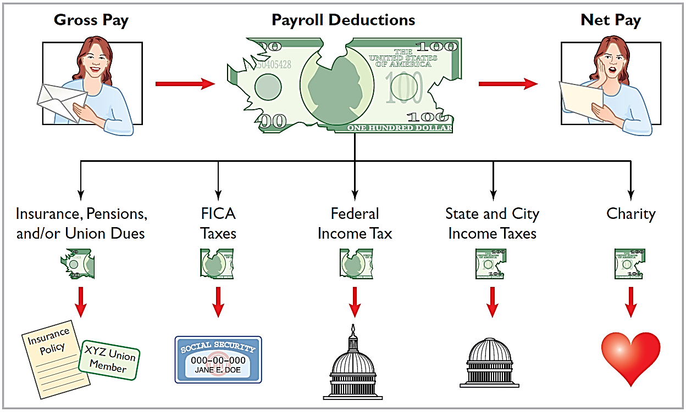
PAYROLL DEDUCTIONS
Illustration 11-8
Payroll deductions
LO 3

Slide 33
Determining the Payroll
PAYROLL DEDUCTIONS
Mandatory:
FICA tax
Federal income tax
State income tax
Voluntary:
Charity
Insurance
Union dues
Pension plans
LO 3

Slide 34
Determining the Payroll
PAYROLL DEDUCTIONS
Mandatory:
FICA tax
Federal income tax
State income tax
Social Security and Medicare tax
Supplemental retirement, employment disability, and medical benefits.
Illustration 11-9
FICA tax rate and tax base
LO 3

Slide 35
Determining the Payroll
PAYROLL DEDUCTIONS
Mandatory:
FICA tax
Federal income tax
State income tax
Employers are required to withhold income taxes from employees’ pay.
Withholding amounts are based on gross wages and the number of allowances claimed.
LO 3

Slide 36
Determining the Payroll
PAYROLL DEDUCTIONS
Mandatory:
FICA tax
Federal income tax
State income tax
Most states (and some cities) require employers to withhold income taxes from employees’ earnings.
LO 3

Slide 37
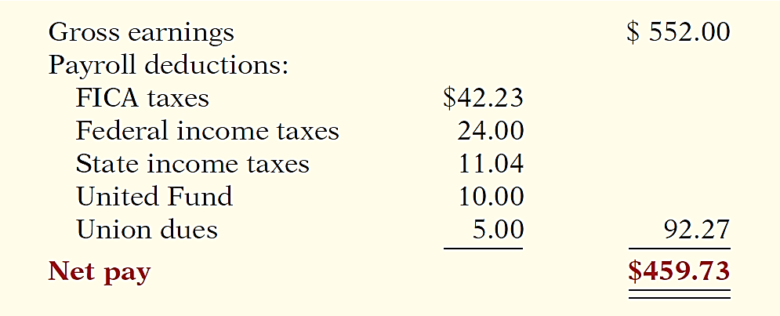
Determining the Payroll
NET PAY
Gross earnings minus payroll deductions.
Illustration 11-12
Computation of net pay
LO 3

Slide 38
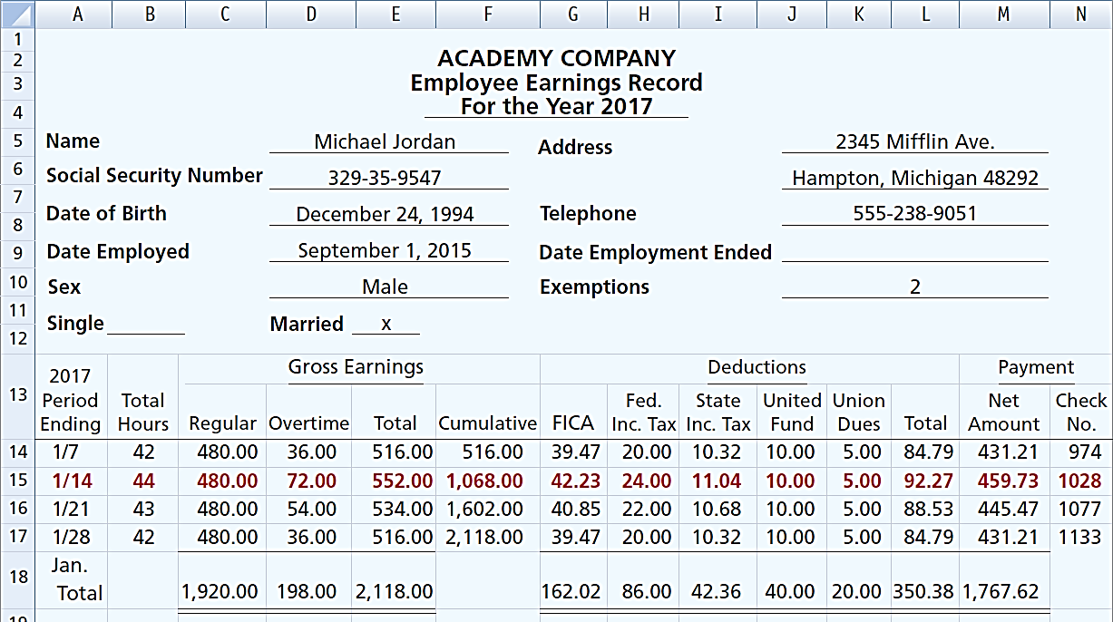
Recording the Payroll
Illustration 11-13
Employee earnings record
LO 3

Slide 39
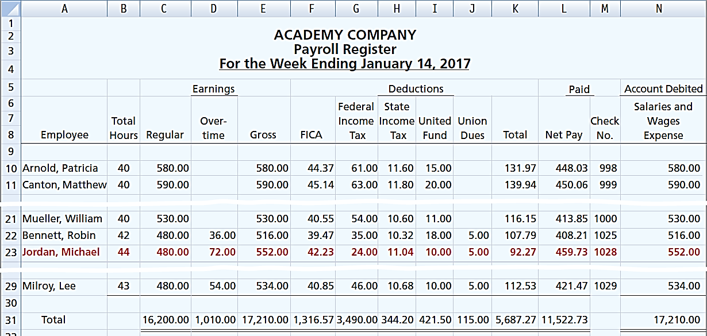
Recording the Payroll
Illustration 11-14
Payroll register
LO 3

Slide 40
Recording the Payroll
RECOGNIZING PAYROLL EXPENSES AND LIABILITIES
Illustration: Prepare the entry Academy Company would make to record the payroll for the week ending January 14.
Salaries and Wages Expense 17,210.00
FICA Taxes Payable 1,316.57
Federal Income Taxes Payable 3,490.00
State Income Taxes Payable 344.20
United Fund Contributions Payable 421.50
Union Dues Payable 115.00
Salaries and Wages Payable 11,522.73
LO 3

Slide 41
Recording the Payroll
RECORDING PAYMENT OF THE PAYROLL
Illustration: Prepare the entry Academy Company would make to record the payment of the payroll.
Salaries and Wages Payable 11,522.73
Cash 11,522.73
LO 3

Slide 42
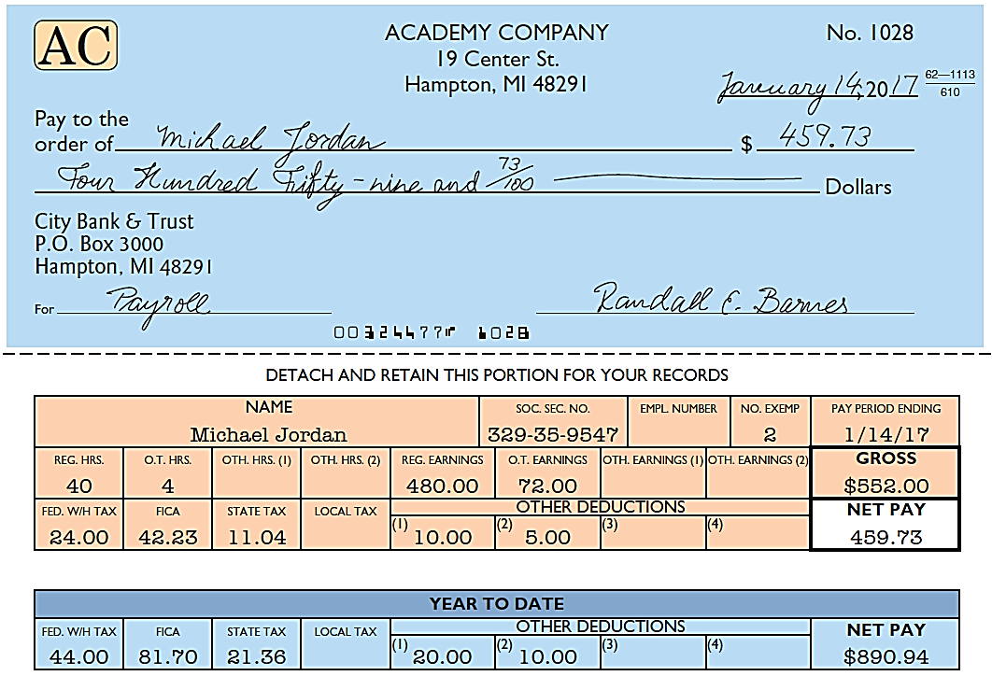
RECORDING PAYMENT OF THE PAYROLL
Illustration 11-15
Paycheck and statement of
earnings
LO 3

Slide 43
DO IT!
3a
Payroll
In January, gross earnings in Ramirez Company were $40,000. All earnings are subject to 7.65% FICA taxes. Federal income tax withheld was $9,000, and state income tax withheld was $1,000. (a) Calculate net pay for January, and (b) record the payroll.
(a) Net pay: $40,000 - (7.65% x $40,000) - $9,000 - $1,000 = $26,940
Salaries and Wages Expense 40,000
FICA Taxes Payable 3,060
Federal Income Taxes Payable 9,000
State Income Taxes Payable 1,000
Salaries and Wages Payable 26,940
LO 3

Slide 44
Employer Payroll Taxes
Payroll tax expense results from three taxes that governmental agencies levy on employers.
These taxes are:
FICA taxes
Federal unemployment tax
State unemployment tax
Same rate and maximum earnings as the employee’s.
LO 3

Slide 45
Employer Payroll Taxes
Payroll tax expense results from three taxes that governmental agencies levy on employers.
These taxes are:
FICA tax
Federal unemployment tax
State unemployment tax
FUTA tax rate is 6.2% of first $7,000 of taxable wages.
Employers who pay the state unemployment tax on a timely basis will receive an offset credit of up to 5.4%. Therefore, the net federal tax rate is generally 0.8%.
LO 3

Slide 46
Employer Payroll Taxes
Payroll tax expense results from three taxes that governmental agencies levy on employers.
These taxes are:
FICA tax
Federal unemployment tax
State unemployment tax
SUTA basic rate is usually 5.4% on the first $7,000 of wages paid.
LO 3

Slide 47
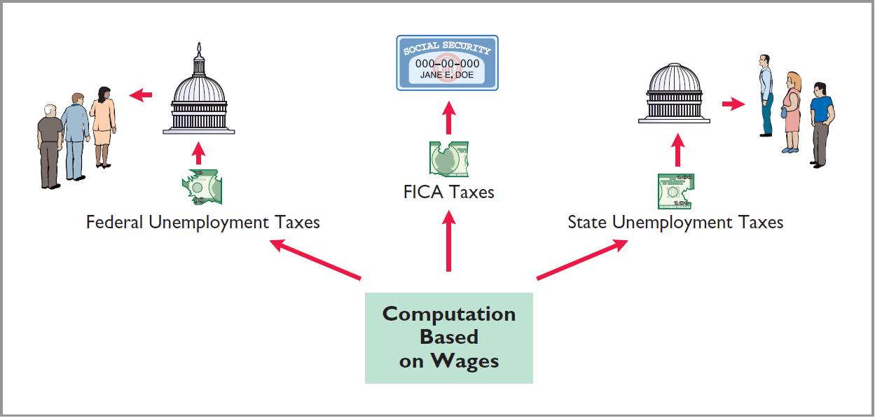
Recording Employer Payroll Taxes
Illustration 11-16
Employer payroll taxes
LO 3

Slide 48
Recording Employer Payroll Taxes
Illustration: Academy records the payroll tax expense associated with the January 14 payroll (Illustration 11-14) with the following entry. Use the following rates: FICA 8%, state unemployment 5.4%, federal unemployment 0.8%.
Payroll Tax Expense 2,383.59
*
FICA Tax Payable 1,316.57
Federal Unemployment Tax Payable 137.68
**
State Unemployment Tax Payable 929.34
***
* $ 17,210.00 x 7.65% = $1,316.57
** $17,210 x .8% = $137.68
*** $17,210.00 x 5.4% = $929.34
LO 3

Slide 49
Recording Employer Payroll Taxes
Question
Employer payroll taxes do not include:
Federal unemployment taxes.
State unemployment taxes.
Federal income taxes.
FICA taxes.
LO 3

Slide 50
Accounting Across the Organization
It Cost $74,000 to Put $44,000 in Sally’s Pocket
Sally works for Bogan Communications, a small company in New Jersey that provides audio systems. She makes $59,000 a year but only nets $44,000. What happened to the other $15,000? Well, $2,376 goes for Sally’s share of the medical and dental insurance that Bogan provides, $126 for state unemployment insurance, $149 for disability insurance, and $856 for Medicare. New Jersey takes $1,893 in income taxes, and the federal government gets $3,658 for Social Security and another $6,250 for income tax withholding. All of this adds up to some 22% of Sally’s gross pay going to Washington or Trenton. Employing Sally costs Bogan plenty too. Bogan has to write checks for $74,000 so Sally can receive her $59,000 in base pay. Health insurance is the biggest cost. While Sally pays nearly $2,400 for coverage, Bogan pays the rest—$9,561. Then, the federal and state governments take $56 for federal unemployment coverage, $149 for disability insurance, $300 for workers’ comp, and $505 for state unemployment insurance. Finally, the government requires Bogan to pay $856 for Sally’s Medicare and $3,658 for her Social Security. When you add it all up, it costs $74,000 to put $44,000 in Sally’s pocket and to give her $12,000 in benefits.
Source: Michael P. Fleischer, “Why I’m Not Hiring,” Wall Street Journal (August 9, 2010), p. A17.
LO 3

Slide 51
Filing and Remitting Payroll Taxes
Companies must report FICA taxes and federal income taxes withheld no later than one month following the close of each quarter.
Companies generally file and remit federal unemployment taxes annually on or before January 31 of the subsequent year. Companies usually file and pay state unemployment taxes by the end of the month following each quarter.
Employers must provide each employee with a Wage and Tax Statement (Form W-2) by January 31.
LO 3

Slide 52
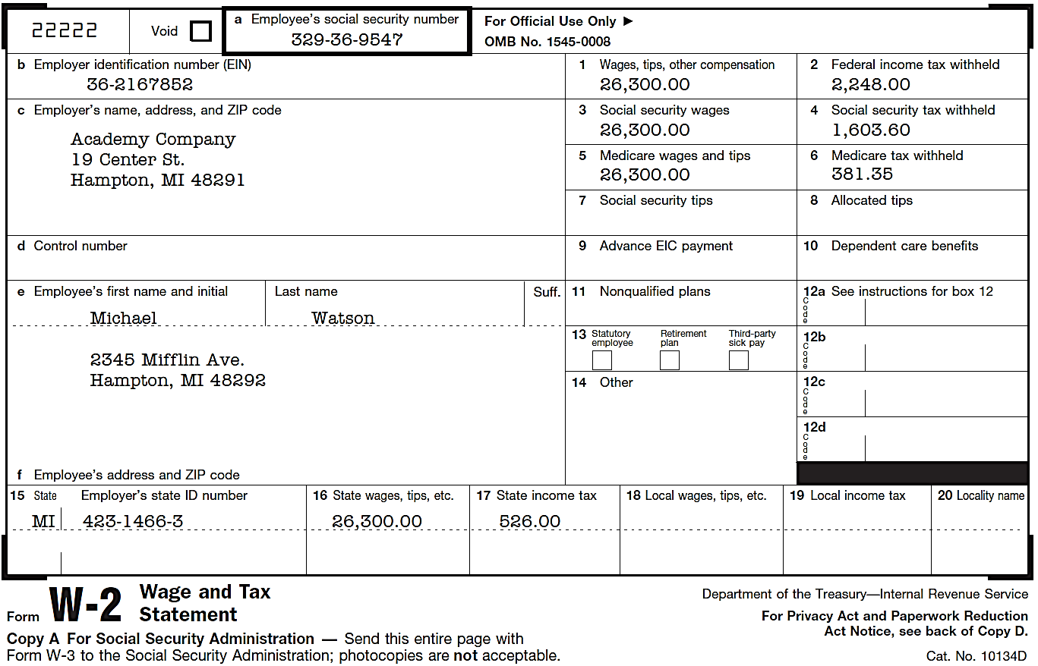
Filing and Remitting Payroll Taxes
APPENDIX
Illustration 11-17
LO 3

Slide 53
ANATOMY OF A FRAUD
Art was a custodial supervisor for a large school district. The district was supposed to employ between 35 and 40 regular custodians, as well as 3 or 4 substitute custodians to fill in when regular custodians were absent. Instead, in addition to the regular custodians, Art “hired” 77 substitutes. In fact, almost none of these people worked for the district. Instead, Art submitted time cards for these people, collected their checks at the district office, and personally distributed the checks to the “employees.” If a substitute’s check was for $1,200, that person would cash the check, keep $200, and pay Art $1,000.
Total take: $150,000
THE MISSING CONTROLS
Human resource controls. Thorough background checks should be performed.
No employees should begin work until they have been approved by the Board of
Education and entered into the payroll system. No employees should be entered
into the payroll system until they have been approved by a supervisor. All paychecks
should be distributed directly to employees at the official school locations by designated
employees.
Independent internal verification. Budgets should be reviewed monthly to identify
situations where actual costs significantly exceed budgeted amounts.
Source: Adapted from Wells, Fraud Casebook (2007), pp. 164–171.
Advance slide in slide show to reveal missing controls.
LO 3

Slide 54
Internal Control for Payroll
As applied to payrolls, the objectives of internal control are
to safeguard company assets against unauthorized payments of payrolls, and
to ensure the accuracy and reliability of the accounting records pertaining to payrolls.
LO 3

Slide 55
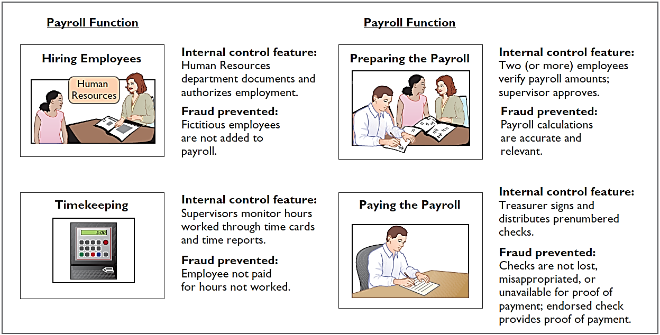
Internal Control for Payroll
APPENDIX
Illustration 11-18
Internal control for payroll
LO 3

Slide 56
DO IT!
3b
Employer’s Payroll Taxes
In January, the payroll supervisor determines that gross earnings for Halo Company are $70,000. All earnings are subject to 7.65% FICA taxes, 5.4% state unemployment taxes, and 0.8% federal unemployment taxes. Halo asks you to record the employer’s payroll taxes.
The entry to record the employer’s payroll taxes is:
Payroll Tax Expense 9,695
FICA Taxes Payable (7.65%) 5,355
Federal Unemployment Taxes Payable (0.8%) 560
State Unemployment Taxes Payable (5.4%) 3,780
LO 3

Slide 57
LEARNING
OBJECTIVE
APPENDIX 11A: Discuss additional fringe benefits associated with employee compensation.
4
Paid Absences
Paid absences for vacation, illness, and holidays.
Accrue a liability if:
Payment of the compensation is probable.
The amount can be reasonably estimated.
LO 4

Slide 58
Paid Absences
Illustration: Academy Company employees are entitled to one
day’s vacation for each month worked. If 30 employees earn an average of $110 per day in a given month record the adjusting entry to record accrued vacation for the month.
Vacation Benefits Expense 3,300
Vacation Benefits Liability 3,300
Academy pays vacation benefits for 10 employees.
Vacation Benefits Liability 1,100
Cash 1,100
LO 4

Slide 59
Postretirement Benefits
Post-retirement benefits are benefits that employers provide to retired employees for
health care and life insurance
pensions.
Companies account for post-retirement benefits on the accrual basis.
LO 4

Slide 60
Postretirement Benefits
POSTRETIREMENT HEALTHCARE AND LIFE INSURANCE BENEFITS
Companies estimate and expense postretirement costs during the working years of the employee.
Companies rarely sets up funds to meet the cost of the future benefits.
Pay-as-you-go basis for these costs.
Major reason is that the company does not receive a tax deduction until it actually pays the medical bill.
LO 4

Slide 61
Postretirement Benefits
PENSION PLANS
An arrangement whereby an employer provides benefits to employees after they retire for services they provided while they were working.
Pension Plan
Administrator
Employer
Contributions
Retired
Employees
Benefit Payments
Assets &
Liabilities
LO 4

Slide 62
Postretirement Benefits
PENSION PLANS
Defined-Contribution Plan
Defined-Benefit Plan
Employer contribution determined by plan (fixed)
Risk borne by employees
Benefits based on plan value
Benefit determined by plan
Employer contribution varies (determined by Actuaries)
Risk borne by employer
Companies record pension costs as an expense.
Actuaries estimate the employer contribution by considering mortality rates, employee turnover, interest and earning rates, early retirement frequency, future salaries, etc.
LO 4

Slide 63
A Look at IFRS
LEARNING
OBJECTIVE
Compare the accounting for liabilities under GAAP and IFRS.
5
Key Points
Similarities
The basic definition of a liability under GAAP and IFRS is very similar. Liabilities are defined by the IASB as a present obligation of the entity arising from past events, the settlement of which is expected to result in an outflow from the entity of resources embodying economic benefits.
The accounting for current liabilities such as notes payable, unearned revenue, and payroll taxes payable are similar between GAAP and IFRS.
LO 5

Slide 64
A Look at IFRS
Key Points
Under IFRS, liabilities are classified as current if they are expected to be paid within 12 months.
Differences
Companies using IFRS sometimes show liabilities before assets. Also, they will sometimes show long-term liabilities before current liabilities.
Under IFRS, companies sometimes will net current liabilities against current assets to show working capital on the face of the statement of financial position.
LO 5

Slide 65
A Look at IFRS
Key Points
Differences
Under GAAP, some contingent liabilities are recorded in the financial statements, others are disclosed, and in some cases no disclosure is required. Unlike GAAP, IFRS reserves the use of the term contingent liability to refer only to possible obligations that are not recognized in the financial statements but may be disclosed if certain criteria are met.
LO 5

Slide 66
A Look at IFRS
Key Points
Differences
For those items that GAAP would treat as recordable contingent liabilities, IFRS instead uses the term provisions. Provisions are defined as liabilities of uncertain timing or amount. Examples of provisions would be provisions for warranties, employee vacation pay, or anticipated losses. Under IFRS, the measurement of a provision related to an uncertain obligation is based on the best estimate of the expenditure required to settle the obligation.
LO 5

Slide 67
A Look at IFRS
Looking to the Future
The FASB and IASB are currently involved in two projects, each of which has implications for the accounting for liabilities. One project is investigating approaches to differentiate between debt and equity instruments. The other project, the elements phase of the conceptual framework project, will evaluate the definitions of the fundamental building blocks of accounting. The results of these projects could change the classification of many debt and equity securities.
LO 5

Slide 68
A Look at IFRS
IFRS Self-Test Questions
Which of the following is false?
Under IFRS, current liabilities must always be presented before noncurrent liabilities.
Under IFRS, an item is a current liability if it will be paid within the next 12 months.
Under IFRS, current liabilities are shown in order of liquidity.
Under IFRS, a liability is only recognized if it is a present obligation.
LO 5

Slide 69
A Look at IFRS
IFRS Self-Test Questions
The joint projects of the FASB and IASB could potentially:
change the definition of liabilities.
change the definition of equity.
change the definition of assets.
All of the above.
LO 5

Slide 70
Copyright
“Copyright © 2015 John Wiley & Sons, Inc. All rights reserved. Reproduction or translation of this work beyond that permitted in Section 117 of the 1976 United States Copyright Act without the express written permission of the copyright owner is unlawful. Request for further information should be addressed to the Permissions Department, John Wiley & Sons, Inc. The purchaser may make back-up copies for his/her own use only and not for distribution or resale. The Publisher assumes no responsibility for errors, omissions, or damages, caused by the use of these programs or from the use of the information contained herein.”

