Slide 1
Introduction To MYSQL
Lab Session

Slide 2
Introduction to Databases
A database is a collection of Data (Information).
Examples of databases, which we use in our daily life, is an Attendance Register, Telephone Directory, Muster Rule.
Database Management System(DBMS):
A database management system is a collection of programs written to manage a database. That is, it acts as a interface between user and database.

Slide 3
MYSQL
MySQL is an open-source Relational Database Management System (RDBMS) widely used for managing and organizing data in structured formats. It supports multiple operating systems and offers features like automatic backups and replication for high availability.

Slide 4
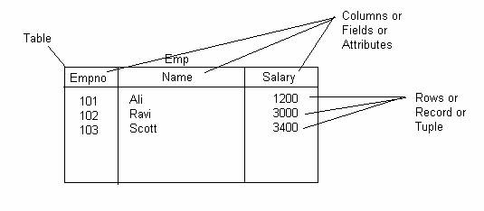
Creating Tables
A table is the data structure that holds data in a relational database.
A table is composed of rows and columns.

Slide 5
Designing Tables
Consider the following guidelines when designing your tables:
Use descriptive names for tables, columns, indexes, and clusters.
Be consistent in abbreviations and in the use of singular and plural forms of table names and columns.
Document the meaning of each table and its columns with the COMMENT command.
Normalize each table.
Select the appropriate datatype for each column.
Define columns that allow nulls last, to conserve storage space.
Cluster tables whenever appropriate, to conserve storage space and optimize performance of SQL statements.

Slide 6
Datatypes
Before creating a Table you have to decide what type of data each column can contain. This is known as datatype. Lets Discuss what datatypes are available in MYSQL.
Datatype | Description
CHAR (size ) | A FIXED length string (can contain letters, numbers, and special characters). The size parameter specifies the column length in characters - can be from 0 to 255. Default is 1
VARCHAR (size) | A VARIABLE length string (can contain letters, numbers, and special characters). The size parameter specifies the maximum column length in characters - can be from 0 to 65535

Slide 7
Datatypes
Datatype | Description
INT(size) | A medium integer. Signed range is from -2147483648 to 2147483647. Unsigned range is from 0 to 4294967295. The size parameter specifies the maximum display width (which is 255)
DATE | A date. Format: YYYY-MM-DD. The supported range is from '1000-01-01' to '9999-12-31'
TIMESTAMP (precision) | A value representing a date and time, including fractional seconds. format: YYYY-MM-DD hh:mm:ss. The supported range is from '1970-01-01 00:00:01' UTC to '2038-01-09 03:14:07' UTC.
YEAR | A year in four-digit format. Values allowed in four-digit format: 1901 to 2155, and 0000. MySQL 8.0 does not support year in two-digit format.
TIME(fsp) | A time. Format: hh:mm:ss. The supported range is from '-838:59:59' to '838:59:59'

Slide 8
The MySQL CREATE DATABASE Statement
Syntax
CREATE DATABASE databasename;
Example
CREATE DATABASE testDB;

Slide 9
The MySQL DROP DATABASE Statement
To select a database to work with, you use the USE statement:
USE database_name;

Slide 10
The MySQL DROP DATABASE Statement
Syntax
DROP DATABASE databasename;
Example
DROP DATABASE testDB;

Slide 11
The Grant Statement
Syntax
GRANT privilege_type ON database_name.table_name TO 'username'@'host';
Example
GRANT SELECT, INSERT, UPDATE ON mydatabase.* TO 'myuser'@'localhost';

Slide 12
The Revoke Statement
Syntax
REVOKE privilege_type ON database_name.table_name FROM 'username'@'host';
Example
REVOKE INSERT, UPDATE ON mydatabase.* FROM 'myuser'@'localhost';

Slide 13
Basics SQL
Select sysdate from dual;
Select 5*(3+2) from dual;

