Slide 1
Chapter 03
Introduction to SQL

Slide 2
Aggregate Functions
3.7

Slide 3
Aggregate Functions
Aggregate functions are functions that take a collection (a set or multiset) of values as input and return a single value.
SQL offers five built-in aggregate functions:
Average: avg
Minimum: min
Maximum: max
Total: sum
Count: count

Slide 4
Basic Aggregation
Find the average salary of instructors in the Computer Science department.

Slide 5
Basic Aggregation
Find the total number of instructors who teach at least one course in the Spring 2010 semester.

Slide 6
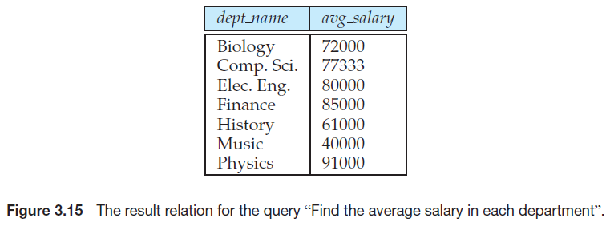
Aggregation with Grouping
Find the average salary in each department.
Notes:
select dept_name,count(ID),avg(salary)
from instructor
group by dept_name;

Slide 7
Aggregation with Grouping
Find the number of instructors in each department who teach at least one course in the Spring 2010 semester.
When an SQL query uses grouping, it is important to ensure that the only attributes that appear in the select statement without being aggregated are those that are present in the group by clause.
Notes:
select * from teaches;
select dept_name,count(distinct ID) as instrr-count
from instructor natural join teaches
where semester='Spring' and year=2010
group by dept_name;

Slide 8
The Having Clause
The HAVING clause was introduced in SQL to allow the filtering of query results based on aggregate functions and groupings, which cannot be achieved using the WHERE clause that is used to filter individual rows.
In simpler terms, the HAVING clause is used to apply a filter on the result of GROUP BY based on the specified condition.
The conditions are Boolean type i.e. use of logical operators (AND, OR). This clause was included in SQL as the WHERE keyword failed when we use it with aggregate expressions.
Having is a very generally used clause in SQL. Similar to WHERE it helps to apply conditions, but HAVING works with groups.
If you wish to filter a group, the HAVING clause comes into action.

Slide 9
The Having Clause
Find the departments where the average salary of the instructors is more than $42,000.

Slide 10
The Having Clause
For each course section offered in 2009, find the average total credits of all students enrolled in the section, if the section had at least 2 students.
5
1
2
3
4

Slide 11
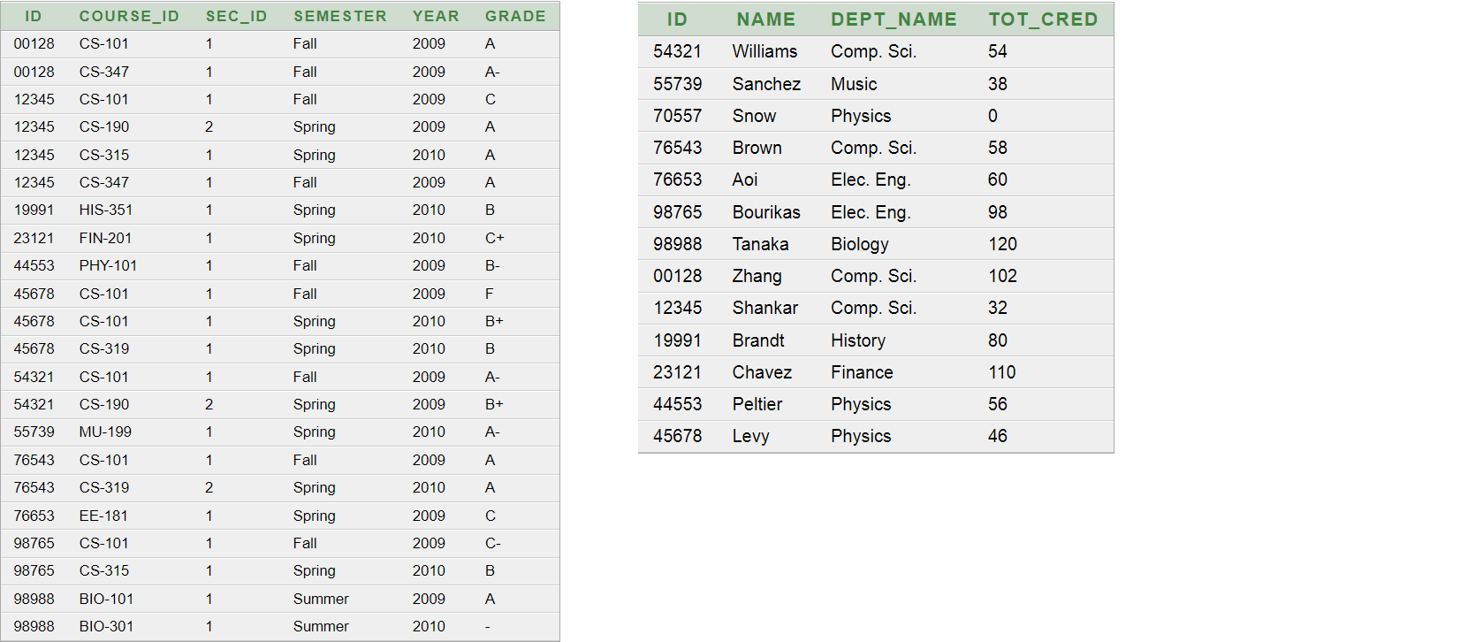
وصف الجداول عاليمين student
عاليسار takes

Slide 12
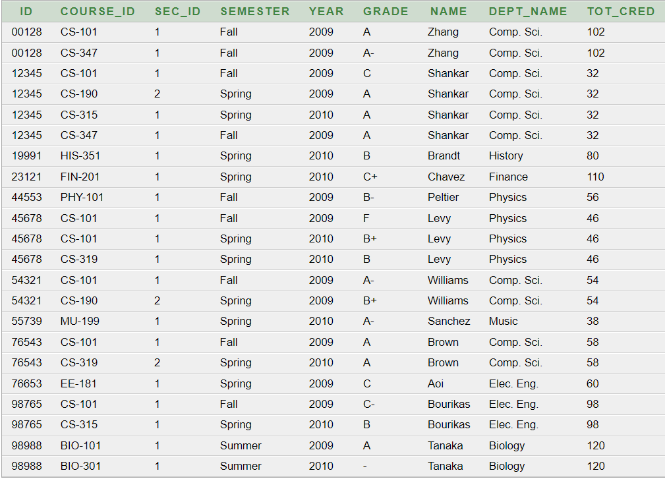
Result table from natural join
Notes:
select *
from takes natural join student
22 row

Slide 13
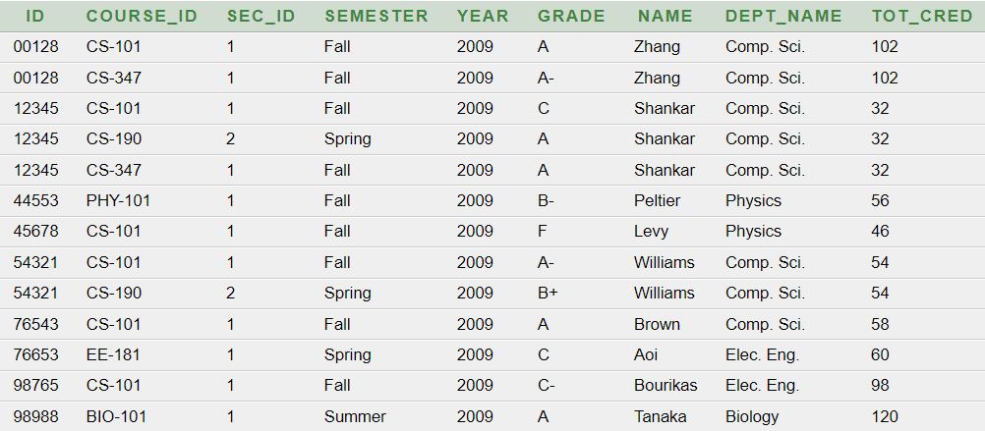
Filtration by where clause based on year = 2009
Notes:
select *
from takes natural join student
where year=2009
13 row

Slide 14
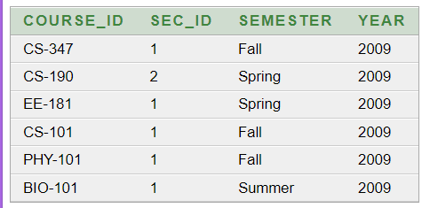
Group by تم تجميع كل مساق من الجدول السابق بناءا على كل الاعمدة حيث ظهر كل مساق بدون تكرار
having count(ID)>=2;
كل مساق مسجل فيه طالبين او اكثر تم فلترته حيث ان عدد الطلاب اللذين ياخذون المساقات نتج عن طريق natural join
Notes:
select course_id,sec_id,semester,year
from takes natural join student
where year=2009
group by course_id,sec_id,semester,year;
select course_id,sec_id,semester,year
from takes natural join student
where year=2009
group by course_id,sec_id,semester,year
having count(ID)>=2;

Slide 15
تم اضافة معدل ساعات الطلاب اللذين يدرسون كل مساق
مثلا مساق CS-347 يأخذه طالبين
من نتيجية الجوين عدد ساعات الطالب الاول102 عدد ساعات الطالب الثاني 32 --------------- 67 المعدل
Notes:
select course_id,sec_id,semester,year,avg(tot_cred)
from takes natural join student
where year=2009
group by course_id,sec_id,semester,year
having count(ID)>=2;

Slide 16
Aggregation with Null
In general, aggregate functions treat nulls according to the following rule:
All aggregate functions except count (*) ignore null values in their input collection.
The count of an empty collection is defined to be 0 , and all other aggregate operations return a value of null when applied on an empty collection.

Slide 17
Aggregation with Null
Salary
1000
Null
3000
Null
Count(*) → 4
Sum→(4000)تجاهل النل
Avg→4000/2→2000
In HR schema there is a one employee hasn’t manger_id (null)
When using
select count (MANAGER_ID)
from employees
The count function IS NOT COUNT null value
But when using
select count (*)
from employees
The count function IS COUNT null value

