Slide 1
Chapter 2
Quadratic and Other Special Functions
2.4 Special Functions and Their Graphs

Slide 2
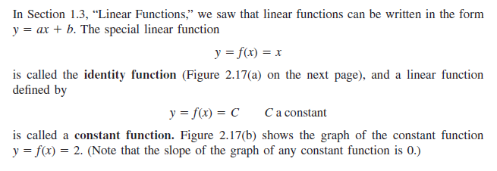
Basic Functions :

Slide 3
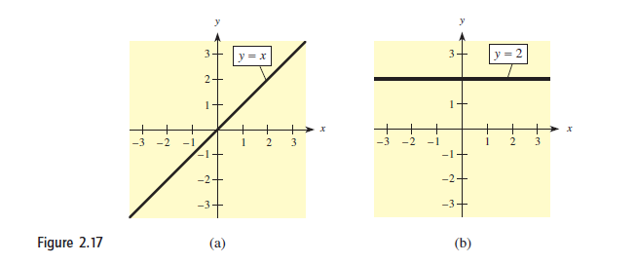

Slide 4
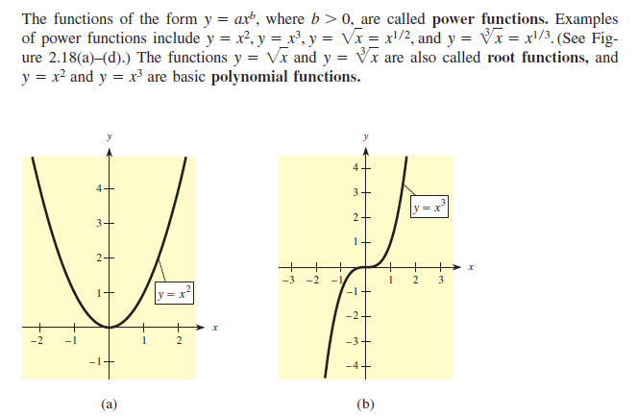

Slide 5
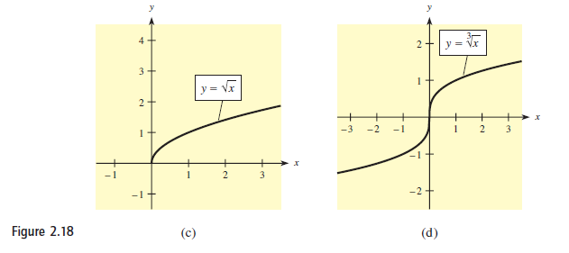

Slide 6
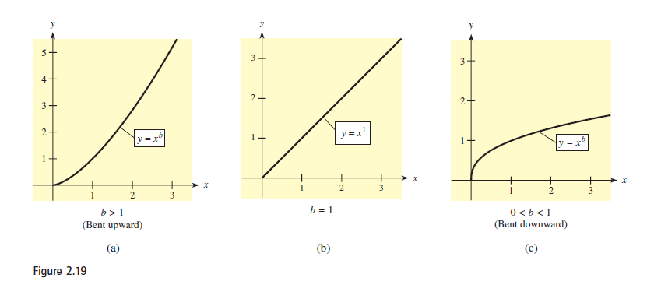

Slide 7
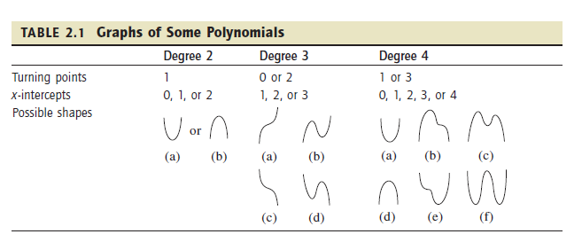
Polynomial and Rational Functions :

Slide 9
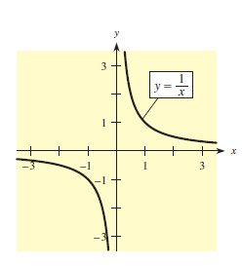

Slide 11
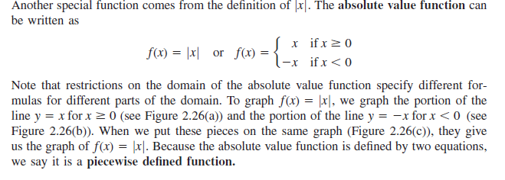
Piecewise Defined Functions :

Slide 12
