Slide 2
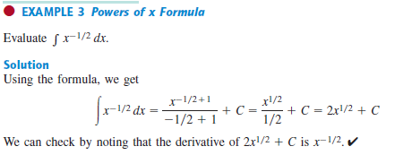
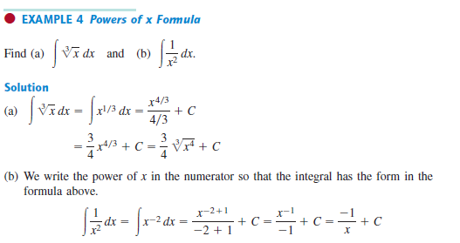

Slide 3
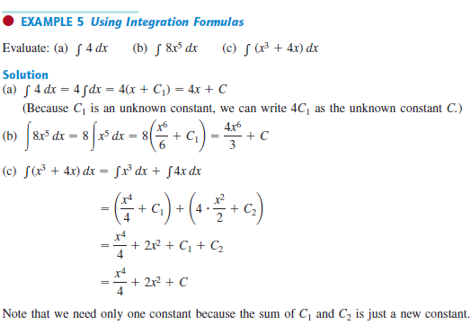
${(x^{2}−4)}^{2}=(x^{2}−4)$ $\left(x^{2}−4\right)=$
$x^{4}−$4$x^{2}−4x^{2}+16\text{=}$
$$x^{4}−8x^{2}+16$$

Slide 5
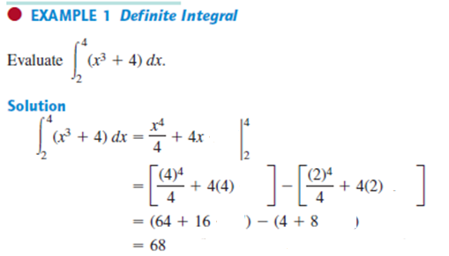

Slide 6
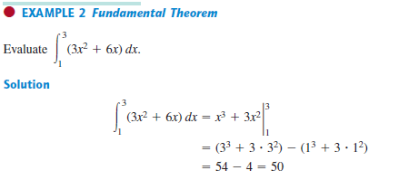
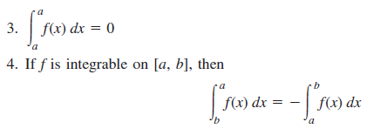
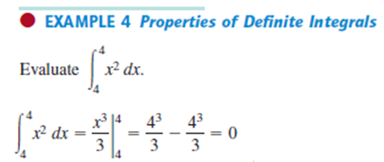

Slide 7
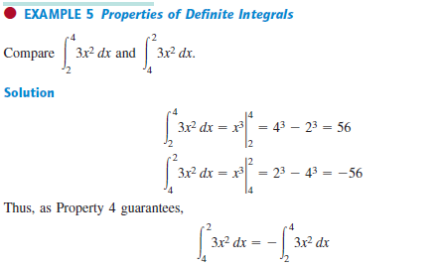
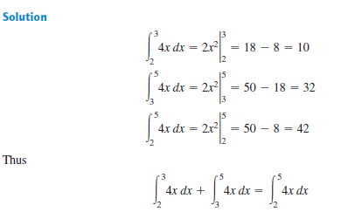

Slide 8
find
$$=$$
+
$$=$$
+
$$=$$
$$0$$
$$0$$
find

