Slide 1
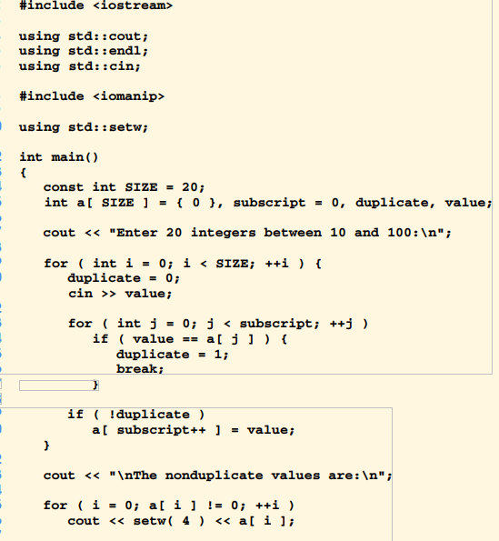
Use a single-subscripted array to solve the following problem. Read in 20 numbers, each of which is between 10 and 100,inclusive. As each number is read, print it only if it is not a duplicate of a number already read. Provide for the “worst case”in whichall 20 numbers are different. Use the smallest possible array to solve this problem.

Slide 2
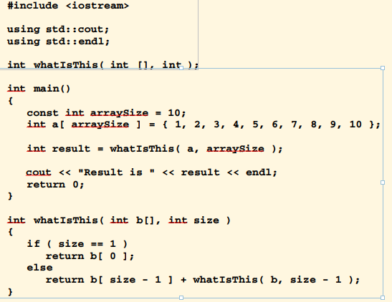

Slide 3
