Slide 1
Introduction To Oracle
Lab Session

Slide 2
Introduction to Databases
A database is a collection of Data (Information).
Examples of databases, which we use in our daily life, is an Attendance Register, Telephone Directory, Muster Rule.
Database Management System(DBMS):
A database management system is a collection of programs written to manage a database. That is, it acts as an interface between user and database.

Slide 3
ORACLE
Oracle is an Object-Relational Database Management System.

Slide 4
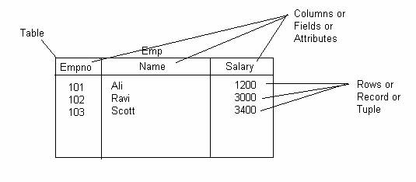
Tables Structures in DBs
A table is the data structure that holds data in a relational database.
A table is composed of rows and columns.

Slide 5
Designing Tables
Consider the following guidelines when designing your tables:
Use descriptive names for tables, columns, indexes, and clusters.
Document the meaning of each table and its columns with the COMMENT command.
Normalize each table.
Select the appropriate datatype for each column.
Define columns that allow nulls last, to conserve storage space.

Slide 6
Datatypes
Before creating a Table you have to decide what type of data each column can contain. This is known as datatype. Lets Discuss what datatypes are available in Oracle.
Datatype | Description
CHAR (size ) | Fixed-length character data of length size bytes or characters. Fixed for every row in the table maximum size is 2000 bytes per row, default size is 1 byte per row.
VARCHAR2 (size) | Variable-length character data, with maximum length size bytes or characters. Variable for each row, up to 4000 bytes per row.

Slide 7
Datatypes
Datatype | Description
NUMBER (p, s) | Variable-length numeric data. Maximum precision p and/or scale s is 38. Variable for each row. The maximum space required for a given column is 21 bytes per row.
DATE | Fixed-length date and time data, ranging from Jan. 1, 4712 B.C.E. to Dec. 31, 4712 C.E. Fixed at 7 bytes for each row in the table. Default format is a string (such as DD-MON-RR) specified by the NLS_DATE_FORMAT parameter.
TIMESTAMP (precision) | A value representing a date and time, including fractional seconds. (The exact resolution depends on the operating system clock.) Varies from 7 to 11 bytes, depending on the precision.
BLOB | Unstructured binary data. Up to 2³² - 1 bytes, or 4 gigabytes.
BFILE | Binary data stored in an external file . Up to 2³² - 1 bytes, or 4 gigabytes.

Slide 8
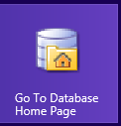
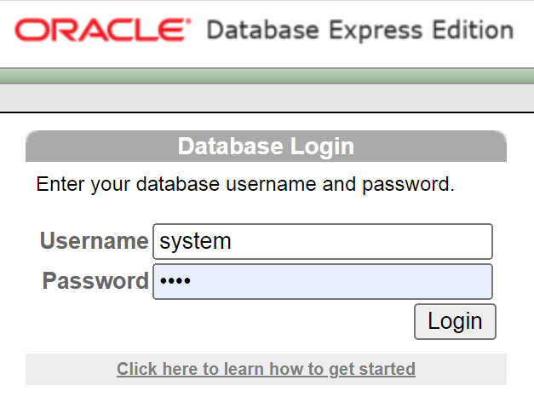
How to get start on ORACLE

Slide 9
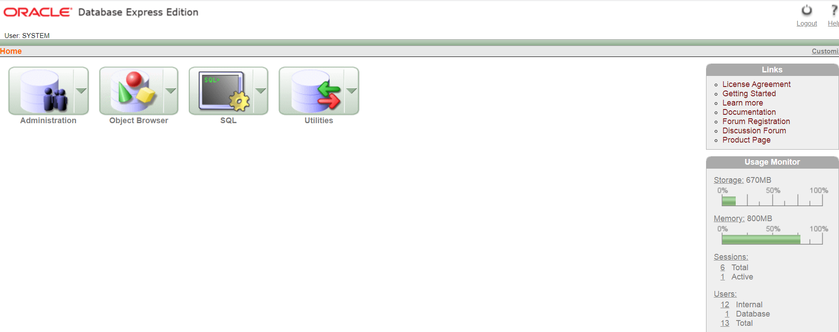
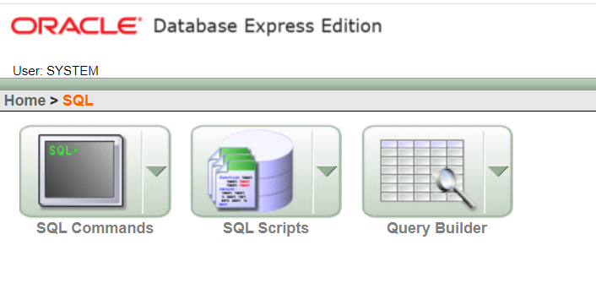

Slide 10
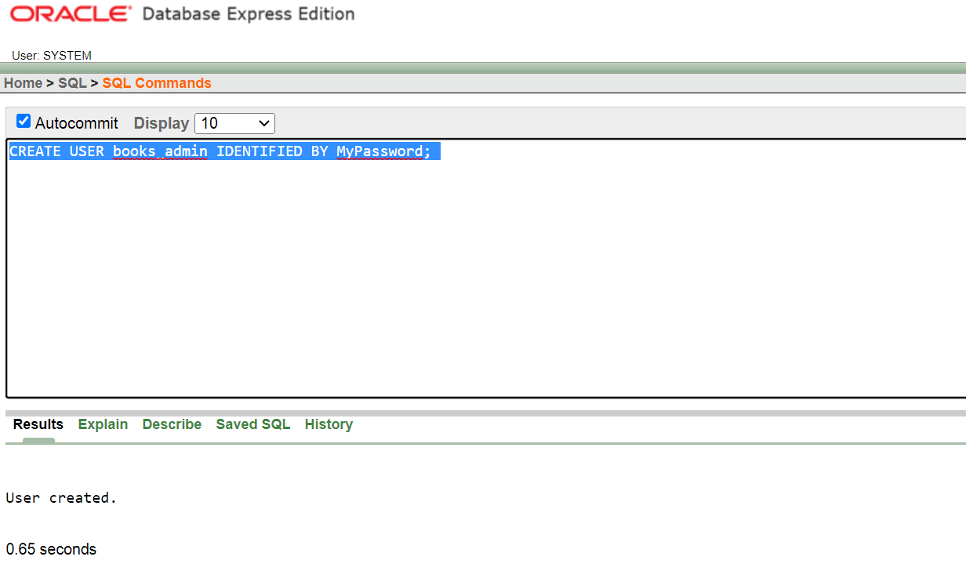
Creating a User

Slide 11
CREATE USER Samer IDENTIFIED BY s123;
Here we’re simply creating a Samer account that is IDENTIFIED or authenticated by the specified password.
Notes:
CREATE USER Samer IDENTIFIED BY s123;

Slide 12
The GRANT Statement
With our new books_admin account created, we can now begin adding privileges to the account using the GRANT statement.
GRANT CONNECT TO books_admin;
GRANT CONNECT, RESOURCE, DBA TO books_admin;

Slide 13
The REVOKE Statement
Revoke CONNECT from books_admin;
Revoke CONNECT, RESOURCE, DBA from books_admin;

Slide 14
Grant/revoke Table Privileges
GRANT SELECT, INSERT, UPDATE, DELETE ON schema.books TO books_admin;
Revoke INSERT, UPDATE ON schema.books from books_admin;

Slide 15
Change User Password
alter user <user_name> identified by <new_password>

Slide 16
Lock Account
alter user <user_name> account lock;

Slide 17
Unlock Account
alter user <user_name> account unlock;

Slide 18
Basics SQL
Select username from dba_users;
Select user from dual;
Select table_name from user_tables;
Select sysdate from dual;
Select 5*(3+2) from dual;
هذا الــ dual ممكن نستغله لإجراء عمليات حسابية، أو تعرف تاريخ اليوم.

Slide 19
Connect to HR and show its tables
First of all we have to reset its password and unlock the account:
Alter user hr identified by hr123;
Alter user hr account unlock;
Then, connect to hr:
Connect;
Enter-username : hr
Enter-Password : hr123
Then, display its tables:
Select table_name from user_tables;

Slide 20
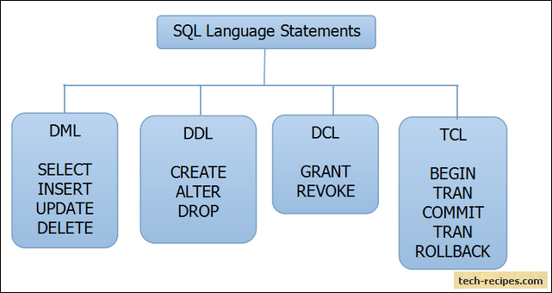
SQL
SQL is a standard language for storing, manipulating and retrieving data in databases.

Slide 21
DDL
DDL is abbreviation of Data Definition Language.
It is used to create and modify the structure of database objects in database.
CREATE – Creates objects in the database
ALTER – Alters objects of the database
DROP – Deletes objects of the database
TRUNCATE – Deletes all records from a table and resets table identity to initial value.

Slide 22
SQL CREATE TABLE Statement
The CREATE TABLE statement is used to create a new table in a database.
Simple Example:
CREATE TABLE Persons ( PersonID number(9,0), LastName varchar(255), FirstName varchar(255), Address varchar(255), City varchar(255) );
ملاحظة مهمة: أسماء الجداول و الحقول والمستخدمين هي case sensitive
Notes:
CREATE TABLE Persons(PersonID number(9,0),LastName varchar(255),FirstName varchar(255),Address varchar(255),City varchar(255));

Slide 23
SQL DROP TABLE Statement
The DROP TABLE statement is used to drop an existing table in a database.
DROP TABLE table_name;

Slide 24
SQL TRUNCATE TABLE
The TRUNCATE TABLE statement is used to delete the data inside a table, but not the table itself.
TRUNCATE TABLE table_name;

Slide 25
SQL ALTER TABLE Statement
The ALTER TABLE statement is used to delete ,add, or modify columns in an existing table.
The ALTER TABLE statement is also used to used to modify data type columns in an existing columns table.
The ALTER TABLE statement is also used to add and drop various constraints on an existing table.

Slide 26
Alter / Drop Columns
ALTER TABLE table_name DROP COLUMN column_name;
ALTER TABLE table_name DROP (column_name1, column_name2);
Ex
ALTER TABLE Persons DROP COLUMN City;
ALTER TABLE Persons DROP (FirstName, LastName);
Notes:
ALTER TABLE Persons DROP COLUMN City;
ALTER TABLE Persons DROP (FirstName, LastName);

Slide 27
Alter / Add Column
ALTER TABLE table_name ADD column_name column_definition;
ALTER TABLE table_name ADD (column_name1 column1_definition,
column_name2 column2_definition);
Ex:
ALTER TABLE Persons ADD Email varchar(255);
ALTER TABLE Persons ADD (FirstName varchar(255), LastName varchar(255));
Notes:
ALTER TABLE Persons ADD Email varchar(255);
ALTER TABLE Persons ADD (FirstName varchar(255), LastName varchar(255));

Slide 28
Alter / Rename tables and columns
ALTER TABLE table_name RENAME TO new_table_name;
ALTER TABLE table_name RENAME COLUMN column_name TO new_column_name;
Ex:
ALTER TABLE Persons RENAME TO Persons1;
ALTER TABLE Persons1 RENAME COLUMN PersonID TO ID;
Notes:
ALTER TABLE Persons RENAME TO Persons1;
ALTER TABLE Persons1 RENAME COLUMN PersonID TO ID;

Slide 29
Alter / Change Datatype

