Slide 1
Introduction to Microcontroller Lab Course (12120306)
Instructor: Dr. Diaa Salman Email: diyasalman70@gmail.com

Slide 2
Course Overview
This course is designed to equip you with essential skills and knowledge in the world of microcontrollers, a fundamental technology in modern electronics and computer engineering.
What is a Microcontroller?
A microcontroller is a compact integrated circuit that contains a processor, memory, and input/output peripherals.
They are the brains behind countless devices we encounter daily, from microwave ovens to smartphones.
Why is this Course Important?
Microcontrollers are the building blocks of embedded systems, which power devices in automotive, healthcare, robotics, and more.
Understanding microcontrollers is crucial for a career in electronics, robotics, IoT, or firmware development.

Slide 3
Course Objectives
1. Master Microcontroller Fundamentals
Understand the core concepts of microcontrollers, including architecture, memory organization, and instruction sets.
2. Develop Programming Skills
Gain proficiency in programming microcontrollers using languages like C/C++ or assembly language.
3. Hands-On Experience
Acquire practical experience with microcontroller development boards and related peripherals, such as sensors, actuators, and displays.
4. Problem-Solving Skills
Develop problem-solving abilities by designing and implementing projects that involve real-world applications.
5. Debugging and Troubleshooting
Learn to identify and resolve issues that may arise during microcontroller-based projects.

Slide 4
Importance of Microcontrollers
Microcontrollers play a pivotal role in shaping the modern world of technology. Understanding their significance is key to appreciating the relevance of this course. Here's why microcontrollers are indispensable:
1. Ubiquity in Everyday Life
Microcontrollers are embedded in countless devices around us, from household appliances like washing machines and microwave ovens to automotive systems and medical devices.
2. Automation and Control
They enable automation and precise control in industrial processes, making manufacturing more efficient and reliable.
3. Internet of Things (IoT)
Microcontrollers form the core of IoT devices, connecting physical objects to the digital world, facilitating smart homes, and enabling data-driven decision-making.
4. Robotics
In robotics, microcontrollers serve as the brains behind the machines, controlling movement, sensors, and decision-making.

Slide 5
Importance of Microcontrollers
5. Research and Innovation
Researchers and innovators use microcontrollers to prototype and develop new technologies, making them essential tools for innovation.
6. Career Opportunities
Proficiency in microcontrollers opens doors to diverse career opportunities in electronics, embedded systems, firmware development, and more.
7. Customization and Flexibility
Microcontrollers allow for customization and adaptation of electronics to specific requirements, reducing cost and complexity.
8. Sustainable Technology
Microcontroller-based solutions can contribute to energy efficiency and sustainability through optimized control and monitoring.
As technology continues to evolve, so does the importance of microcontrollers. This course will provide you with the knowledge and skills needed to harness the potential of microcontrollers and make a meaningful impact in today's technology-driven world.

Slide 6
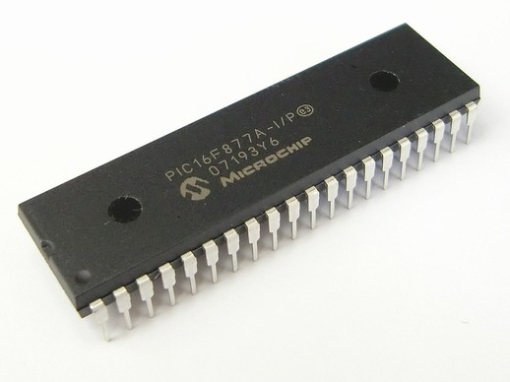
Lab Equipment and Software
PIC is an abbreviation used for Peripheral Interface Controller. PIC microcontroller is the smallest microcontroller in the world and are programmed to execute large number of operations. These were initially designed to support PDP (programmed data processor) computers, for controlling the peripheral devices.

Slide 7
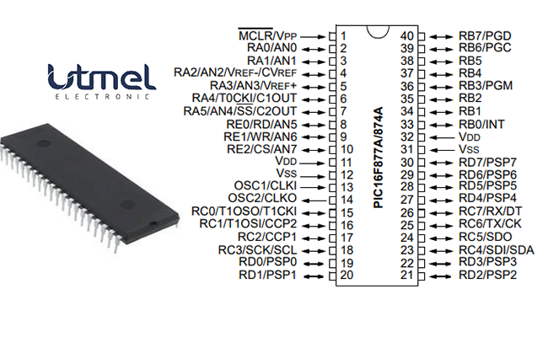
Lab Equipment and Software
PIC16F877A

Slide 8
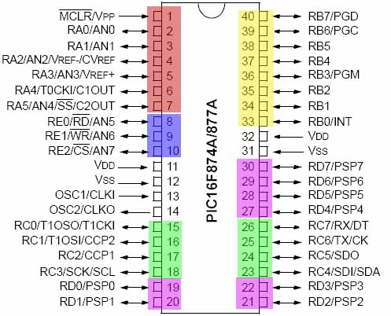
Lab Equipment and Software
PIC16F877A

Slide 9
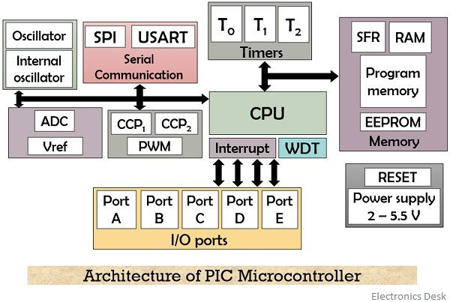
microcontroller is nothing but a combination of processor, memory and peripherals in a single chip. In a similar way PIC microcontroller consists of data RAM with some hundred bytes of ROM for storing the desired program, some I/O ports, one timer on a single chip.

Slide 10
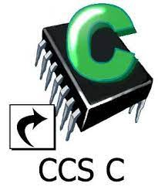
Lab Softwares
Proteus
PIC C Compiler

