Slide 1
Chapter 03
Introduction to SQL

Slide 2
Nested Subqueries
3.8

Slide 3
Set Membership
The in connective tests for set membership.
Where the set is a collection of values produced by a select clause.
The not in connective tests for the absence of set membership.
Example : Find all the courses taught in the both the Fall 2009 and Spring 2010 semesters.

Slide 4
Set Membership
Example, to find all the courses taught in the Fall 2009 semester but not in the Spring 2010 semester, we can write:

Slide 5
Set Membership
Selects the names of instructors whose names are neither “Mozart” nor “Einstein”
Find the total number of (distinct) students who have taken course sections taught by the instructor with ID 34175
select distinct name
from student, takes
where student.id = takes.id and takes.course_id in
(select course_id
from section natural join teaches
where ID=34175);

Slide 6
Set Comparison
Find the names of all instructors whose salary is greater than at least one instructor in the Biology department.
Notes:
select name ,salary
from instructor
where salary > some
(select salary
from instructor
where dept_name='Biology')
order by salary

Slide 7
Set Comparison
Find the names of all instructors that have a salary value greater than that of each instructor in the Biology department.

Slide 8
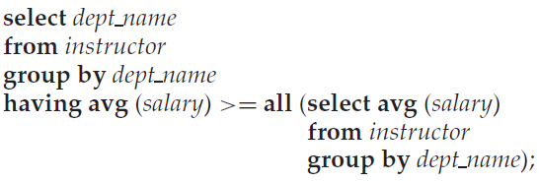
Set Comparison
Find the departments that have the highest average salary.
select dept_name, avg(salary)
from instructor
group by dept_name
having avg(salary) >= all (select dept_name,avg(salary)
from instructor
group by dept_name)

Slide 9
Test for Empty Relations
The exists construct returns the value true if the argument subquery is nonempty.
Find all courses taught in both the Fall 2009 semester and in the Spring 2010 semester.

Slide 10
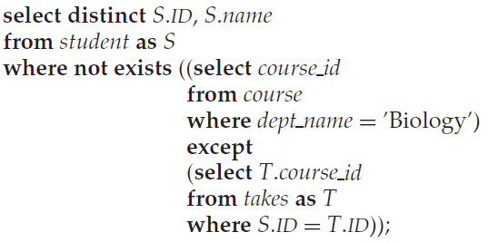
Test for Empty Relations
Find all students who have taken all courses offered in the Biology department.

Slide 11
Test for the Absence of Duplicate Tuples
The unique construct returns the value true if the argument subquery contains no duplicate tuples.
Find all courses that were offered at most once in 2009.

Slide 12
Test for the Absence of Duplicate Tuples
Find all courses that were offered at least twice in 2009.

Slide 13
Subqueries in the From Clause

Slide 14
Subqueries in the From Clause
Find the maximum across all departments of the total salary at each department.

Slide 15
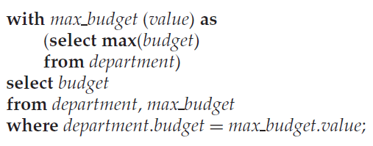
The with Clause
The with clause provides away of defining a temporary relation whose definition is available only to the query in which the with clause occurs.
Finds the departments with the maximum budget
Notes:
select dept_name, budget
from department
where budget in(
select max(budget)
from department)

Slide 16
Scalar Subqueries
scalar subqueries is a subquery that returns only one tuple containing a single attribute.
Notes:
select count(*), dept_name
from instructor
group by dept_name
select dept_name,
(select count(*)
from instructor
where department.dept_name=instructor.dept_name)
from department

