Slide 1
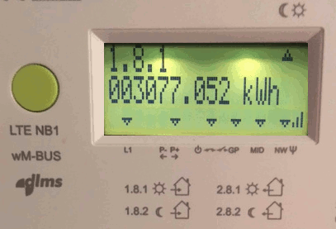
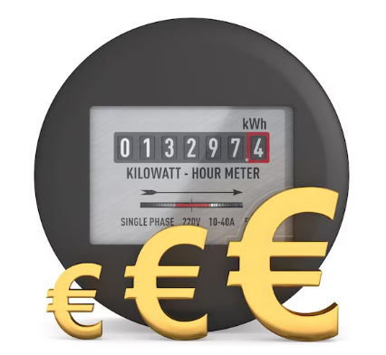

Slide 2
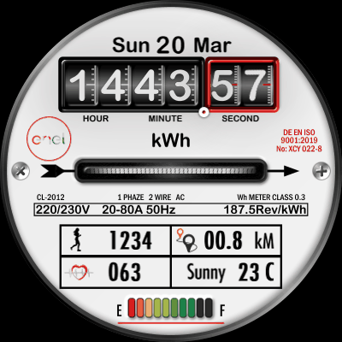
LECTURE19:
kwH Meter
Second Semester 2024/2025
Eng. Asma’ shara’b PTUK

Slide 3
Eng. Asma’ shara’b PTUK

Slide 4
Eng. Asma’ shara’b PTUK

Slide 5
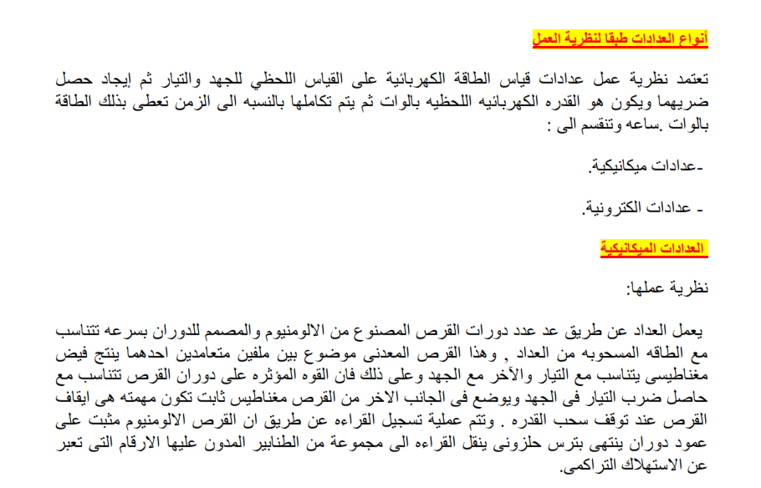
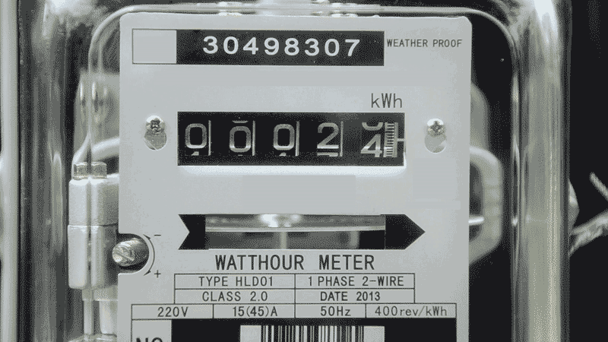
Eng. Asma’ shara’b PTUK

Slide 6
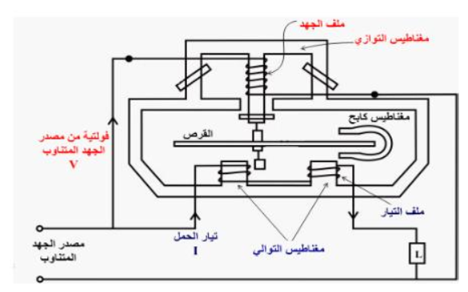
Eng. Asma’ shara’b PTUK

Slide 7
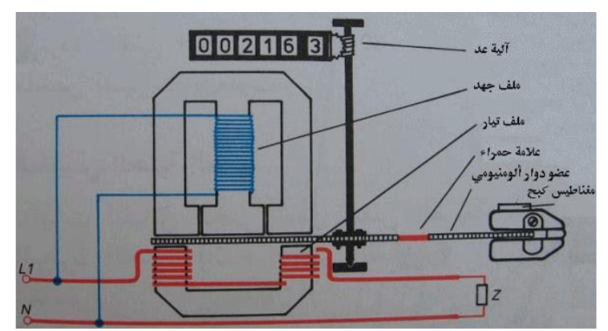
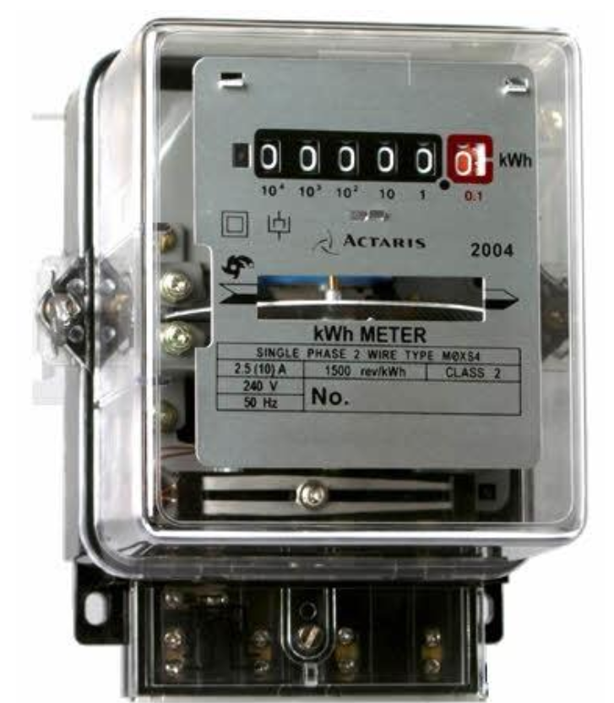
Eng. Asma’ shara’b PTUK

Slide 8
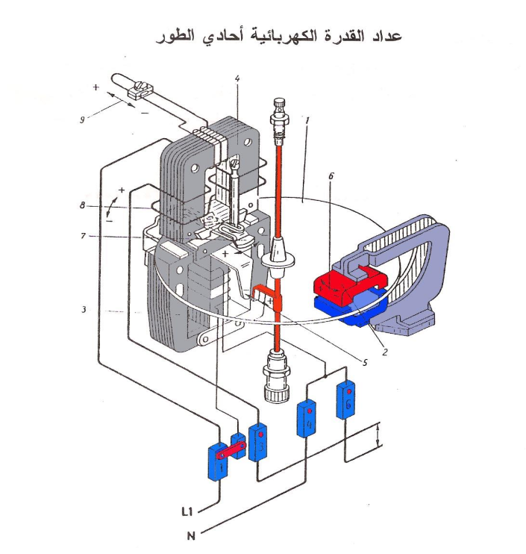
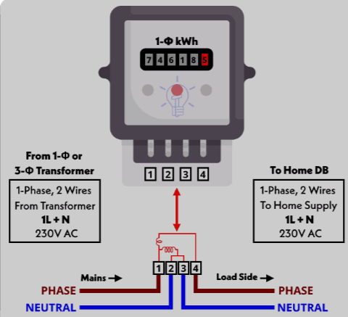
Eng. Asma’ shara’b PTUK

Slide 9
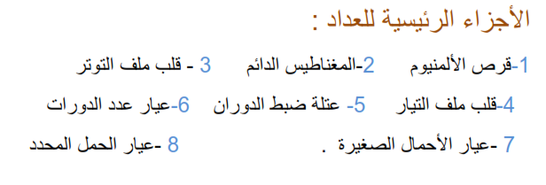
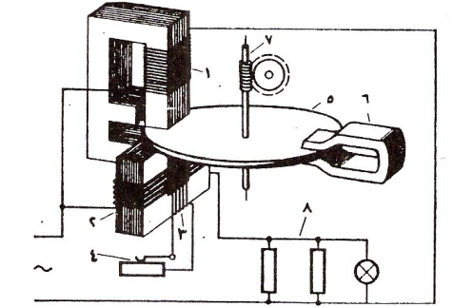
Eng. Asma’ shara’b PTUK

Slide 10
Eng. Asma’ shara’b PTUK

Slide 11
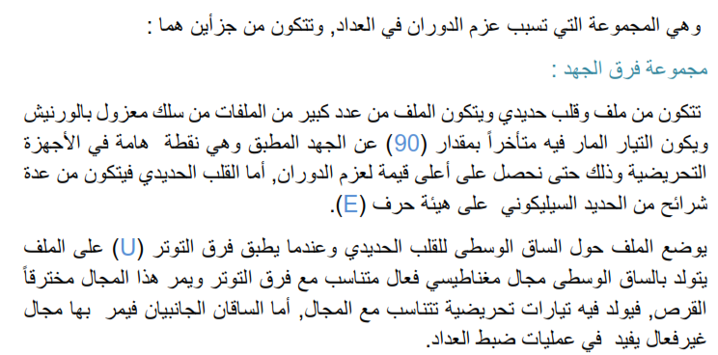
Eng. Asma’ shara’b PTUK

Slide 12
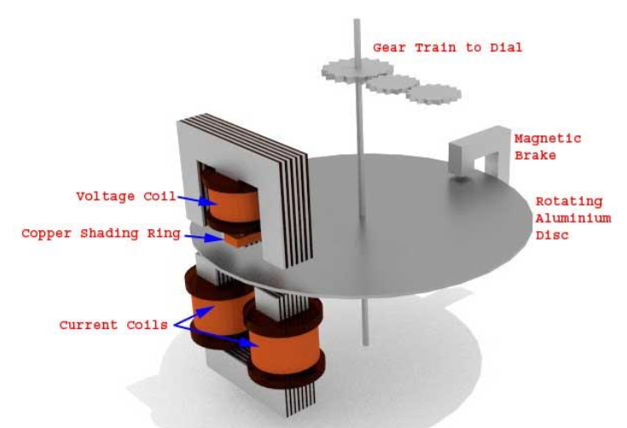
Eng. Asma’ shara’b PTUK

Slide 13
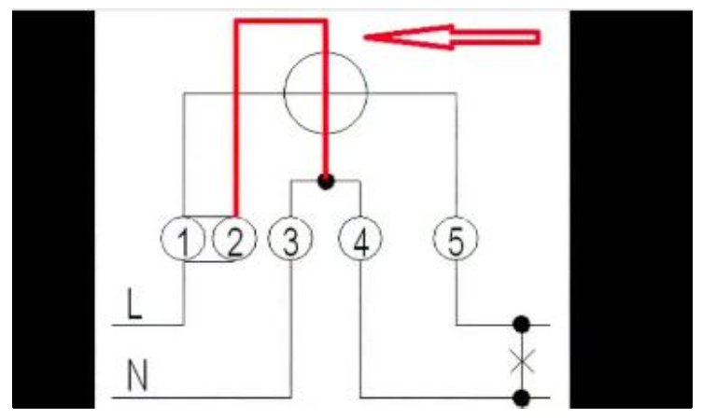
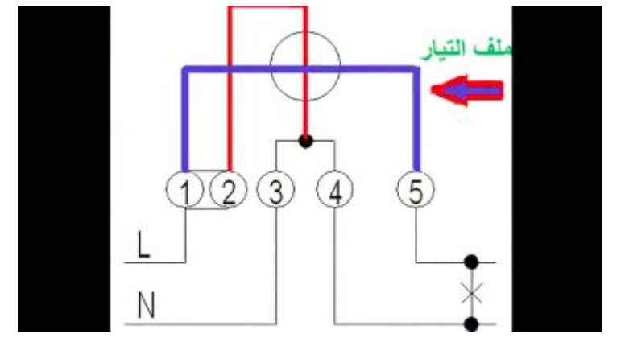
Eng. Asma’ shara’b PTUK

Slide 14
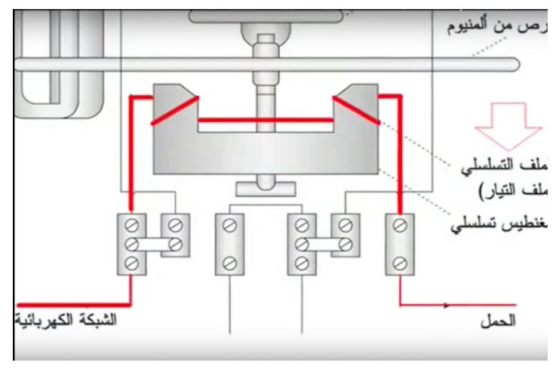
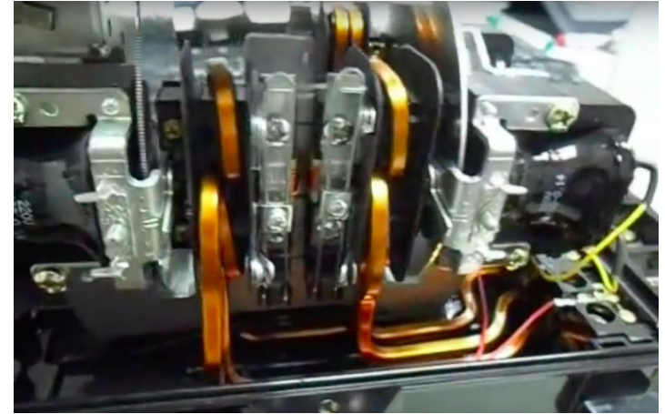
Eng. Asma’ shara’b PTUK

Slide 15
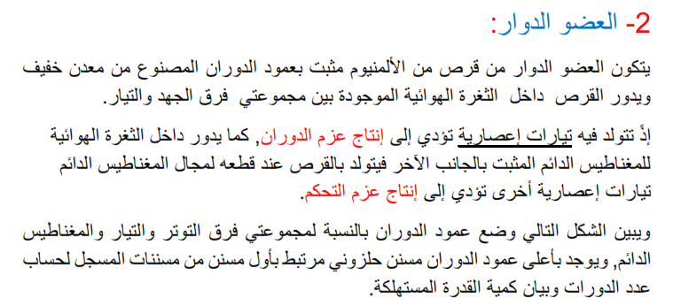
Eng. Asma’ shara’b PTUK

Slide 16
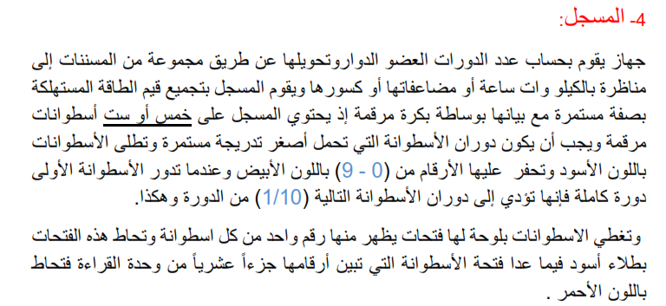
Eng. Asma’ shara’b PTUK

Slide 17
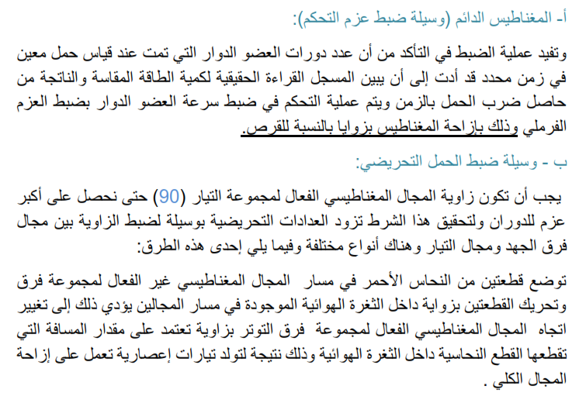
Eng. Asma’ shara’b PTUK

Slide 18
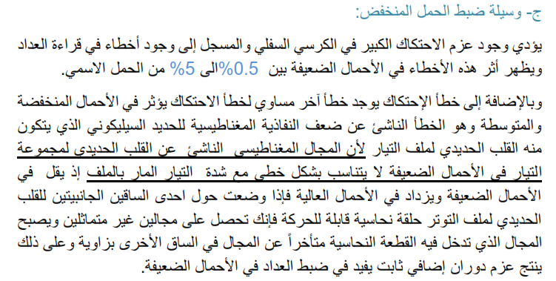
Eng. Asma’ shara’b PTUK

Slide 19
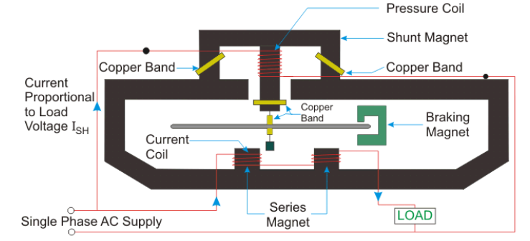
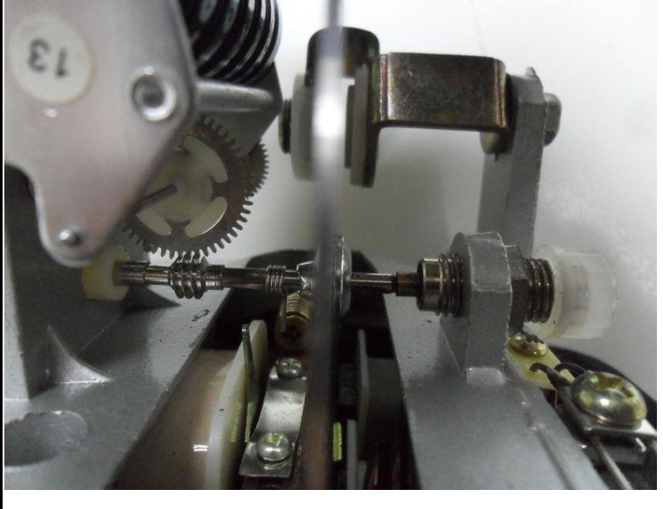
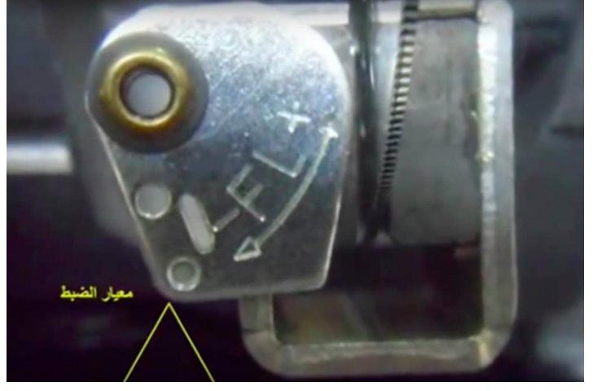
Eng. Asma’ shara’b PTUK

Slide 20
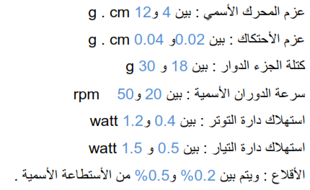
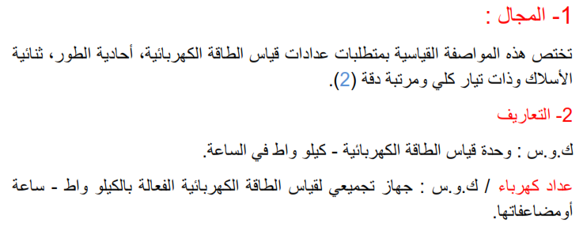
Eng. Asma’ shara’b PTUK

Slide 21
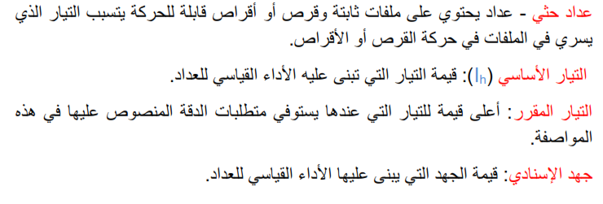
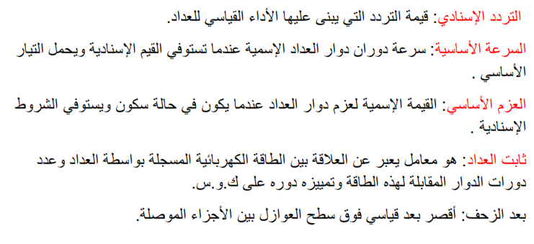
Eng. Asma’ shara’b PTUK

Slide 22
Eng. Asma’ shara’b PTUK

Slide 23
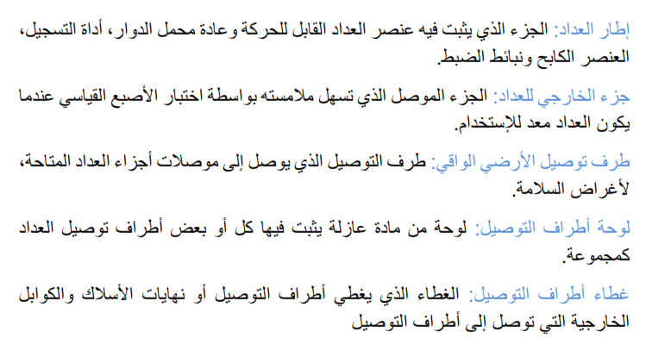
Eng. Asma’ shara’b PTUK

Slide 24
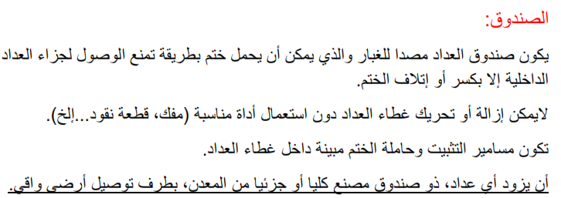
Eng. Asma’ shara’b PTUK

Slide 25
Eng. Asma’ shara’b PTUK

Slide 26
Eng. Asma’ shara’b PTUK

Slide 27
Eng. Asma’ shara’b PTUK

Slide 28
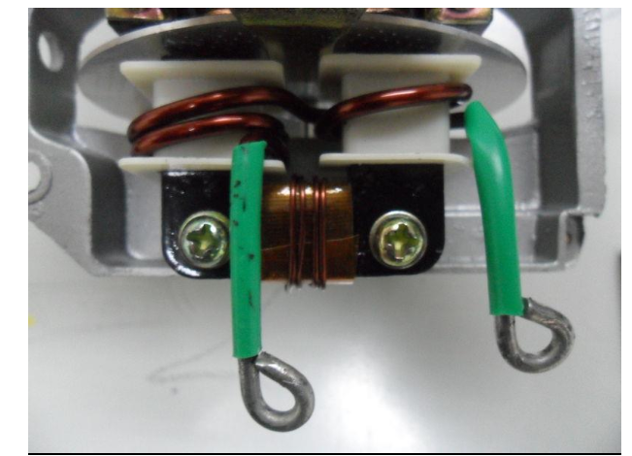
Eng. Asma’ shara’b PTUK

Slide 29
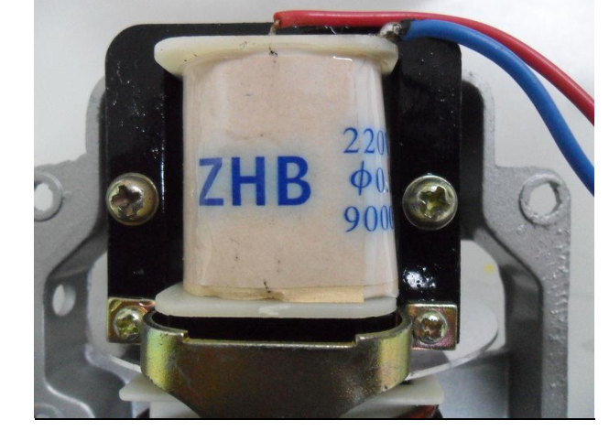
Eng. Asma’ shara’b PTUK

Slide 30
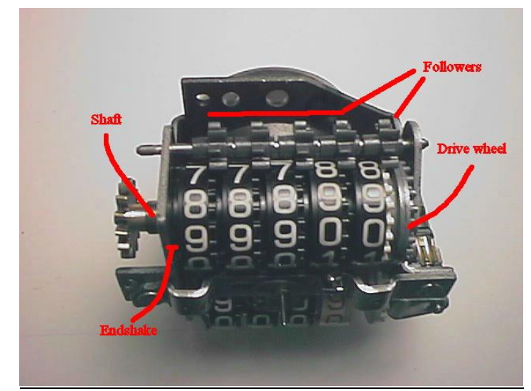
Eng. Asma’ shara’b PTUK

Slide 31
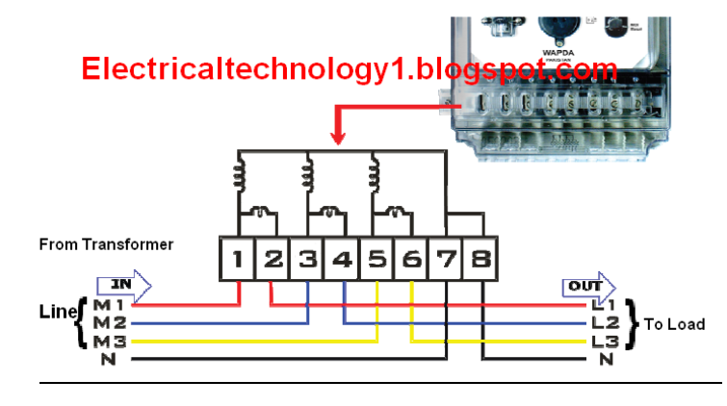
Eng. Asma’ shara’b PTUK

Slide 32
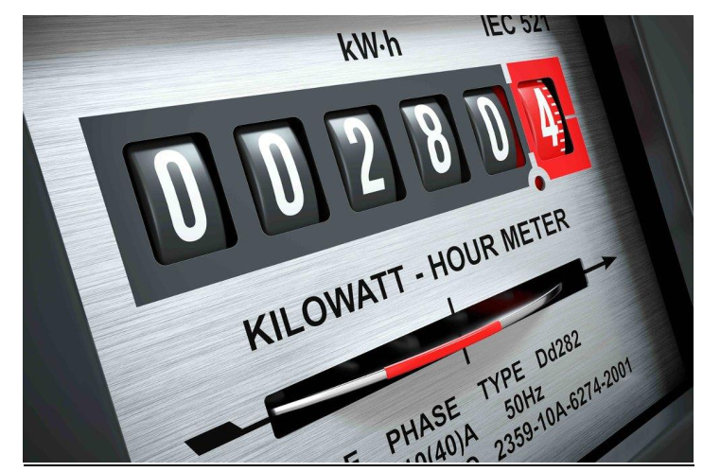
Eng. Asma’ shara’b PTUK

Slide 33
Eng. Asma’ shara’b PTUK

Slide 34
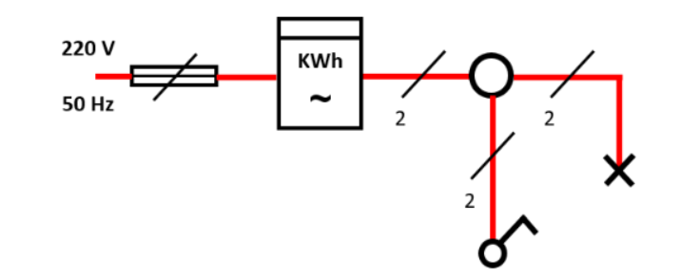
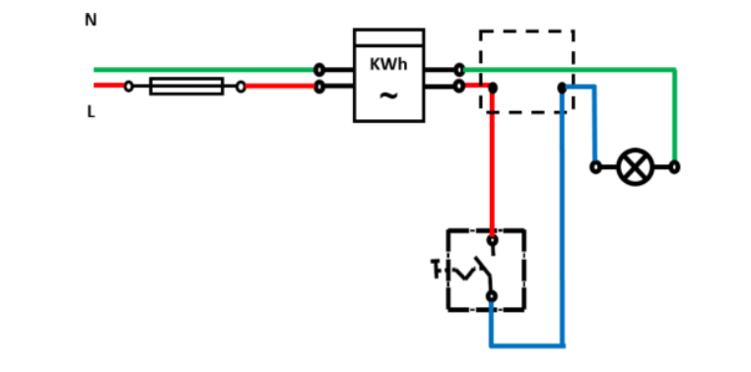
Eng. Asma’ shara’b PTUK

Slide 35
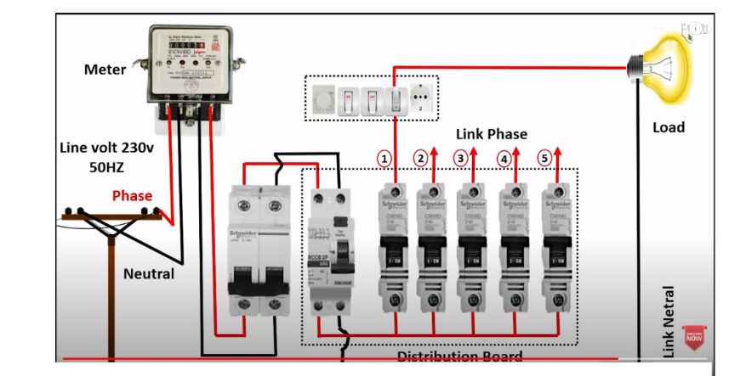
Eng. Asma’ shara’b PTUK

Slide 36
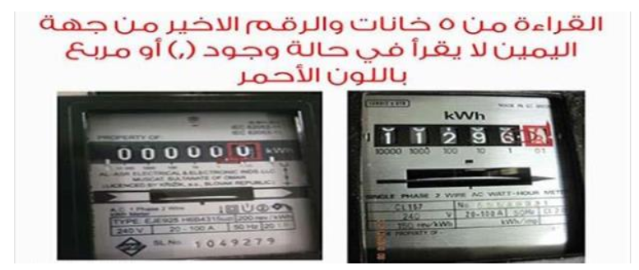
Eng. Asma’ shara’b PTUK

Slide 37
Eng. Asma’ shara’b PTUK

Slide 38
Eng. Asma’ shara’b PTUK

Slide 39
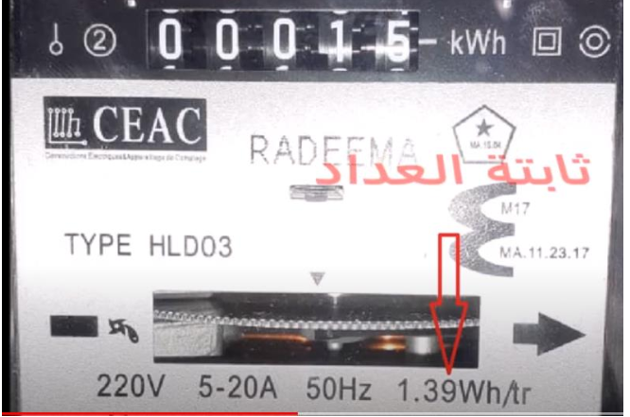
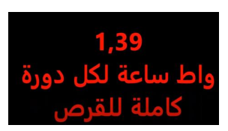
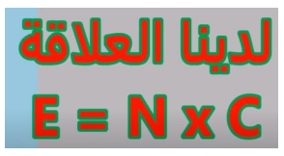
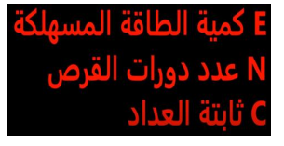
Eng. Asma’ shara’b PTUK

Slide 40
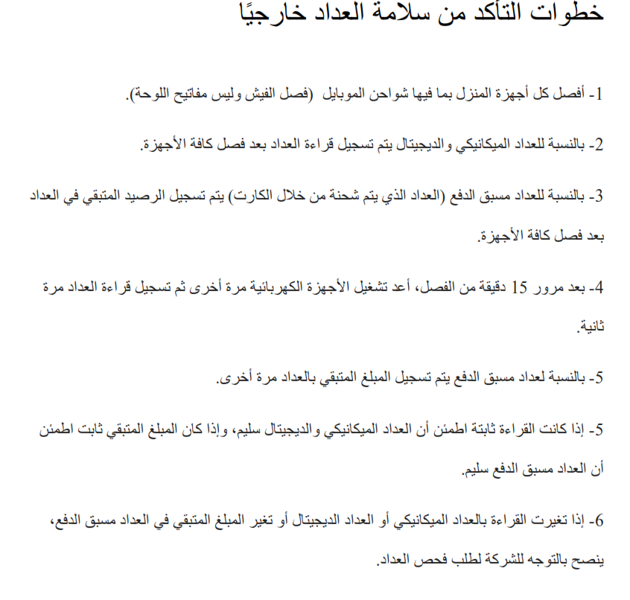
Eng. Asma’ shara’b PTUK

