Slide 3
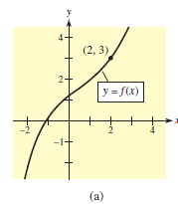
$\underset{x→2^{+}}{a) lim}{f(x)}$=3 and $\lim_{x→2^{−}}{f(x)}$=3
So $\lim_{x→2}{f(x)}$=3
$$f\left(2\right)=3$$

Slide 4
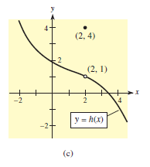
$\underset{x→2^{+}}{b) lim}{g(x)}$=-1 and $\lim_{x→2^{−}}{g(x)}$=-1
So $\lim_{x→2}{g(x)}$=-1
$$g\left(2\right) is undefined$$
$\underset{x→2^{+}}{c) lim}{h(x)}$=1 and $\lim_{x→2^{−}}{h(x)}$=1
So $\lim_{x→2}{h(x)}$=1
$h\left(2\right)=4$

Slide 8
$\underset{x→2^{+}}{a) lim}{f(x)}$=$∞$and $\lim_{x→2^{−}}{f(x)}$= $∞$
So $\lim_{x→2}{f(x)}$= $∞ ,\lim_{x→2}{f(x)} doesnt exist.\left(DNE\right)$
$\underset{x→2^{+}}{b) lim}{f(x)}$=$∞$and $\lim_{x→2^{−}}{f(x)}$= $−∞$
$$,\lim_{x→2}{f(x)}doesnt exist\left(DNE\right)$$
$\underset{x→2^{+}}{c) lim}{f(x)}$=$3$and $\lim_{x→2^{−}}{f(x)}$= $0,$
$\lim_{x→2}{f(x)} doesnt exist \left(DNE\right)$ because $: \lim_{x→2^{+}}{f(x)}≠\lim_{x→2^{−}}{f(x)}$

Slide 9
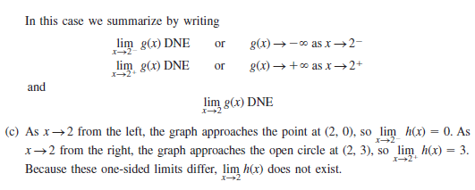

Slide 13
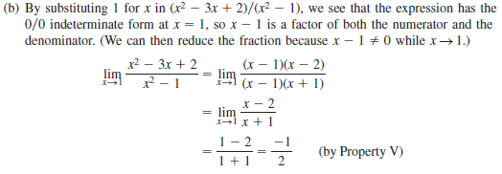

Slide 14
$\lim_{x→−1}{\frac{3x+2}{x−1}}=\frac{3\left(−1\right)+2}{−1−1}=\frac{−3+2}{−2}=\frac{−1}{−2}=\frac{1}{2}$
$\lim_{x→2}{{(2x^{2}−5)}^{3}={(2{\left(2\right)}^{2}−5)}^{3}={(2∗4_5)}^{3}}={(8−5)}^{3}=3^{3}=27$
examples

Slide 15
$\lim_{x→2}{\frac{3x^{2}+3x−18}{x−2}=\frac{3\left(2^{2}\right)+3\left(2\right)−18}{2−2}=\frac{12+6_18}{0}}=\frac{0}{0}$
في هذه الحالة نحلل البسط
$$\lim_{x→2}{\frac{3x^{2}+3x−18}{x−2}=}\lim_{x→2}{\frac{3(x^{2}+x−6)}{x−2}=\lim_{x→2}{\frac{3(x+3)(x−2)}{x−2}=\lim_{x→2}{3(x+3)=}}}15$$
$\lim_{x→−2}{\frac{x^{2}−4}{x+2}=\frac{4−4}{−2+2}=\frac{0}{0}}$
$$\lim_{x→−2}{\frac{x^{2}−4}{x+2}=}\lim_{x→−2}{\frac{(x−2)(x+2)}{x+2}=}\lim_{x→−2}\left(x−2\right)=−2−2=−4$$

Slide 16
$\lim_{x→2}{\frac{x^{3}−8}{x−2}}=\frac{0}{0}$
$$\lim_{x→2}{\frac{x^{3}−8}{x−2}}=\lim_{x→2}{\frac{x^{3}−2^{3}}{x−2}}=\lim_{x→2}{\frac{{(x−2)(x}^{2}+2x+4)}{x−2}=}\lim_{x→2}{x^{2}+2x+4=4+4+4=12}$$
$\lim_{x→−3}{\frac{x^{3}+27}{x+3}}=$
$$\underset{x→−3}{=lim}{\frac{x^{3}+3^{3}}{x+3}}=\lim_{x→−3}{\frac{{(x+3)(x}^{2}−3x+9)}{x+3}=}$$
$$\lim_{x→−3}{x^{2}−3x+9=9+9+9=27}$$
$\lim_{x→1}{\frac{x^{2}−x}{x^{2}+x−2}=\lim_{x→1}{\frac{x(x−1)}{(x−1)(x+2)}=\lim_{x→1}{\frac{x}{x+2}=\frac{1}{1+2}=\frac{1}{3}}}}$

