Slide 1
Managerial Economics

Slide 2
Managerial Economics can be defined as amalgamation of economic theory with business practices so as to ease decision-making and future planning by management.
Amalgamation: the action, process, or result of combining or uniting

Slide 3
Managerial Economics assists the managers of a firm in a rational solution of obstacles faced in the firm’s activities. It makes use of economic theory and concepts. It helps in formulating logical managerial decisions.

Slide 4
Managerial Economics is a science dealing with effective use of scarce resources. It guides the managers in taking decisions relating to the firm’s customers, competitors, suppliers as well as relating to the internal functioning of a firm.

Slide 5
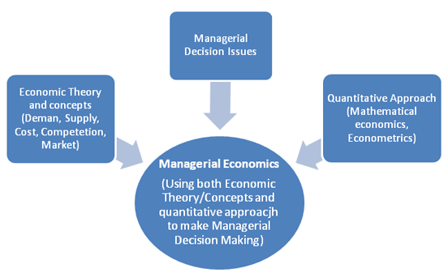

Slide 6
Scope of Managerial Economics
the fact of scarcity of resources gives rise to three fundamental questions-
What to produce?
what goods and services should be produced and in what amount/quantities. The managers use demand theory for deciding this.
How to produce?
how to produce goods and services. The firm has now to choose among different alternative techniques of production. It has to make decision regarding purchase of raw materials, capital equipments, manpower, etc.
For whom to produce?
who should consume and claim the goods and services produced by the firm. The firm, for instance, must decide which is it’s niche market-domestic or foreign? It must segment the market. It must conduct a thorough analysis of market structure and thus take price and output decisions depending upon the type of market.
To answer these questions, a firm makes use of
managerial economics principles.

Slide 7
https://www.bing.com/videos/riverview/relatedvideo?&q=circular+flow+of+economic+activity+with+four+sectors&&mid=6F109268ACC6C0289C6E6F109268ACC6C0289C6E&&FORM=VRDGAR

Slide 8
The role of managerial economist can be summarized as follows:
A managerial economist helps the management by using his analytical skills and highly developed techniques in solving complex issues of successful decision-making and future advanced planning.

Slide 9
The role of managerial economist can be summarized as follows:
He/She studies the economic patterns at macro-level and analysis it’s significance to the specific firm he is working in.
They have to consistently examine the probabilities of transforming an ever-changing economic environment into profitable business avenues.

Slide 10
He/She assists the business planning process of a firm.
He/She also carries cost-benefit analysis.

Slide 12
They assists the management in the decisions pertaining to internal functioning of a firm such as changes in price, investment plans, type of goods/services to be produced, inputs to be used, techniques of production to be employed, expansion/ contraction of firm, allocation of capital, location of new plants, quantity of output to be produced, replacement of plant equipment, sales forecasting, inventory forecasting, etc.

Slide 13
In addition, a managerial economist has to analyze changes in macro- economic indicators such as national income, population, business cycles, and their possible effect on the firm’s functioning.
He/She is also involved in advicing the management on public relations, foreign exchange, and trade. He guides the firm on the likely impact of changes in monetary and fiscal policy on the firm’s functioning.
He/She also makes an economic analysis of the firms in competition. He has to collect economic data and examine all crucial information about the environment in which the firm operates.

Slide 14
Gross Domestic Product (GDP):
Effect on Business: GDP is a broad measure of a country's economic activity. High GDP growth usually indicates a healthy economy with increased consumer spending. Businesses may thrive in such an environment as demand for goods and services rises.

Slide 15
Inflation Rate:
Effect on Business: Moderate inflation is generally considered healthy for economic growth. However, high inflation can erode purchasing power, affecting consumer spending. Businesses may face challenges in cost management and pricing strategies during periods of high inflation.

Slide 16
The most significant function of a managerial economist is to conduct a detailed research on industrial market.
In order to perform all these roles, a managerial economist has to conduct an elaborate statistical analysis.
He must be vigilant and must have ability to cope up with the pressures.
He also provides management with economic information such as tax rates, competitor’s price and product, etc. They give their valuable advice to government authorities as well.
At times, a managerial economist has to prepare speeches (or reports) for top management.

