Slide 1
law of Demand
market / the circular flow of economic activity /demand
demand and supply are the driving force behind the market economy
Demand: is the ability and willingness to buy a specific quantity of good at a specific price in a given period of time
Law of Demand : the quantity of a good demanded in a given time periode increases as its priece falls .
Demand schedual ... a table of quantities that a consumer is willing and able to buy at the prevailing price in a given time period.

Slide 2
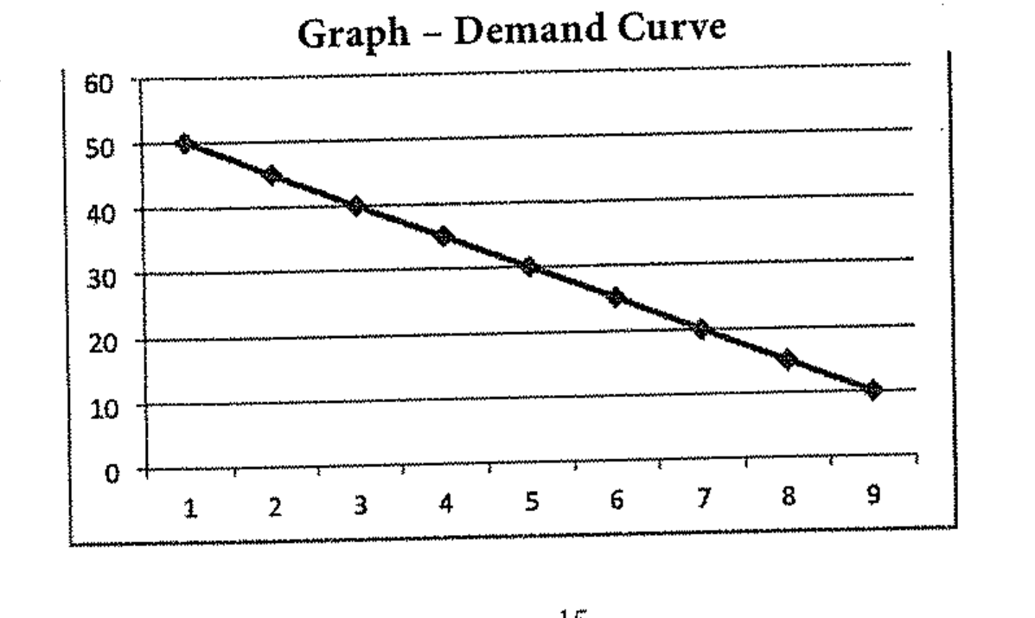
price of coke | quantity demanded
50 | 1
45 | 2
40 | 3
35 | 5
30 | 7
25 | 9
20 | 12
15 | 15
10 | 20
a curve indicating the total quantity of a product that all consumers are willing and able to purchase at the prevailing price level holding the prices of related goods, income, and other variables as constant.

Slide 3
This inverse relationship between price and quantity is called as the law of demand .
The movement on the demand curve is due to the changes in the prices, the higher the price the smaller the quantity demanded and the lower the price, the higher the quantity demanded

Slide 4
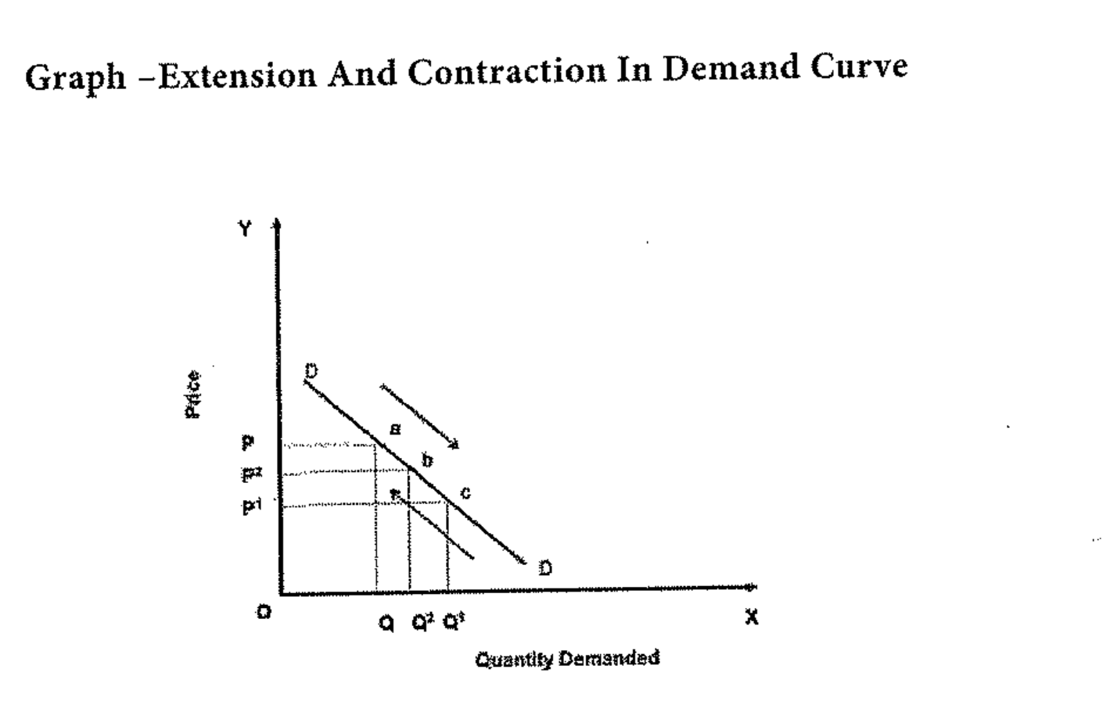
movments on the demand curve
price is affecting the quantity demanded
The movemment on a Demand curve takes place (extension of contraction) due to price rise or fall

Slide 5
Determenants of Demand
1- price of the good
2- price of related goods
3- Consumers income
4- Taste, Prefrences, and habit
5- population
6- mony circulation
7- weather condition
8- value of mony
9- advertisment and salesmanship
10- consumer price expectation
11- government policy (Taxation)
complementary good
substitute good
12- credit facilities
13-multiplicity of uses of goods

Slide 6
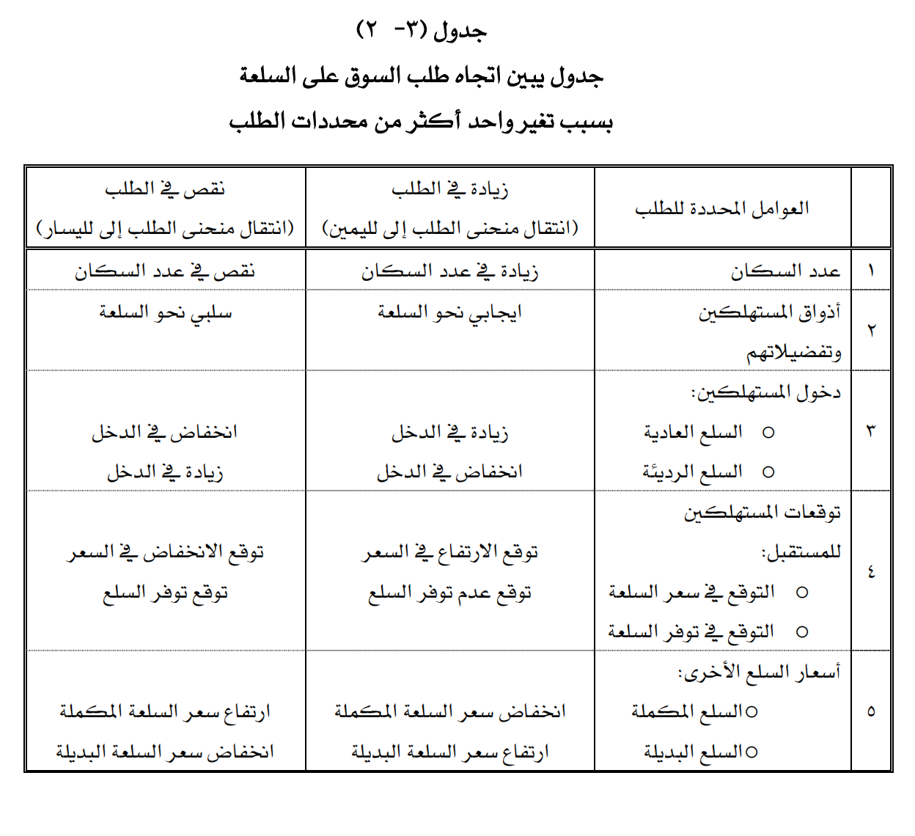

Slide 7
Types of Demand
- Direct and indirect demand
- Dirived demand and autonomas demand
- Durable and non durable
- Firm and Industry demand
- Total market and market segmant demand
-Short run and Long run demand
- Joint demand and composit demand
- Price demand, income demand and cross demand

Slide 8
price demand : the ability and willingness to buy specific quentities of a good at the prevailing price in a given time period.
income demand: the ability and willingness to buy a commodity at the available income in a given period of time
market demand : the total quantity of agood or service that people are willing and able to buy at prevailing price in a given time period. it is the sum of individual demands.
cross demand : the ability and willingness to buy a commodity or service at the prevailing price of the related commodity, substitues or complementary products.
Exceptional demand curve: the demand curve slopes from left to right upward if deposit the increase in price the commodity, people tend to buy more due to reasons like fear of shortage or it may be an

Slide 9
exceptional demand curve
(cases when the law of demand becomes ineffective)
1- Giffen goods/ Giffen Paradox
people spend more of their income on inferior good (سلعة رديئة) like potato and less of their income on meat.
2- conspicuous consumption / veblen effect
rich people consume some very high price good like diamonds because its prestige value, so when price of these goods falls, the consumers think that the prestige value comes down, so the quantity demanded falls as its prices falls.
3- conspicuous necessities
things that we consume inspite of thier high prices just because they are Necessary in our modern life, like cars and refrigeators .
4- Ignorance
consumers sometimes buy more of the good at a higher price / he thinks its better quality
5-Emergencise
during emargencies like war, people behave in an upnormal war, so they purchase more even at a higher prices. and during a de pression, fall in prices is not a sufficient condition for them to demand more if they are needed.

Slide 10
6- future changes in prices
when the prices are rising, househodes tend to purchase large quantity (apprehention or fear)
7-change in fashion
achange in fashion or taste affects the market of a good, example: digital camera versas manual camera
8- demonestration effect low income grorp imitate the consumption patter of the high income groups

