Slide 1
Chapter 7
Capacitor and Inductor

Slide 2
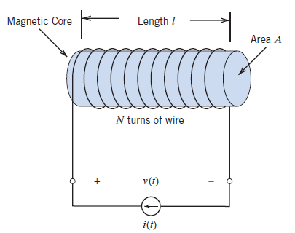
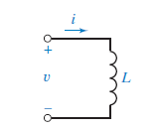
Ideal Inductor
Inductor is used to store energy in electromagnetic field

Slide 3
Inductor is storing energy through charging process
and returning energy through discharging process
Over total cycle ideal inductor never dissipate energy

Slide 5
Energy stored in the Inductor is computed by

Slide 6
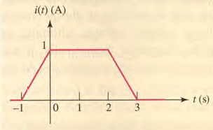
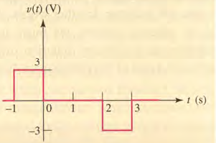
Solution

Slide 7
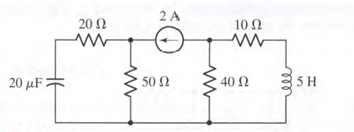
Find total energy stored in the following circuit

