Slide 1
Chapter 18
Circuit analysis methods and techniques

Slide 2
Transform a voltage source in series with an impedance to a current source in parallel with an impedance for simplification or vice versa.
Source Transformation

Slide 3
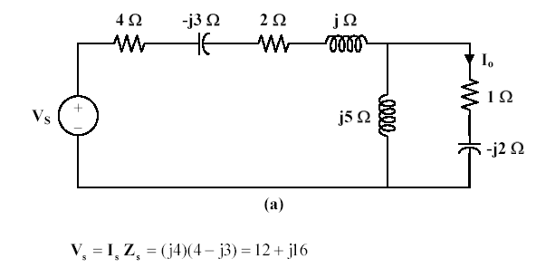
Source Transformation
Calculate the current I_{o}
If we transform the current source to a voltage source, we obtain the circuit shown in Fig. (a).

Slide 4
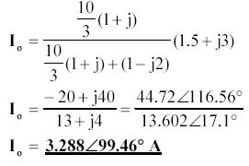
Source Transformation
Calculate the current I_{o}

Slide 5
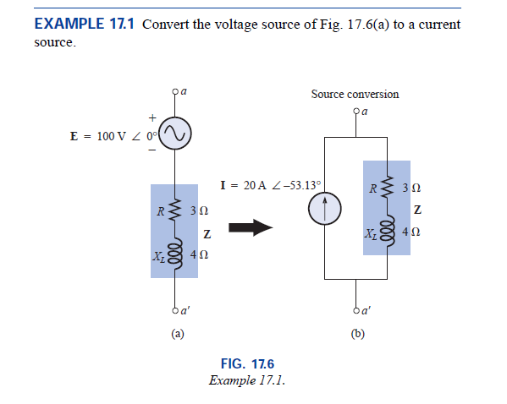

Slide 6
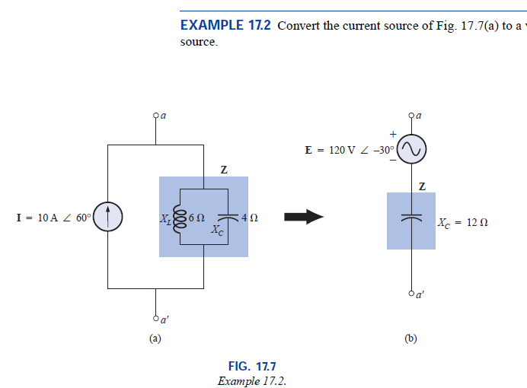
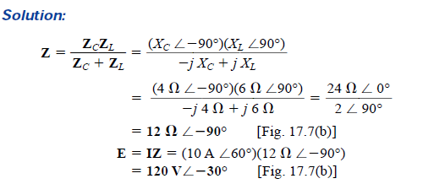

Slide 7
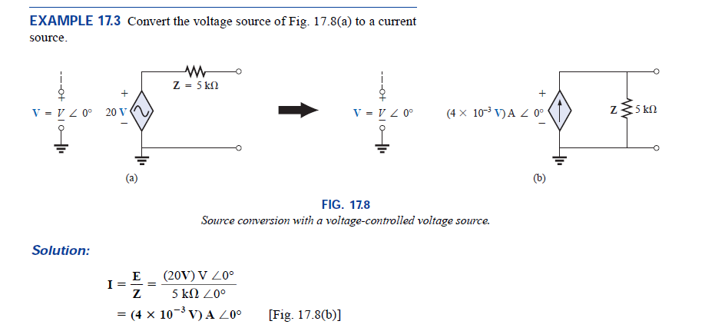

Slide 8
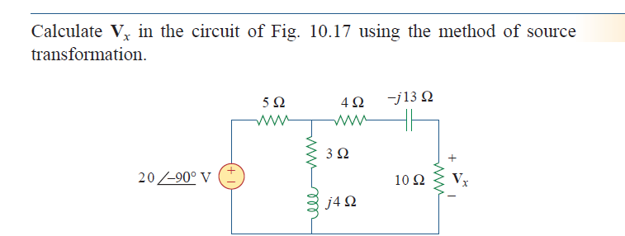
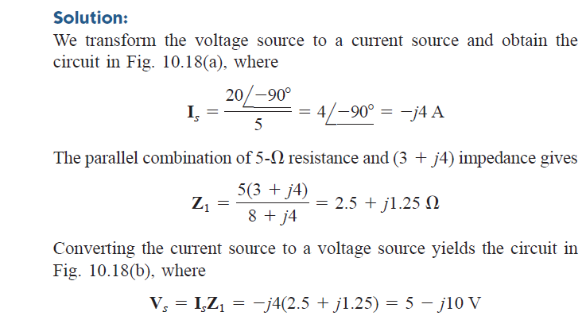

Slide 10
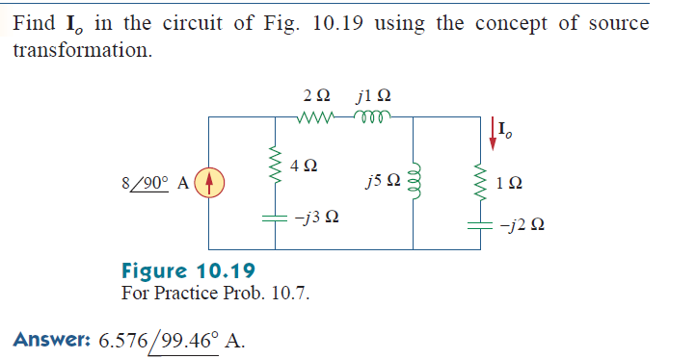

Slide 11
Superposition Theorem
The superposition theorem eliminates the need for solving simultaneous linear equations by considering the effect on each source independently.
To consider the effects of each source we remove the remaining sources; by setting the voltage sources to zero (short-circuit representation) and current sources to zero (open-circuit representation).
The current through, or voltage across, a portion of the network produced by each source is then added algebraically to find the total solution for current or voltage.
The only variation in applying the superposition theorem to AC networks with independent sources is that we will be working with impedances and phasors instead of just resistors and real numbers.
The superposition theorem is not applicable to power effects in AC networks since we are still dealing with a nonlinear relationship.
It can be applied to networks with sources of different frequencies only if the total response for each frequency is found independently and the results are expanded in a nonsinusoidal expression .
One of the most frequent applications of the superposition theorem is to electronic systems in which the DC and AC analyses are treated separately and the total solution is the sum of the two.

Slide 12
Superposition Theorem
When a circuit has sources operating at different frequencies,
The separate phasor circuit for each frequency must be solved independently, and
The total response is the sum of time-domain responses of all the individual phasor circuits.

Slide 13
a) All sources except DC 5-V set to zero
Superposition Theorem
Superposition Theorem applies to AC circuits as well.
For sources having different frequencies, the total response must be obtained by adding individual responses in time domain.
Superposition Technique for sources having different frequencies
b) All sources except 10cos(10t) set to zero

Slide 14
c) All sources except 2 sin 5t set to zero
Superposition Theorem
Exp. 10.6 Superposition Technique for sources having different frequencies
v_{o}= v₁+ v₂+ v₃

Slide 15
Superposition Theorem

Slide 16
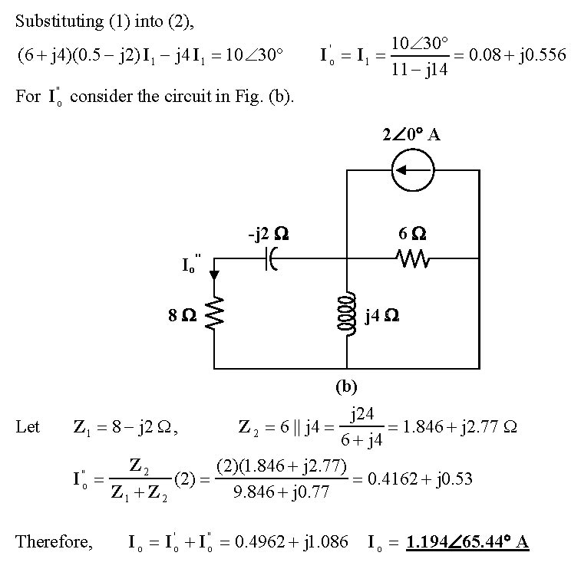
Superposition Theorem

Slide 17
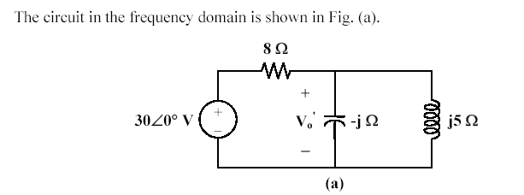
Superposition Theorem
Superposition Technique for sources having different Frequencies

Slide 18
Superposition Theorem

Slide 19
Superposition Theorem

Slide 20
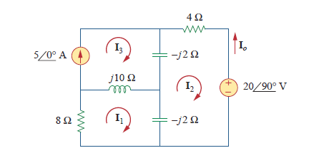
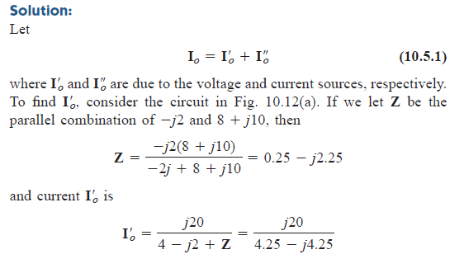
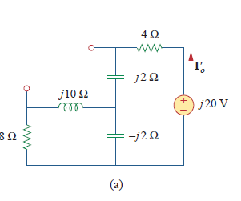

Slide 21
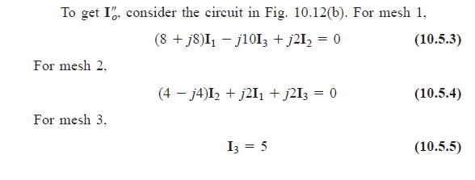
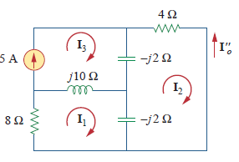
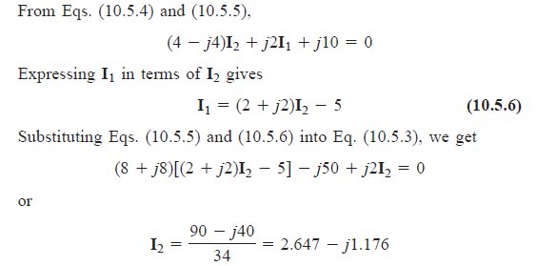

Slide 22
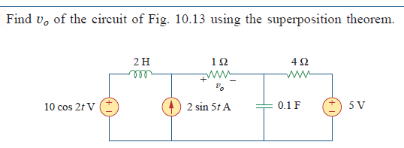

Slide 23
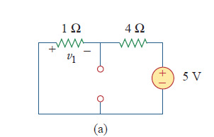
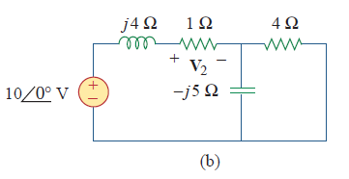
To find v1

Slide 24
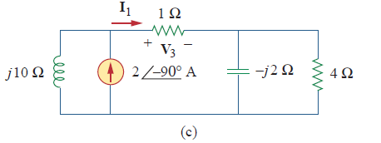

Slide 25
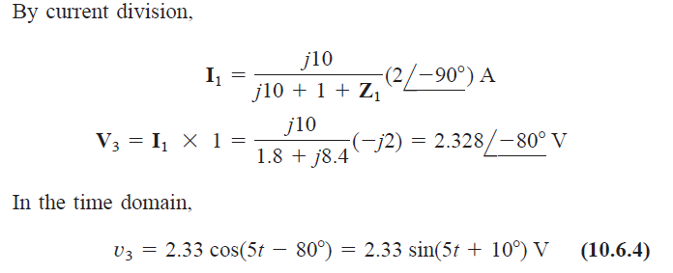
Overall v

Slide 26
