Slide 1
Production Analysis

Slide 2
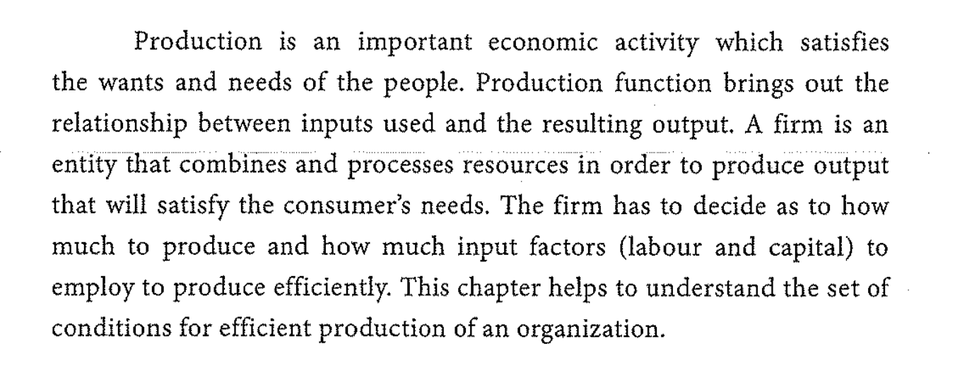
The importnace of production analysis
satisfies the wants and needs of people.
inputs (resources -labour- capital ---------Production process --------------------- outputs
efficiently

Slide 3
Factors of Production
(Inputs ) Resources used to produce goods and services
Land : fixed and permenant, it is productive only with capital and labor
Labor : the supply of labor is inelastic , and it is differs in productivity and it can be improved.
Capital : elastic, man made = that is created, designed, or influenced by human beings.
Organizaion (Entrepreneurship) : plans, organizes, supervises, and controls the bussiness activities, - takes risks -

Slide 4
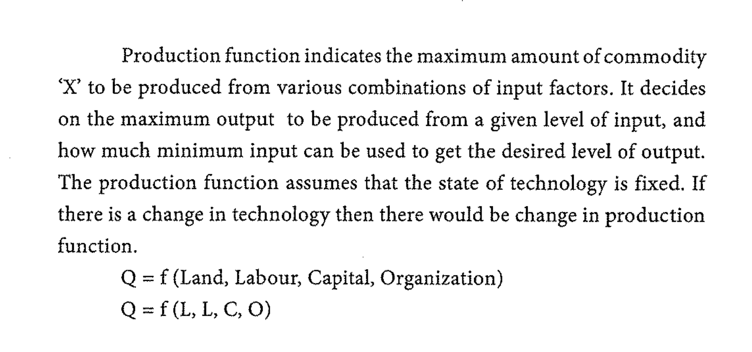
Production Function
how much of X to be produced, given a specific amounts of inputs
how much minimum inputs can be used to produce certain level of output
-technology is fixed
-efficintly

Slide 5
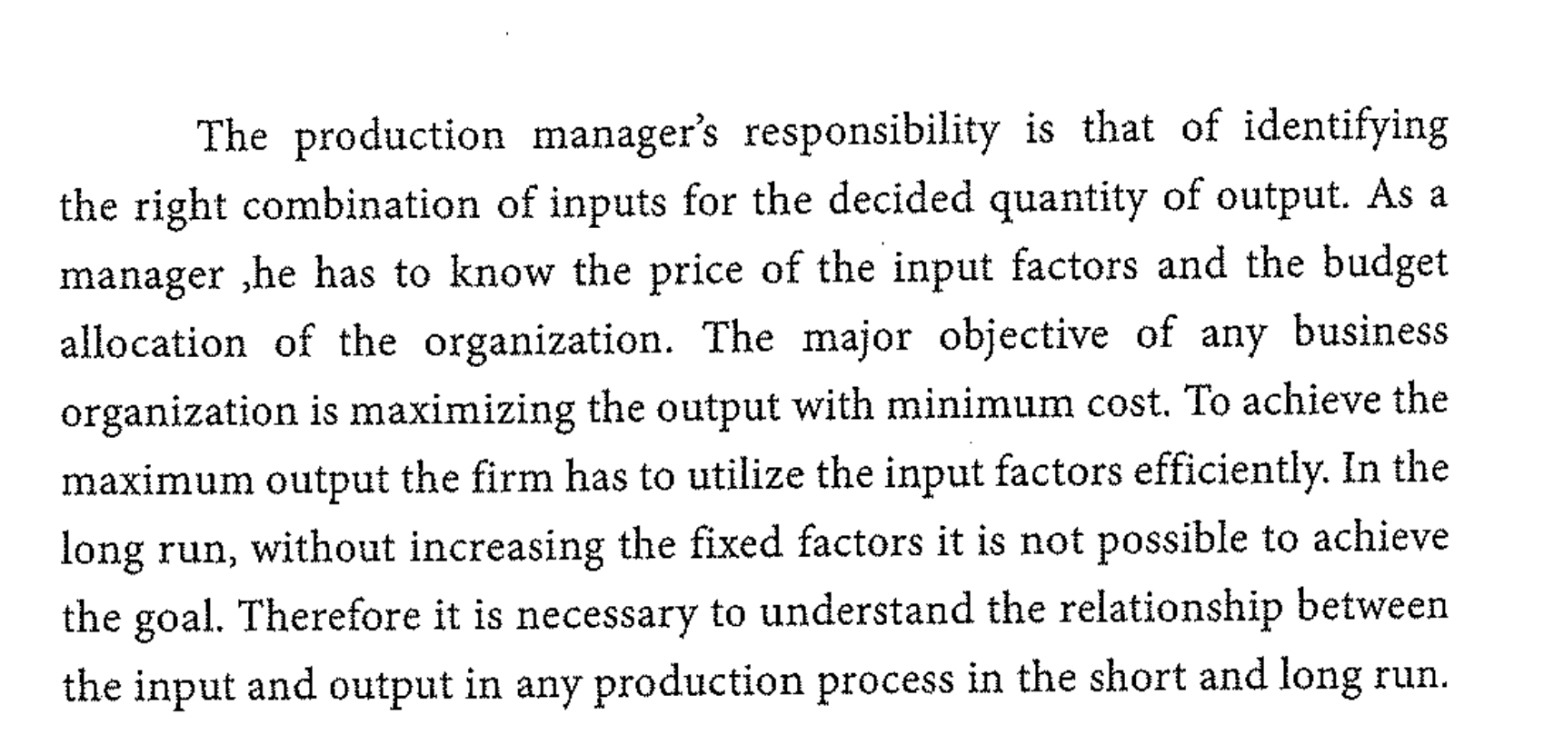
Entrepreneure : decisions, prices of inputs, minimizing costs, maximum amount ot output, working efficienty to achieve the targets.
the relationship between the inputs and outputs in any production process in the short run and long run

Slide 7
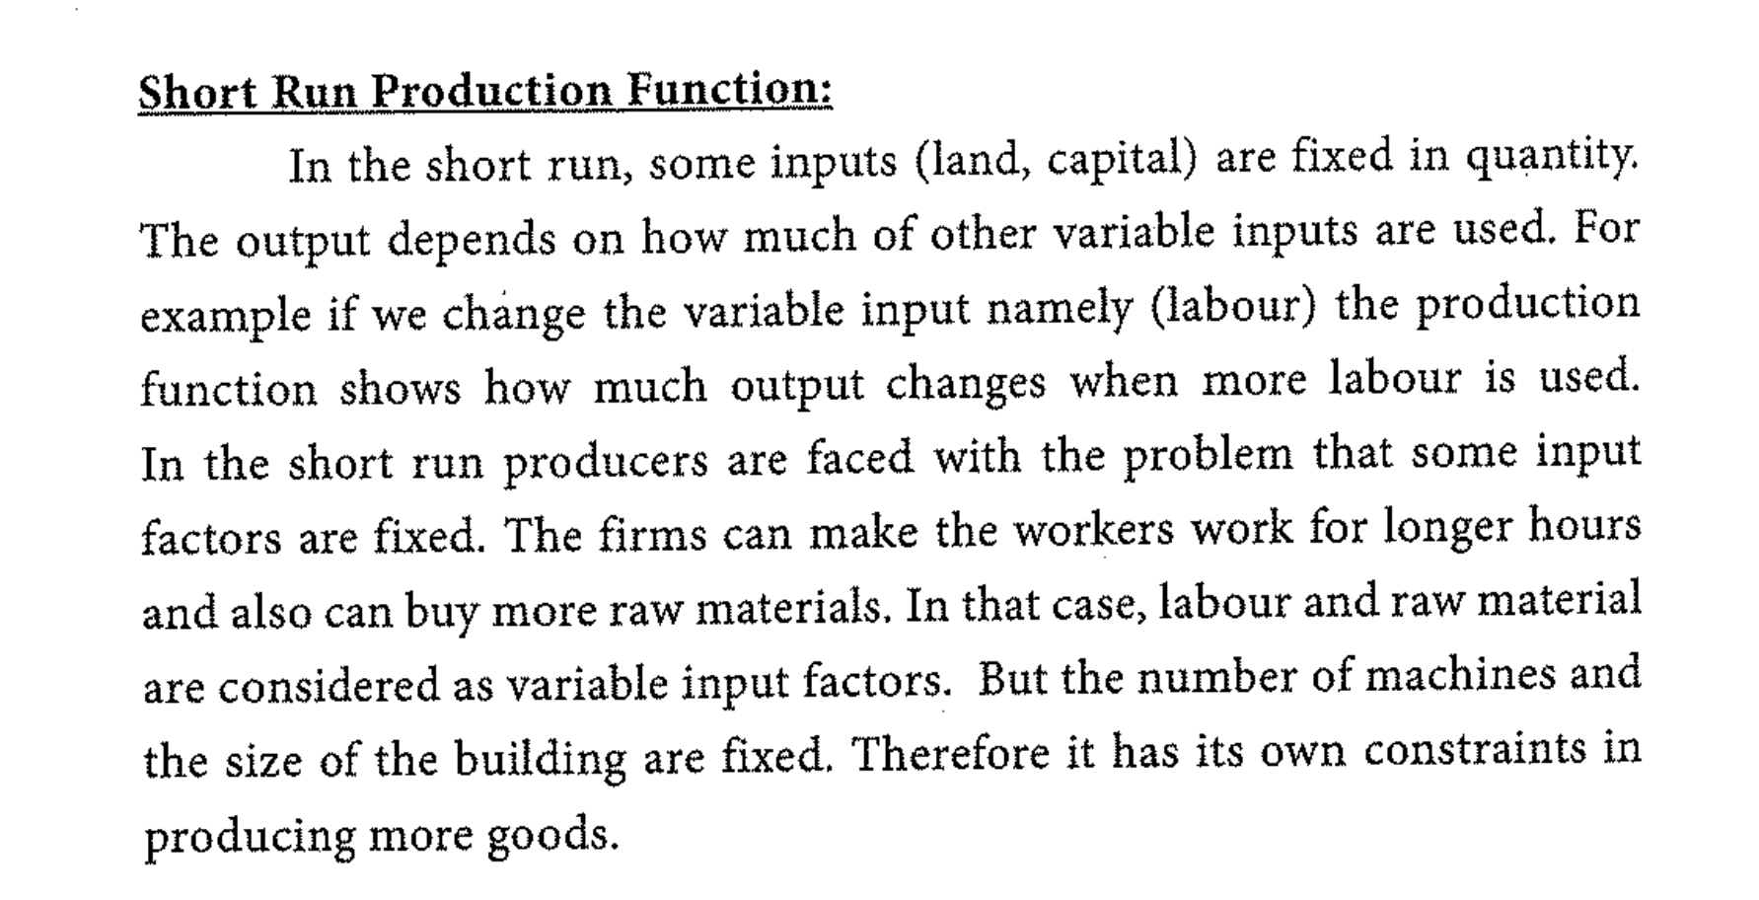

Slide 9
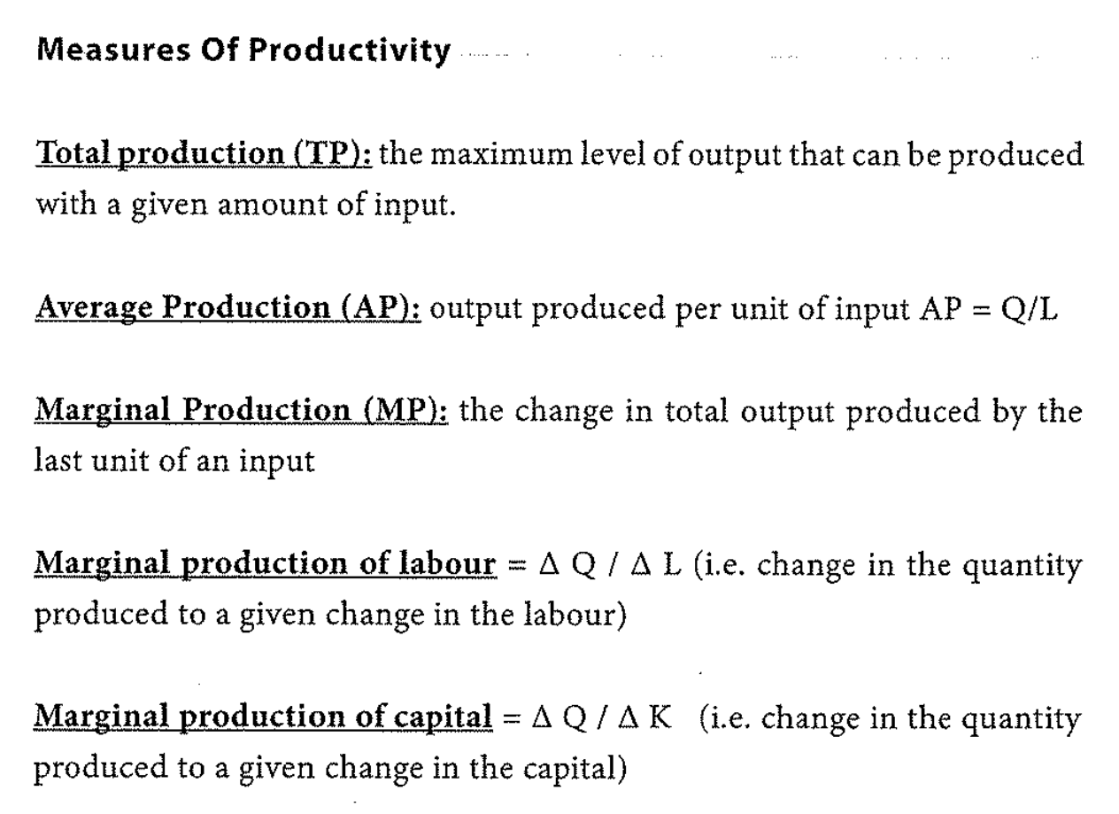

Slide 10
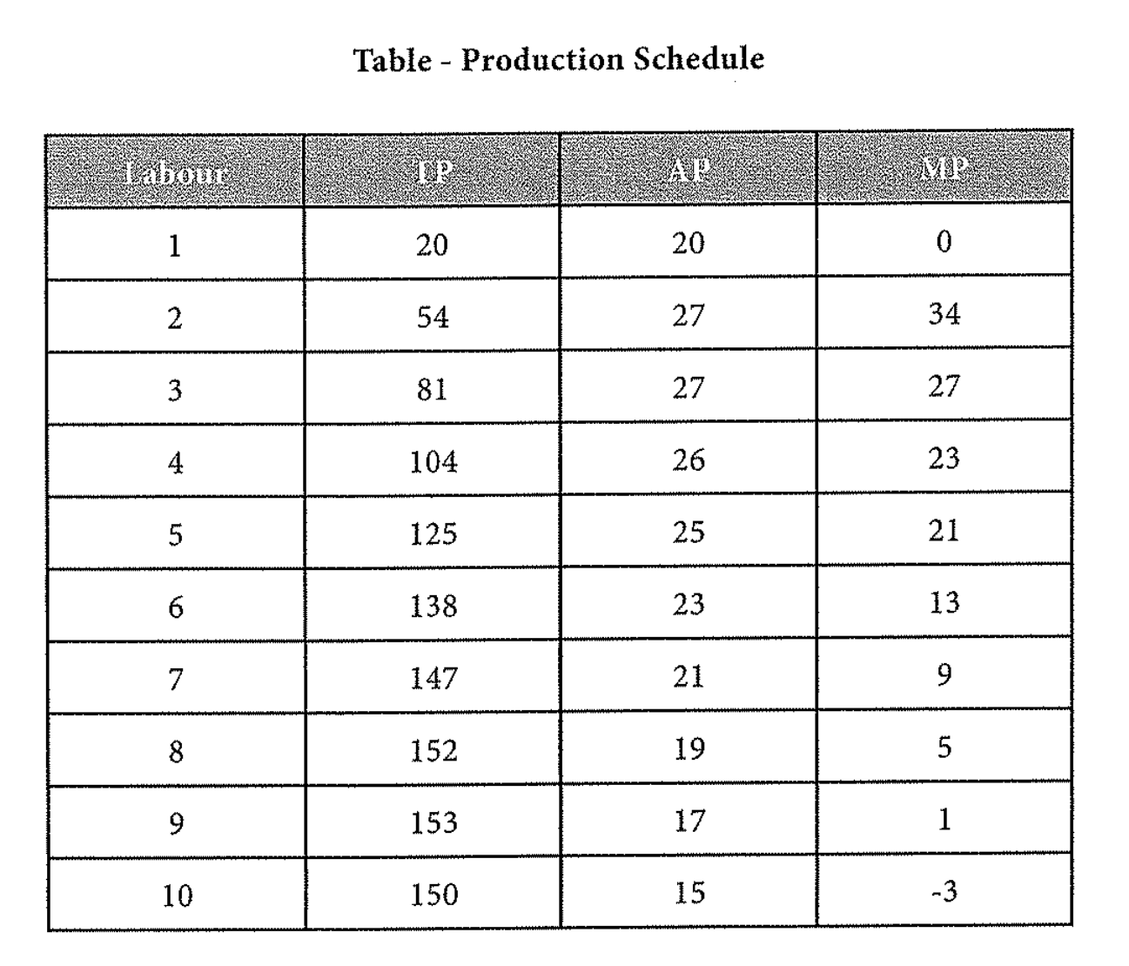

Slide 11
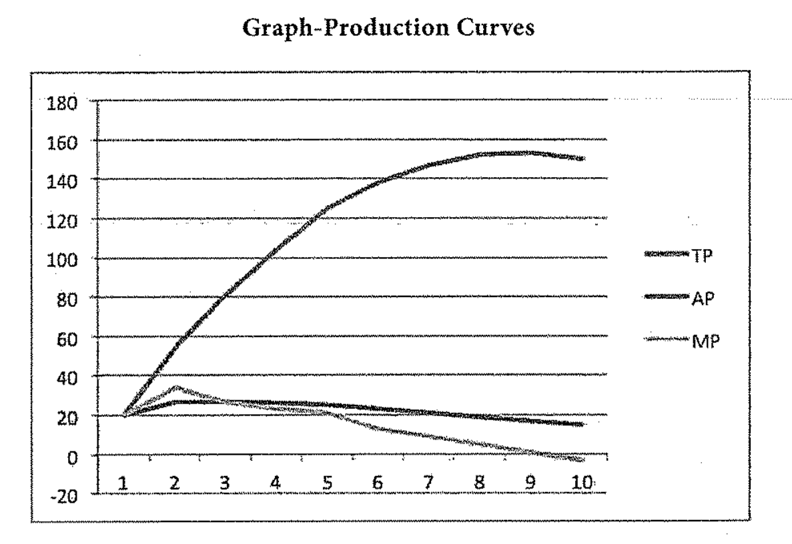

Slide 14
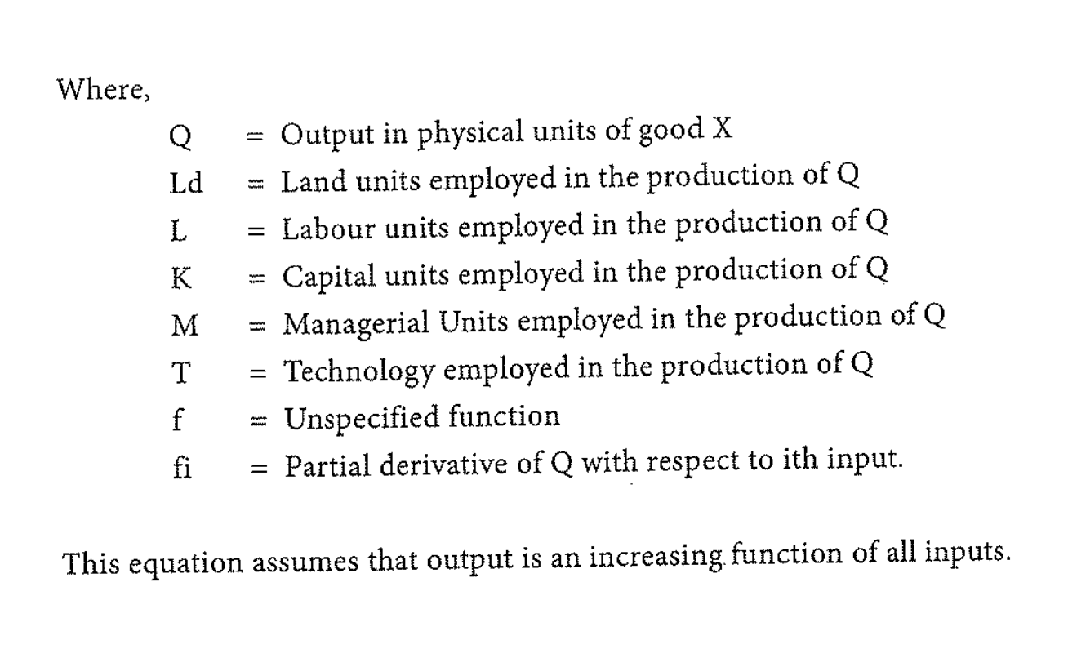

Slide 15
2 sewing machains .... 2 tailors ..... a firm can produce maximum 14 curtains (ستائر) .... first shift is from 9:00 --5:00
so the firm hired another 2 tailors for a second sheft ...so the production increases to 28 units.
then the firm hired another 2 more labour to assest those people ... and the production increased to 30 units.
when the firm appoints 2 more people (now we have 8 labour) there will not be any change of thier production becouse thier marginal productivity is Zero. there is no addition in the total production.

Slide 16
there is a limit for output from a fixed input factors.
in the long run purchase of one more sewing machine alone will help the firm to increase the production more than 30 units

Slide 18
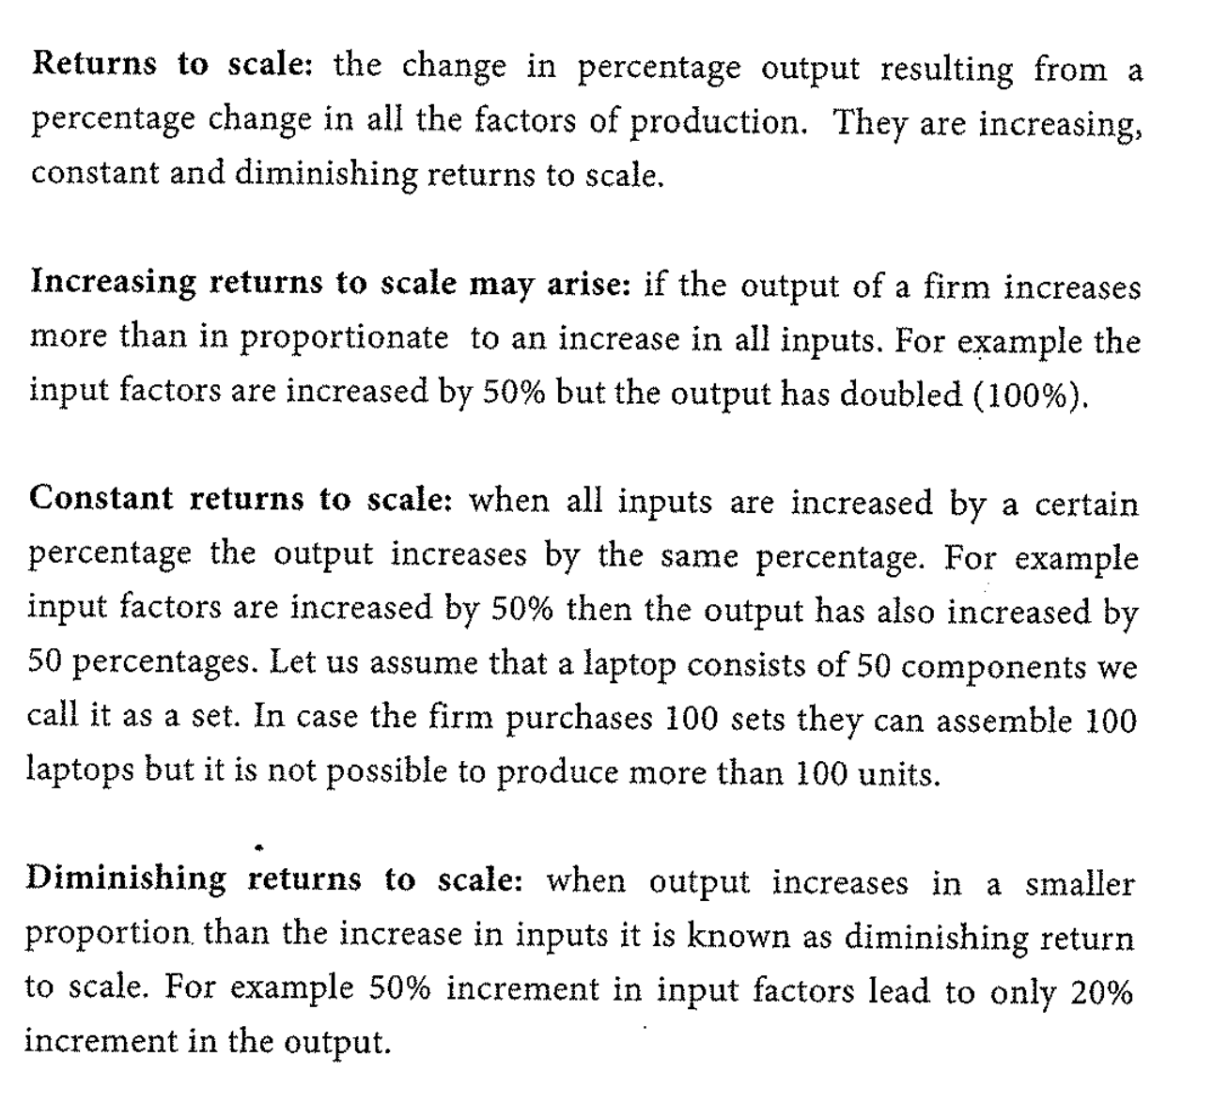

Slide 19
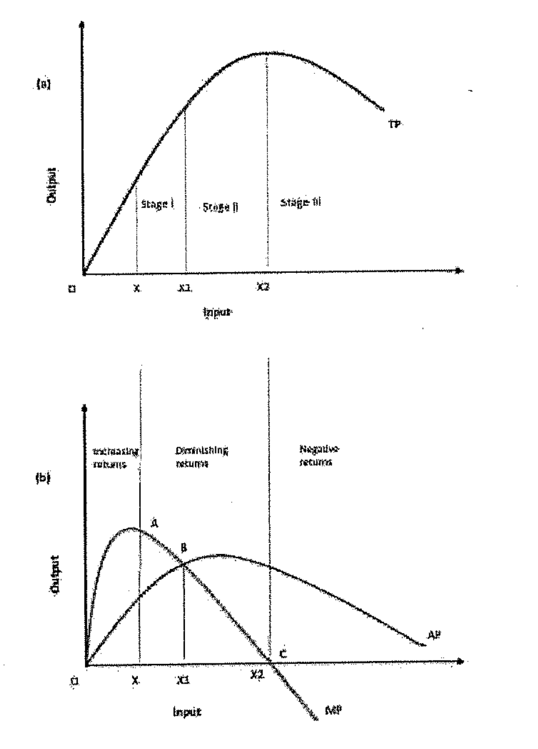

Slide 21
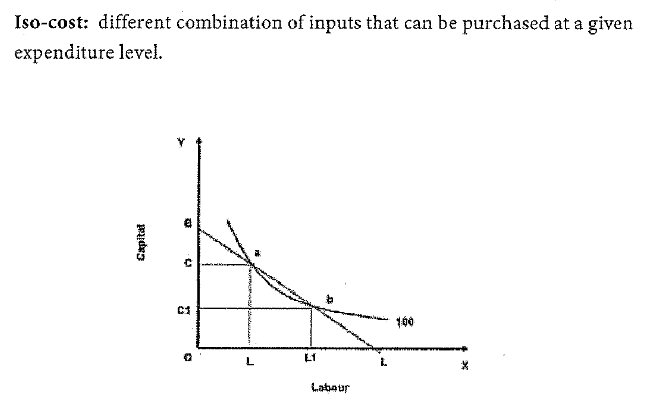

Slide 22
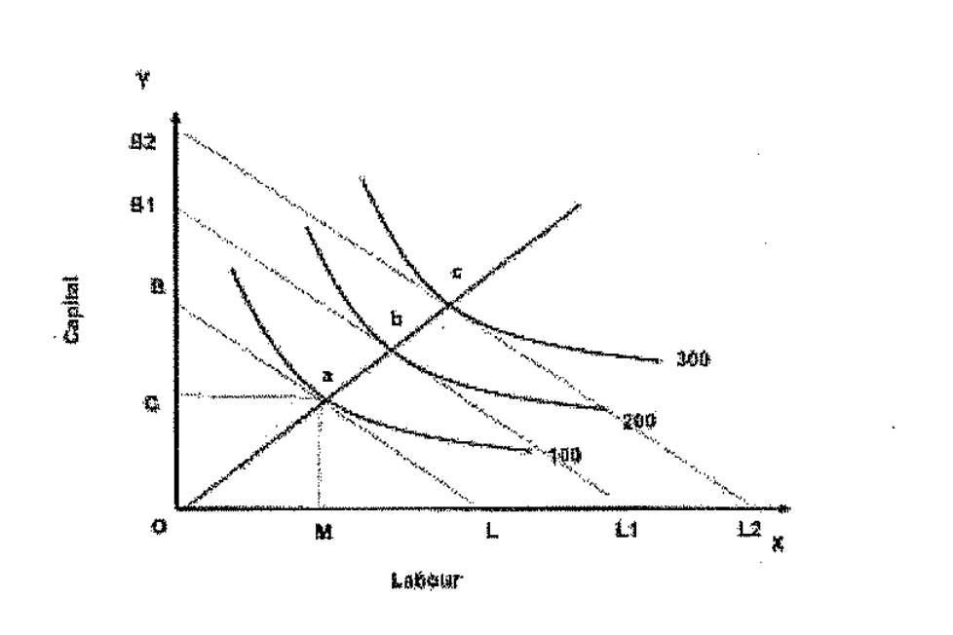
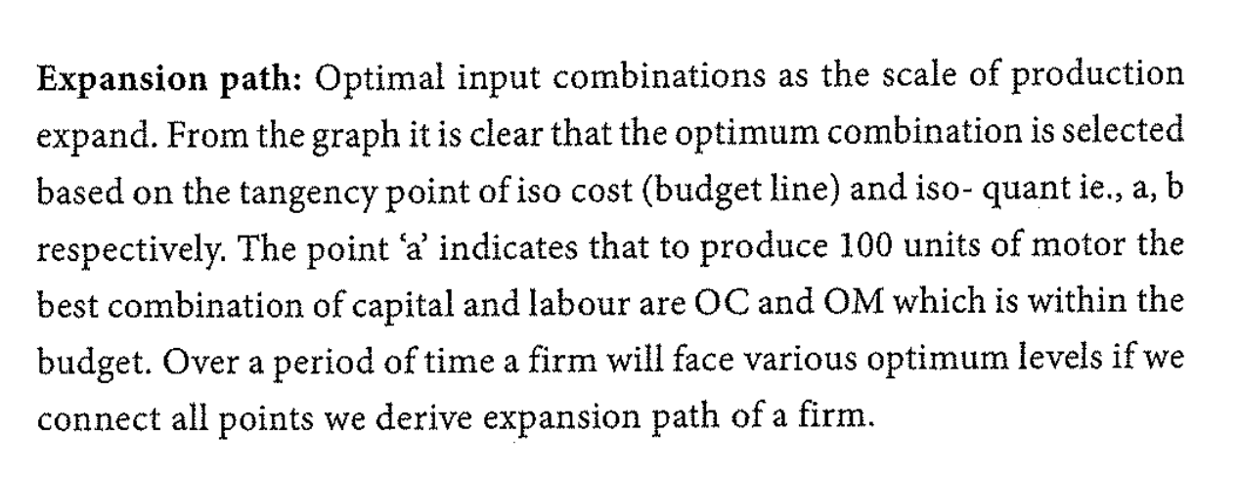

Slide 24
