Slide 1
Learning Objectives
6.1 Define and measure the expected rate of return of an individual investment.
6.2 Define and measure the riskiness of an individual investment.
6.3 Compare the historical relationship between risk and rates of return in the capital markets.
6.4 Explain how diversifying investments affects the riskiness and expected rate of return of a portfolio or combination of assets.
6.5 Explain the relationship between an investor’s required rate of return on an investment and the riskiness of the investment.

Slide 2
The Meaning and Measurement of Risk and Return
The Meaning and Measurement of Risk and Return

Slide 3
Expected Return Defined and Measured

Slide 4
Holding-Period Return (1 of 2)
Historical or holding-period or realized rate of return
Holding-period return = payoff during the "holding" period. Holding period could be any unit of time such as one day, a few weeks, or a few years.

Slide 5
Holding-Period Return (2 of 2)
You bought one share of Google for $837.17 on April 17 and sold it one week later for $862.76. Assuming no dividends were paid, your dollar gain was:
862.76 – 837.17 = $25.59

Slide 6
Holding-Period Rate of Return
Google = 25.59/837.17 = 0.0306 = 3.06%

Slide 7
Expected Return (1 of 2)
Expected cash flows and expected rate of return
The expected benefits or returns an investment generates come in the form of cash flows
Cash flows are used to measure returns (not accounting profits).

Slide 8
Expected Return (2 of 2)
The expected cash flow is the weighted average of the possible cash flow outcomes such that the weights are the probabilities of the occurrence of the various states of the economy.

Slide 9
Table 6.1 Measuring the Expected Return of an Investment

Slide 10
Expected Cash Flow Equation 6.3

Slide 11
Expected Cash Flow
= $1,260 on $1,000 investment

Slide 12
Probability of Payoffs (1 of 2)
We can also determine the percent expected return on $1,000 investment. Expected return is the weighted average of all the possible returns, weighted by the probability that each return will occur.

Slide 13
Expected Rate of Return Equation 6.4

Slide 14
Expected Rate of Return (2 of 2)

Slide 15
Risk Defined and Measured

Slide 16
Risk
What is risk?
How do we measure risk?
Will diversification reduce the risk of portfolio?

Slide 17
Risk Defined
Risk refers to potential variability in future cash flows.
The wider the range of possible future events that can occur, the greater the risk.
Thus, the returns on common stock are more risky than returns from investing in a savings account in a bank.

Slide 18
Risk Measured
Consider two investment options:
Invest in Treasury bond that offers a 2 percent annual return.
Invest in stock of a local publishing company with an expected return of 14 percent based on the payoffs (given on next slide).

Slide 19
Probability of Payoffs (2 of 2)
Stock
Chance of Occurrence | Rate of Return on Investment
1 chance in 10 (10% chance) | −10%
2 chances in 10 (20% chance) | 5%
4 chances in 10 (40% chance) | 15%
2 chances in 10 (20% chance) | 25%
1 chance in 10 (10% chance) | 30%
Treasury Bond
100% chance of 2%

Slide 20
Expected Rate of Return
Treasury bond = 1×2% = 2%
Stock
= 0.1×(−10) + 0.2×5% + 0.4×15% + 0.2×25% + 0.1×30% = 14%

Slide 21
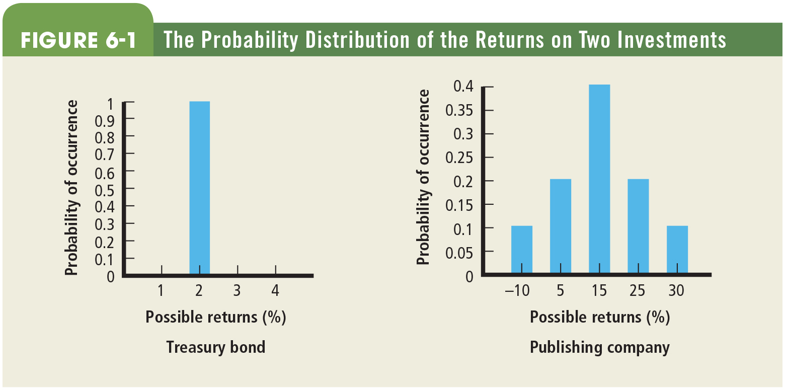
Figure 6.1 The Probability Distribution of the Returns on Two Investments

Slide 22
Treasury Bond versus Stock
We observe from Figure 6.1 that the stock of the publishing company is more risky, but it also offers the potential of a higher payoff.

Slide 23
Standard Deviation (S.D.) (1 of 2)
Standard deviation (S.D.) is one way to measure risk. It measures the volatility or riskiness of portfolio returns.
S.D. = square root of the weighted average squared deviation of each possible return from the expected return.

Slide 24
Standard Deviation (S.D.) (2 of 2)

Slide 25
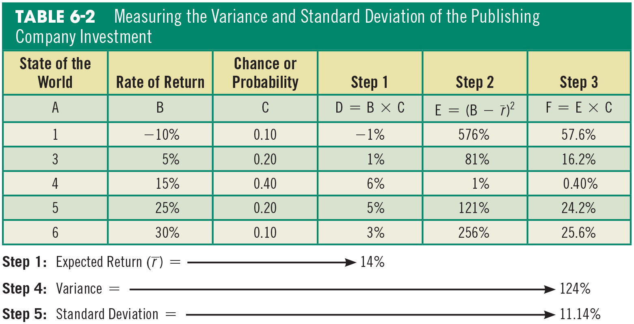
Table 6.2 Measuring the Variance and Standard Deviation of the Publishing Company Investment

Slide 26
Comments on Standard Deviation
There is a 66.67 percent probability that the actual returns will fall between 2.86 percent and 25.14 percent. So actual returns are far from certain!
Risk is relative; to judge whether 11.14 percent is high or low risk, we need to compare the standard deviation of this stock to the standard deviation of other investment alternatives.
To get the full picture, we need to consider not only the standard deviation but also the expected return.
The choice of a particular investment depends on the investor’s attitude toward risk.

Slide 27
Rates of Return: The Investor's Experience

Slide 28
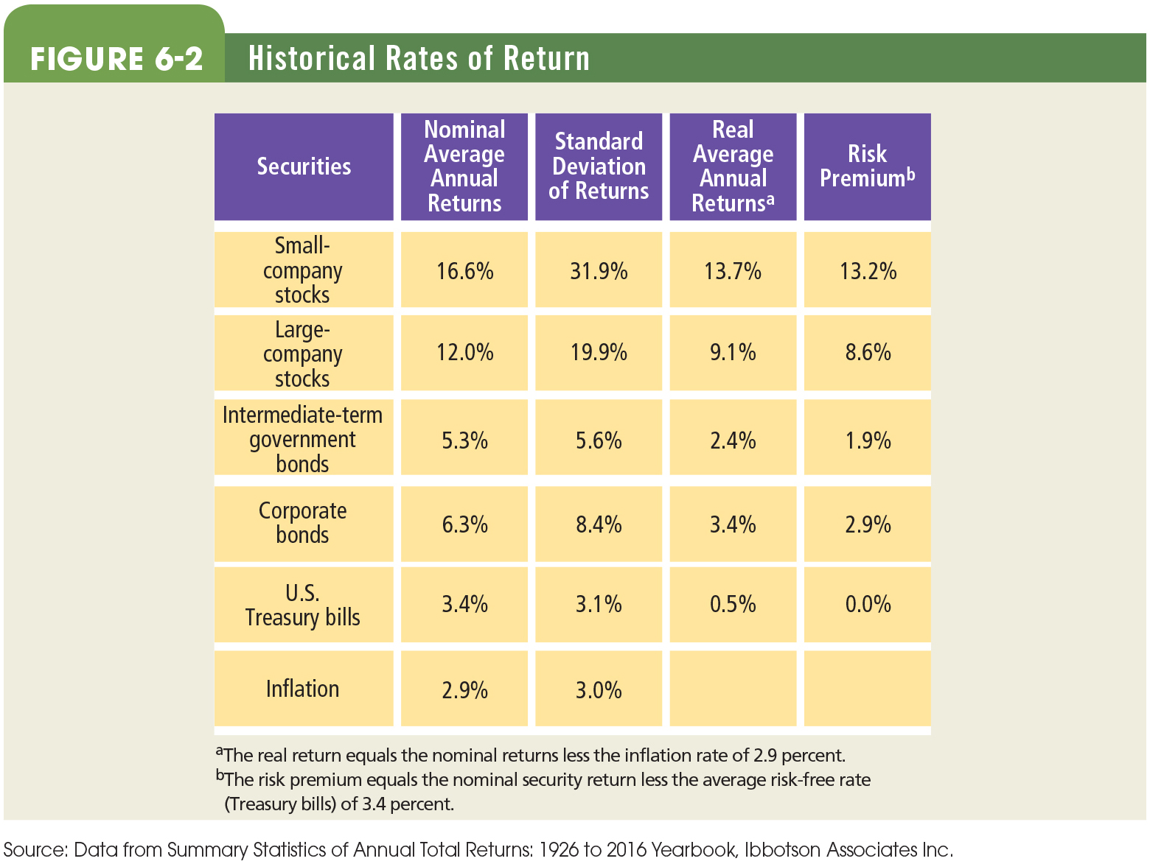
Figure 6.2 Historical Rates of Return

Slide 29
Rates of Return: The Investor’s Experience (1926–2016)
Figure 6.2 shows:
A. The direct relationship between risk and return.
B. Only common stocks provide a reasonable hedge against inflation.
The study also observed that between 1926 and 2016, large stocks had negative returns in 22 of 91 years, while Treasury bills generated negative returns in only one year.

Slide 30
Risk and Diversification

Slide 31
Portfolio
Portfolio refers to combining several assets.
Examples of portfolio:
Investing in multiple financial assets (stocks – $6000, bonds – $3000, T-bills – $1000)
Investing in multiple items from a single market (example: investing in 30 different stocks)

Slide 32
Risk and Diversification
Total risk of portfolio is due to two types of risk:
Systematic (or market risk) is risk that affects all firms (e.g., tax rate changes, war)
Unsystematic (or company-unique risk) is risk that affects only a specific firm (e.g., labor strikes, CEO change)
Only unsystematic risk can be reduced or eliminated through effective diversification.

Slide 33
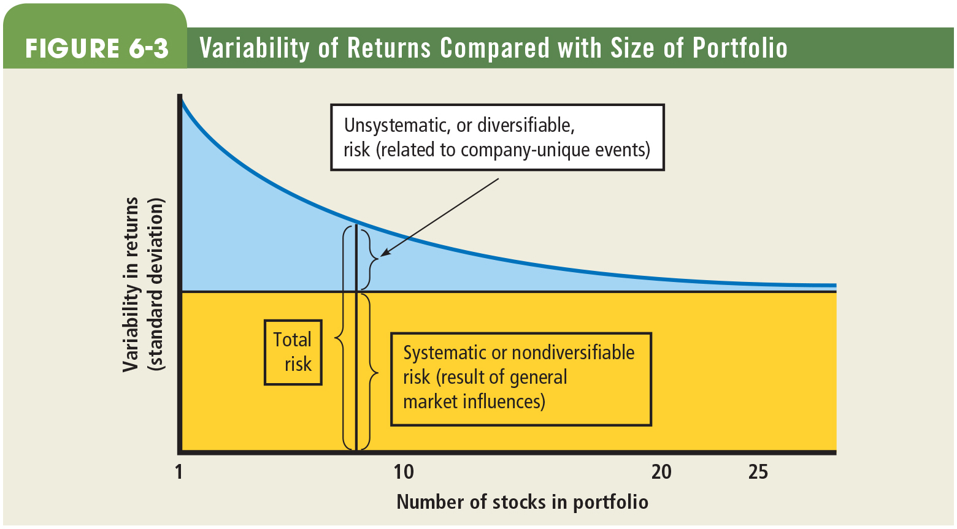
Figure 6.3 Variability of Returns Compared with Size of Portfolio

Slide 34
Correlation and Risk Reduction (1 of 2)
The main motive for holding multiple assets or creating a portfolio of stocks (called diversification) is to reduce the overall risk exposure. The degree of reduction depends on the correlation among the assets.
If two stocks are perfectly positively correlated, diversification has no effect on risk.
If two stocks are perfectly negatively correlated, the portfolio is perfectly diversified.

Slide 35
Correlation and Risk Reduction (2 of 2)
Thus, while building a portfolio, we should pick securities/assets that have negative or low-positive correlation to realize diversification benefits.

Slide 36
Market Risk or Systematic Risk
Measuring Market Risk:
eBay vs. S&P 500 Index
Table 6.3 and Figure 6.4 display the monthly returns for eBay and the S&P 500 Index.

Slide 37
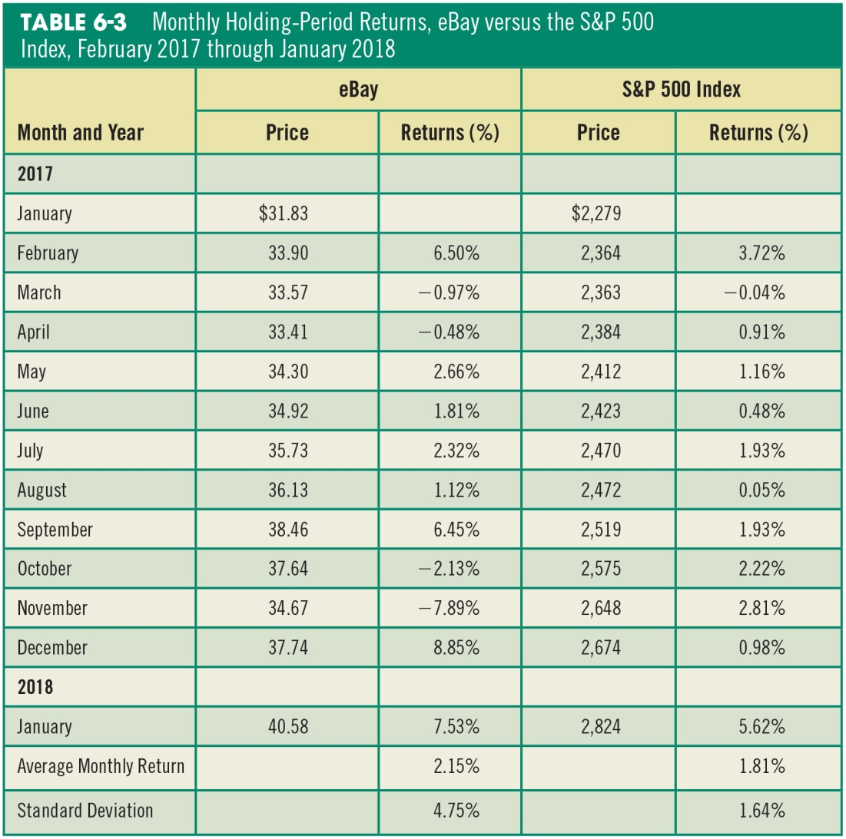
Table 6.3 Monthly Holding-Period Returns, eBay versus the S&P 500 Index, February 2017 through January 2018

Slide 38
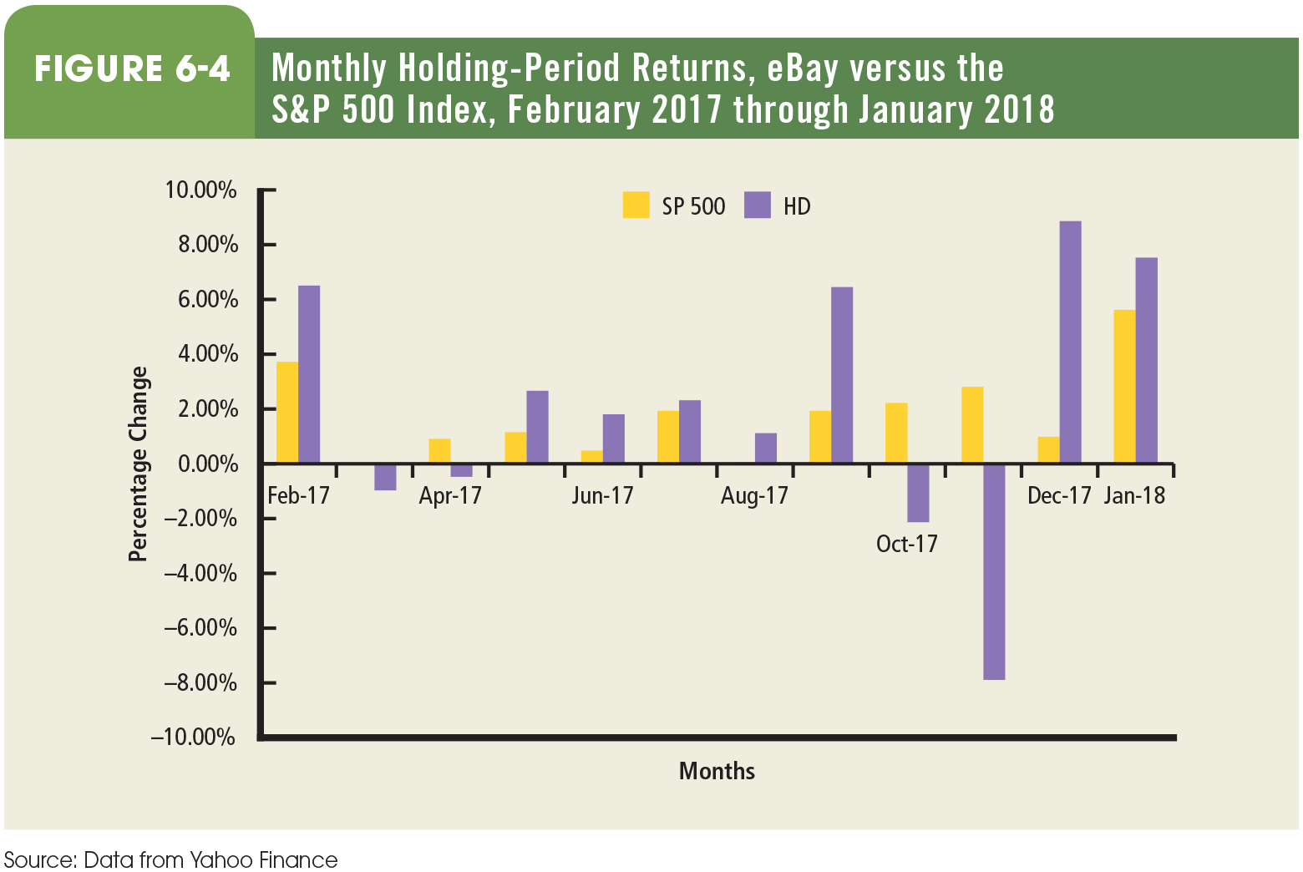
Figure 6.4 Monthly Holding-Period Returns, eBay versus the S&P 500 Index, February 2017 through January 2018

Slide 39
Measuring Market Risk Equation 6.6

Slide 40
Equations 6.7 and 6.8

Slide 41
From Figure 6.4 and Table 6.3
Average monthly return: eBay = 2.15%
S&P 500 Index = 1.86%
Risk was higher for eBay with standard deviation of 4.75 percent versus 1.64 percent for S&P 500.
There is a moderate positive relationship in the movement of returns between eBay and S&P 500 (in 9 of the 12 months) (see Figure 6.5).

Slide 42
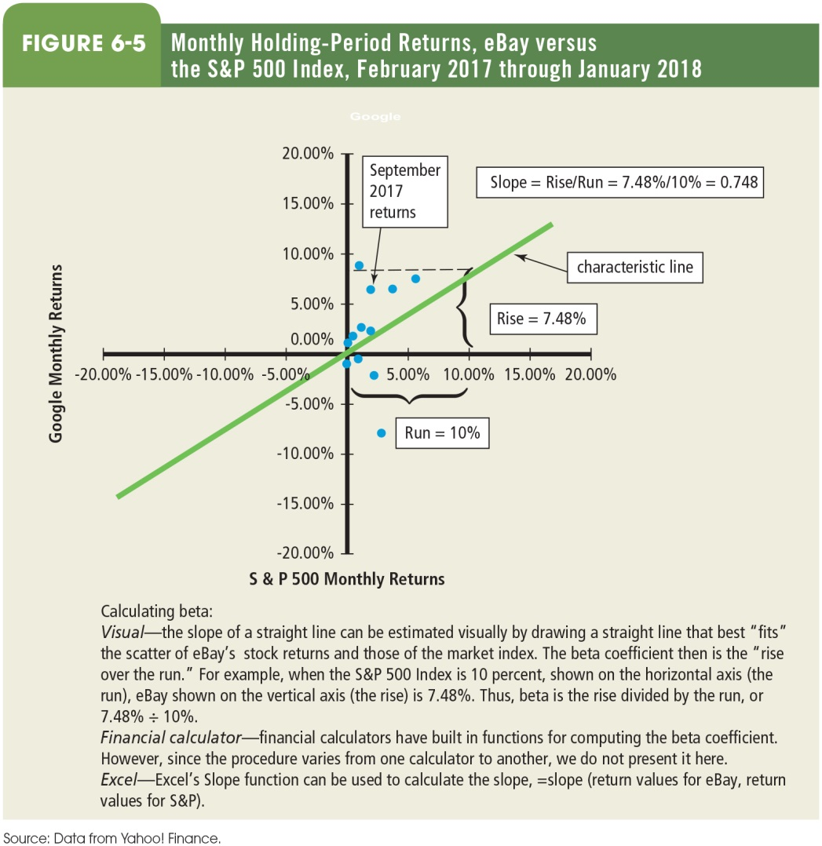
Figure 6.5 Monthly Holding-Period Returns, eBay versus the S&P 500 Index, February 2017 through January 2018

Slide 43
Characteristic Line and Beta
The relationship between eBay and S&P 500 is captured in Figure 6.5.
Characteristic line is the “line of best fit” for all the stock returns relative to returns of S&P 500.
The slope of the characteristic line (= 0.748) measures the average relationship between a stock’s returns and those of the S&P 500 Index Returns. This slope (called beta) is a measure of the firm’s market risk; i.e., eBay’s returns are 0.748 times as volatile on average as those of the overall market.

Slide 44
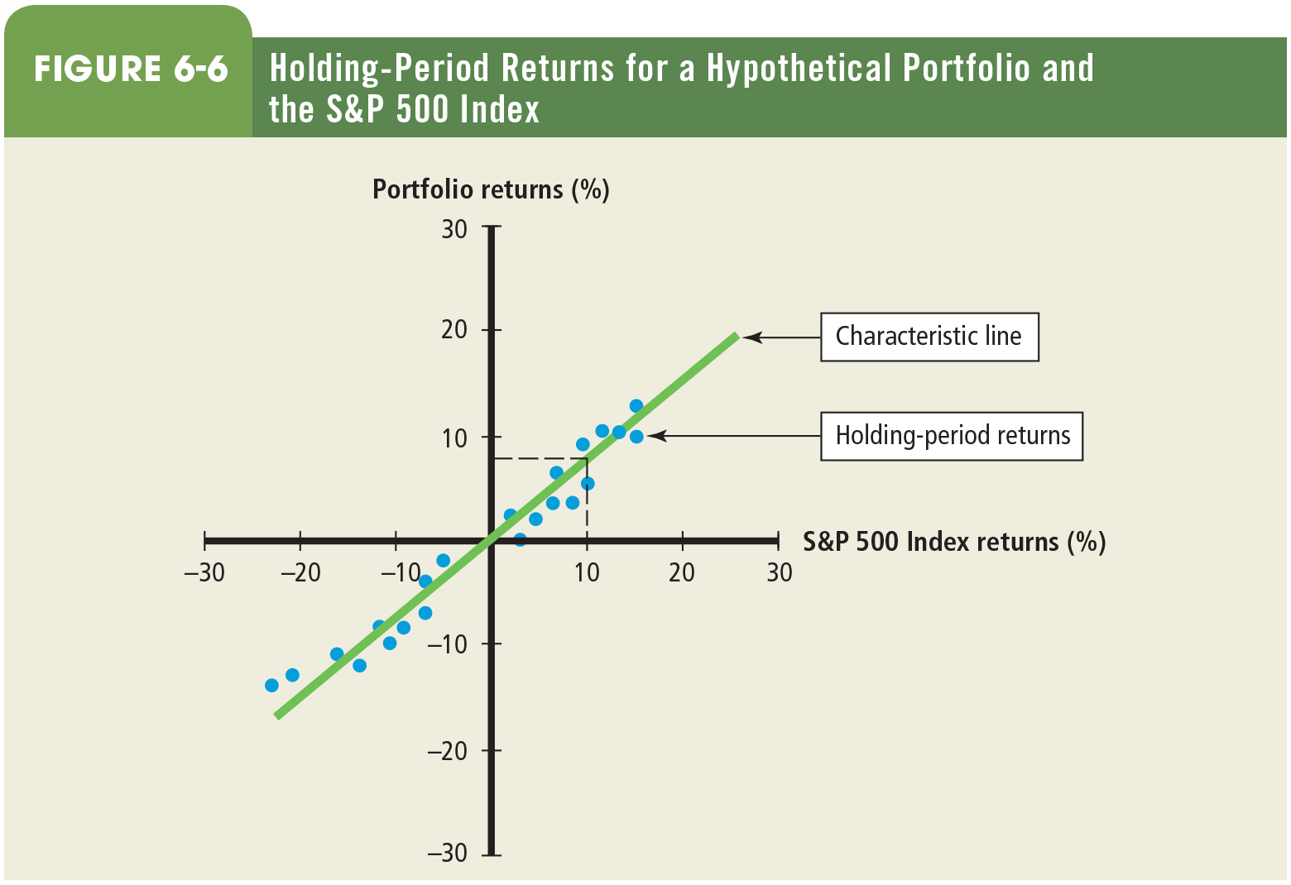
Figure 6.6 Holding-Period Returns for a Hypothetical Portfolio and the S&P 500 Index

Slide 45
Interpreting Beta
Beta is the risk that remains for a company even after we have diversified our portfolio.
A stock with a Beta of 0 has no systematic risk.
A stock with a Beta of 1 has systematic risk equal to the “typical” stock in the marketplace.
A stock with a Beta exceeding 1 has systematic risk greater than the “typical” stock.
Most stocks have betas between 0.60 and 1.60. Note, the value of beta is highly dependent on the methodology and data used.

Slide 46
Portfolio Beta
Portfolio beta indicates the percentage change on average of the portfolio for every 1 percent change in the general market.

Slide 47
Equation 6.10

Slide 48
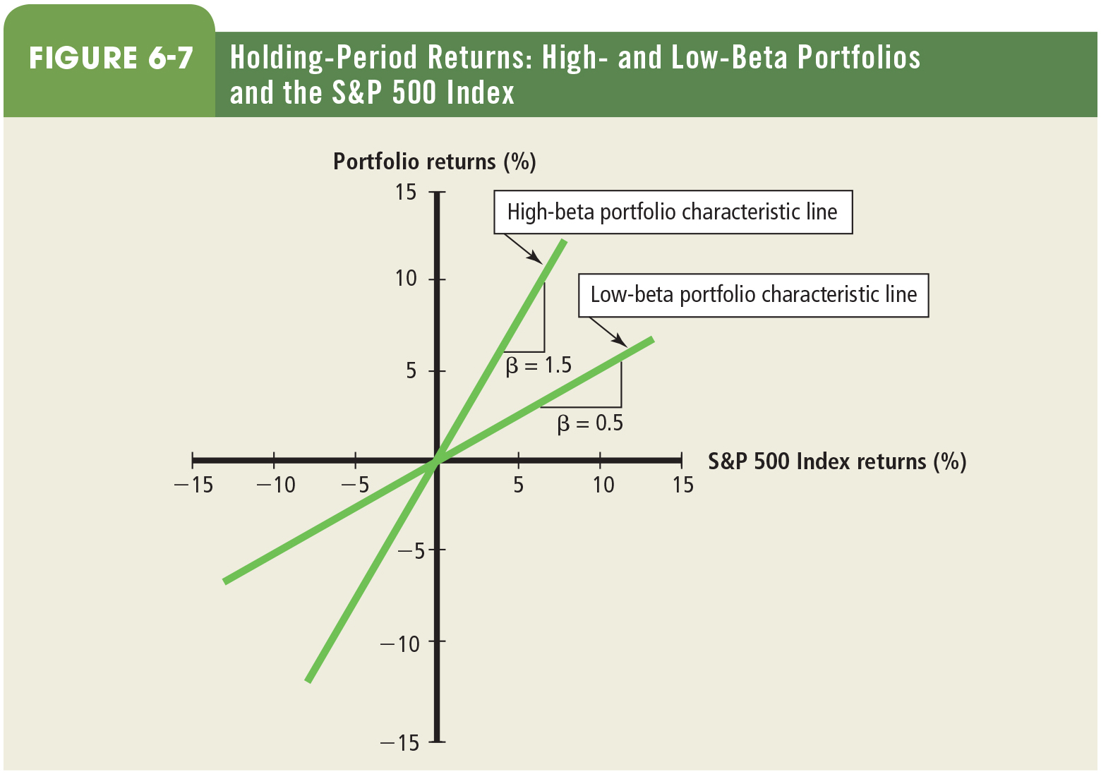
Figure 6.7 Holding-Period Returns: High- and Low-Beta Portfolios and the S&P 500 Index

Slide 49
Risk and Diversification Demonstrated
The market rewards diversification.
Through effective diversification, we can lower risk without sacrificing expected returns, and we can increase expected returns without having to assume more risk

Slide 50
Asset Allocation
Asset allocation refers to diversifying among different kinds of asset types (such as treasury bills, corporate bonds, common stocks).
Asset allocation decision has to be made today—the payoff in the future will depend on the mix chosen before, which cannot be changed. Hence asset allocation decision is considered the “most important decision” while managing an investment portfolio.

Slide 51
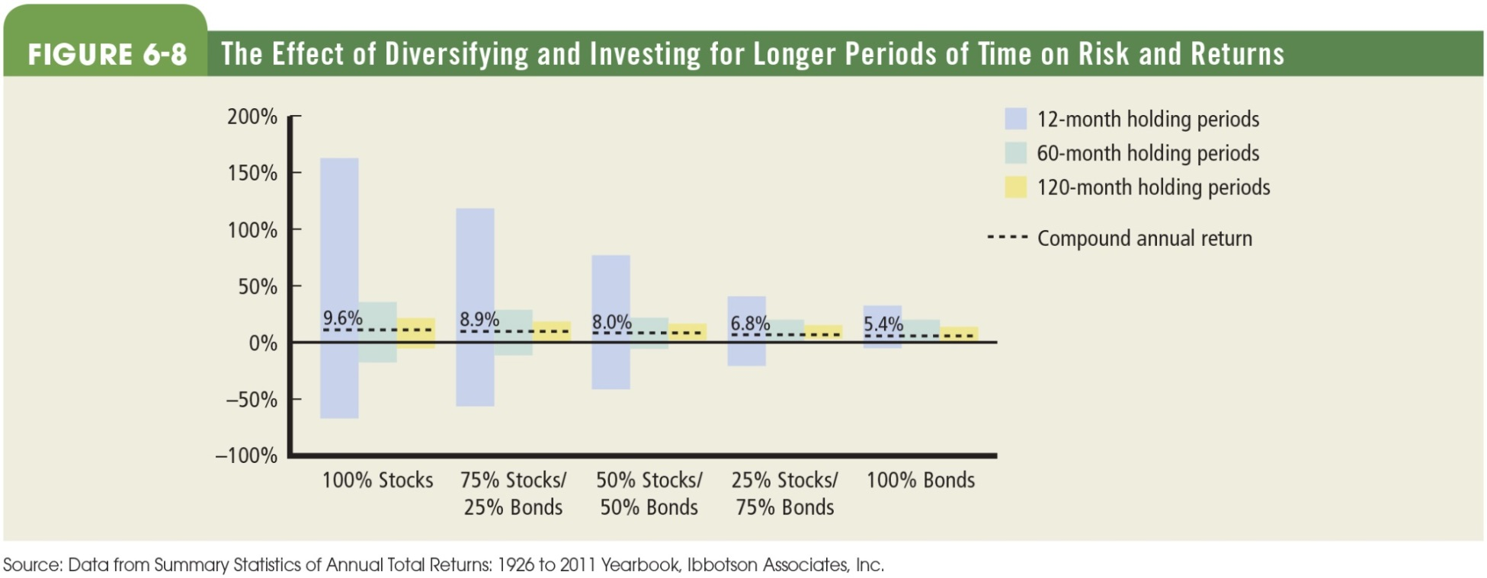
Figure 6.8 The Effect of Diversifying and Investing for Longer Periods of Time on Risk and Returns.

Slide 52
Asset Allocation Matters!
We observe the following from Figure 6.8.
Direct relationship between risk and return: As we move from an all-stock portfolio to a mix of stocks and bonds to an all-bond portfolio, both risk and return decline.
Holding period matters: As we increase the holding period, risk declines.

Slide 53
Asset Allocation Summary
There has never been a time when investors lost money if they held an all-stock portfolio—the most risky portfolio—for 10 years.
The market rewards the patient investor.

Slide 54
The Investor's Required Rate of Return

Slide 55
The Investor’s Required Rate of Return
Investor’s required rate of return is the minimum rate of return necessary to attract an investor to purchase or hold a security.
This definition considers the opportunity cost of funds, i.e., the forgone return on the next best investment.

Slide 56
The Investor’s Required Rate of Return Equation 6.11
Investor’s required rate of return = risk-free rate of return + risk premium

Slide 57
Risk-Free Rate
This is the required rate of return or discount rate for risk-free investments.
Risk-free rate is typically measured by the U.S. Treasury bill rate.

Slide 58
Risk Premium
The risk premium is the additional return we must expect to receive for assuming risk.
As the level of risk increases, we will demand additional expected returns.

Slide 59
Capital Asset Pricing Model (CAPM) (1 of 2)
CAPM equation equates the expected rate of return on a stock to the risk-free rate plus a risk premium for the systematic risk.
CAPM provides for an intuitive approach for thinking about the return that an investor should require on an investment, given the asset’s systematic or market risk.

Slide 60
Measuring the Required Rate of Return Equation 6.12

Slide 61
Capital Asset Pricing Model (CAPM) (2 of 2)
If the required rate of return for the market portfolio r_{m} is 12 percent, and the r_{f} is 3%, the risk premium for the market would be 9 percent.
This 9 percent risk premium would apply to any security having systematic (nondiversifiable) risk equivalent to the general market, or beta of 1.
In the same market, a security with beta of 2 would provide a risk premium of 14 percent.

Slide 62
CAPM Equation 6.13
CAPM suggests that beta is a factor in determining the required returns.

Slide 63
CAPM Example
Market risk = 10%
Risk-free rate = 3%
Required return = 3% + beta×(10% − 3%)
Beta | Required Return
0 | 3%
1 | 10%
2 | 17%

Slide 64
The Security Market Line (SML)
SML is a graphic representation of the CAPM, where the line shows the appropriate required rate of return for a given stock’s systematic risk.

Slide 65
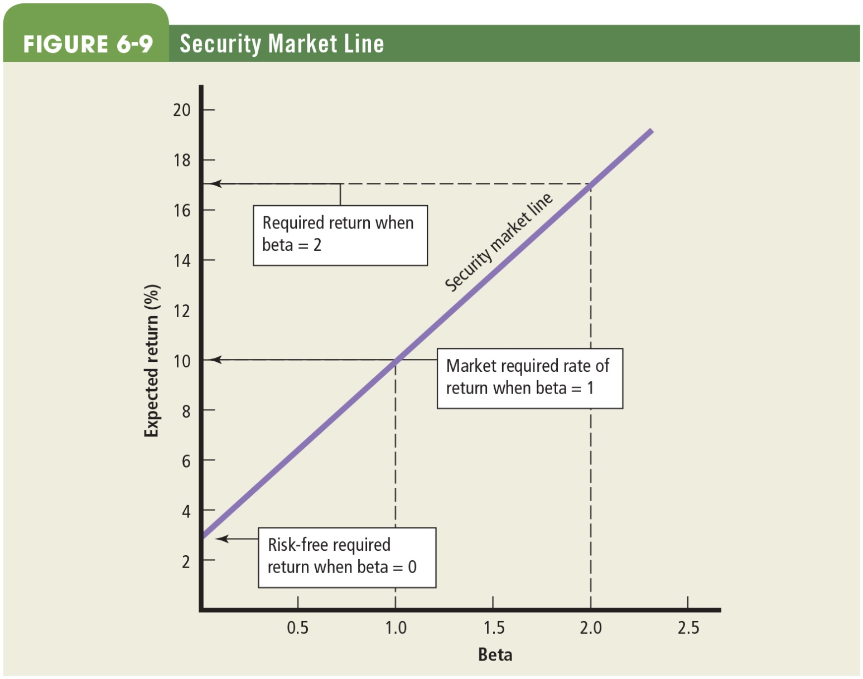
Figure 6.9 Security Market Line

Slide 66
Key Terms (1 of 2)
Asset allocation
Beta
Capital asset pricing model (CAPM)
Characteristic line
Expected rate of return
Holding-period return
Portfolio beta

Slide 67
Key Terms (2 of 2)
Required rate of return
Risk
Risk-free rate of return
Risk premium
Security market line
Standard deviation
Systematic risk
Unsystematic risk

Slide 68
Copyright
This work is protected by United States copyright laws and is provided solely for the use of instructors in teaching their courses and assessing student learning. Dissemination or sale of any part of this work (including on the World Wide Web) will destroy the integrity of the work and is not permitted. The work and materials from it should never be made available to students except by instructors using the accompanying text in their classes. All recipients of this work are expected to abide by these restrictions and to honor the intended pedagogical purposes and the needs of other instructors who rely on these materials.

